Slide 1

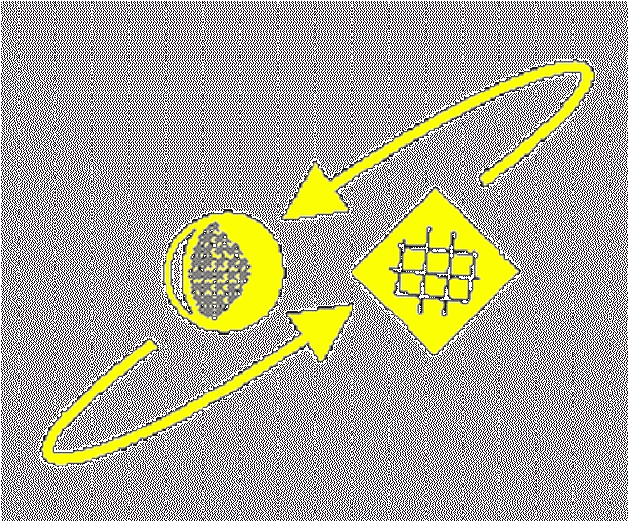
Script Recognition – 03
Human reading process
prof. dr. L. Schomaker
KI
RuG

Slide 2
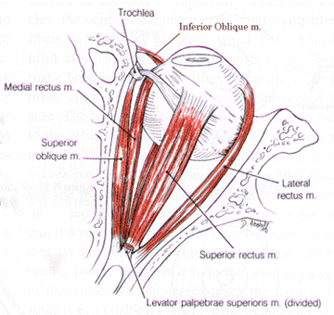
Human Reading
Eyes are no flat-bed scanners!
There are 6 extra-
ocular muscles
© Schomaker 2001

Slide 3
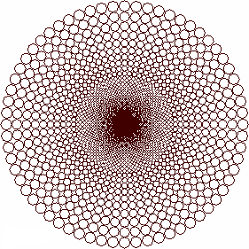
Human Reading
Eyes are no flat-bed scanners!
The retina is not
a Cartesian but
logpolar grid
© Schomaker 2001

Slide 4
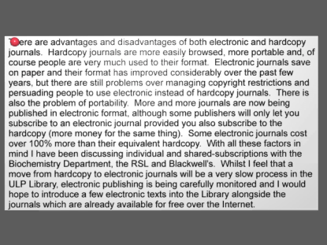
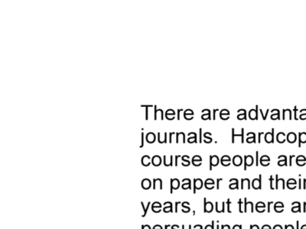
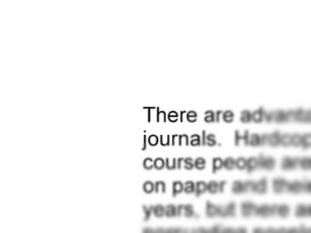
Human Reading
Eyes are not flat-bed scanners!
  Fast movements: saccades
  Alternated with fixations: the high-resolution center of the retina is positioned to capture a limited area of the complete visual array
© Schomaker 2001

Slide 5
Human Reading – saccades & fixations 1
© Schomaker 2001

Slide 6
Human Reading – fixations, eye-centric
© Schomaker 2001

Slide 7
Human Reading – foveal/parafoveal
© Schomaker 2001

Slide 8
Human Reading
Eyes are not statically positioned cameras
  Looking and reading involve an active process of selective attention, opportunistically jumping to the next area of visual interest
  The illusion of a global and consistent view of the world is generated by the integrative processes in the visual cortex (not in the eyes):
© Schomaker 2001

Slide 9
Human reading research (HRR)
HRR is mostly guided by epistemologic dynamics intrinsic to the used experimental paradigms, less by fundamental questions concerning geometry and features of scripts influencing reading performance
Findings are of little use to developers of reading systems
Modeling efforts are limited, where models do exist, they concern toy problems (small dictionaries, oversimplified character shapes)
© Schomaker 2001

Slide 10
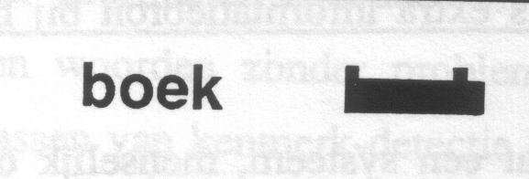
Global word shape
General framework: Merton’s “Logogen”:
there exists a lexicon of words. Words get a
score of likelihood on the basis of detected
features. This example: word contour pattern.
© Schomaker 2001

Slide 11
Tests with ascender/descender coding
a = | x | h = | lx | o = | x | v = | x
b = | lx | I = | x | p = | jx | w = | x
c = | x | j = | j | q = | xj | x = | x
d = | xl | k = | lx | r = | x | y = | xj
e = | x | l = | l | s = | x | z = | x
f = | l | m = | x | t = | l
g = | xj | n = | x | u = | x
© Schomaker 2001

Slide 12
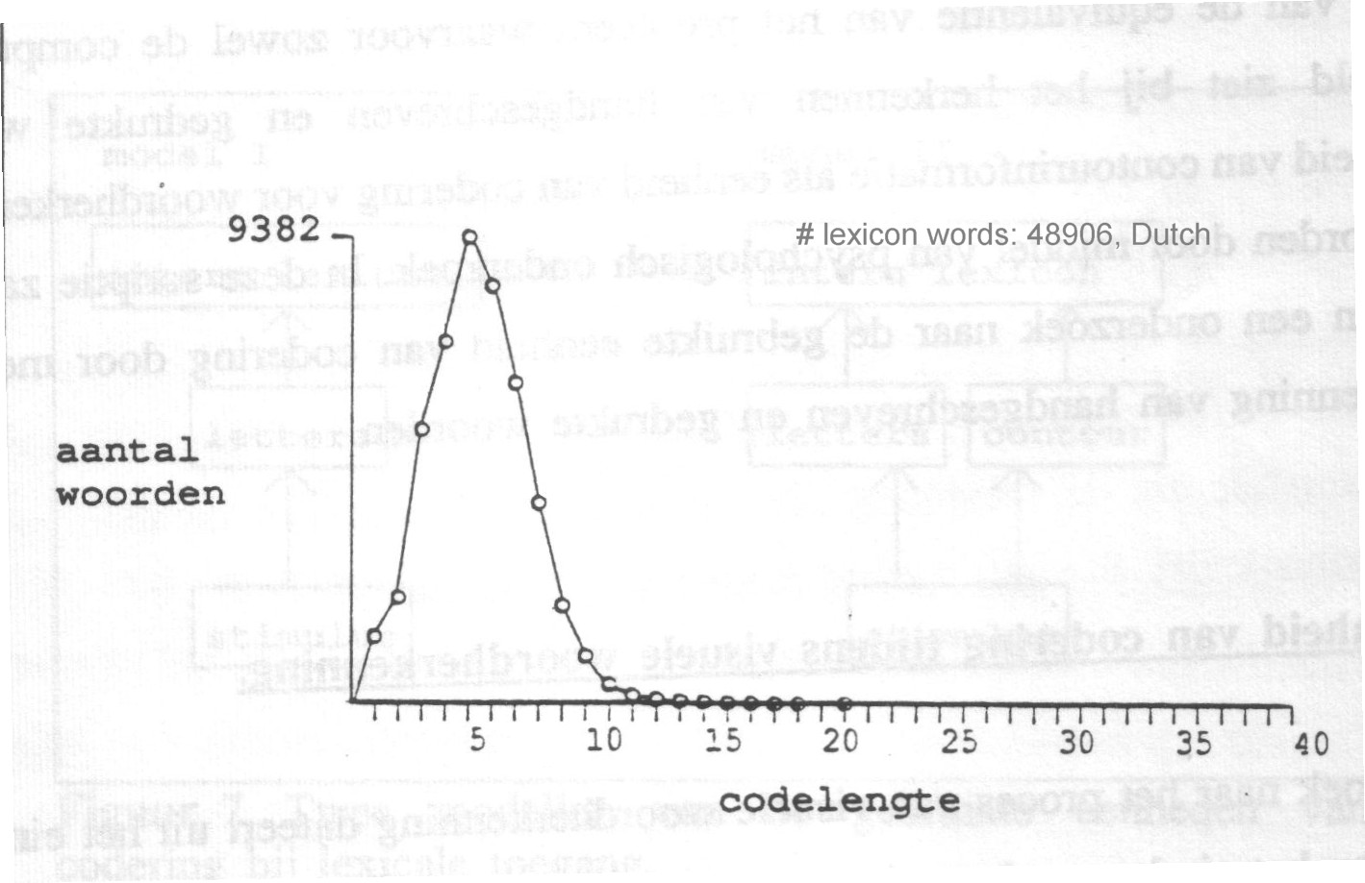
Code-length frequencies in 48k lexicon
© Schomaker 2001

Slide 13
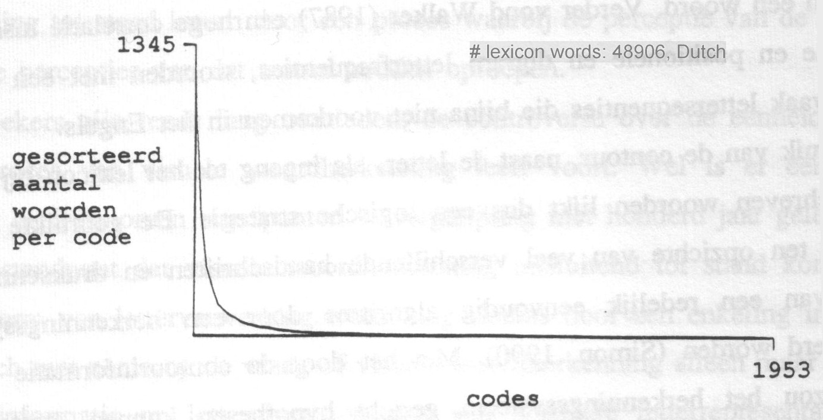
Code ‘collisions’ : amount of different words per code
Worst case: 1345 words for code ‘x’
2¹⁶ → 2¹⁰ alternatives
© Schomaker 2001

Slide 14
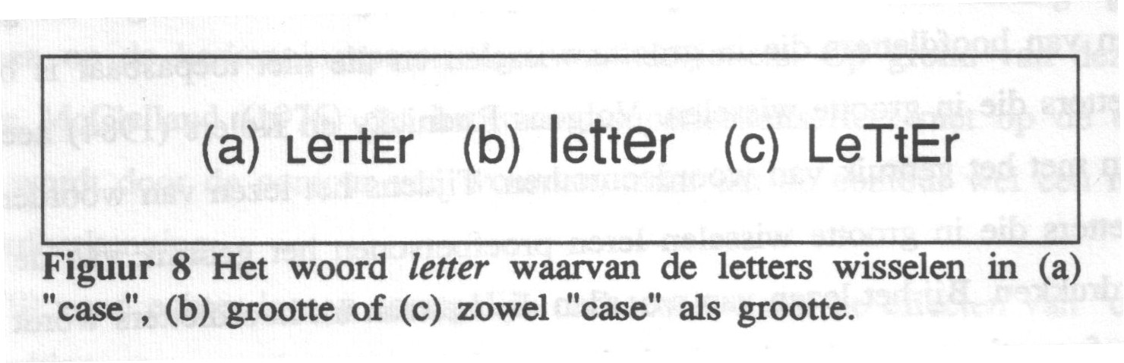
However: humans do not seem to use word contour extensively, in the reading of machine-print words
“case-mixing” experiments
© Schomaker 2001

Slide 15
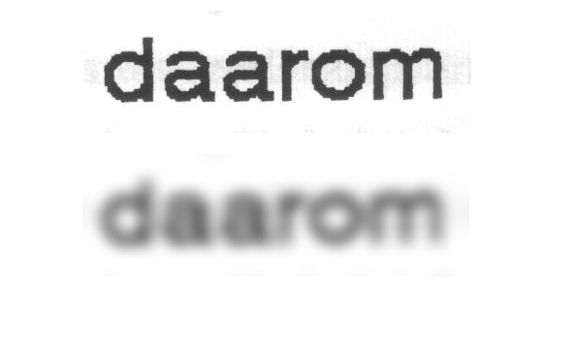
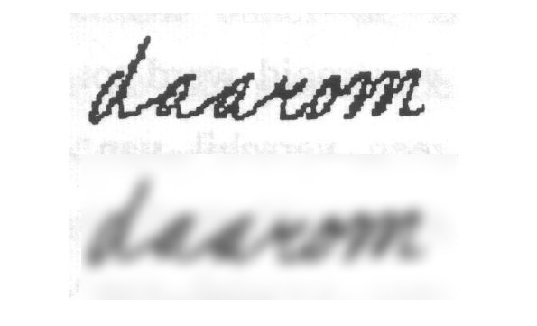
Experiment on reading handwriting
© Schomaker 2001

Slide 16
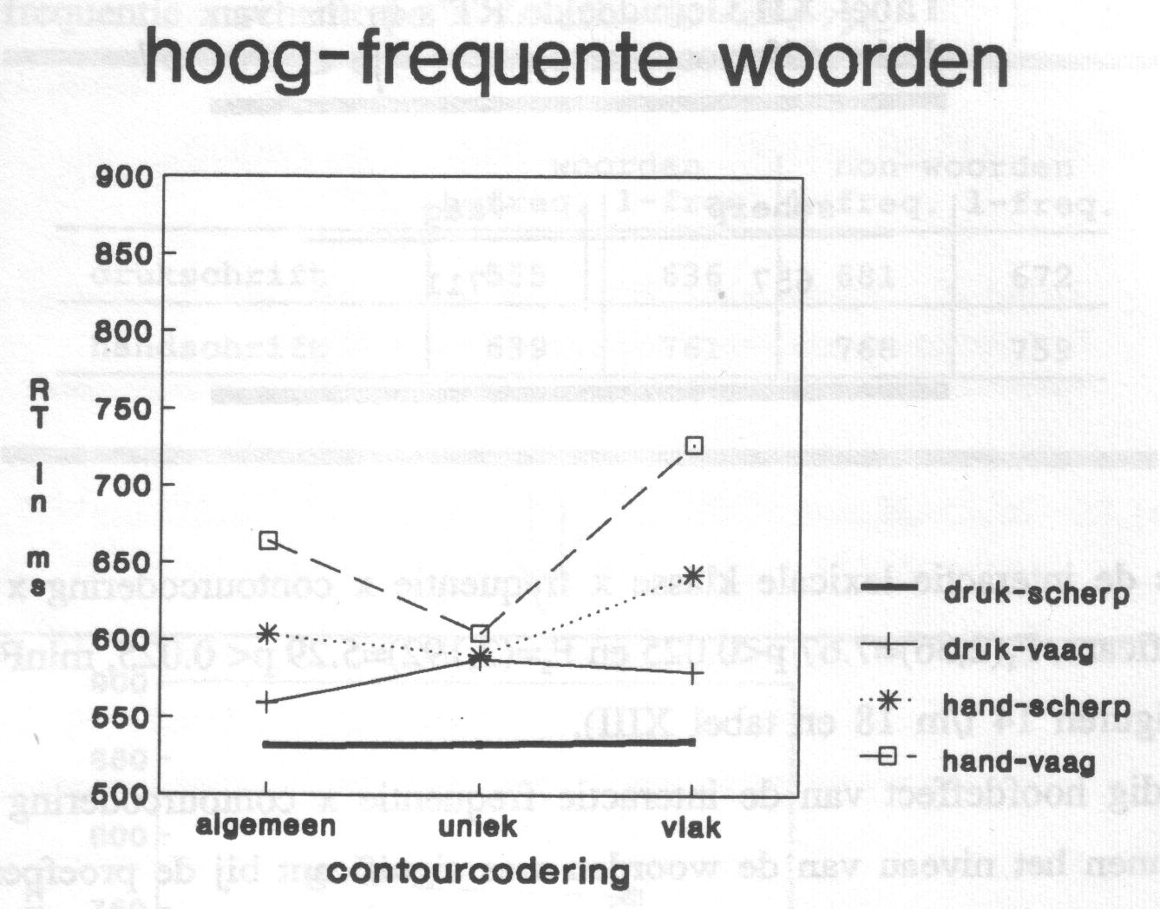
Reaction times, common words
© Schomaker 2001

Slide 17
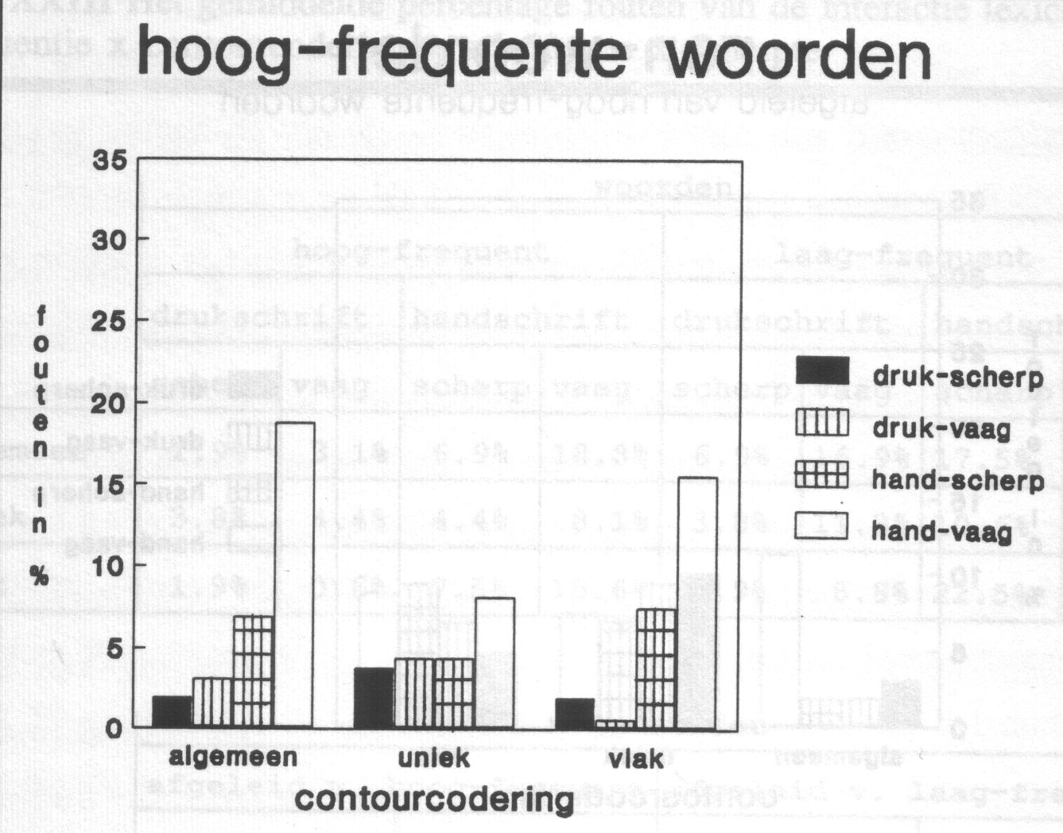
Error rates, common words
© Schomaker 2001

Slide 18
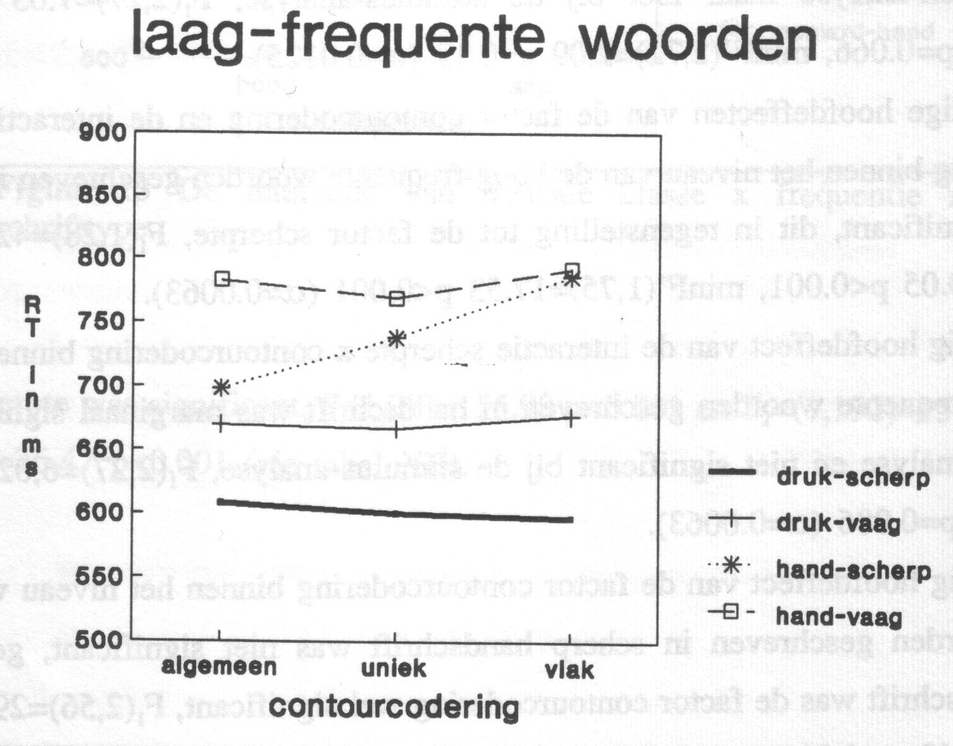
Reaction time, rare words
© Schomaker 2001

Slide 19
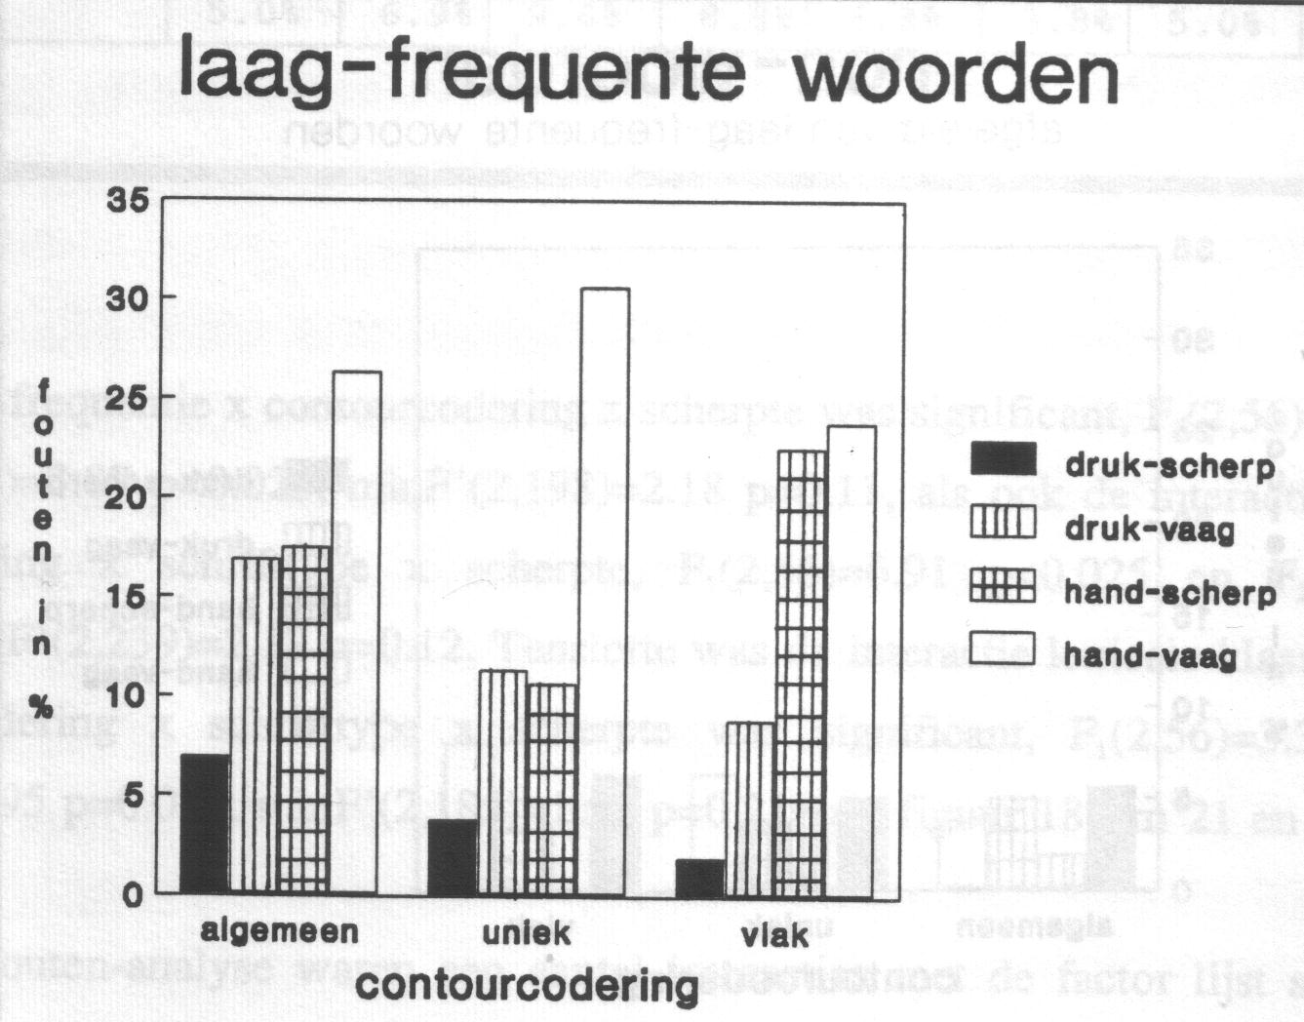
Error rates, rare words
© Schomaker 2001

Slide 20
Human use of context in reading
Human reading is characterized by an opportunistic use of all available information at all possible levels of abstraction
Three context types:
  featural (shape) context
  linguistic context
  pragmatics (real-life context)
© Schomaker 2001

Slide 21
Human use of context in reading: featural context
The complete image of a piece of script can and will be used to read it
Experiment: subjects had to read handwritten words, drawn at random from text by several writers
Three words were presented on screen:
flanking_left target_word flanking_right
© Schomaker 2001

Slide 22
Experiment in featural context
koektrommel achterdeur democratie
Read this word!
words were from the same language,
but were linguistically/semantically unrelated
© Schomaker 2001

Slide 23
Experiment in featural context
Two conditions
The flanking words Left and Right were from
  A: the same writer as the target word
  B: other writers than the target word
© Schomaker 2001

Slide 24
koektrommel achterdeur democratie

Slide 25
vervelend meermaals aflevering

Slide 26
Condition B
gedurende voetballer onwil

Slide 27
Condition B
minimum onderdelen plaats

Slide 28
Condition B
kenmerk wervels grondsoort

Slide 29
Condition B
gebakje speelplaats kwik

Slide 30
Condition B
mengvorm leeftijden geheel

Slide 31
Condition B

Slide 32
Condition A
koektrommel achterdeur democratie

Slide 33
Condition A
mengvorm leeftijden geheel

Slide 34
Condition A
minimum onderdelen plaats

Slide 35
Condition A
vervelend meermaals aflevering

Slide 36
Condition A
gedurende voetballer onwil

Slide 37
Condition A
kenmerk wervels grondsoort

Slide 38
Condition A
gebakje speelplaats kwik

Slide 39
Condition A

Slide 40
Results featural context experiment
words were handwritten, hastily
same-writer flanking words (72% correct):
➔ better human word recognition
than different-writer flanking words (54%)
Conclusion: human readers exploit similarities at the letter and feature level
© Schomaker 2001

Slide 41
Human reading of handwriting
Exp. Context Style Writers Targets Readers Words Recognized
A frequently-used Dutch words handprint 1 30 12 360 98 %
frequently-used Dutch words neat cursive 1 30 12 360 88 %
B sentence fragments, same writer cursive 3 15 12 180 85 %
C sentence fragments, same writer cursive 4 13 20 260 85 %
unrelated words, same writer cursive 4 13 20 260 77 %
D unrelated words, same writer fast cursive 12 12 15 180 72 %
unrelated words, different writers fast cursive 12 12 15 180 54 %
Explanation of Experiments
A: single-word recognition
B-D: three-word sequences, middle-word recognition
© Schomaker 2001

Slide 42
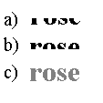
Zoom in on information source
There is a difference in informational value for different zones in words.
Example:
© Schomaker 2001

Slide 43
Zoom in on information source
There is a difference in informational value for different zones in words.
Example:
© Schomaker 2001

Slide 44
Zoom in on information source
There is a difference in informational value for different zones in words.
Example:
© Schomaker 2001

Slide 45
Zoom in on information source
There is a difference in informational value for different zones in words.
Example:
upper zone
is more
informative
© Schomaker 2001

Slide 46
The power of linguistic statistics
Aoccdrnig to a rscheearch at an Elingsh uinervtisy, it deosn’t mttaer in waht oredr the ltteers in a wrod are, the olny iprmoetnt tihng is taht frist and lsat ltteer is at the rghit pclae.
© Schomaker 2001

Slide 47
Are the spaces between words important?
Rayner & Pollatsek (96): Unspaced text slowed readers slowed by 30%.
Rayner, Fischer & Pollatsek (98):
  Readers slowed down about 30% when spaces removed from text.
  Word frequency effect greater:
  if words are uncommon, the slowdown is worse
  One possible reason for found effects: Irregular landing position due to reduced segmentation information.
  Unspaced text
  Whathappensifyouremove thespacesbetweenwords?
  Spaces replaced with x
  Whatxhappenxsifxyoux
  removexthexspacesx
  betweenwords?
  Words flanked with x
  xWhatx xhappensx xifx xyoux xremovex xthex xspacesx xbetweenx xwordsx?
© Schomaker 2001

Slide 48
Conclusion
Human reading works through the use of context:
  shape context
  linguistic context of sample
  linguistic statistics learned by reader
Features: (?) Letter features, whole-word features are both important.
© Schomaker 2001

