Slide 1

Script Recognition – 05
Pattern Classification
prof. dr. L. Schomaker
Artificial Intelligence & Cognitive Engineering (ALICE), University of Groningen

Slide 2
Pattern Classification
Algorithms to identify instances of patterns as being a member of a more general class of patterns
Pattern: any information representation of a natural or artificial object
© Schomaker 2001

Slide 3
Methods in Pattern Classification
Non-parametric techniques: distance measures
Bayesian techniques and Markov models
Linear discriminant functions
Multilayer perceptrons (Neural nets)
Structural classification (rules & symbols)
Unsupervised learning & Clustering
© Schomaker 2001

Slide 4
Methods in Pattern Classification
Non-parametric techniques: distance measures
Bayesian techniques and Markov models
Linear discriminant functions
Multilayer perceptrons (Neural nets)
Structural classification (rules & symbols)
Unsupervised learning & Clustering
© Schomaker 2001

Slide 5
Non-parametric techniques:
Distance measures
Hamming or city-block distance
Euclidean distance
Minkowski distance with order n
Hausdorff distance
Distribution distances:
  Bhattacharyya
  Chi-square
  Kullback-Leibler
© Schomaker 2001

Slide 6
Manhattan (city block)
The distance traveled when you move from
point u to v in an American city.
Assume vectors u and v in N-dim. space,
with individual features u_{i}
D(u,v) = | u_{i} – v_{i} |
N
Σ
i=1
© Schomaker 2001

Slide 7
Euclidean
The distance traveled when you move from
point u to v
Assume vectors u and v in N-dim. space,
with individual features u_{i}
D(u,v) = ( u_{i} – v_{i} )²
N
Σ
i=1
© Schomaker 2001

Slide 8
Euclidean, 2-D
D(a,b) = dx²+dy²
dx = x_{a}-x_{b}
dy = y_{a}-y_{b}
© Schomaker 2001

Slide 9
Minkowski, with order m
Assume vectors u and v in N-dim. space,
with individual features u_{i}
D(u,v) = ( ( |u_{i} – v_{i}| )^{m})^{1/m}
N
Σ
i=1
m=1 → Manhattan
m=2 → Euclidean
m=3 ….
© Schomaker 2001

Slide 10
Distribution-based distances
Assume vectors p,q in N-dim. space,
where each dimension is a bin in a PDF:
with individual values p_{i} and Σ p_{i} = 1
  Bhattacharyya: 1 - Σ √ (p_{i} q_{i})
  Chi-square:
  Σ (p_{i} – q_{i})² / (p_{i} + q_{i})
© Schomaker 2001

Slide 11
Curse of dimensionality
Performance
Number of dimensions (features)
© Schomaker 2001

Slide 12
Curse of dimensionality
Performance
WHY?
Number of dimensions (features)
© Schomaker 2001

Slide 13
Curse of dimensionality, WHY?
1) In an N-classes problem, features which are good for classes (1…n) may consist of noise for the other classes (n+1…N)
2) Correlated features may cause a problem in some classification approaches
3) Distance is a funny measure in high-dimensional space: “le grand vide”
© Schomaker 2001

Slide 14
1) Curse of dimensionality, feature relevance
A feature which is important for class distinction u vs a
may constitute noise for another class comparison
(if it can be computed, at all)
Example: dX of “top hole” in u vs a
Will it have meaning in the d vs a comparison?
What about k vs a?
For each class, there will exist an optimal subset of
the total feature set
dX
dX
© Schomaker 2001

Slide 15
2) Correlated features may cause a problem
Also known as the collinearity problem
Example: two inputs of correlated feature
Reality
f₁ + ε
Observed feature values
F
f₂ + ε
Pearson r(f₁, f₂) > 0.99
© Schomaker 2001

Slide 16
2) Correlated features may cause a problem
Also known as the collinearity problem
Example: two inputs of correlated feature
W₁
f₁
C Target output value
Observed feature values
f₂
W₂
Pearson r(f₁, f₂) > 0.99
C = f₁*W₁ + f₂*W₂
© Schomaker 2001

Slide 17
2) Correlated features may cause a problem
Also known as the collinearity problem
Example: two inputs of correlated feature
Assume C=1, f₁ = 0.2, f₂ = 0.3
W₁ = 3.5 W₂ = 1.0 is correct
W₁ = 1.0 W₂ = 2.27 also is correct etc.
Problem for neural net training, regression, system ID etc.
C = f₁*W₁ + f₂*W₂
© Schomaker 2001

Slide 18
3) Curse of dimensionality, le grand vide
r = 1, D = 2
d ?
© Schomaker 2001

Slide 19
Curse of dimensionality, le grand vide
r = 1, D = 2
d ? → √2 - 1 ≈ 0.4
© Schomaker 2001

Slide 20
Curse of dimensionality, le grand vide
r = 1, D = 3
d ? → √3 - 1 ≈ 0.7
© Schomaker 2001

Slide 21
Curse of dimensionality, le grand vide
r = 1, D = 16
d ? → √16 - 1 = 3
© Schomaker 2001

Slide 22
Curse of dimensionality, le grand vide
r = 1, D = ∞
d ? → √∞ - 1 = ∞
and r = 1, still!
© Schomaker 2001

Slide 23
Curse of dimensionality, le grand vide
in high dimensional spaces, every feature vector
is usually “far” from other vectors
Only if distance is very small, there is “proximity”
© Schomaker 2001

Slide 24
Related: the no free lunch theorem (NFL)
No free lunch theorem (Wolpert & MacReady, 1997)
“if one optimizes a system to solve a subset of problems C from the total problem universe U, there will be another subset E of problems which the system will not be able to handle after the optimization”
© Schomaker 2001

Slide 25
no free lunch theorem (NFL) corollaries
“don’t expect your system to generalize beyond what it has seen during training”
“if the number of classes goes up, the average performance will decrease”
© Schomaker 2001

Slide 26
Bayes
    Probabilities count!
    prior, conditional and posterior:
    P(Class|Feature) = P(Feature|Class) * P(Class)
    / P(Feature)
“Classify an observation as a member of Class if the
Feature occurs often in that class, if the class occurs
at all, and if the probability of finding that feature in any
observation is low”
© Schomaker 2001

Slide 27
naïve Bayes
    assume conditional independence to avoid
    having to know the probabilities of all feature
    combinations
    P(Class|F₁,F₂,…,F_{n}) = P(Class) * P(F₁|Class) * P(F₂ |Class) * … * P(F_{n} |Class)
    1 P(F₁) P(F₂) P(F_{n})
© Schomaker 2001

Slide 28
naïve Bayes, continuous features
P(F₁|Class)
P(F₂|Class)
P(F_{n}|Class)
Π_{i} p(F_{i}|Class)
© Schomaker 2001

Slide 29
How to obtain the conditional feature PDFs?
Parametric: what distribution
(Gauss?), mean, variance
Non-Parametric: make histogram
and smooth it if necessary
Π_{i} p(F_{i}|Class)
© Schomaker 2001

Slide 30
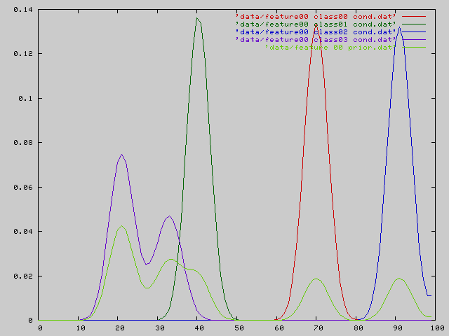
P(F|Class) for four classes
Overall p(F)
A
B
C
D

Slide 31
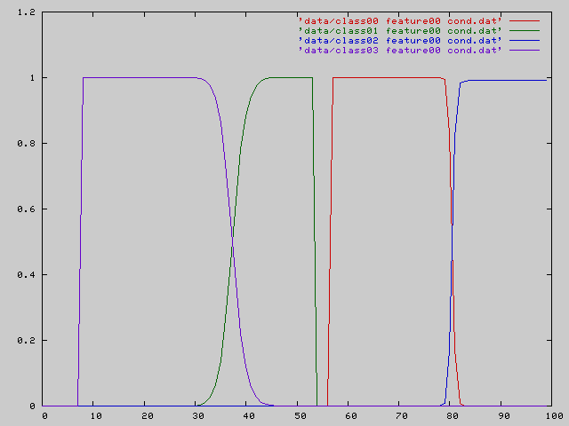
P(Class|F)=P(F|Class) * P(Class) / P(F)
A
B
C
D
Bayesian a posteriory probabilities: ‘blow up’

Slide 32
Problems with (naïve) Bayes
Product of probabilities: one feature wrong, or noise
on the features destroys the product. p=0 ... (?)
Naïve Bayes may be wrong: need feature combination
probabilities
A lot of data must be collected (!)
No contrasting transform on feature vector to
separate classes optimally: no use of geometry
© Schomaker 2001

Slide 33
Types of handwriting-recognition applications
Retrieval (“Googling”)
  scribble matching
  word spotting
Text transcription (“ugly2ascii”)
© Schomaker 2001

Slide 34
Types of cursive-script recognizers
whole-word (lexicon = list of word models)
  image template matching (~30-60%)
  whole-word feature vector matching (60-91%)
  whole-word HMMs, discrete or continuous
character-based (lexicon = list or graph)
  segmentation-based, lexicon + tree search
  HMM character models, chained, tree search
  HMM or Markov on letter hypotheses from
  another approach: MLP, 1NN etc.
© Schomaker 2001

Slide 35
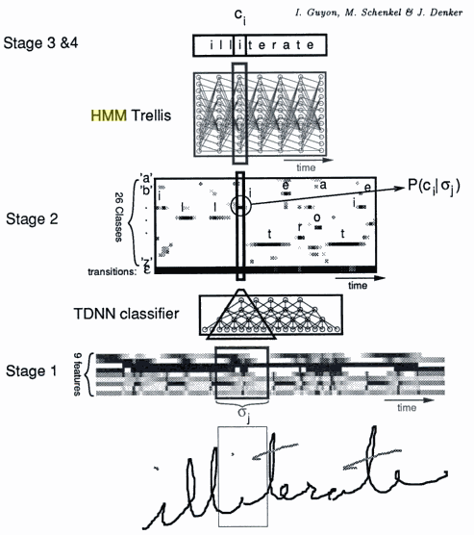

Slide 36
convolutional MLPs
Convolutional multi-layer perceptrons are invented by Yann Le Cun (http://yann.lecun.com/exdb/lenet/)
Main purpose: positional invariance, some rotational, scale and shear robustness
Insight: 32x32 pixels = 1024. Five hundred hidden units means half a million of weights in the first layer (bundle) alone.
The number of training samples is usually much lower than the number of coefficients: underdetermined set of equations
Idea: each hidden unit only looks at a small window of the preceding layer of units, but its activation is computed from a convolution over the total image.
© Schomaker 2001

Slide 38
Common approaches
Image → MLP → CharHyps (isolated chars)
Image → sliding window → MLP → CharHyps
Image → convolutional MLP → CharHyps
Image → Features → CharHyps (isolated chars)
Image → Segmentation points → Features → CharHyps
© Schomaker 2001

Slide 39
Uncommon approaches
Old
  structural pattern recognition
  Also see: “Handbook of character recognition and document
  image analysis” (Bunke et al) in books.google.com
New
  SVM (only for isolated characters)
  CRF (Conditional random fields)
© Schomaker 2001

Slide 40
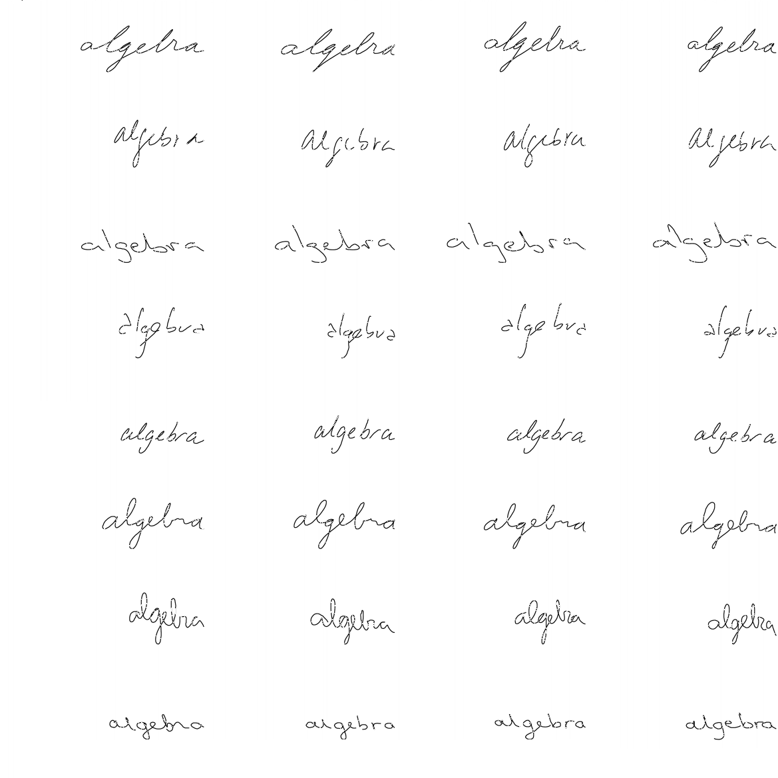
Algebra
(Schomaker, Segers, Vuurpijl, Mackowiak, 1996)

Slide 41
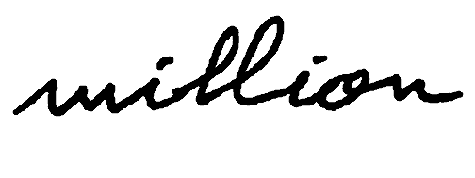
image million

Slide 42
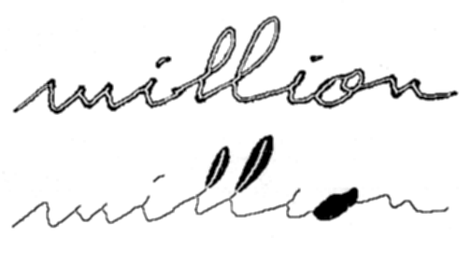
million processed

Slide 43
+regulariteiten
Regelmatigheden

Slide 44
+singulariteiten
Singulariteiten
Regelmatigheden

Slide 45
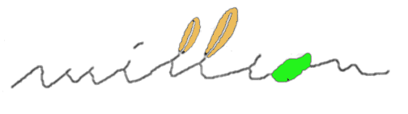
JC-Simon
"million" ==>
convex:concave:3(north:concave)
:(north:LOOP):concave:(north:LOOP)
:concave:north
:concave:HOLE
:2(convex:concave)
(J.-C. Simon, 1989)

Slide 46
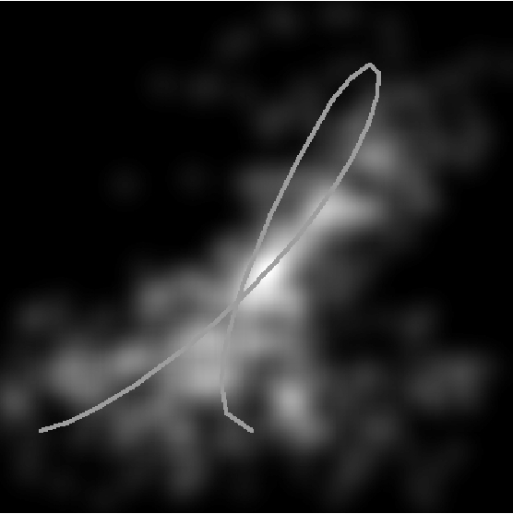
menselijk lezen

Slide 47
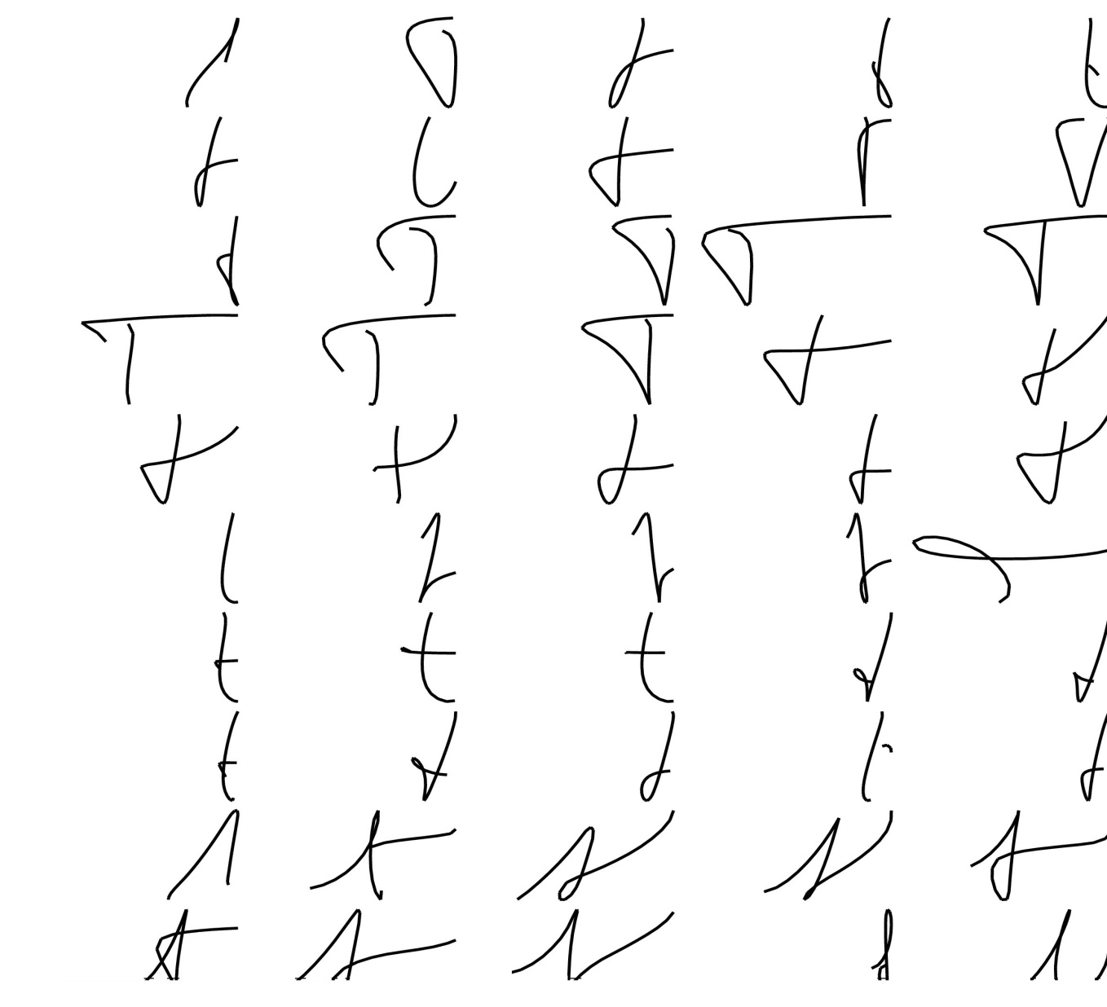
allografen “t”
(Vuurpijl & Schomaker, 1997)

Slide 48
kenmerkenlogica
All x with feature F1, F2 and not F3, F4, …
{ x : has(x,F1) & has(x,F2)
& ¬ has(x, F3) & ¬ has(x,F4)…}

Slide 49
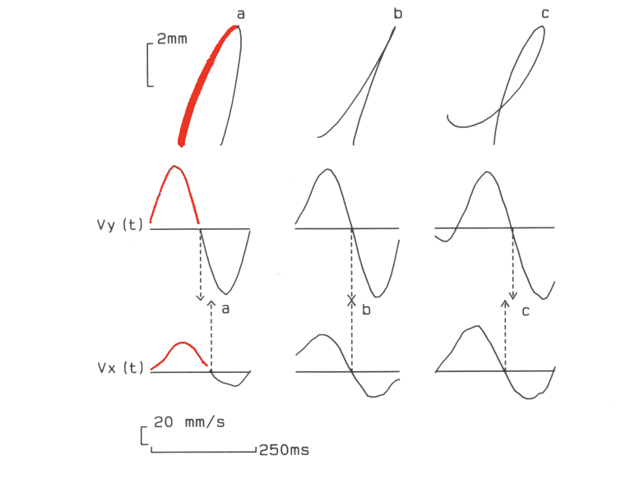
Stroke definition
(Teulings, Maarse, Thomassen, van Galen, Hulstijn, Schomaker e.v.a.)

Slide 50
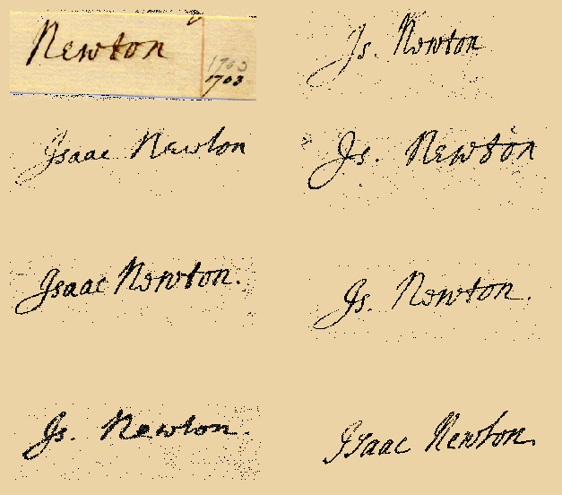
Newton handtekeningen

Slide 51
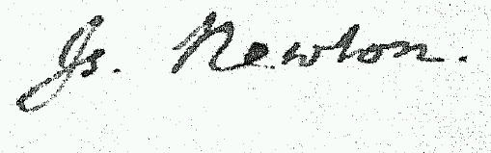
Newton tijdschatting
100 ms
per stroke,
also
for
Isaac
Newton

Slide 52
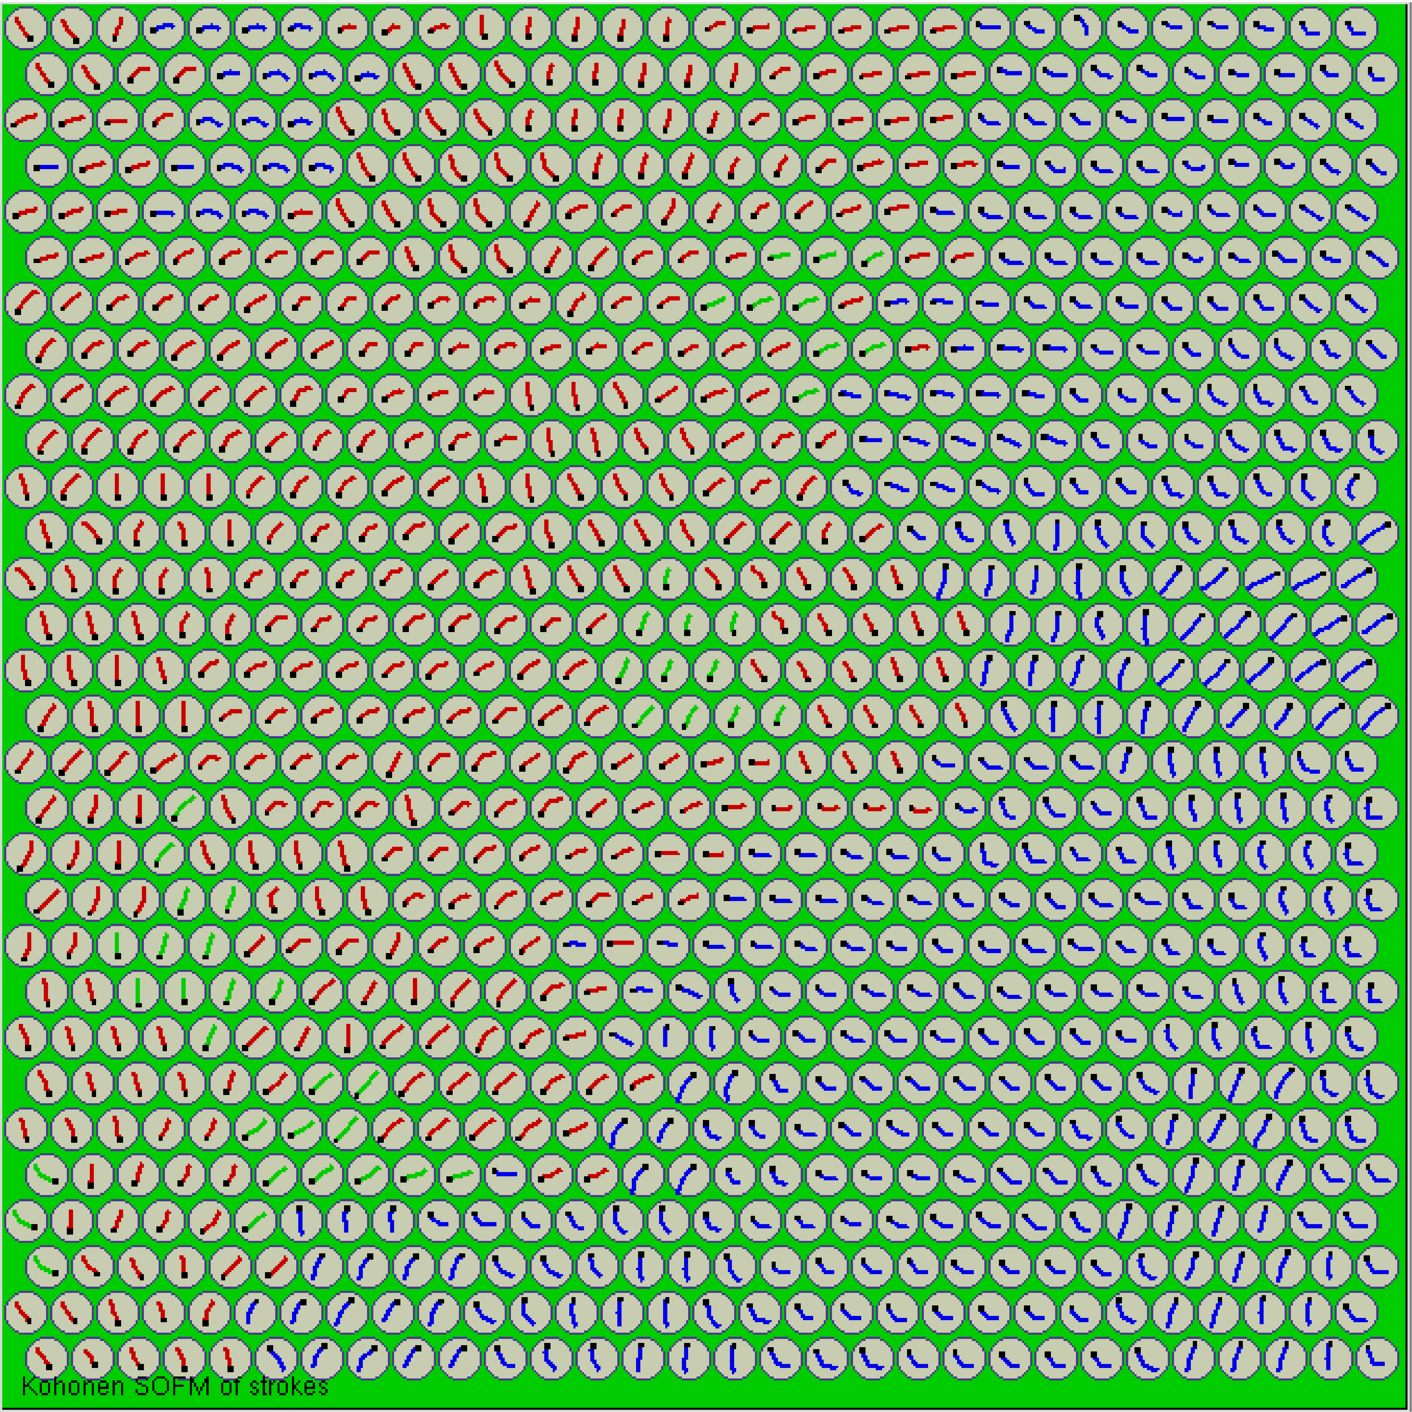
KohSom
Kohonen SOM of strokes
(Morasso, Schomaker, 1990-1993)

Slide 53
+ woordtraject
(Schomaker, 1993)
Probabilistic Stroke-Transition Network

Slide 54
Sensory input

Slide 55
Kenmerken
F₂
low-dimensional
feature representation
F₁
high-dimensional
sensory representation

Slide 56
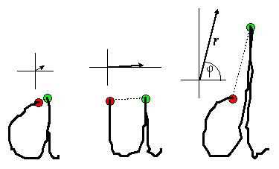
aud 2kenmerken
F₂
F₁
F₁ ₌ angle phi
F₂ ₌ distance r

