Slide 1

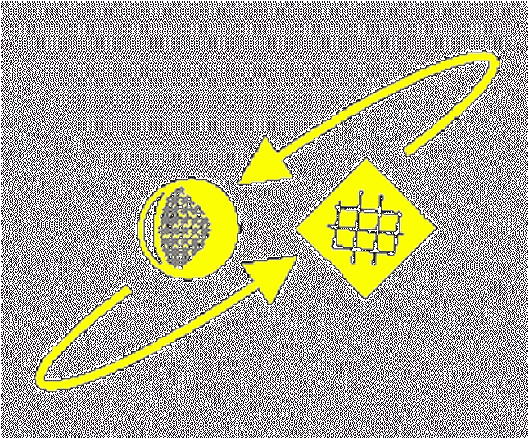
Script Recognition – 05b
Preprocessing
prof. dr. L. Schomaker
KI
RuG

Slide 2
Processing pipeline
sensing: scanner L(x,y), tablet (x_{t},y_{t,}z_{t})
low-level image problems
low-level segmentation
segmentation
feature computation
classification
linguistic processing
© Schomaker 2001

Slide 3
Scanning problems
Resolution (300dpi and up)
Contrast (gamma)
Rectangle of interest
(to exclude book-cover boundaries)
Rotation (skew)
Color bias and variation
Scanning duration
© Schomaker 2001

Slide 4
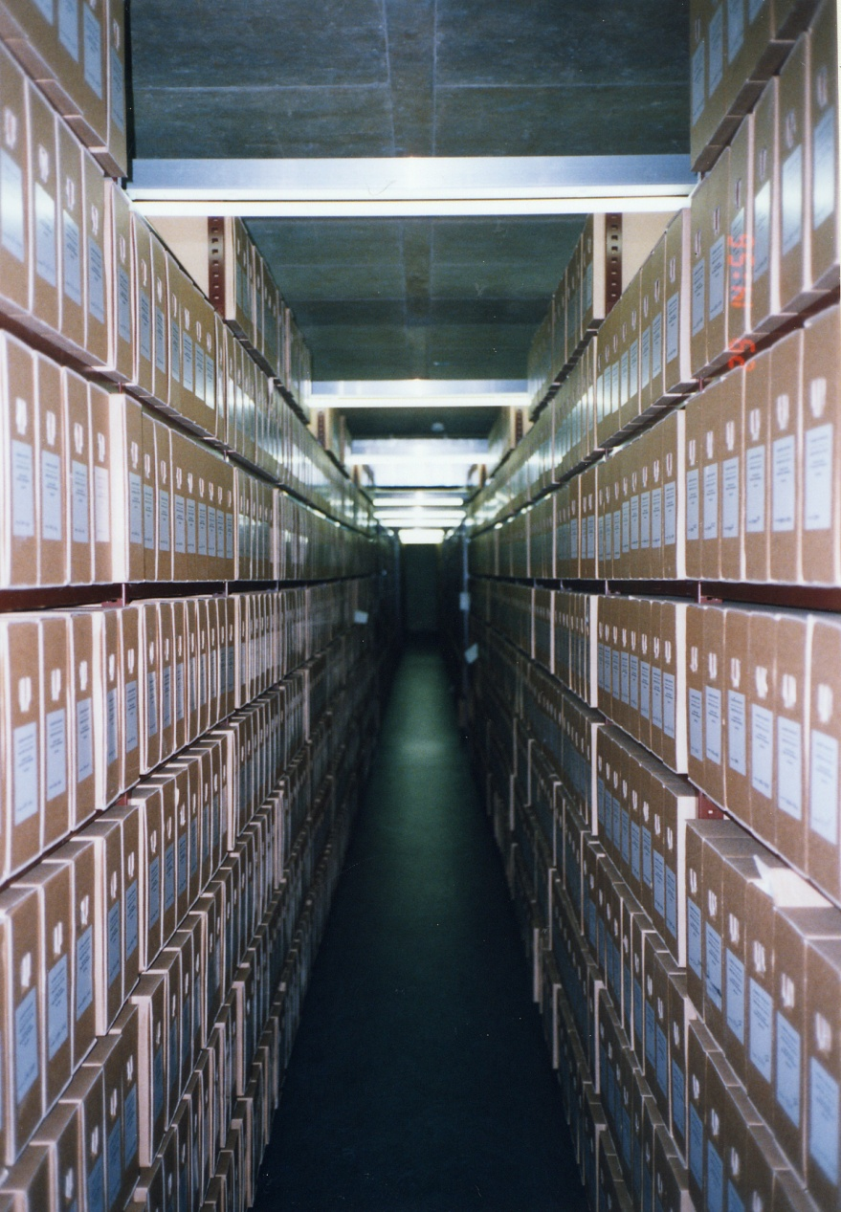
Archives themselves
3,250 linear meter of shelve
28,000 boxes
1000 pages /box
~ 28.000.000 pages
© Schomaker 2001

Slide 5
Low-level image sample problems
Contrast: general ink color versus background
Variation in intensity over scans
Shadows
Reflections (plastic-coated paper)
Broken ink
Complex background texture
Irrelevant elements and speckles
© Schomaker 2001

Slide 6
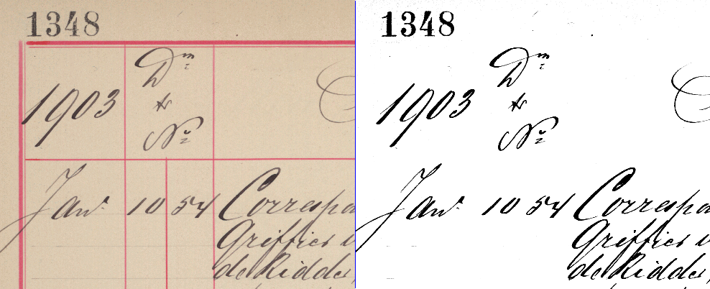
Color to grey-scale conversion
© Schomaker 2001

Slide 7
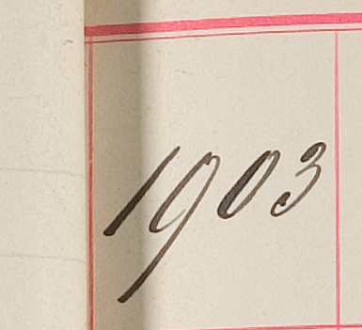
Binarization
© Schomaker 2001

Slide 8


Binarization
Paper ..... Ink
Simple thresholding
© Schomaker 2001

Slide 9

Binarization, Otsu
Find threshold t which minimizes within-class variance
σ²(t)=c₁(t)σ²₁(t)+c₂(t)σ²₂(t)
Assumes 2 intensity classes
c = cumulative p()
Maximize F=σ²_{between} / σ²_{within}
© Schomaker 2001

Slide 10

Localized fg/bg estimation
threshold = µ(x,y)+ ∆
localized method
strong smoothing filter
subtract from original
apply threshold
expensive
leaves some problems:
  speckles
  lines
© Schomaker 2001

Slide 11
Despeckling
Define square of size, smaller than the smallest meaningful object (point, comma ?)
Find all connected-ink components
Make all small CoCos white
© Schomaker 2001

Slide 12
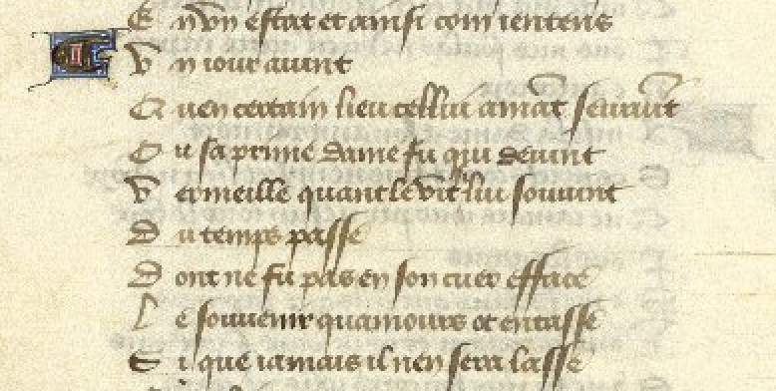
Despeckling, original
© Schomaker 2001

Slide 13
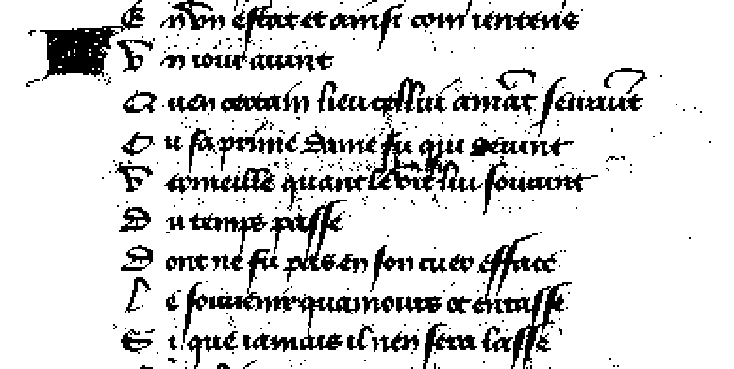
Binarized with speckles
© Schomaker 2001

Slide 14

Despeckle w=h=3
© Schomaker 2001

Slide 15
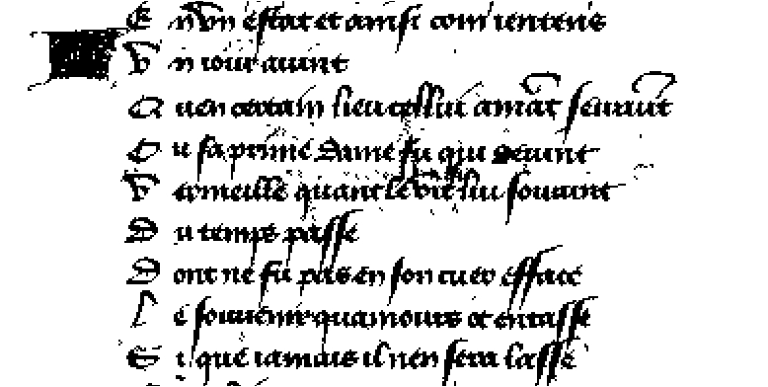
Despeckle w=h=5
© Schomaker 2001

Slide 16

Despeckle w=h=7
© Schomaker 2001

Slide 17
Despeckle w=h=9
© Schomaker 2001

Slide 18

Despeckle w=h=11
© Schomaker 2001

Slide 19
Low-level segmentation problems
Relevant text block detection
Tabular lines
Touching characters, horizontally
Touching ascenders/descenders, vertically
Broken characters
Non-uniform character size over the page
Underlines
Marginal notes & comments vs body of text
Titles, headers, footers
© Schomaker 2001

Slide 20

Low-level segmentation problems
Broken characters
Example: each color is a connected component:
Solution: ink dilation/erosion
© Schomaker 2001

Slide 21







Ink dilation/erosion
too thin
CoCos
B/W raw
dilate (1x)
then erode (1x)
not perfect
dilate (2x)
then erode (1x)
too fat, irreparable
dilate (4x)
© Schomaker 2001

Slide 22
Segmentation problems
page image
  paragraphs
    lines
      words
        characters
        strokes
        connected components
Punctuations, diacritics
© Schomaker 2001

Slide 23
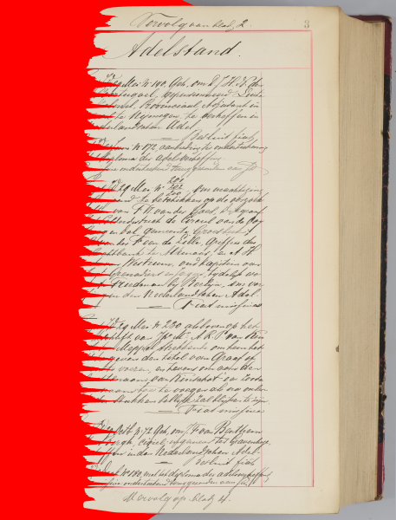
Line segmentation
Horizontal density
projection
Also: horizontal run-lengths
density projection
Find maxima and minima
© Schomaker 2001

Slide 24
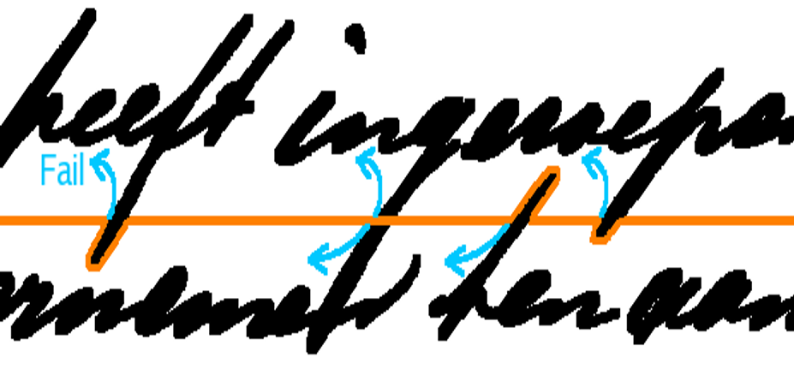
Acid-droplet method for line segmentation
© Schomaker 2001

Slide 25
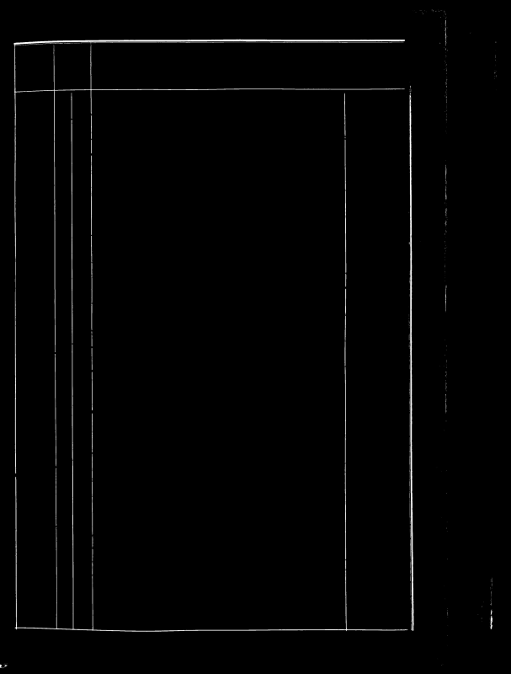
Tabular-structure detection
Threshold on R (in RGB)
Compute horizontal & vertical projection profile
© Schomaker 2001

Slide 26
Word segmentation
Stuur der Vereeniging ter verpleging van zieken
Connected components ≠ Words
Even:
Connected components ≠ Characters
© Schomaker 2001

Slide 27
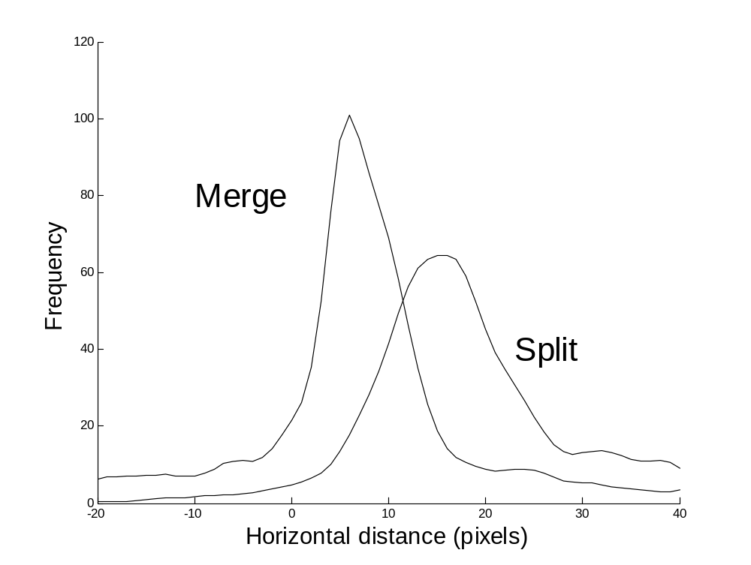
Word segmentation
within-word gaps
between-word gaps
© Schomaker 2001

Slide 28

Segmentation problems
Complicated objects
© Schomaker 2001

Slide 29
Segmentation problems
Complicated objects
© Schomaker 2001

Slide 30

Unshear
Complicated objects
© Schomaker 2001

Slide 31
Non-text CoCos
Complicated objects: the case of a fractional number
© Schomaker 2001

Slide 32
Unshear and rotate
x,y (new space) → find pixel x’,y’ (old space)
“pull” otherwise: need to fill empty pixels
usually: 2x2 matrix times 2d vector
(1 0) Shear
(m 1)
(cos -sin) Rotate
(sin cos)
➔ Ugly aliasing unless bicubic interpolation!
© Schomaker 2001

