Slide 1
Features for handwriting recognition
L. Schomaker / A. Brink

Slide 2

Processing pipeline
Learn
Pre-processing
image
Feature extraction
10101
“Moordrecht”
Memory
Perform
Pre-processing
image
Feature extraction
10101
Classify
“Moordrecht”
Memory

Slide 3
Processing pipeline
Pre-processing
normalized object
Feature extraction
image
Segmen-tation
object
Normali-zation
10101
Input image
Object representation
Feature type

Slide 4



Input image types
Color
Grayscale
Binary

Slide 5
Processing pipeline
Pre-processing
normalized object
Feature extraction
image
Segmen-tation
object
Normali-zation
10101
Input image
Object representation
Feature type

Slide 6
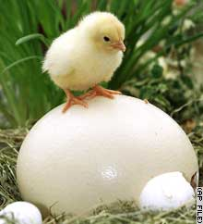
Object of classification (1/2)
Sentences (use grammar or bag of words)
Words (use dictionary)
Characters (use alphabet)

Slide 7
Object of classification (2/2)
Connected components (→)
“Fraglets”

Slide 8
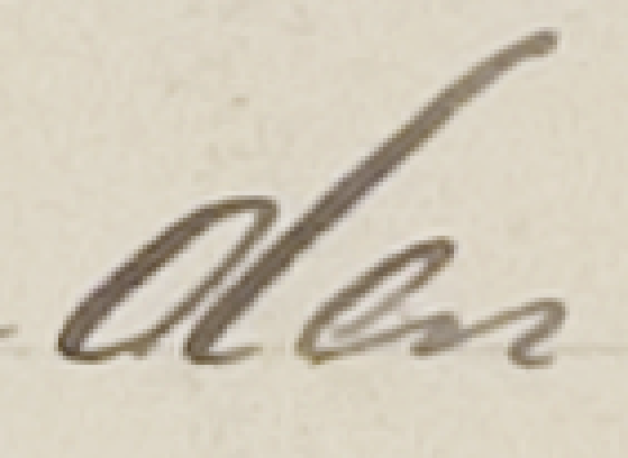



Connected components

Slide 9
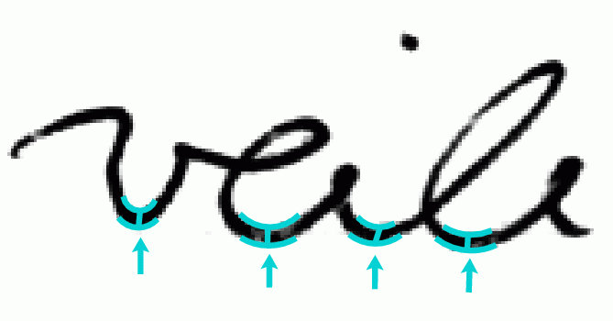
Connected components ?
What to do if they span a complete word? ➔ Fraglets

Slide 10
Processing pipeline
Pre-processing
normalized object
Feature extraction
image
Segmen-tation
object
Normali-zation
10101
Input image
Object representation
Feature type

Slide 11
Invariance (1/2)
Luminance / contrast
Position
Size
Rotation
Shear
Writer style
Ink thickness
…

Slide 12
Invariance (2/2)
How:
Normalize
  Size: scale
  Position: center
  Shear: unshear
  …
Use invariant features
  Rotation: Zernike invariant moments
  …

Slide 13
Processing pipeline
Pre-processing
normalized object
Feature extraction
image
Segmen-tation
object
Normali-zation
10101
Input image
Object representation
Feature type

Slide 14
Object representations
Image
Unordered pixel vectors
Contour vectors
On-line vectors
Skeleton image
Skeleton vectors
I(x, y)
(x, y)_{i}
(x, y)_{k}
(x, y)_{t}
I(x, y)
(x, y)_{k}

Slide 15
Processing pipeline
Pre-processing
normalized object
Feature extraction
image
Segmen-tation
object
Normali-zation
10101
Input image
Object representation
Feature type

Slide 16
Feature ROI types
Whole object (“wholistic”)
Zones
Windowing

Slide 17
Whole object

Slide 18
Zones

Slide 19
Windowing

Slide 20
Processing pipeline
Pre-processing
normalized object
Feature extraction
image
Segmen-tation
object
Normali-zation
10101
Input image
Object representation
Feature type

Slide 21
Feature types
Image features
  1D list of counts (1 – 13)
  2D matrix of counts (1 – 13)
  2D image (1 – 13)
  Abstract features (14 – 17)
  Structural features (18 – 20)
Contour features
  Various (21 – 28)

Slide 22
Feature 1: density histogram

Slide 23
Feature 2: radon transform

Slide 24
Feature 3: run count pattern
3
6
2
3

Slide 25
Feature 4: run length pattern
avg
stdev
avg
stdev

Slide 26
Feature 5: Autocorrelation

Slide 27
Feature 6: Polar zones

Slide 28
Feature 7: radial zones (tip!)

Slide 29
Feature 8: zone histograms

Slide 30
Feature 9 – 11
Connected component images
Scaled image
Distance transform
(on whiteboard)

Slide 31
Feature 12 – 13: Hinge, Fraglets
(Marius’s talk)

Slide 32
Feature types
Image features
  1D list of counts (1 – 13)
  2D matrix of counts (1 – 13)
  2D image (1 – 13)
  Abstract features (14 – 17)
  Structural features (18 – 20)
Contour features
  Various (21 – 28)

Slide 33
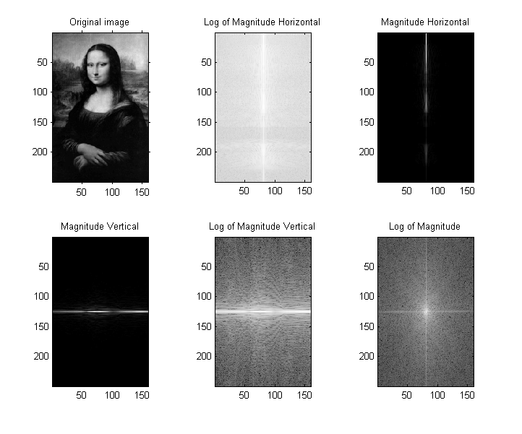
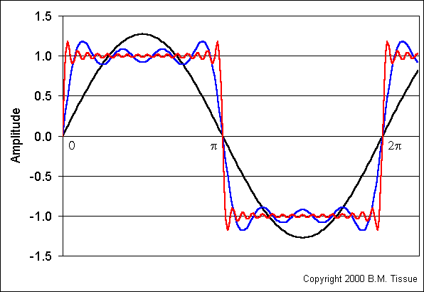
Feature 14: Fourier transform
Fig. 1 and 3 from: http://www.csse.uwa.edu.au/~wongt/matlab.html
Fig. 2 from: http://www.chemicool.com/definition/fourier_transform.html

Slide 34
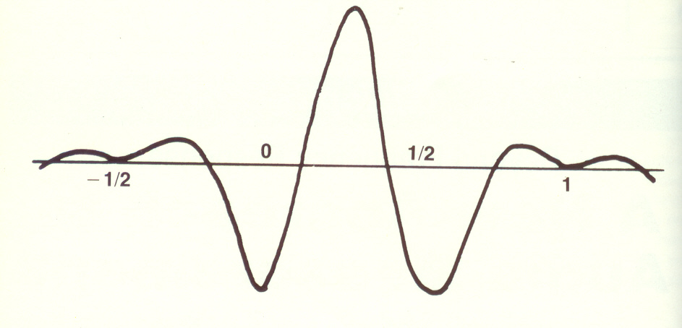
Feature 15: Wavelet transform
From: http://www.regonaudio.com/Audio%20Measurement%20via%20Wavelets.html

Slide 35
Feature 16: Hu invariant moments (1/2)
Invariant for scale, position and rotation
Works on (x, y) vectors
Derived from moments

Slide 36
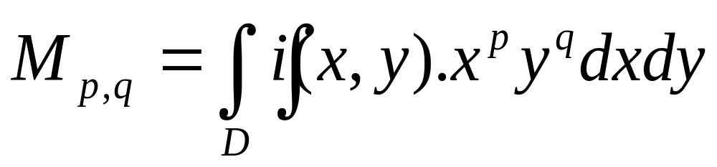
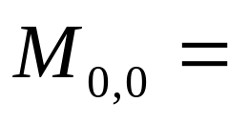
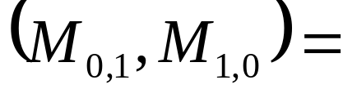
Feature 16: Hu invariant moments (2/2): Moments
describe the image content (or distribution) with respect to its axes
area of the object
center of mass
Slide from: http://www.cedar.buffalo.edu/~govind/CSE717/lectures/CSE717_3.ppt

Slide 37
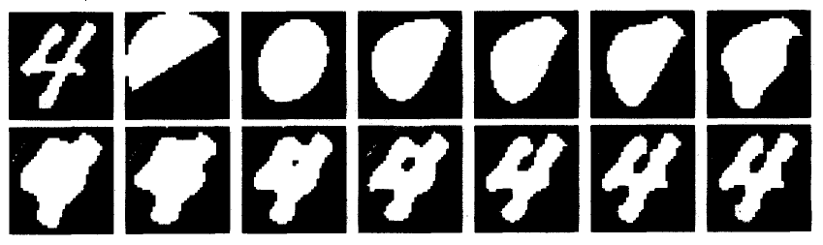
Feature 17: Zernike moments
From: Trier, O. D., Jain, A. K., and Taxt, T. (1996). Feature extraction methods for character recognition - a survey. Pattern Recognition,29:641–662.

Slide 38
Feature types
Image features
  1D list of counts (1 – 13)
  2D matrix of counts (1 – 13)
  2D image (1 – 13)
  Abstract features (14 – 17)
  Structural features (18 – 20)
Contour features
  Various (21 – 28)

Slide 39


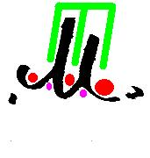

Feature 18: Structure of background (1/3)

Slide 40


Feature 18: Structure of background (2/3)

Slide 41





Feature 18: Structure of background (3/3)

Slide 42
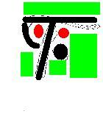
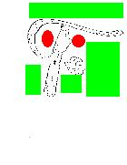

Feature 19: Structure of foreground + background

Slide 43
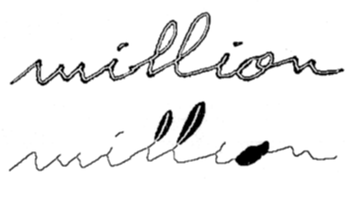
Feature 20: J.C. Simon (1/2)
Singulariteiten
Regelmatigheden

Slide 44

Feature 20: J.C. Simon (2/2)
"million" ==>
convex:concave:3(north:concave)
:(north:LOOP):concave:(north:LOOP)
:concave:north
:concave:HOLE
:2(convex:concave)
(J.-C. Simon, 1989)

Slide 45
Feature types
Image features
  1D list of counts (1 – 13)
  2D matrix of counts (1 – 13)
  2D image (1 – 13)
  Abstract features (14 – 17)
  Structural features (18 – 20)
Contour features
  Various (21 – 28)

Slide 46
Feature 21 – 28: Contour features
(cos, sin) of running angle
(cos, sin) of running angular difference
Angular difference
Fourier transform
Ink density (horizontal or vertical)
Radon transform: (ink density, computed radially from the c.o.g.)
Angular histogram
Curvature scale space (→)

Slide 47
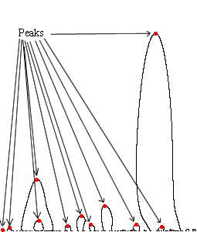
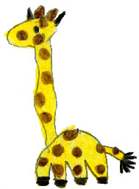

Feature 28: Curvature scale space
iteration
pos
From: http://www.christine.oppe.info/blog/category/formen-und-farben/formenvergleich/

