Slide 1

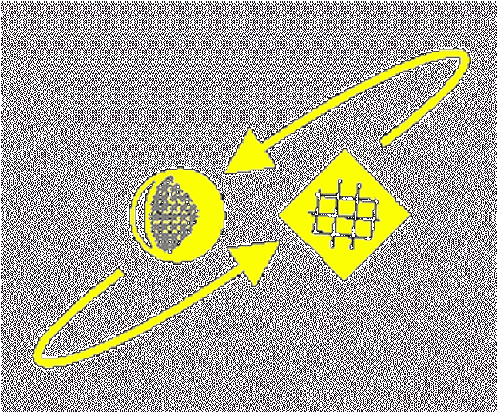
Script Recognition – 01
History of scripts
prof. dr. L. Schomaker
KI
RuG

Slide 2
Booklet
Writing: The story of alphabets and scripts, Georges Jean (1997), London: Thames and Hudson Ltd. [New Horizons]
© Schomaker 2010

Slide 3
The function of script
Precursors of script:
  a sand path in the jungle or grass
  cave paintings (cf. “Lascaux, FR”)
  scratches on trees and stones
  in order to mark a path or territory
© Schomaker 2010

Slide 4
The function of script: The role of cognition
Human memory is volatile
… and unreliable
Counting and arithmetic are difficult
Needed during evolution: extension of the
  working memory and
  long-term memory
© Schomaker 2010

Slide 5
What information is contained in the symbols?
Pictograms [concrete, pictorial]
Ideograms [reference to abstractions]
Phonograms [speech-related codes]
© Schomaker 2010

Slide 6
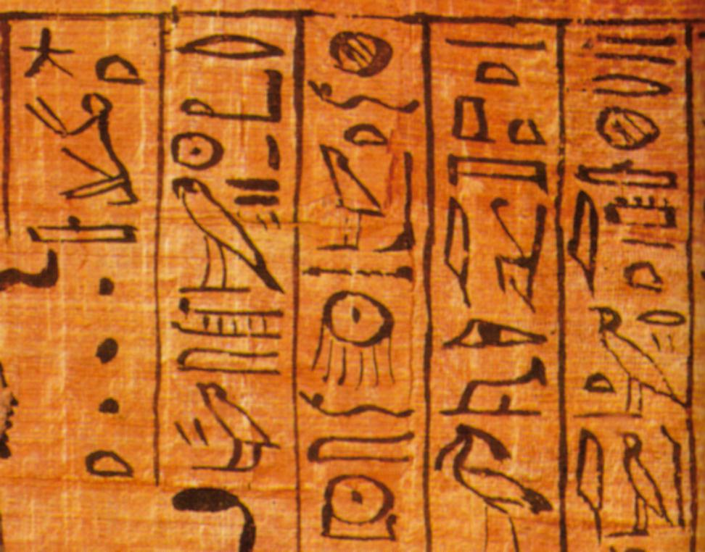
Pictograms
© Schomaker 2010

Slide 7
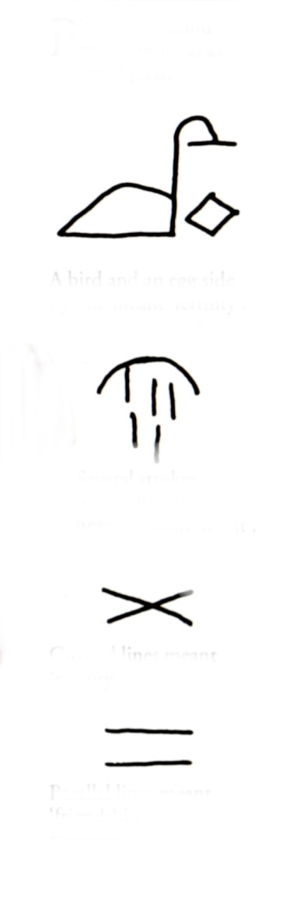
Ideograms
Bird & Egg → Fertility
Night
Enmity/animosity
Friendship
© Schomaker 2010

Slide 8
Phonograms
o
© Schomaker 2010

Slide 9
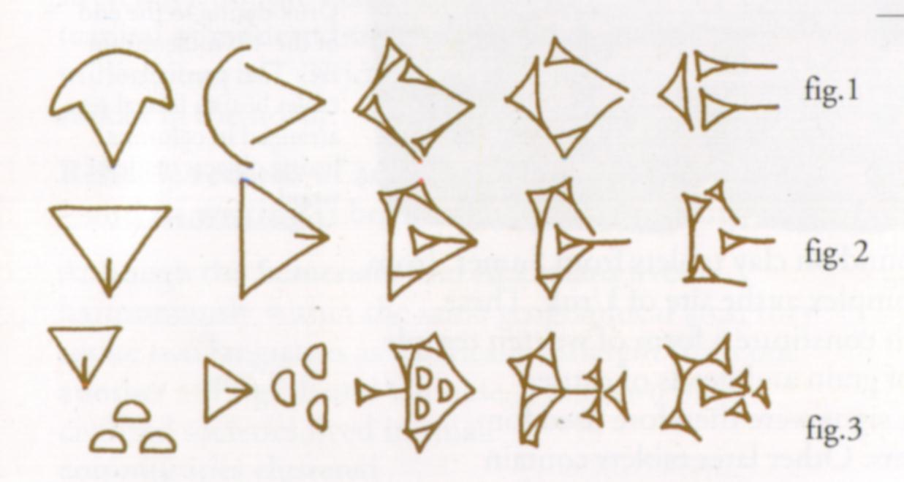
5000 years ago: Sumerian script on clay tablets
Cow
Woman
Female slave (woman from beyond mountains)
Where does this evolution in shapes originate?
© Schomaker 2010

Slide 10
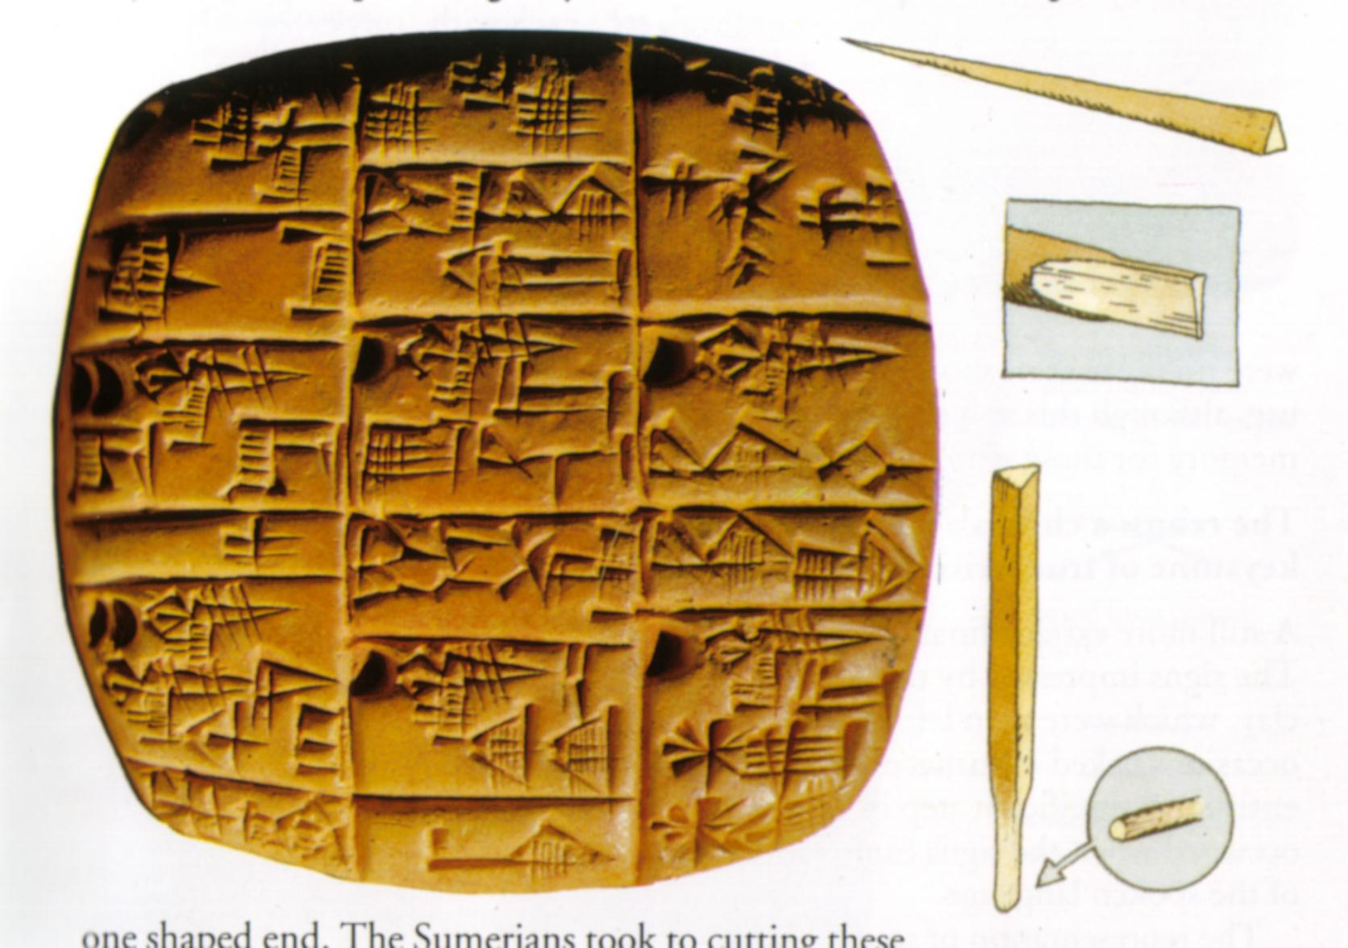
5000 years ago: Sumerian script on clay tablets
Cow
Woman
Female slave (woman from beyond mountains)
© Schomaker 2010

Slide 11
5000 years ago: Sumerian script on clay tablets
Cow
Woman
Female slave
© Schomaker 2010

Slide 12
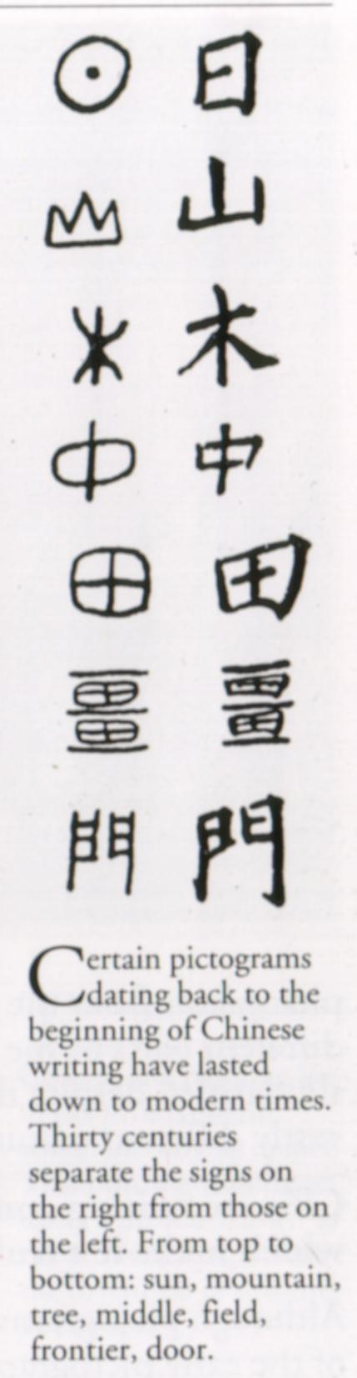
Iconic symbols in Hanji (3000 years stable)
sun
mountain
tree
‘middle’
field
frontier
door
Origin of Chinese ideograms:
Shang dynasty,
3400 years ago
© Schomaker 2010

Slide 13
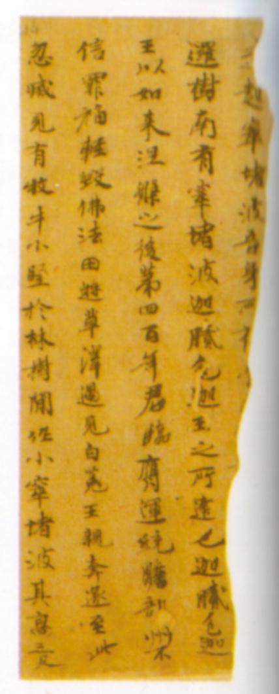
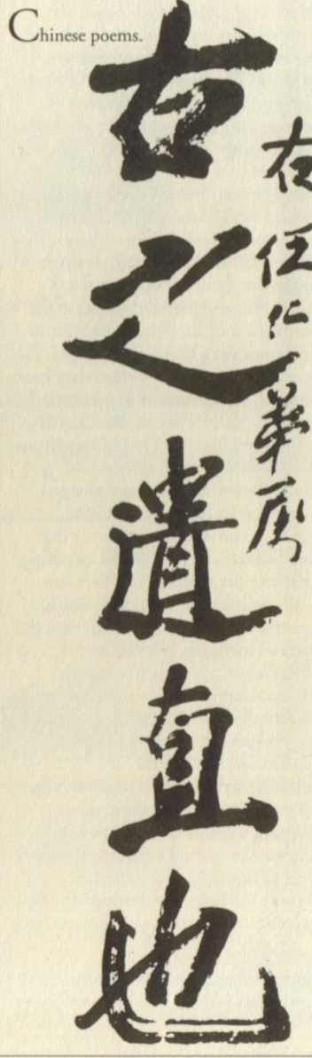
Medium and writing-implement influence
The static shape of
Chinese characters
is determined by the
dynamics of the writing
implement during the
writing process:
the brush and its ink
deposition process
© Schomaker 2010

Slide 14
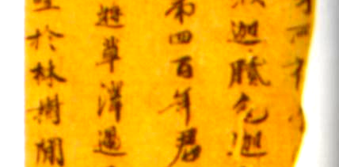
ink deposition (Franke & Schomaker) “The physical process
in which a coloring pigment is made to adhere to a writing
surface, with typical characteristics for each type of
stylus, pigment and surface material”
© Schomaker 2010

Slide 15
Other Asian scripts
Japan: Kanji, Hiragana, Katakana
Korea: Hangul [syllabic]
Vietnam
Etc.: many script types still in actual use today!
© Schomaker 2010

Slide 16
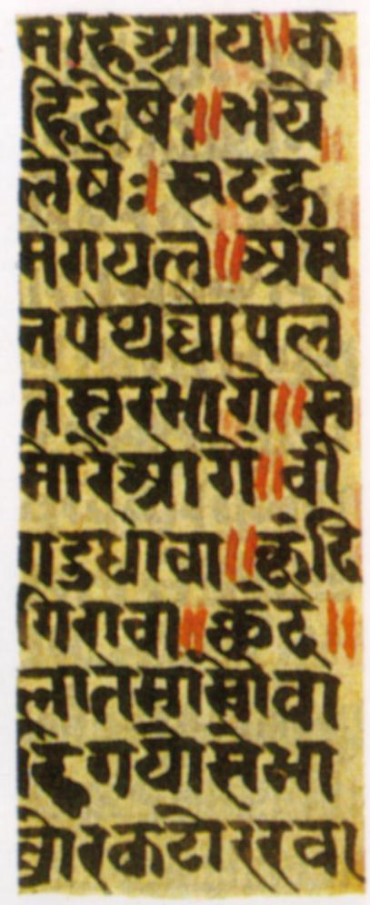
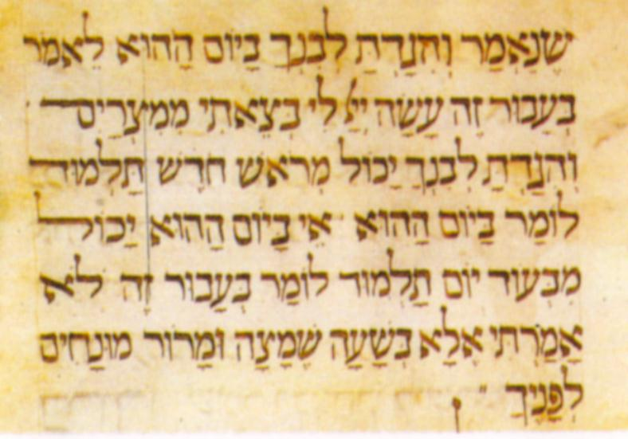
Asia and middle east
Hebrew (3000 yrs. ago)
Devanagari (India)
© Schomaker 2010

Slide 17
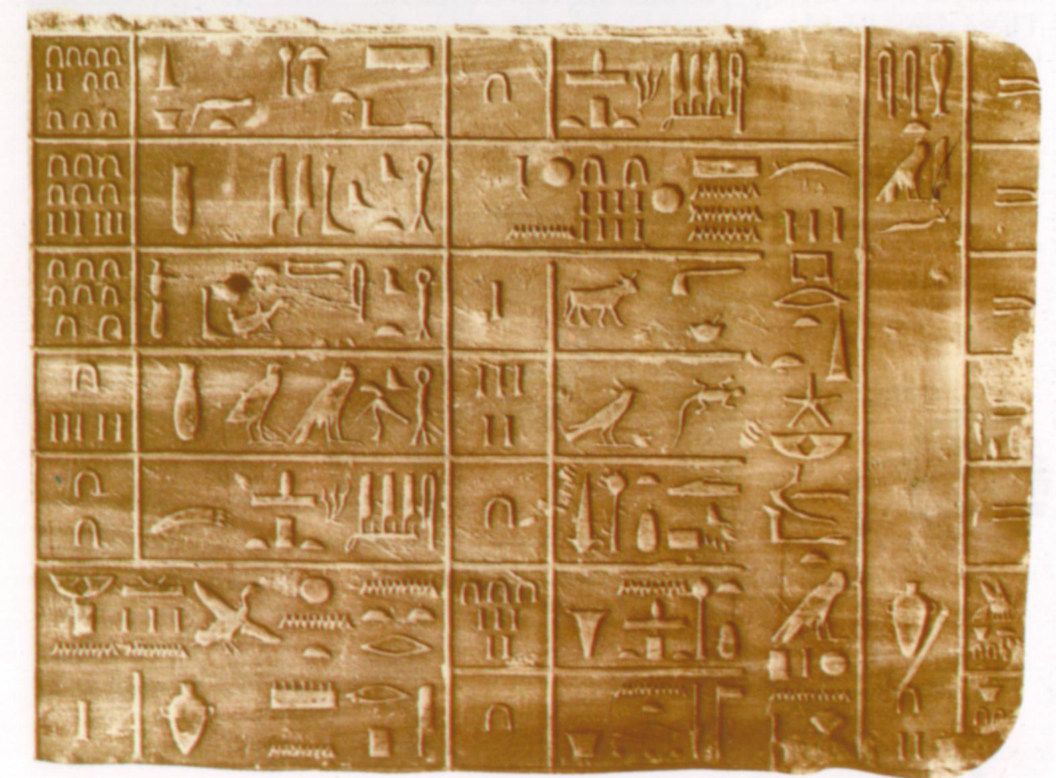
Egyptian hieroglyphs (5000 year ago)
Brush on papyrus Carved in stone
© Schomaker 2010

Slide 18
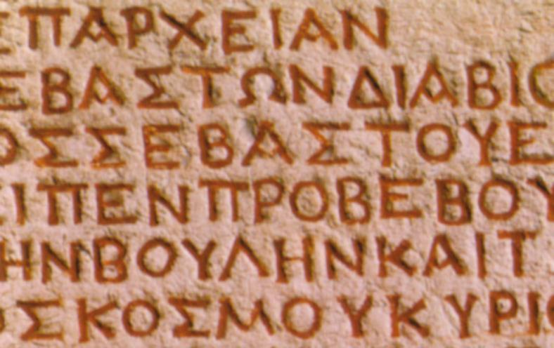
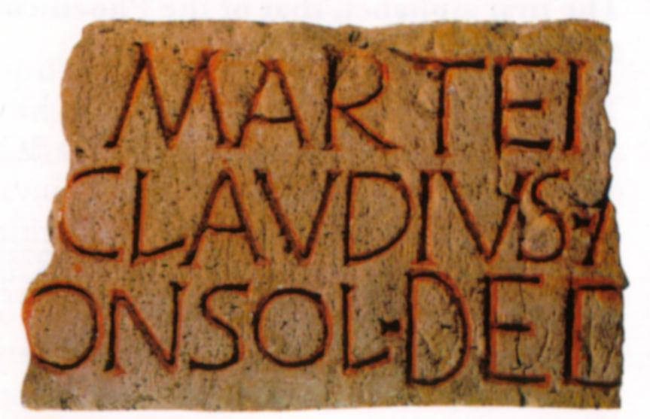
Europe
3000 years ago, the alphabet was introduced by Phenicians
Greek
Latin
© Schomaker 2010

Slide 19
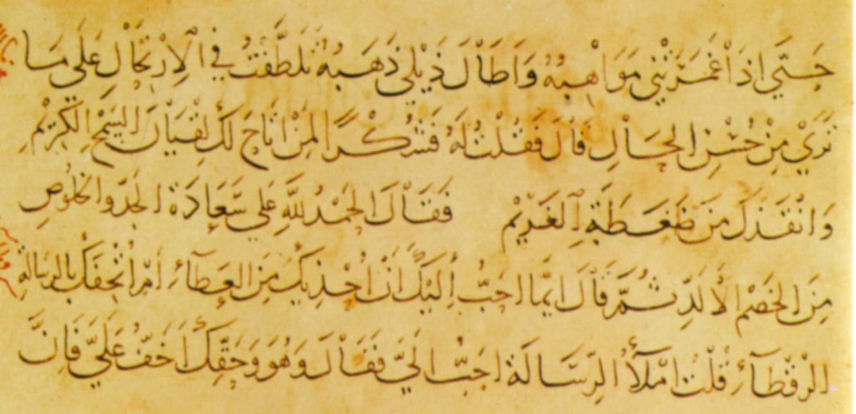
Arabic (1500 years ago)
© Schomaker 2010

Slide 20
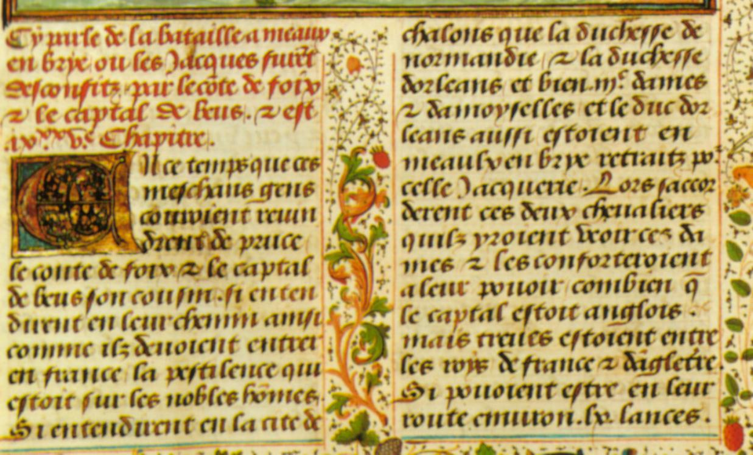
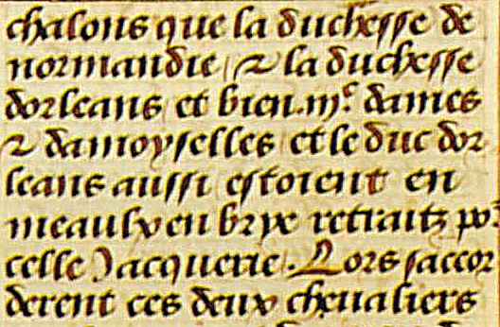
French manuscript, 1340-50
© Schomaker 2010

Slide 21
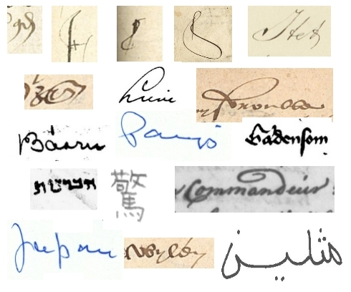
Currently studied, in the Monk project
© Schomaker 2010

Slide 22
Book printing and connected-cursive Western script
Book printing reduced the need for manual
handwritten copies of texts.
However, there was a need for printed books
which looked as impressive as the old manuscripts.
© Schomaker 2010

Slide 23
Book printing and connected-cursive Western script
Book printing reduced the need for manual
handwritten copies of texts.
However, there was a need for printed books
which looked as impressive as the old manuscripts.
Out of this need grew the italic type, in use by the papal
offices in Rome. It was easy to concatenate characters.
By the seventeenth century, connected-cursive script
had evolved
© Schomaker 2010

Slide 24
connected-cursive Western script
Origin: the italic font and the need for fast writing
Purposes of connected-cursive script
  (a) official documents
  (b) personal note taking
  (c) communicating letters
© Schomaker 2010

Slide 25
Connected-cursive Western script
connected-cursive script can be written faster than
i s o l a t e d h a n d p r i nt characters or
B L O C K P R I N T characters
…. at the expense of legibility
© Schomaker 2010

Slide 26
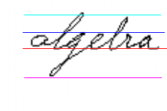
Connected-cursive & lineation definitions
a: ascender line
c: corpus line
b: base line
d: descender line
Note: connected-cursive is still considered to be
the most difficult target for computer-based
handwriting recognition because of the ambiguous
segmentation of characters in a word
and of words in a line-strip image
© Schomaker 2010

Slide 27
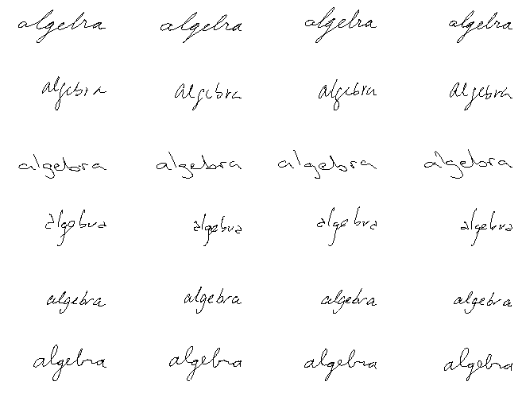
Within-writer variability, between-writer style variation

Slide 28
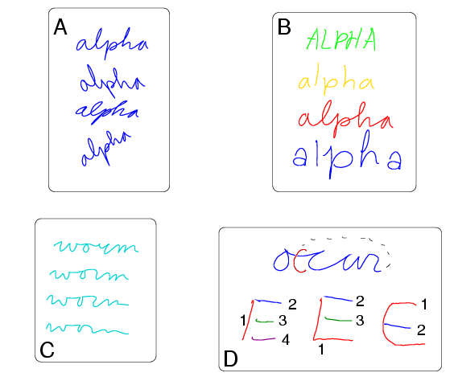
Sources of variation and variability in handwriting
Affine transforms
Style variations (allographs)
Neuro-biomechanical variation
Sequencing (temporal-order variation)

Slide 29
Connected-cursive script recognition
Still a challenge to science & technology!
State-of-the art is lagging w.r.t. speech recognition and ‘machine-print’ OCR.
‘segmentation’: where are the words in a sentence? Where are the letters in a word?
minimum
© Schomaker 2010

Slide 30
Applications in script recognition
Text input on small hand-held devices (organizers, pen-based mobile phones)
Cheque reading in banks
Address field recognition on envelopes
Writer identification, signature verification
Historical data collections, archive cards, ‘kadaster’, genealogical data, journals (… also of authors, politicians etc.)
© Schomaker 2010

Slide 31
Conclusions
Script serves as a means to extend the limited
abilities of human memory
The character shapes in scripts are related to
(1) surface characteristics (e.g., texture),
(2) writing implement (e.g., stylus), and
(3) human motor constraints:
using this information helps to design HWR systems
State-of-the art in HWR is lagging w.r.t. speech recognition and ‘machine-print’ OCR.
Pervasive problem: ‘segmentation’: where are the words in a sentence? Where are the letters in a word?
© Schomaker 2010

