Slide 1
H3drv homework (RZ+SL)
RZ, SL
12.6.2023
Notes:
v1.1: added slides for ppt (SL, 5.6.23)
v1.0: first version with basic structure (SL, 30.5.23)

Slide 2
H3drv homework - agenda
Goal
Setup
Theory
MCC-H3 prj
Findings
Authors
reiner.zieglmeier@microchip.com
stefan.luethin@microchip.com

Slide 3
Goal

Slide 4
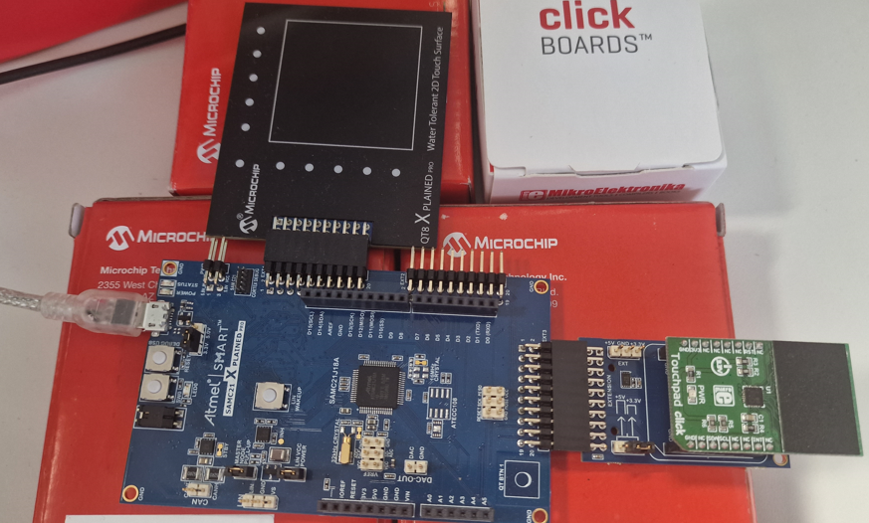
H3drv homework: goal
x: ... / y: ...
QT8-touch
clickTouch
python
moveMouseOnScreen -> winLib see last slide
analyzing x,y-inputs and maybe FFT over it, we could maybe detect a button-press and with python then indicate this - eg: different icon, like filled-hand vs not-filled-hand that just moves
PTC
I2C
x,y
getXY()
MCU/H3
sendToHost(x,y)
UART
PC
comm to sensor
initSens()
initTouch()
initQT8()
readSens() -> call on if flag=set / flag set in ISR
rdTouch()
rdQT8()
extractXY()
sendToHost()
...
#eof
use H3-modules
console (UART,USB)
mcuOutPos(X,Y)
debug
??needed?
cmdIF
mcuInSens() -> change activeSensor
#eof
simulate mouse and animation x,y
init() -> selectIcon()
read icon, eg: mouse, that will be moved on screen
getXY()
just read from keyboard in v1
will come from MCU/realSensor later in v2
moveIcon(x,y)
use winCalls (last slide) to move icon
#eof

Slide 5
Setup

Slide 6
H3drv homework: setup
Setup step
MPLABX -> chaos/nightmare (still ongoing) with v6.10 vs v6.05
git-repo
git-account -> create git-repo and invite collaborators
git-bash & SourceTree
Work-flow, branches…
Harmony3-repos
Which repos are needed and how to fetch and/or update -> use MCC-CM
BUT due to current problems with MCC-CM stick to old MHC3-CM or git-bash
need to install git.exe AND old HMC3-CM plugin doesn’t show up in MPLABX-plugins-available -> need to do manually
runme.bat just pops up a dos-shell and disappears, why? Well runme.bat needs ‘java.exe’ in path…
Finally MHC3-CM is up and now can setup your H3-repos
Create initial H3-prj -> see ‘part: touchClick’
Where to start? MHC3 vs MCC-H3 (see later slides)
Steps to create final goal
How to break it down
How to org parallel development

Slide 7
H3drv homework: setup
hide
Used env:
Use H3-plib and -drv to access two different touch-solutions with SAMC21J18a
QT8 -> requires PTC-peripheral
mikroE touch-click-1995 with ‘MTCH6102’ -> required I2C-peripheral
Physical setup on the right
Environment
MPLABX-v6.05
XC32-v4.21
DFP-3.8.119, CMSIS-5.8.0
MCC-H3 repos used:
csp-v3.16.0, core-v3.12.0,
content-manager

Slide 8
Theory

Slide 9
H3drv homework: theory
…
REINER
Theorie

Slide 10
MCC-H3 project
HIDE
SAMC21J18a with
a) touch-1995 click (I2C)
b) QT8-xpl (PTC)

Slide 11
H3drv homework: concept
HIDE
concept
Start with baseline-prj = MCC-H3 prj for SAMC21J18a with
only STDIO+SERCOM=printf()
Then work on tree git-branches
B1: baseline + click touch-1995
B2: baseline + QT8
->merge1: have both touch-solution and select with static-bool
B3: H3-console
->merge2: replace STDIO/printf() in B2 with H3-console
B4: H3-cmdIF, so we can switch between touch1/2 from ext-command (eg: python-script)
->merge3: B3 + H3-cmdIF
…
merge3
merge2
merge1
QT8
(=> git-tag x???x )
Touch-1995 click
(=> git-tag x???x )
H3_console (=> git-tag x???x )
H3_cmdIF (=> git-tag x???x )
B2
B1
B3
B4
Baseline: MCCH3 for SAMC21 with STDIO -> printf() (=> git-tag x???x )

Slide 12
H3drv homework/b1: MCC-prj for click
Part1: step-by-step guidance for SAMC21J18a + mikroE-click touch-1995 on EXT3

Slide 13
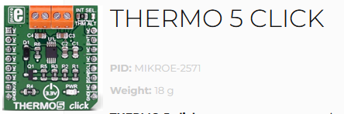
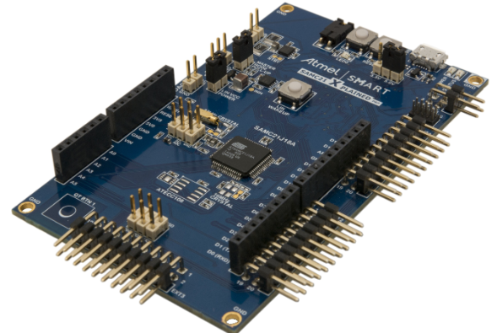
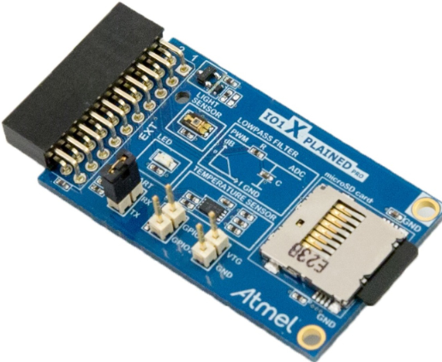
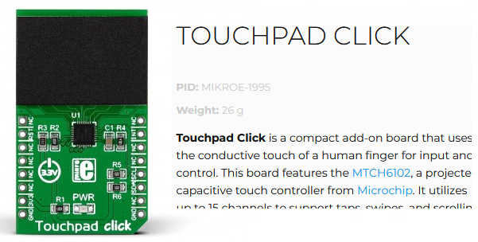
H3drv homework/b1: MCC-prj for click
B1: touchClick – step1a: h3-prj on PLIB->DRV-level to access thermo5Click on I2C
Start: DEV7/PLIB Lab1: reads Temp from IOxpl and outputs via UART, but on SAMD21 with challenges
Next port DEV8/DRV Lab1 = DEV7/L1 but DRV-level and on SAME54 -> port to SAMC21 more challenges
Adding SW0
Added SW0 to only UARTprint if SW=pressed
BUT SW not working, why? -> click on EXT3 connected, but EXT3 pins collide with SW0…
removing EXT3 board, SW worked immediately
Replacing IOxpl-tempSens with thermo5Click
IOxpl-tempSens stores T as 2B@oneAddr -> 1x I2C_WrRd()
Thermo5-click stores T as 1B@twoAddr -> 2x I2C_WrRd()
Replacing SW0 with touchButton
… (inWork)
Replacing thermo5 with touchClick
… (inWork)
State-of-today
SAMC21
SPI/I2C
Step1a: H3-DRV prj
Step1b: thermo5 + SW0
Step1c: SW0 -> touchButton
goal
SAMC21
SPI/I2C

Slide 14
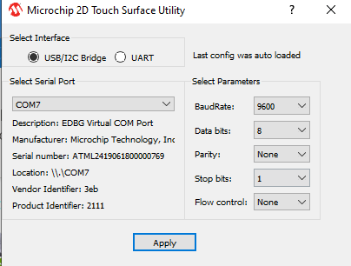
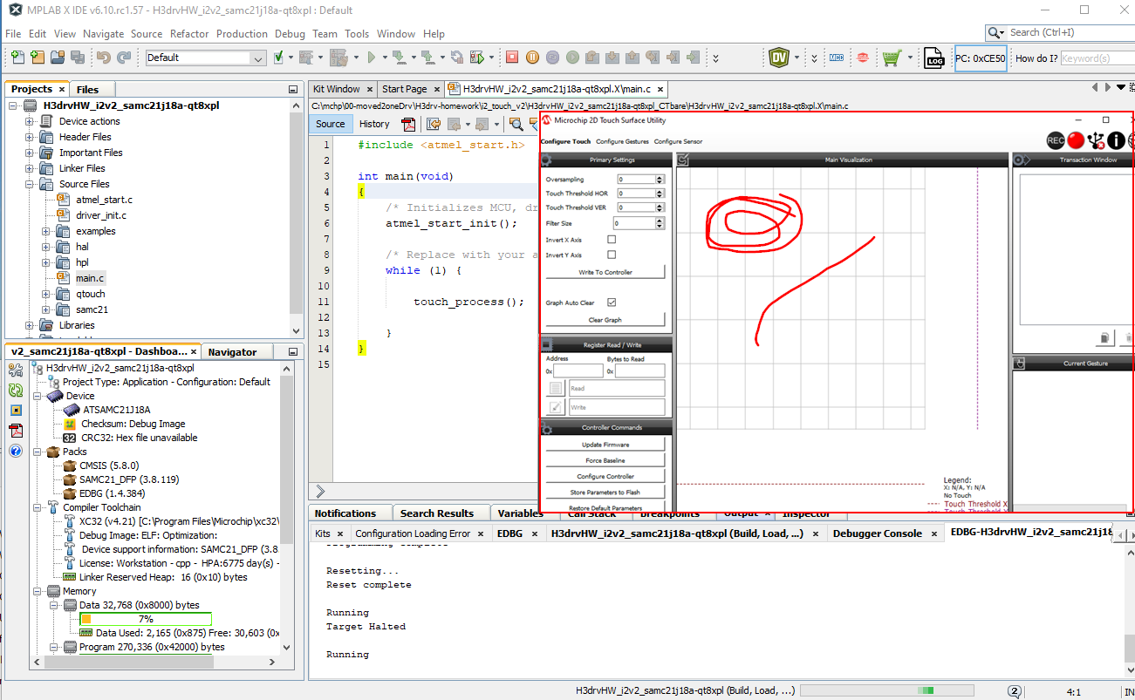
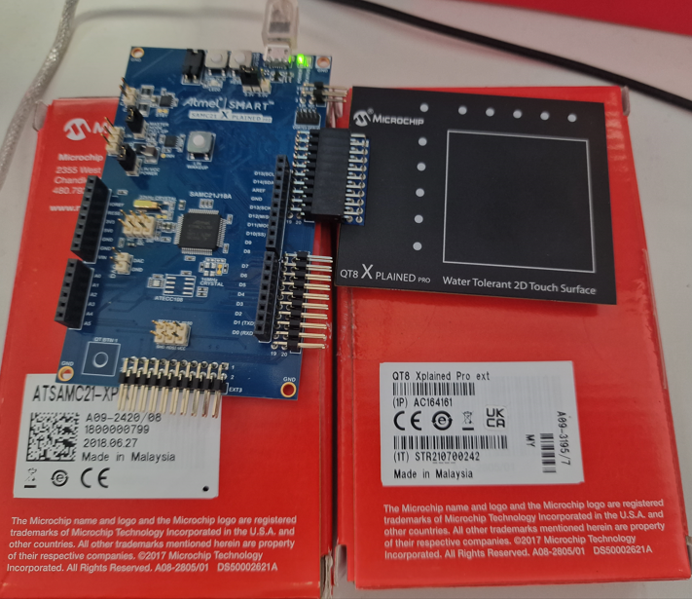
H3drv homework/b2: MCC-prj for click
START-prj ->hide
Branch2: QT8-xpl on EXT1 - Step1: start from Atmel-START prj
in A-START: create Atmel-START prj and make sure it compiles ok
in A-START: export A-Start prj
in MPLABX: import into MPLABX
in MPLABX: fix
libraries are not added to prj -> manually add tx-libs in prj-view
adjust #include-paths (??)
download+run ok?

Slide 15
H3drv homework/b2: MCC-prj for click
Step-by-step guidance for SAMC21J18a with Touch2 = QT8-xpl on EXT1

Slide 16
H3drv homework/b2: MCC-prj for click
Branch2: QT8-xpl on EXT1 – Step2: create with MCC-H3 with same result BUT created with MCC-H3 from scratch
…
REINER
Prj QT8+python

Slide 17
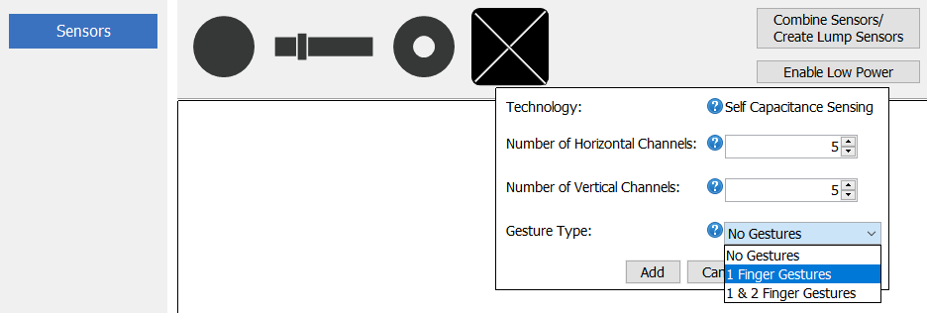

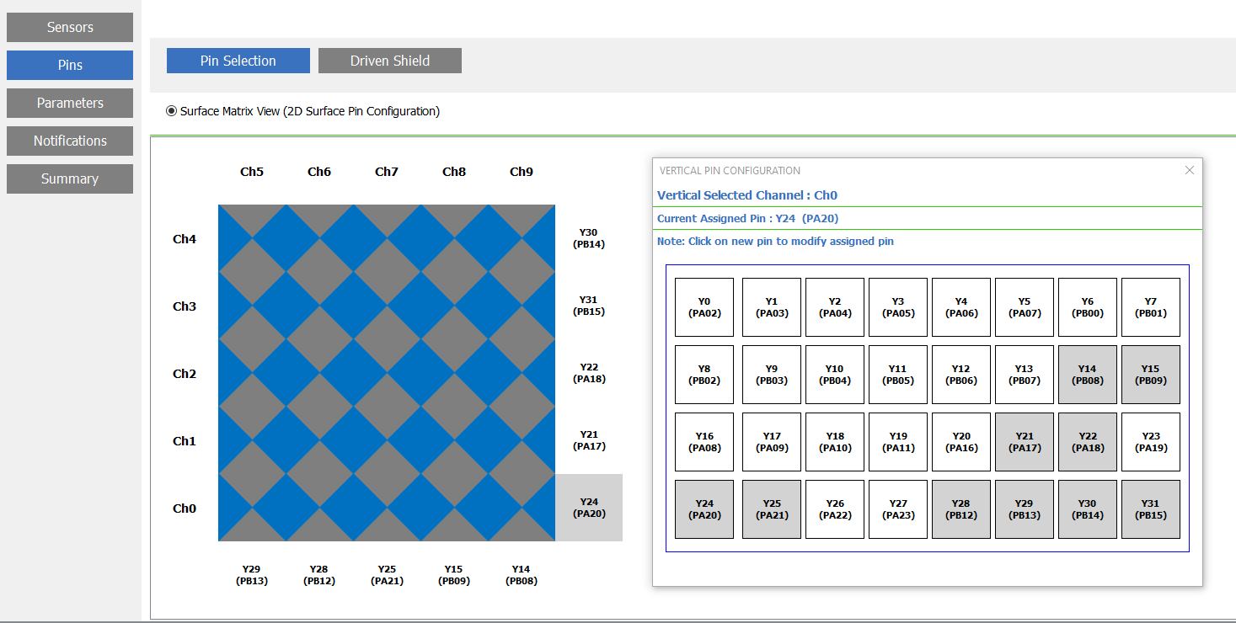
Touch Configurator – Sensor /Pin Selection
The kit has a 5x5 2D Touch Surface sensor and driven shield.

Slide 18
Findings
Finding during H3-usage

Slide 19
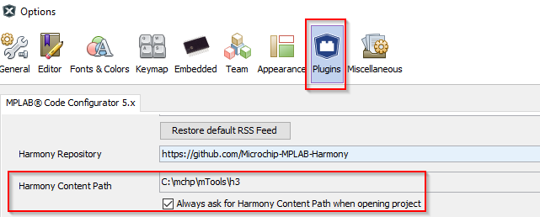
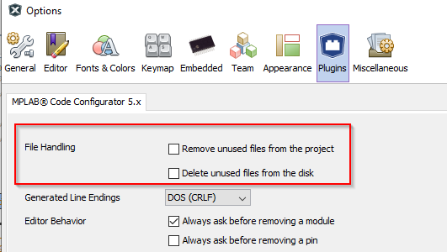
H3drv homework: findings
Findings part1: setup+touchClick
MPLABX
MPLABX-v6.10 screws up v6.05
MPLABX-exceptions
MCC-CM not stable -> only stable way still
Use old MHC3-CM or git-bash or …
AND make sure on MCC-CM start ‘all required content is available…’
Set H3-path + ‘always ask’ flag
Default settings ‘File Handling’ deletes you app*.c/h ->not clear yet why, when..

Slide 20
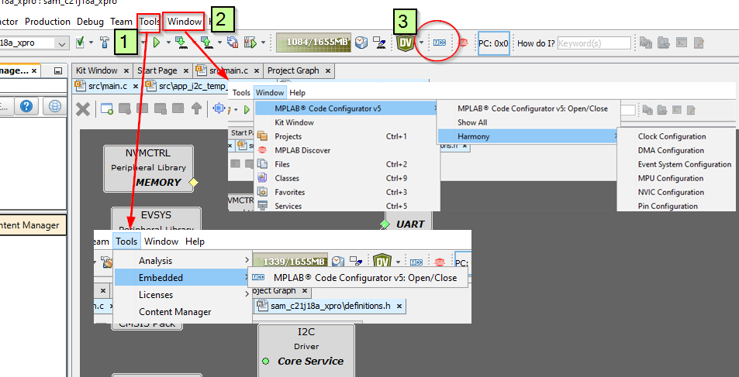
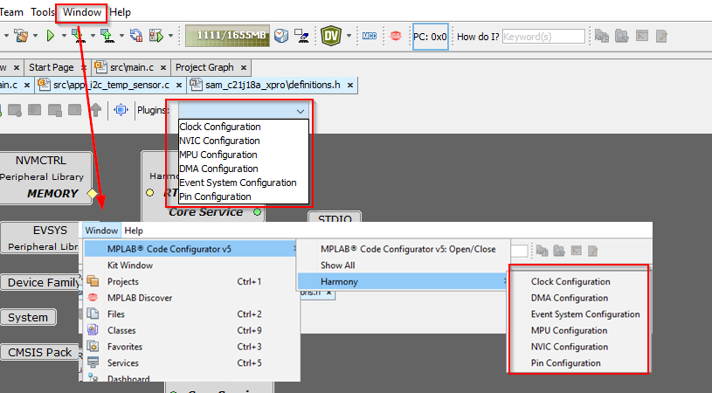
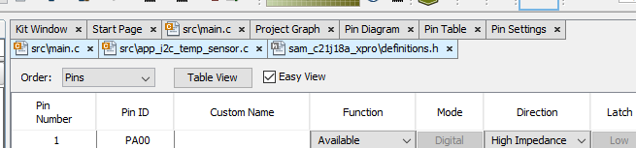
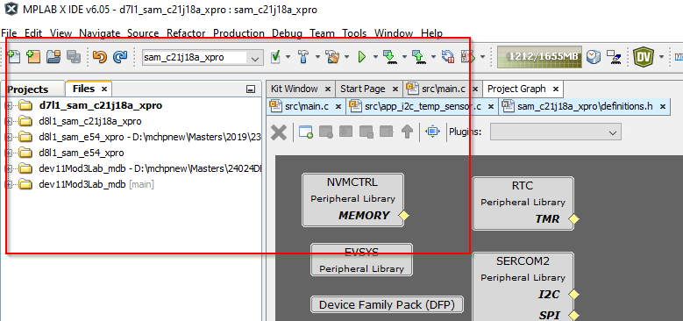
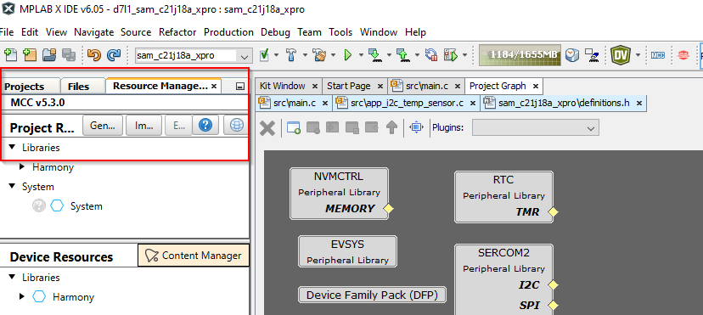
H3drv homework: findings
Findings part1: touchClick (continued)
MCC-H3 confusing tool structure – eg:
Start/stop MCC-H3 from three different places
H3-addOn-managers (where are they?)
How to GenerateCode?

Slide 21
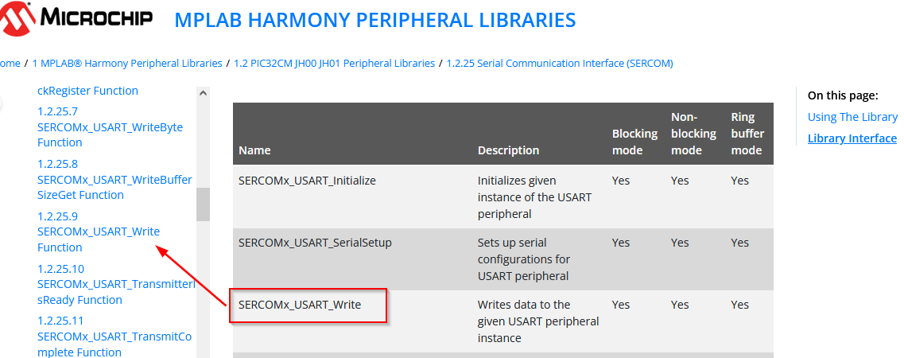
H3drv homework: findings
Findings part1: touchClick (continued)
Documentation -> Docu: hyperlinks missing in online-PLIB-doc and cannot filter on left or enlarge window ->usability

Slide 22
Thank You

Slide 23
H3drv homework/m1: both touch
Merge branch1/click-touch with branch2/qt8-touch
In work

Slide 24
H3drv homework: findings
Keep&hide
Findings part1: touchClick (SL)
MPLABX-v6.10 screws up v6.05
MPLABX-exceptions
MCC-CM not stable -> only stable way still
Use old MHC3-CM or git-bash or …
AND make sure on MCC-CM start ‘all required content is available…’
Set H3-path + ‘always ask’ flag

Slide 25
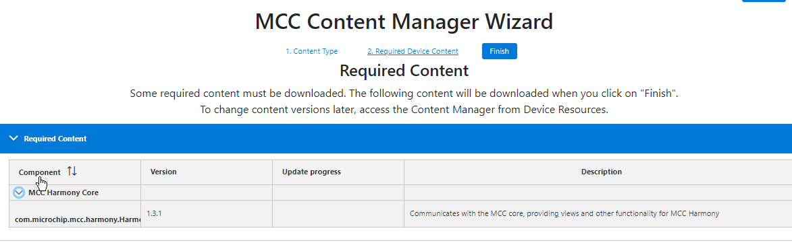
H3drv homework: findings
Keep&hide
Findings part1: touchClick
MCC-Structure
MCC-plugin -> MCC-core-> Harmony-core way to complex…
Must be online to start MCC (if Harmony-core not matching…)
…

Slide 26
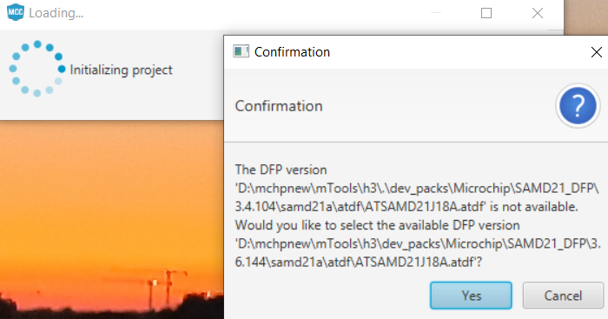
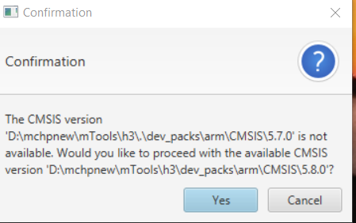
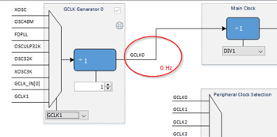
H3drv homework: findings
hide
Findings part1: touchClick (continued)
Porting between versions
Old MHC3 -> stored config in 2 files harmony.prj + <h3config>.xml in ‘firmware\src\config\<h3config>\’ ->opening oldMHC3-prj with latest MCC shows 2 pops and converts h3config into one file ‘firmware\prj.X\*.mc3’ => even if converted to MCCH3-mc3 file, you still get these popups did something go wrong? No, must manually remove old-MHC3cfg ‘*.prj + *.xml’
Last MHC3 stores config in one directory ‘firmware\src\config\<h3config>\<h3config>.mhc\*.yml’ ->porting this to MCC-H3 converts all into *.mc3 AND places a ‘mcc.txt’ into <h3config>.mhc\ that says ‘mcc convert success’ ->but porting from lateMHC3 to MCC, but on first conversion as it doesn’t know any of the prj-files, hence lots of merge-issues and if haven’t seen microchipdeveloper/port-mhc-2-mcc might completely ruin your sources
Porting from D21 -> C21 (same arch = easy?!?!)
Change MCU in MPLABX-prjProp -> start MCC
MCC detects new arch and offers with popup to port BUT clock connected on GCLK1 is left open, hence no cpu-clock…

