Slide 1
H3drv homework (RZ+SL)
RZ, SL
12.6.2023
Notes:
v1.0: first version with basic structure (SL, 30.5.23)

Slide 2
H3drv homework - agenda
Goal
Setup
Theory
MCC-H3 prj
Findings

Slide 3
Goal

Slide 4
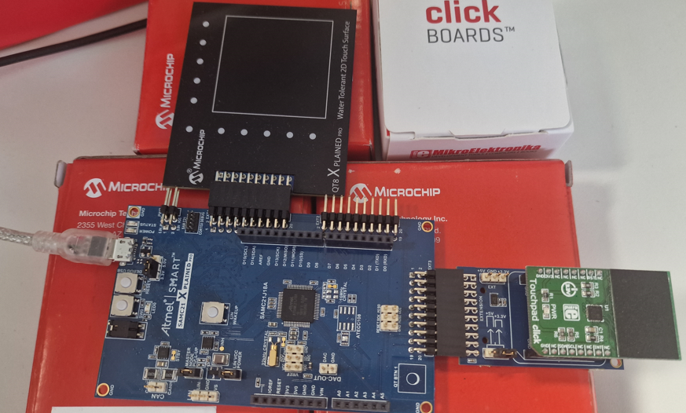
H3drv homework: goal
inWork
Short description of Goal for this project:
Use H3-plib and -drv to access two different touch-solutions with SAMC21J18a
QT8 -> requires PTC-peripheral
mikroE touch-click-1995 with ‘MTCH6102’ -> required I2C-peripheral
Physical setup on the right
Environment
MPLABX-v6.05
XC32-v4.21
DFP-
MCC-H3 repos
x
Authors
reiner.zieglmeier@microchip.com
stefan.luethin@microchip.com

Slide 5
Setup

Slide 6
H3drv homework: setup
inWork
Setup step
x

Slide 7
Theory

Slide 8
H3drv homework: theory
inWork
Short theory on
Mutual vs Selfcapacitance touch
PTC vs mxTouch vs mcthCapacitiveTouch
Boards used
QT8 -> requires PTC-peripheral
mikroE-click_touch-1995 has uC (?which one?) on click-board and only requires I2C interface

Slide 9
MCC-H3 project
SAMC21J18a with
a) touch-1995 click (I2C)
b) QT8-xpl (PTC)

Slide 10
H3drv homework: concept
inWork
concept
Start with baseline-prj = MCC-H3 prj for SAMC21J18a with
only STDIO+SERCOM=printf()
Then work on tree git-branches
B1: baseline + click touch-1995
B2: baseline + QT8
->merge1: have both touch-solution and select with static-bool
B3: H3-console
->merge2: replace STDIO/printf() in B2 with H3-console
B4: H3-cmdIF, so we can switch between touch1/2 from ext-command (eg: python-script)
->merge3: B3 + H3-cmdIF
…
merge3
merge2
merge1
QT8
(=> git-tag x???x )
Touch-1995 click
(=> git-tag x???x )
H3_console (=> git-tag x???x )
H3_cmdIF (=> git-tag x???x )
B2
B1
B3
B4
Baseline: MCCH3 for SAMC21 with STDIO -> printf() (=> git-tag x???x )

Slide 11
H3drv homework/b1: MCC-prj for click
inWork
Step-by-step guidance for SAMC21J18a with Touch1 = mikroE-click touch-1995 on EXT3

Slide 12
H3drv homework/b2: MCC-prj for click
inWork
Step-by-step guidance for SAMC21J18a with Touch2 = QT8-xpl on EXT1

Slide 13
H3drv homework/m1: both touch
inWork
Merge branch1/click-touch with branch2/qt8-touch

Slide 14
Findings
Finding during H3-usage

Slide 15
H3drv homework: findings
inWork
Findings
F1: …

Slide 16
Thank You

Slide 17
xxx
x

