Slide 1
Health APP
By: EdgyElephant

Slide 2

Summary
Goal: Health APP(GUI)
Functionality
Covid symptom checking
Appointment Scheduler
Menu Bar
Saving result to files
Tool: wxWidget
A C++ library that creates apps for window
Single code base
Allows us to develop GUI

Slide 3
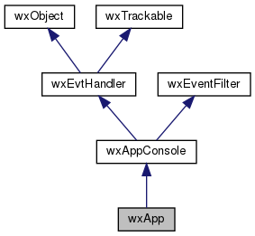
Major Files
4 major Files
cMain.cpp - most of the work
cMain.h
cApp.cpp - inherit wxApp
cApp.h
Does not have main procedure
wxApp::OnInit is the equivalent
OnInit returns a bool to indicates whether process should continue
wxApp represent the application itself
Allows app-wide setting to be accessible
Set and get app-wide properties

Slide 4
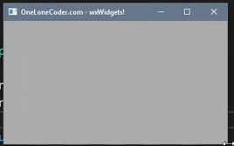
wxFrame
Empty frame
A frame is window
Size & position can be change by user
This was the function where we construct our frame
It takes in a parent pointer - usually nullptr
ID: Value of ID was unimportant, wxID_ANY allows us to use any ID
wxPoint allows us to set position of the frame
wxSize allows us to set the size of the frame

Slide 5


Creating new frame
Declare a frame in cApp.h ->
Creates a pointer that points to cMain object
m_frame1-> Show();
Shows the frame

Slide 6
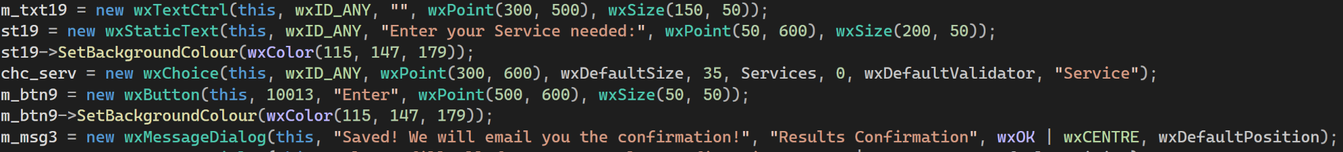
UI Classes
wxButton - has ReadOnly text; triggers an event
wxStaticText - ReadOnly text that explains
wxMessageDialog - pop-up that gives responses to user input
wxTextCtrl - user input text box with size and position
wxChoice - dropdown menu containing a wxString array of options
Reading the option selected requires:
GetSelection() which gives array index
GetString(n) where n is the index

Slide 7
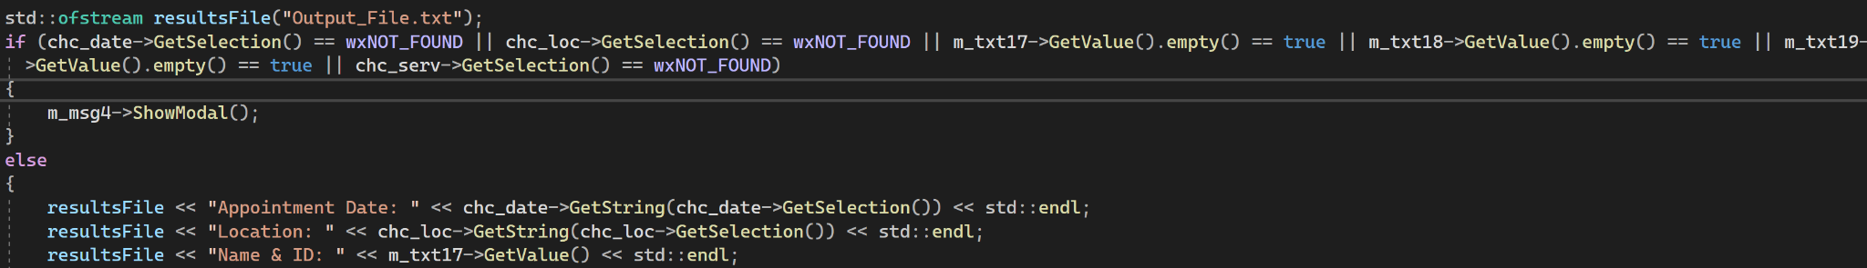
User Friendliness
Prevents submission of empty inputs via if-statements
Outputs a readable .txt file in format to send to doctor’s calendar
Ofstream object
Outputs to multiple file locations with different purposes

Slide 8
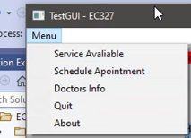


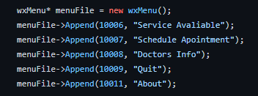
Menu
We declare a menu bar ---------->>>
This just creates Menu name “Menu”
Then we use the -> notation to append a few drop down menus
Service Available
Schedule Appointments
Doctors Info
Quit
About
Numbers like 10006 will be talk about in next slide

Slide 9
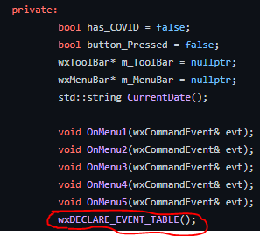
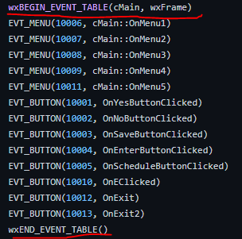
Event Trigger
1
Event trigger or Event handler example
New frame pops up after clicking a button
A New dialog pops up
To do this
We need to declare in cMain.h as shown in picture1
This is then allows the implementation of
Anything between the begin and end will be an event trigger
EVT_MENU is a trigger for menu tab
Clicking on “Service Available” will trigger a new window.
EVT_BUTTON, is a trigger for button click
2

Slide 10
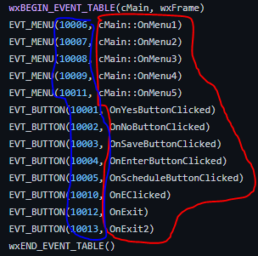
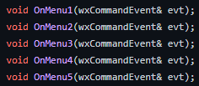
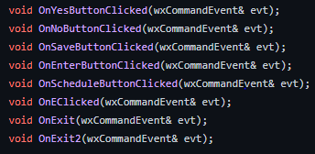
Event Trigger Cont.
The blue circle represents unique number for each trigger
Each number is unique to each event trigger
The red circle represents the class function
The function header was declared in cMain.h
Normally, event trigger function are private
Not called from outside of the class

Slide 11

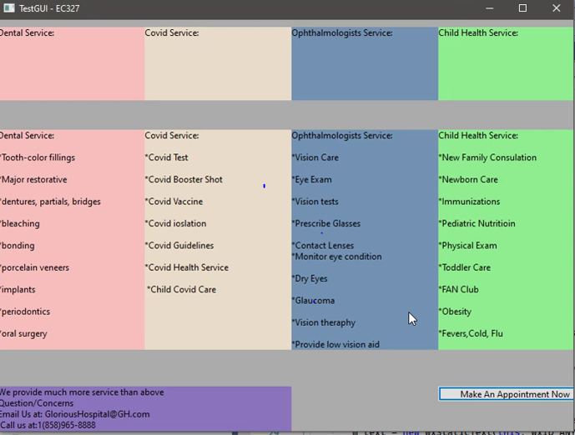
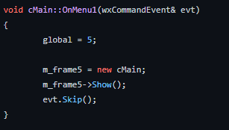
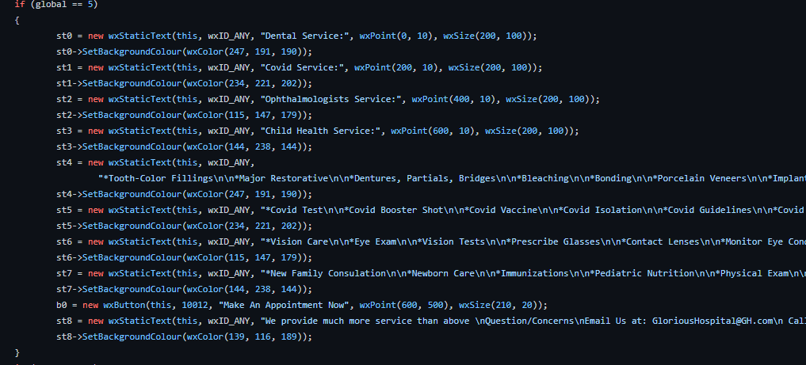
Event Trigger Example
This is event trigger for a menu tab
Global variable acts as a check
If global variable matches given cond, open specific frame
global = 5 -> opens frame call m_frame5
10006 matches with “Service Available”
The big code block just fills m_frame5 with texts and color
Click on “Service Available” -> new frame opens.

Slide 12
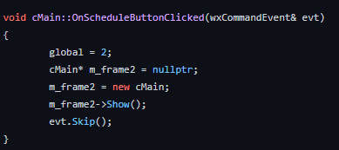
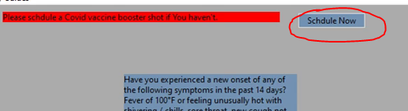
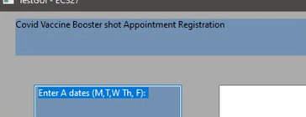
Button Click Example
Click on the circled button will opens up a new frame
evt.Skip() -- in case event is not clicked, skip it
Declare the header in cMain.h
Below shows creation of button m_btn5.
Utilizes this pointer

Slide 13
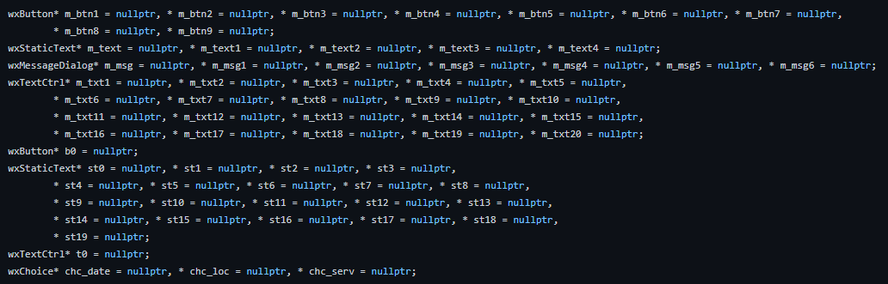
Variables
To build up a frame, we need buttons, text, textbox, drop down menu and so on.
We can declare all variables by setting them to null pointer in header file as shown
We then implement accordingly in the cpp file.

Slide 14
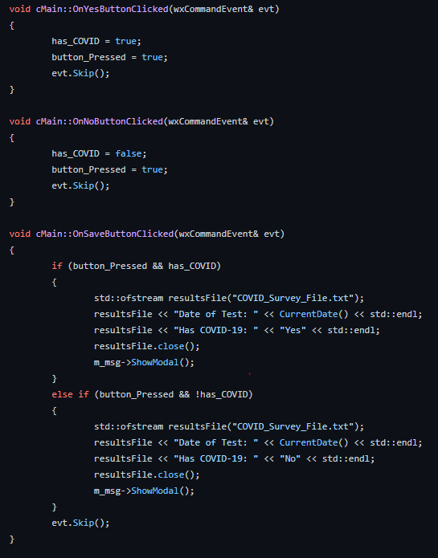
How function work together
One example on main page
The code to the left shows how our program work together
It checks if yes or no button are clicked
Then it checks if this individual have covid or not based from the first two function
It then save the result into an ofstream file

