Slide 1

iNaturalist Species Classification
Presentation by Stefano Di Filippo
Deep Learning for Computer Vision

Slide 2
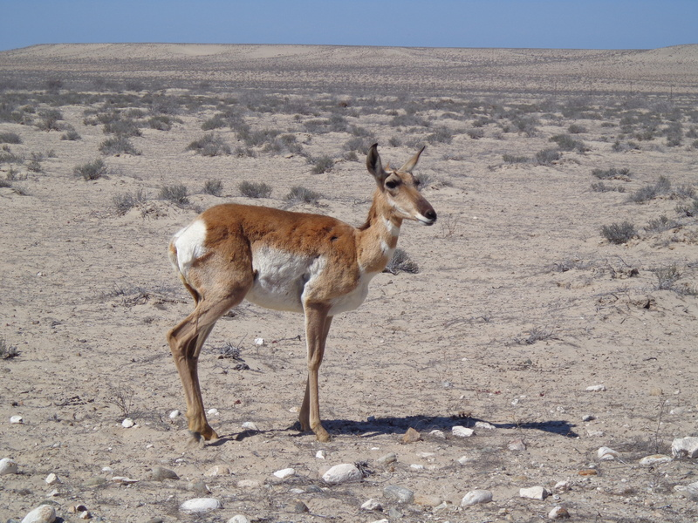
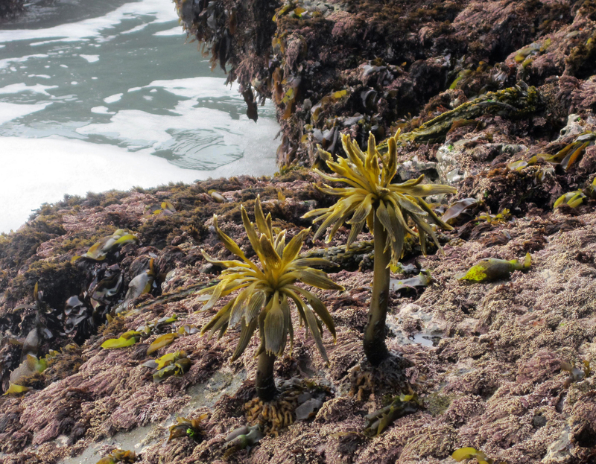
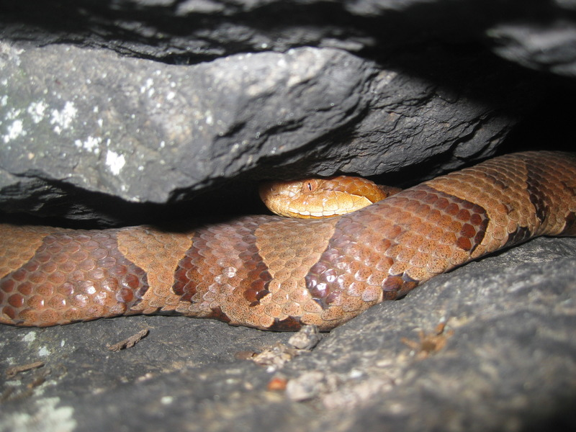
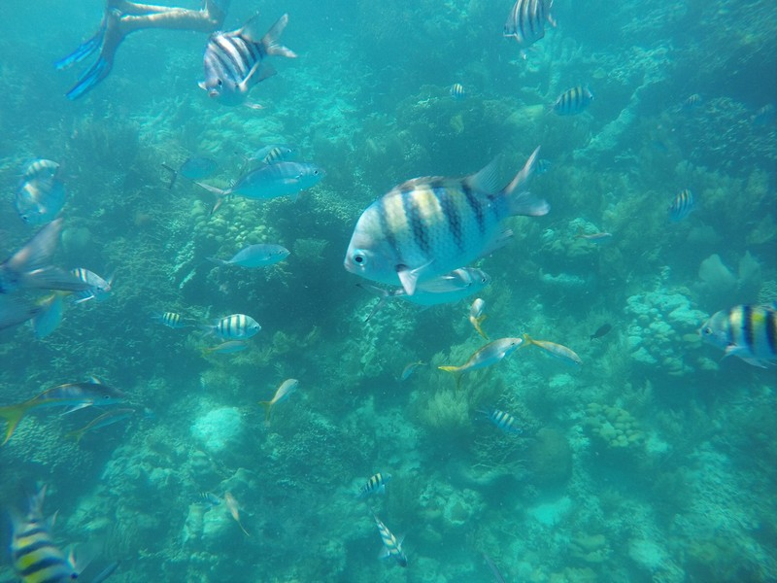
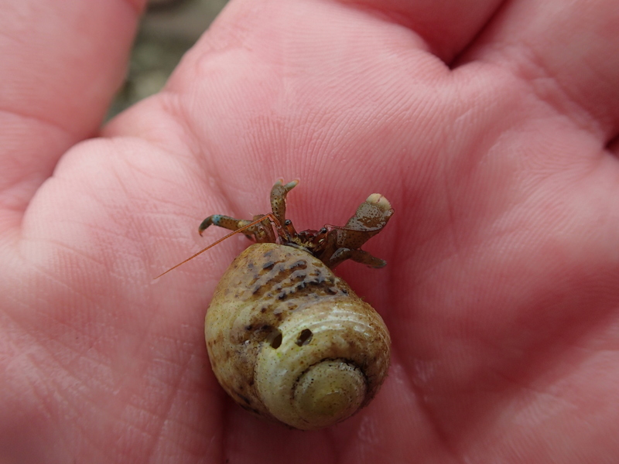
Introduction
Objective: classifying images of the iNaturalist data set to animal and plant species.
Focus on a subset of the data
‘Category’ classes

Slide 3
Introduction
Objective: classifying images of the iNaturalist data set to animal and plant species.
Focus on a subset of the data
‘Category’ classes
Scheme:
Data Preprocessing
Modeling: Optimization
Modeling: Regularization
Modeling: Transfer Learning
Evaluation

Slide 4



Data Preprocessing
1. Inspection of:
Dimensions
Format
Mode

Slide 5



Data Preprocessing
1. Inspection of:
Dimensions
Format
Mode
Resize to common shape
Keep only RGB images

Slide 6

Data Preprocessing
1. Inspection of:
Dimensions
Format
Mode
Resize to common shape
Keep only RGB images
2. Subsample Categories: Keep Top 10%

Slide 7

Data Preprocessing
1. Inspection of:
Dimensions
Format
Mode
Resize to common shape
Keep only RGB images
2. Subsample Categories: Keep Top 10%
3. Pixels Rescaling to [0, 1]

Slide 8

Data Preprocessing
1. Inspection of:
Dimensions
Format
Mode
Resize to common shape
Keep only RGB images
2. Subsample Categories: Keep Top 10%
3. Pixels Rescaling to [0, 1]
4. Train-Validation-Test Split: 60-20-20

Slide 9
Modeling: Optimization
Too Little Capacity
Increase Model Size
Try multiple configurations
Overfitting
Second Modeling Phase
Best Overfitting Model
First Modeling Phase:
Sufficient Capacity for the Problem
Ability to Overfit

Slide 10
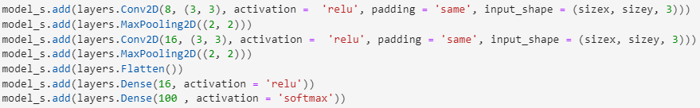
Modeling: Optimization
Too Little Capacity
Increase Model Size
Try multiple configurations
Overfitting
Second Modeling Phase
Best Overfitting Model

Slide 11
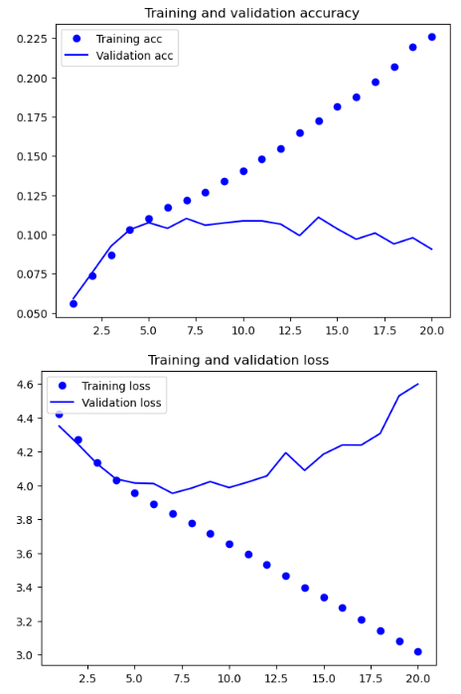
Modeling: Optimization
Too Little Capacity
Increase Model Size
Try multiple configurations
Overfitting
Second Modeling Phase
Best Overfitting Model

Slide 12
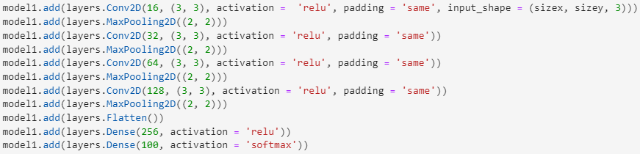
Modeling: Optimization
Too Little Capacity
Increase Model Size
Try multiple configurations
Overfitting
Second Modeling Phase
Best Overfitting Model

Slide 13
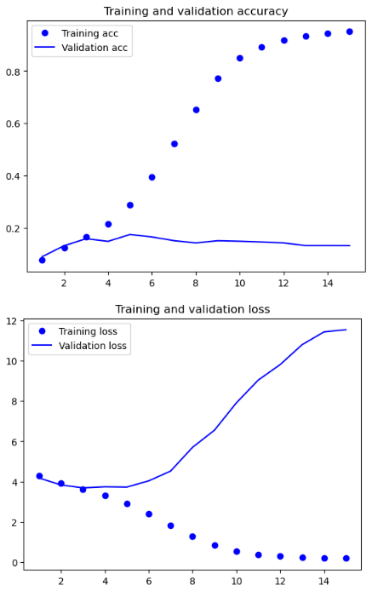
Modeling: Optimization
Too Little Capacity
Increase Model Size
Try multiple configurations
Overfitting
Second Modeling Phase
Best Overfitting Model

Slide 14
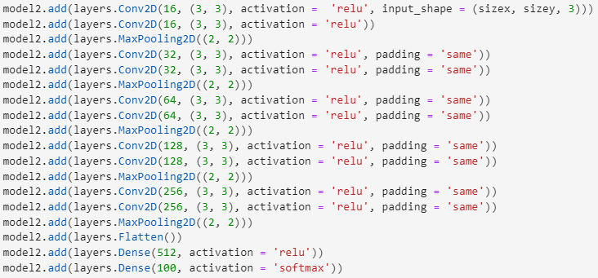
Modeling: Optimization
Too Little Capacity
Increase Model Size
Try multiple configurations
Overfitting
Second Modeling Phase
Best Overfitting Model

Slide 15
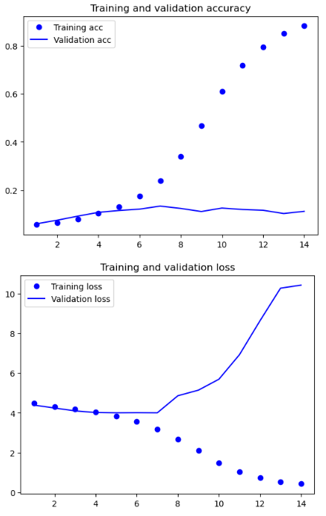
Modeling: Optimization
Too Little Capacity
Increase Model Size
Try multiple configurations
Overfitting
Second Modeling Phase
Best Overfitting Model

Slide 16
Modeling: Optimization
Too Little Capacity
Increase Model Size
Try multiple configurations
Overfitting
Second Modeling Phase
Best Overfitting Model

Slide 17
Modeling: Regularization
Best Overfitting Model
Use Data Augmentation
Add Dropout

Slide 18
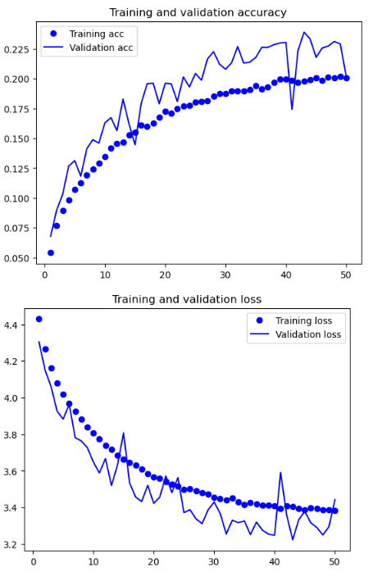
Modeling: Regularization
Best Overfitting Model
Use Data Augmentation
Add Dropout

Slide 19
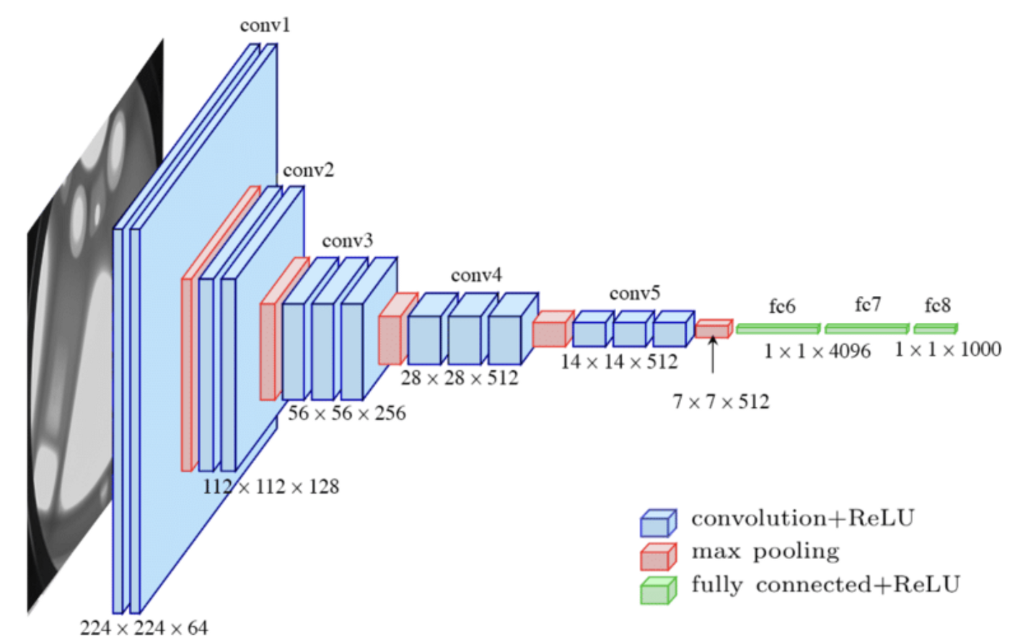
Modeling: Transfer Learning

Slide 20
Modeling: Transfer Learning
Approaches to Leverage VGG16:
1. Feature Extraction w/o DA
2. Feature Extraction with DA
3. Fine-tuning

Slide 21
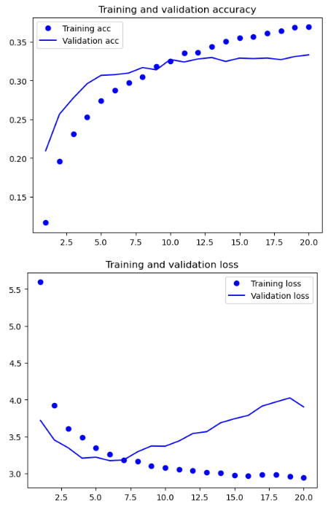
Modeling: Transfer Learning
Approaches to Leverage VGG16:
1. Feature Extraction w/o DA

Slide 22
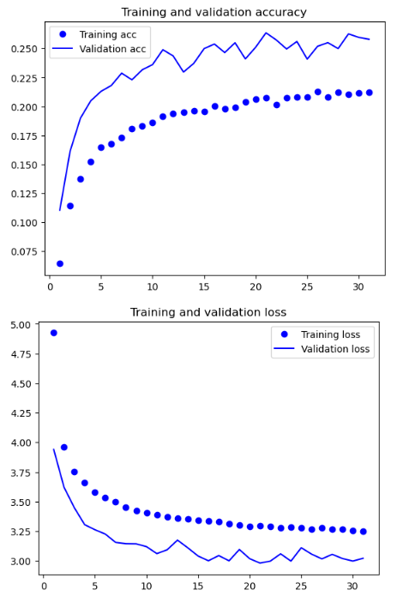
Modeling: Transfer Learning
Approaches to Leverage VGG16:
2. Feature Extraction with DA

Slide 23
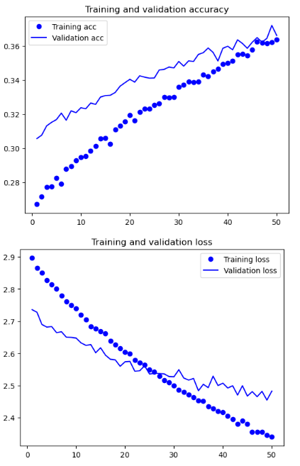
Modeling: Transfer Learning
Approaches to Leverage VGG16:
3. Fine-tuning

Slide 24
Evaluation
Evaluated Models:
Best Unregularized
Best Regularized
F-EX on VGG16 without DA
F-EX on VGG16 with DA
Fine-tuned VGG16

Slide 25
Evaluation
Evaluated Metrics:
(Top-1) Accuracy
Loss
Top-5 Accuracy
Average AUC of ROC
Average Precision-Recall Curve
Sample of Precision-Recall Curves

Slide 26
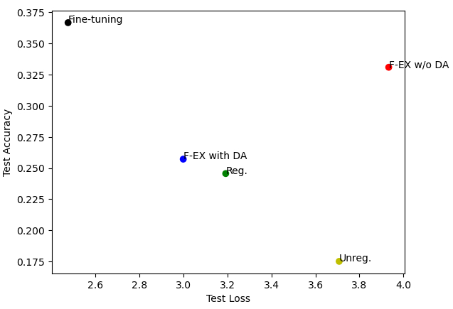
Evaluation
Evaluated Metrics:
(Top-1) Accuracy
Loss
Top-5 Accuracy
Average AUC of ROC
Average Precision-Recall Curve
Sample of Precision-Recall Curves

Slide 27
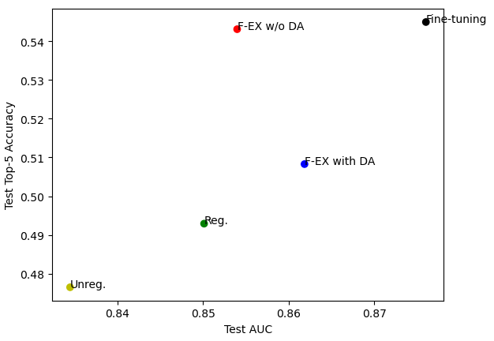
Evaluation
Evaluated Metrics:
(Top-1) Accuracy
Loss
Top-5 Accuracy
Average AUC of ROC
Average Precision-Recall Curve
Sample of Precision-Recall Curves

Slide 28
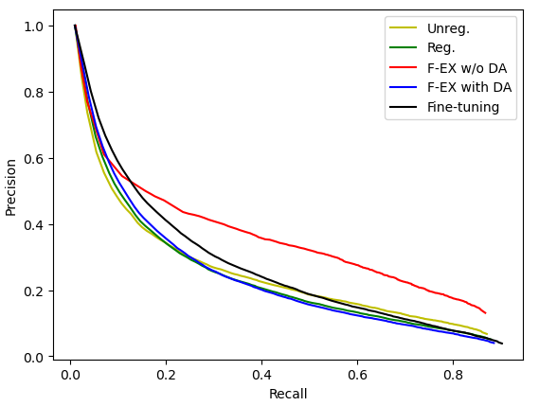
Evaluation
Evaluated Metrics:
(Top-1) Accuracy
Loss
Top-5 Accuracy
Average AUC of ROC
Average Precision-Recall Curve
Sample of Precision-Recall Curves

Slide 29
Evaluation
Evaluated Metrics:
(Top-1) Accuracy
Loss
Top-5 Accuracy
Average AUC of ROC
Average Precision-Recall Curve
Sample of Precision-Recall Curves

Slide 30
Thank You
Stefano Di Filippo

