Slide 1

IN‑MOTION
A PERSONALIZED MEDITATION EXPERIENCE
Face, words, music and mandala.
All drawn from the same particles.
Hamin Jang · Alessandro Cupini · Stefano Morano · Aldo Pinelli
Notes:
Welcome the audience. Introduce the team and the one-line pitch: a personalized meditation experience built from particles.

Slide 2

THE PROJECT
What It’s For, and Where
PURPOSE
CONTEXT
Give a person a few minutes of attention to themselves — and return something entirely their own: the mandala.
Private and individual. A quiet, dimly lit room — not an installation for crowds.
WHERE
READING THE EMOTION
Decompression spaces: museums, wellness centers, trade fairs, quiet corners of companies and universities.
No questionnaire. The person speaks freely, eyes closed. Whisper transcribes locally — facial recognition from MediaPipe coordinates — Claude derives the phrases, the mandala’s character, and the emotion that guides the music.
Notes:
Cover the purpose, the setting, where the installation lives, and how emotion is captured without a questionnaire.

Slide 3

THE PROJECT
Why a Mandala
In Sanskrit, mandala means “circle” — and by extension, “world.” A deeper reading makes it a container of essence.
It is not an ornament. It is a map you enter mentally, moving toward the center — only to see it destroyed at the end. Even attachment to what is beautiful produces suffering.
The project follows the same path: your face breaks apart, becomes words, then a mandala. In the end, it’s you who lets it go — by moving your head.
Notes:
Explain the concept of the mandala and why it grounds the whole project.

Slide 4
THE PROJECT
The Entire System Is an Agent
The four design dimensions of an agent are also the outline of this talk.
PERCEPTION
KNOWLEDGE
RATIONALITY
ACTION
how it perceives the world
what it knows about itself and the environment
the process that decides what to do
how it influences the environment
Webcam · 478 landmarks
A 12-state state machine
13,664 particles
The transcribed narrative
Microphone · Whisper
Temporal confirmation thresholds
Music generated from the emotion
Emotion classified Q1–Q4
Eye opening, gesture energy
Safety nets on every gesture
The mandala as an image
Phrases, color and shape of the mandala
Notes:
Introduce the agent framework: perception, knowledge, rationality, action. This is the outline for the rest of the talk.

Slide 5
THE PROJECT
System Architecture
WORLD
PERCEPTION
RATIONALITY · KNOWLEDGE
ACTION
Webcam
volto.py
esperienza.py
scena.py
Three.js
30 fps
MediaPipe · 478 landmarks
emozioni.py → Claude
state machine
10 states · never blocking
/prepare /scene
/mandala
13,664
particles
occhi.py · movimento.py
eye opening · energy of the gesture
musica.py
audio
narrative
phrases
pad + track
44,100 Hz
testi.py → Claude
Microphone
ascolto.py
structured output
phrases · mandala · Q1-Q4
16 kHz mono
Whisper, local
mandala.py
image
PNG 2400 px
PNG
2400x2400 px
Notes:
Walk through the pipeline end to end: world, perception, rationality and knowledge, action. Emphasize it's a single local process.

Slide 6
PERCEPTION
Reading the Eyes
PERCEPTION
RATIONALITY
ACTION
WEB PORTING
Eye Opening Ratio
height
height
ratio =
width
width
6 points per eye, out of 478 total. An empirical threshold, measured with taratura.py , on our own face and real lighting.
Closed eyes
Open eyes
0.00
0.10
0.20
0.30
0.40
0.117 a blink
0.18 threshold
Notes:
Explain the eye opening ratio and the empirically measured blink threshold.

Slide 7



PERCEPTION
Face and Emotion
PERCEPTION
RATIONALITY
ACTION
WEB PORTING
Two Readings of the Same Face
Russell Emotional Face Algorithm
Claude, in Context
478 landmarks from MediaPipe compute, every second, heuristic weights on smile, duchenne and frown — enough to identify a known, visible emotion: a smile for happiness, a sulk for sadness.
The Claude call also factors in valence, arousal, smile arch, duchenne and frown for richer context — able to recognize humor, lies and shyness.
An existing face-recognition model would have meant a long computation time. Since our features rely on the same landmarks, we kept this lighter approach.
Notes:
Cover the Russell face algorithm plus how Claude extends it for humor, lies, and shyness.

Slide 8
PERCEPTION
Voice and Gesture
PERCEPTION
RATIONALITY
ACTION
WEB PORTING
Voice and Gesture
Microphone & Whisper
Gesture → Dispersal
Three Streams, Opened Once
Runs locally — small model, int8, on CPU. Recording starts when the eyes close and ends when they reopen. Audio never leaves the computer; only the transcription does.
From the tip of the nose — the most protruding of the 478 points — we derive movement energy. Below a threshold, it’s breathing, not intent.
Reconfiguring the sound card mid-stream causes an audible click. Mic, pad and track open at startup and stay open — only a switch turns on and off.
Notes:
Cover Whisper voice capture, the nose-based gesture signal, and why the audio streams stay open.

Slide 9
RATIONALITY
State Machine
PERCEPTION
RATIONALITY
ACTION
WEB PORTING
A Twelve-State Machine
movement
of the face
when Claude responds
timed
timed
Welcome
Invitation
to speak
Listening
Waiting
Display of personalized phrases
Invitation
to meditate
Meditation
Mandala
Mandala Destruction
START
eyes
CLOSED
eyes
OPEN
eyes
CLOSED
eyes
OPEN
Emotional
trend
Final feedback
RESTART
END
Notes:
Walk through the ten-state machine end to end, from Welcome to Final Feedback, and the restart loop.

Slide 10
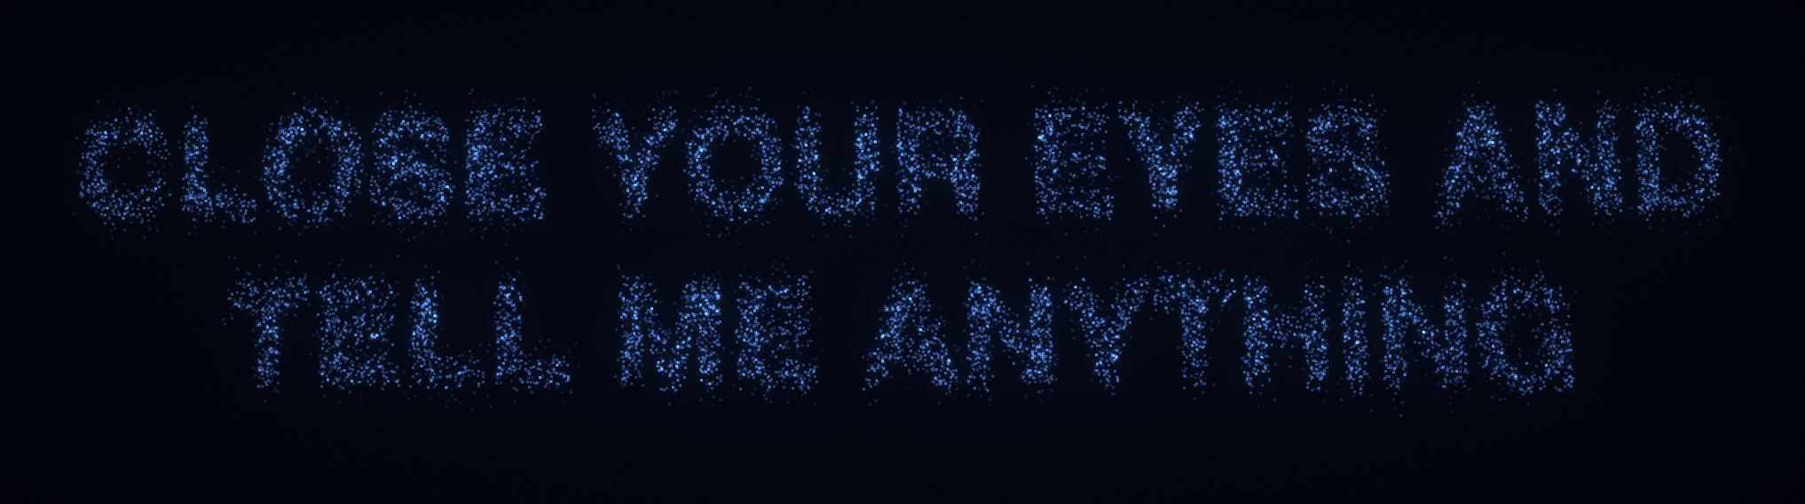
ACTION
Text to Particles
PERCEPTION
RATIONALITY
ACTION
WEB PORTING
Turning a Phrase into Particles
1
The phrase is drawn white on black on an offscreen canvas.
2
Lit pixels above a brightness threshold are read — the silhouette of the letters.
3
~13,664 points are sampled at random among those pixels, with a fixed seed — reproducible.
4
The points are scaled and centered into the scene’s text box.
5
The result is an array of 3D positions (x, y, z≈0), cached for that phrase that each particles has to reach.
Notes:
Explain how a generated phrase becomes a cached array of particle positions: rendered to an offscreen canvas, thresholded, sampled, scaled and centered.

Slide 11
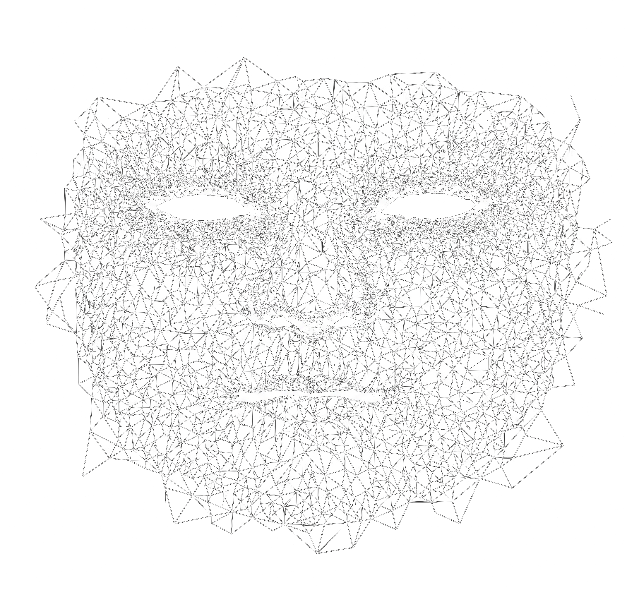
ACTION
Particles on the Face
PERCEPTION
RATIONALITY
ACTION
WEB PORTING
Anchoring Particles to the Face
1
MediaPipe gives 478 landmarks of the face.
2
face_triangoli.txt holds the fixed tessellation — the triangles between those indices.
3
Each particle is assigned a triangle (A, B, C) and fixed random barycentric coordinates (w _{A}, w_{B}, w_{C}).
4
That assignment never changes — the particle always lives at the same relative point of the mesh.
Notes:
Explain how particles are anchored to the 478-landmark face mesh via a fixed triangle and barycentric coordinates, so each particle always lives at the same relative point.

Slide 12
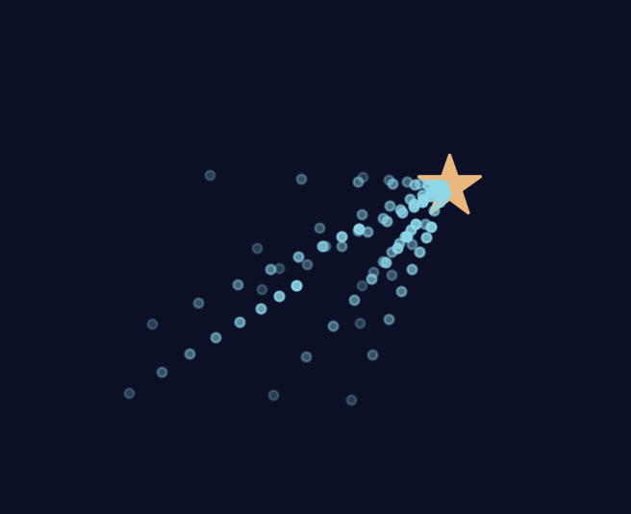
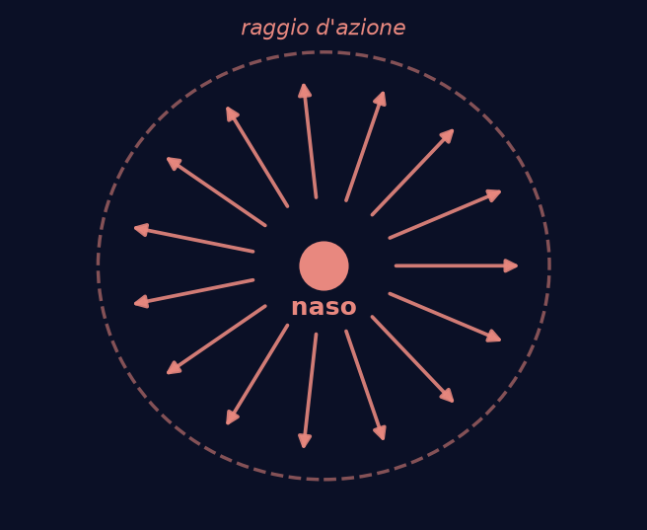
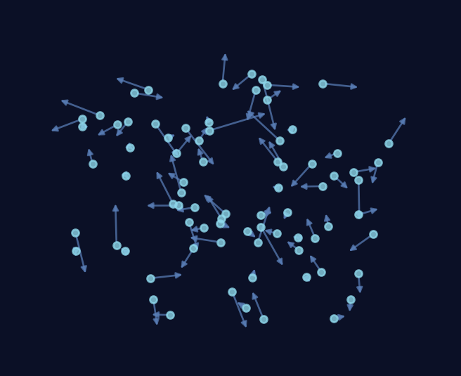
ACTION
The Particles
PERCEPTION
RATIONALITY
ACTION
WEB PORTING
13,664 Reactive Particles
“A particle system is a collection of many minute particles that together represent a fuzzy object.”
— W. T. Reeves, Lucasfilm, 1982
SEEK
REPULSION
SWARM
Each one chases its own position with its own inertia: it compares where it is with where it would like to be, and applies a force.
The nose repels whatever passes near it. The push decreases with the square of the distance and drops to zero at the edge of the radius.
No interaction between particles: the shape emerges from the sum of these forces.
Notes:
Introduce the three particle forces: seek, repulsion, swarm. Open with the Reeves 1982 quote.

Slide 13
ACTION
The Music
PERCEPTION
RATIONALITY
ACTION
WEB PORTING
From Emotion to Score
The Iso Principle
Music meets the listener’s emotion first, then eases it toward calm.
Q1
Q2
Quadrants – Music mapping
high energy, bright
high energy, dark
Arousal -> density of the notes (rhythmic intensity, polyphony)
Valence -> tonal characteristics (bright, dark) of the piece.
GOAL
Musical piece which matches the initial arousal/valence value and gradually changes going to Q4 (low arousal, low valence).
Q4
Q3
calm, bright
calm, dark
Notes:
Explain the iso principle and how Q1-Q4 map to musical descent.

Slide 14
ACTION
The Music
PERCEPTION
RATIONALITY
ACTION
WEB PORTING
Three Additions to MuseMorphose
MuseMorphose: Transformer VAE which encodes each bar of a random reference track into a latent space, then re-performs it with random rhythmic intensity and polyphony values.
Dataset Labeled by Color
An Arousal Curve to Q4
Orchestration for calmness
Every track scored dark-to-bright by its share of minor chords.
Density descends bar by bar until the piece settles into Q4’s calm.
Voices split in 3 (bass, harmony, melody), instruments chosen per emotion, the ending faded.
Additional modifications: fixed 25 bars (~90s), 6 bars of holding in the initial emotional state, fixed BPM to 75:
Notes:
Explain the Transformer-VAE architecture and why a VAE preserves musical material while changing performance.

Slide 15
ACTION
The Music
PERCEPTION
RATIONALITY
ACTION
WEB PORTING
Example: Q1 (high arousal, high valence)
01
02
03
04
Selection
Regeneration
Orchestration
Rendering
Starting from bright reference track.
MuseMorphose re-performs it along an arousal curve, from a high value to low value
Notes split into acoustic bass, pad,
harp using FluidSynth synthesizer.
Added filtering and a deep reverb, with a final fade-out. Out comes a stereo file.
Note: generation takes minutes on CPU, a prerendered library plays during the session
Notes:
Walk through the four steps from MIDI selection to rendered stereo audio.

Slide 16
ACTION
The Object
PERCEPTION
RATIONALITY
ACTION
WEB PORTING
The Session’s Mandala
260,000
2400px
particles as an image (13,664 on screen)
per side, generated in 2 seconds — no TouchDesigner
What you say chooses its character
Petals, rings and tones are born from the narrative, in the same call that generates the phrases.
The length of your meditation chooses its complexity
Every 40 seconds adds a level of detail. Time becomes distance traveled toward the center.
Notes:
Cover the mandala image generation: particle counts, resolution, and how the narrative and duration shape it.

Slide 17


WEB PORTING
Tools and Frameworks
PERCEPTION
RATIONALITY
ACTION
WEB PORTING
Tools and Frameworks
The entire system runs in a web browser, with a login and account a user can reach from any device.
Firebase
Uvicorn
Google’s framework for authentication and databases. Password encryption is managed entirely by Google’s systems.
A web server enabling the simultaneous use of graphics engines in Python and JavaScript, alongside API calls.
Notes:
Introduce the web porting effort and the two core frameworks: Firebase and Uvicorn.

Slide 18
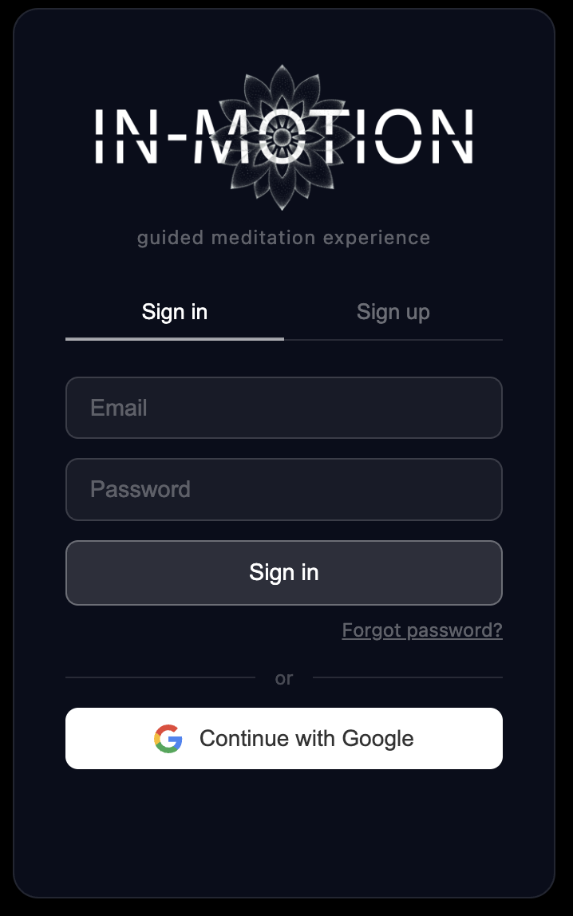
WEB PORTING
Login Interface
PERCEPTION
RATIONALITY
ACTION
WEB PORTING
Login Interface
On launch, the app calls Firebase Auth to check whether the browser cache holds an auth key. If not, login proceeds through one of two providers:
Email and Password
Google Authentication
Notes:
Show the login screen and explain the Firebase auth cache check plus the two sign-in providers.

Slide 19
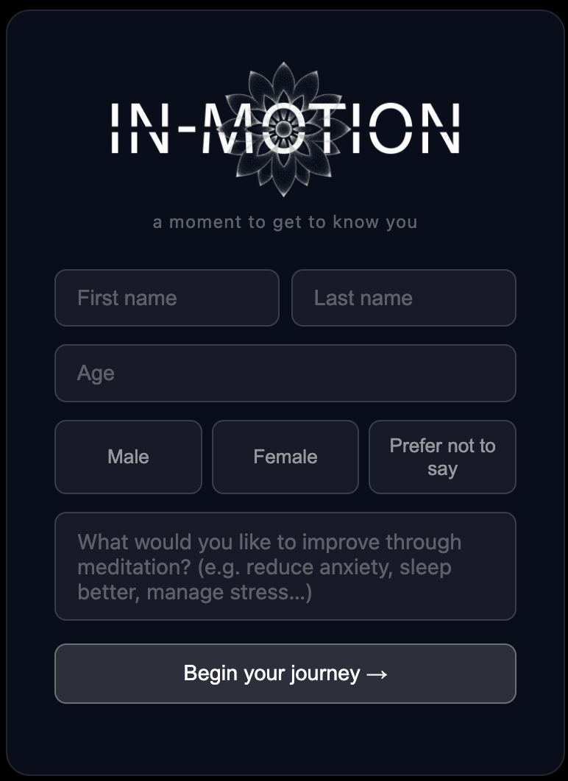
WEB PORTING
First Registration
PERCEPTION
RATIONALITY
ACTION
WEB PORTING
First Registration
At first login, we ask for first name, last name, gender, and a goal to work toward through meditation.
This data is sent to Claude to shape a more personalized experience from the very first session.
Notes:
Show the registration screen and explain that the answers are used to personalize the meditation via Claude.

Slide 20
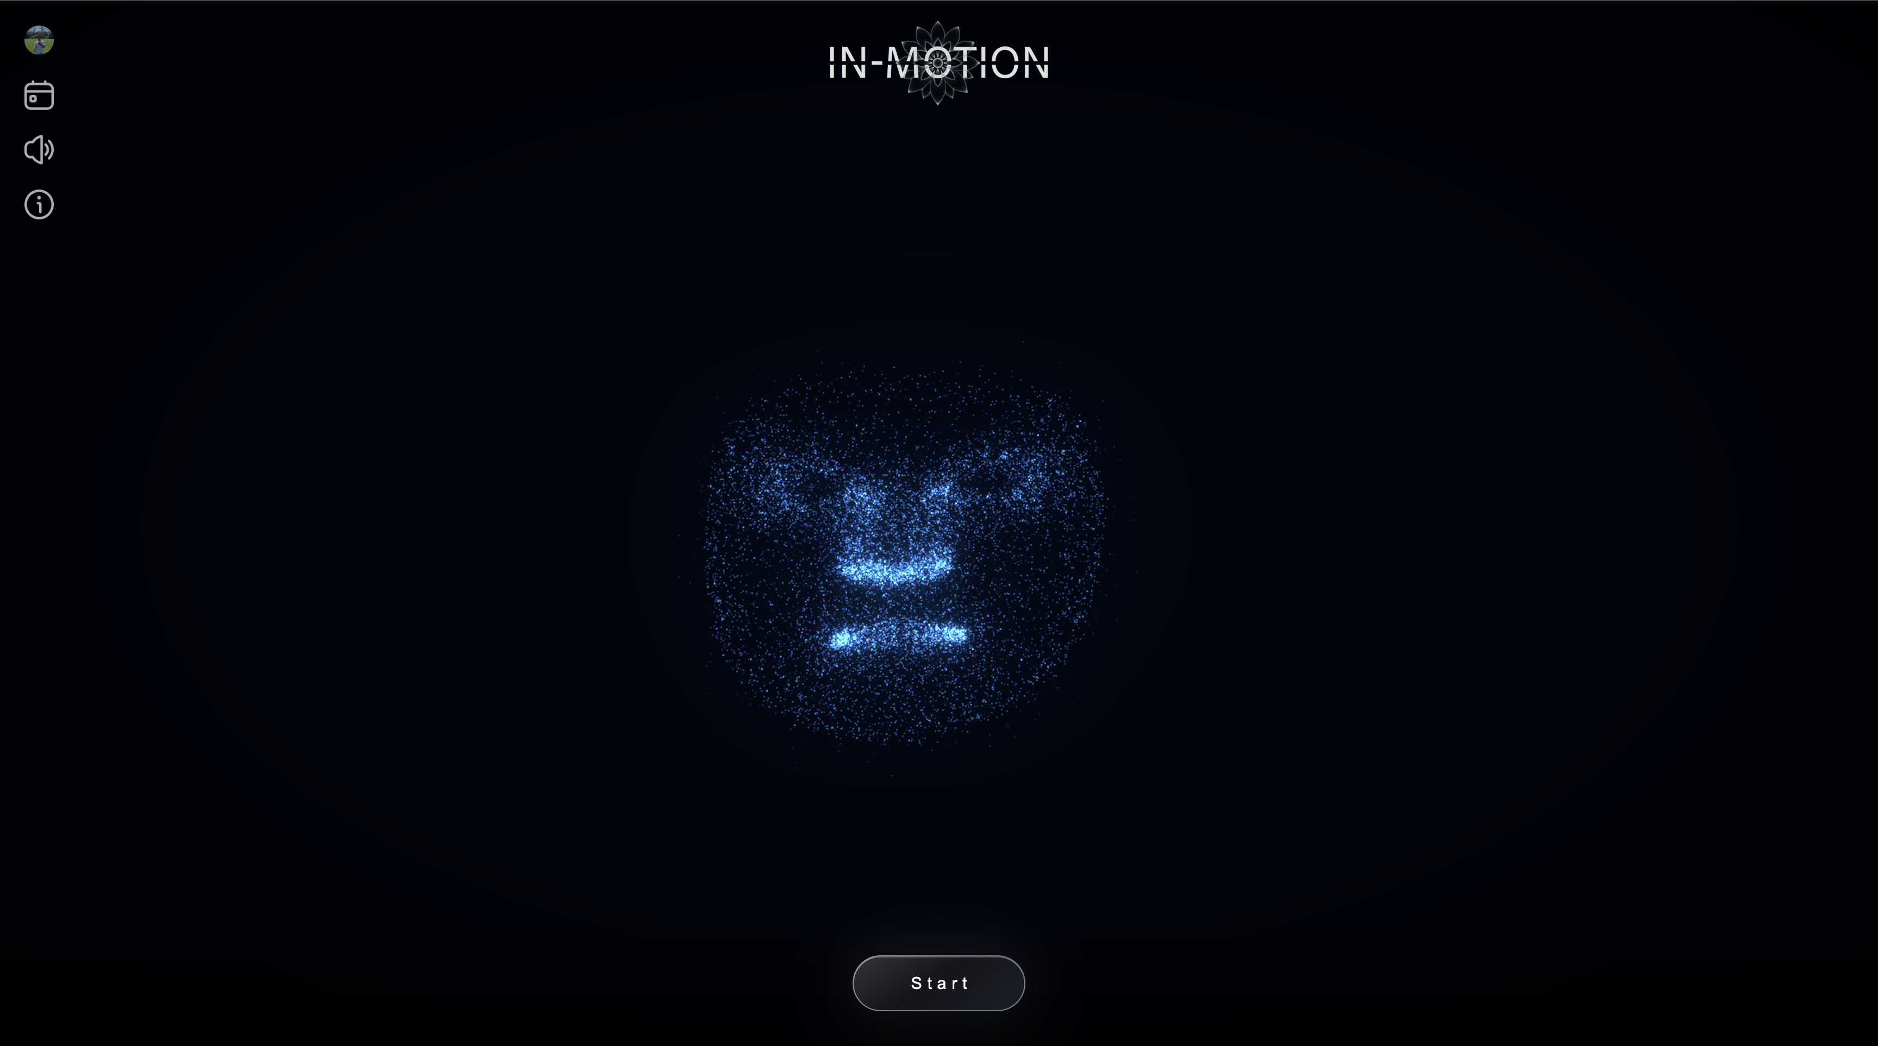
WEB PORTING
The Core Interface
PERCEPTION
RATIONALITY
ACTION
WEB PORTING
The Core Interface
Account manager
Meditation calendar
Volume controller
Information tab
Start button
Very few buttons. No controls to learn.
Notes:
Show the core app screen and emphasize the minimal, low-friction interface.

Slide 21
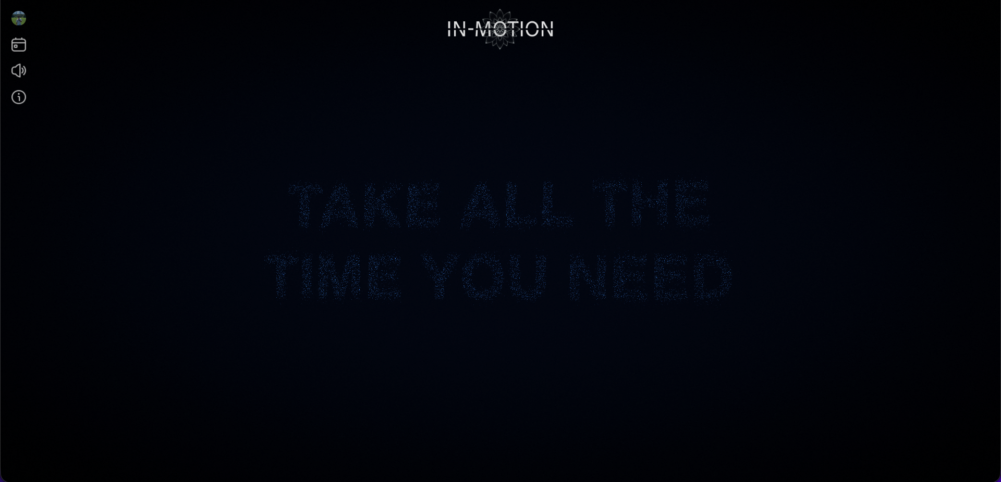
WEB PORTING
Voice Narration
PERCEPTION
RATIONALITY
ACTION
WEB PORTING
Giving the Mandala a Voice
For every sequence, the system generates a short text from the particle narrative — and reads it aloud through text-to-speech.
Generated fresh, per sequence
Read aloud automatically
No need to open your eyes to follow along
Notes:
Explain that for every sequence, the system generates a short text from the particle narrative and reads it aloud via text-to-speech.

Slide 22
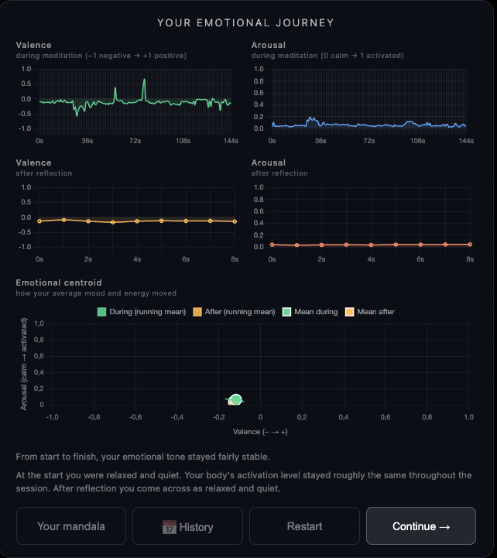
WEB PORTING
Session History
PERCEPTION
RATIONALITY
ACTION
WEB PORTING
Your Sessions, Over Time
A calendar of past sessions lets you look back. Each one opens onto its own valence/arousal graph, tracing how the emotion moved during that meditation.
Calendar of every past session
Valence/arousal graph, per session
Notes:
Explain the session calendar and the per-session valence/arousal graph.

Slide 23
THE PROJECT
A Design Challenge: Reading Emotion
External sensors were on the table early on — but they would have added hardware and friction for very little gain on what we actually needed.
Facial Emotion Recognition
Heuristic weights on smile, duchenne and frown, following Russell’s emotional face model.
Claude
Classified Emotion
→
a large language model, elaborating both signals together
→
Q1–Q4, guiding phrases, mandala and music
The User’s Own Story
Spoken freely, eyes closed — transcribed locally, without a questionnaire.
Notes:
Explain the design challenge of classifying emotion: why external sensors were rejected, and how facial recognition plus storytelling, elaborated by Claude, solved it.

Slide 24
IN‑MOTION
Thank You
A personalized meditation experience — from a face, to particles, to a mandala only you can let go of.
Hamin Jang · Alessandro Cupini · Stefano Morano · Aldo Pinelli
Notes:
Close the talk, thank the audience, and open the floor to questions.

