Slide 1
In-core intrumentation: “Power distribution reconstruction from in-core detector measurements using gaussian process regression” Silva, A. S. et al. (2025)
Stefano Patitucci, 02/2026
Radiation Detection & Measurements, MSc Nuclear Engineering

Slide 2
In-core instrumentation
01

Slide 3
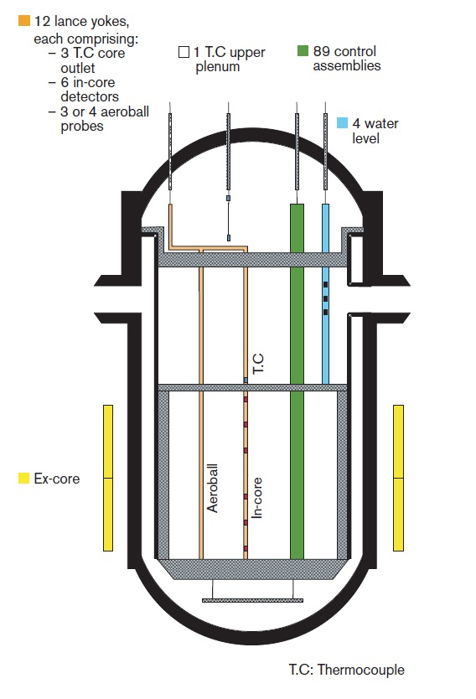
In-core instrumentation
PWR instrumentation for the monitoring of neutron fluence can be ex-core (leaking neutrons from outside the RV) or in-core (detectors inserted into the RV)
detectors measure local neutron fluence (or flux) at discrete in-core locations;
using reactor physics models, neutron fluence is converted into local fission rate;
fission-rate distribution is reconstructed into a 3D power map, consistent with measures of total thermal power and core calculations
Allows safe and efficient operation of PWRs by
verification of control-rod alignment;
detection of axial and radial power asymmetries

Slide 4
Taxonomy of in-core instrumentation
02

Slide 5
Taxonomy of in-core instrumentation
In-core instrumentation can be classified by:
mobility: fixed in-core detectors provide continuous signals at a limited set of locations / movable systems perform periodic scans (flux mapping) with fission chamber moving axially;
measured field: nuclear signals (flux, gamma-related) / thermal signals (thermocouples);
transduction principle: self-powered detectors (SPND) / externally biased detectors (e.g. fission chambers);
time response: prompt-response sensors / delayed-response (SPNDs);
spatial coverage: «sparse but continuous» (only at instrumented assemblies but uninterrupted signal) / «dense but campaign-based» (high-resolution scanning but only during measurement campaigns);
function in core monitoring: continuos trending (fixed) / high-resolution calibration of 3D power maps (movable flux mapping)

Slide 6
Fixed vs. movable in-core detectors
03

Slide 7
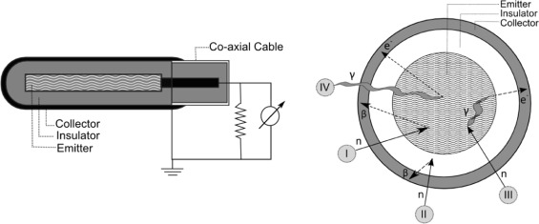
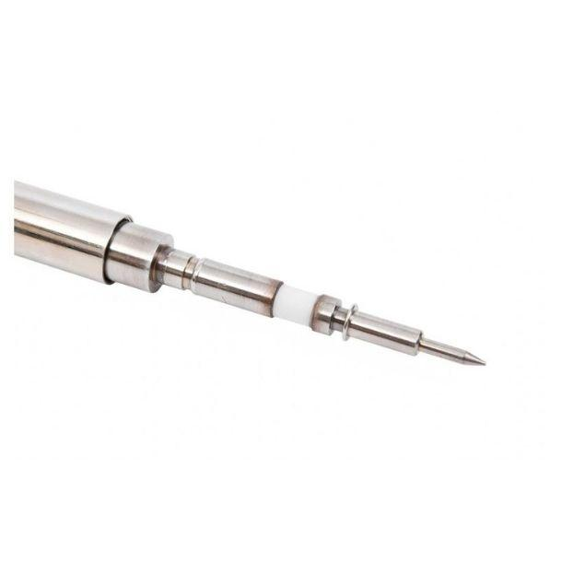
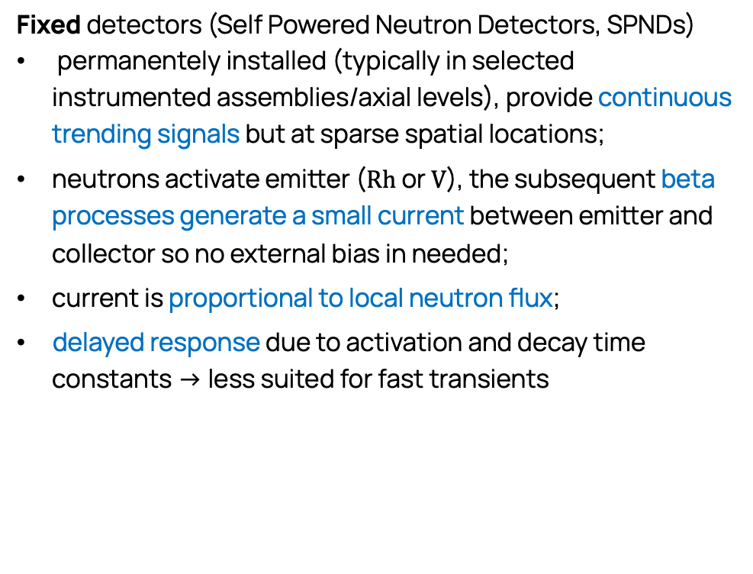
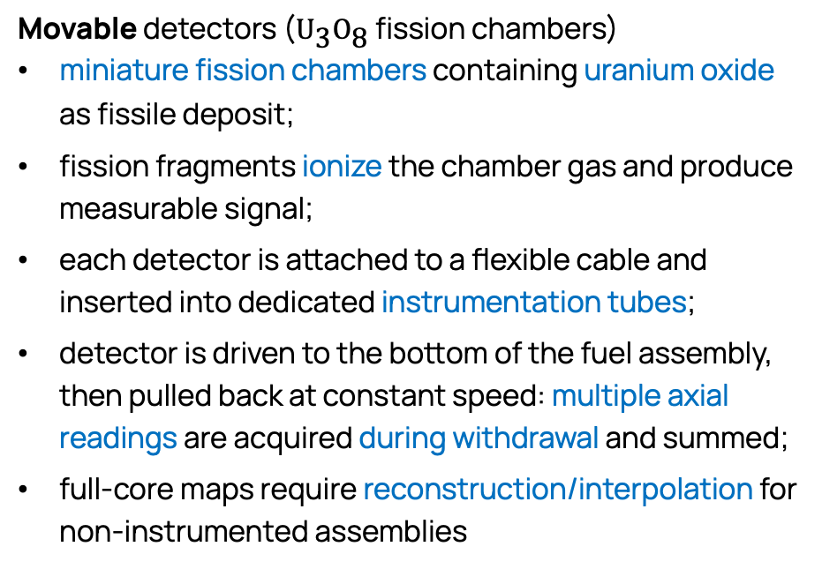
Fixed vs. movable in-core detectors
Fixed detectors (Self Powered Neutron Detectors, SPNDs)
permanentely installed (typically in selected instrumented assemblies/axial levels), provide continuous trending signals but at sparse spatial locations;
neutrons activate emitter ($\text{Rh}$ or $\text{V}$), the subsequent beta processes generate a small current between emitter and collector so no external bias in needed;
current is proportional to local neutron flux;
delayed response due to activation and decay time constants -> less suited for fast transients
Movable detectors (${\text{U}}_{\text{3}}{\text{O}}_{\text{8}}$ fission chambers)
miniature fission chambers containing uranium oxide as fissile deposit;
fission fragments ionize the chamber gas and produce measurable signal;
each detector is attached to a flexible cable and inserted into dedicated instrumentation tubes;
detector is driven to the bottom of the fuel assembly, then pulled back at constant speed: multiple axial readings are acquired during withdrawal and summed;
full-core maps require reconstruction/interpolation for non-instrumented assemblies

Slide 8
Power distribution reconstruction
04

Slide 9
Power distribution reconstruction
3D power distribution reconstruction is essential to evaluate key operational parameters that define thermal-hydraulic safety margins e.g. enthalpy rise factor (measures how uneven power is distributed), departure from nucleate boiling ratio (DNBR, CHF/local HF ratio) or quadrant tilt ratio (compares power among core quadrants)
Supervised learning problem: unknown function (core power distribution) is inferred via limited measured data
Gaussian Process Regression methodological approach
non-parametric: does not assume a fixed functional form and estimate a finite set of parameters, instead infers the functional itself;
Bayesian, power distribution described by a probability distribution
in-core instrumentation provides assembly-wise, axially integrated neutron flux only at a limited number of instrumented fuel assemblies (to reduce cost and complexity)
power in the remaining assemblies must be estimated from sparse measurements

Slide 10
Dataset and methods
05

Slide 11
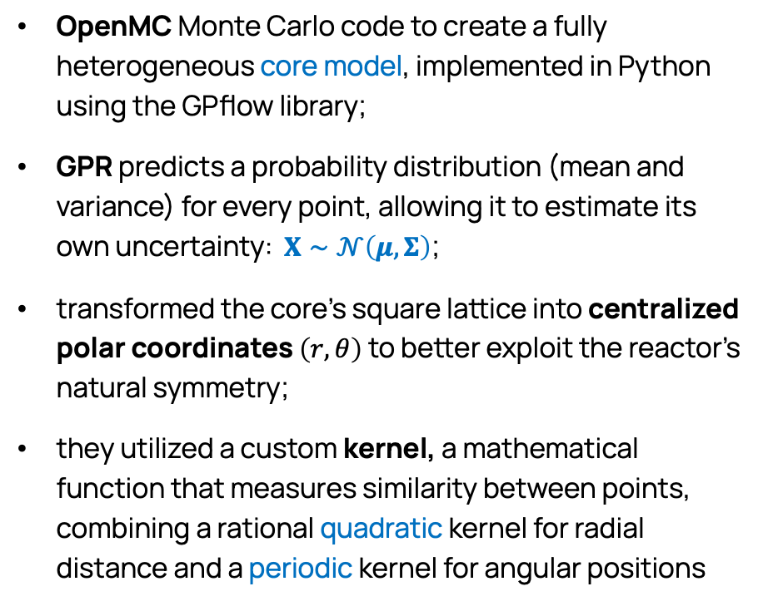
Dataset and methods
due to the lack of full-core experimental power maps, the researchers emulated data from the Angra 1 nuclear power plant, a two-loop PWR in Brazil;
assembly-wise integrated power values for all 121 fuel assemblies across multiple depletion steps;
data from the 36 instrumented assemblies served as the training set, while data from the remaining 85 non-instrumented assemblies was used as the reference (test) set to validate the model's accuracy
OpenMC Monte Carlo code to create a fully heterogeneous core model, implemented in Python using the GPflow library;
GPR predicts a probability distribution (mean and variance) for every point, allowing it to estimate its own uncertainty: $X∼𝒩\left(μ,Σ\right)$;
transformed the core's square lattice into centralized polar coordinates $\left(r,θ\right)$ to better exploit the reactor's natural symmetry;
they utilized a custom kernel, a mathematical function that measures similarity between points, combining a rational quadratic kernel for radial distance and a periodic kernel for angular positions

Slide 12
Results and interpretation
06

Slide 13
Results and interpretation
High accuracy
In a scenario where all 36 detectors were functional, the model was highly precise, with a mean relative discrepancy below 0.8% and a maximum discrepancy under 2.5% across all fuel depletion steps
Robustness to Failure
The researchers conducted a “stress test” by simulating the failure of individual detectors: even in the worst-case single-failure scenario, the maximum relative discrepancy remained low at 5.29%, corresponding to those assemblies that lacked symmetric counterparts in other quadrants of the core

Slide 14
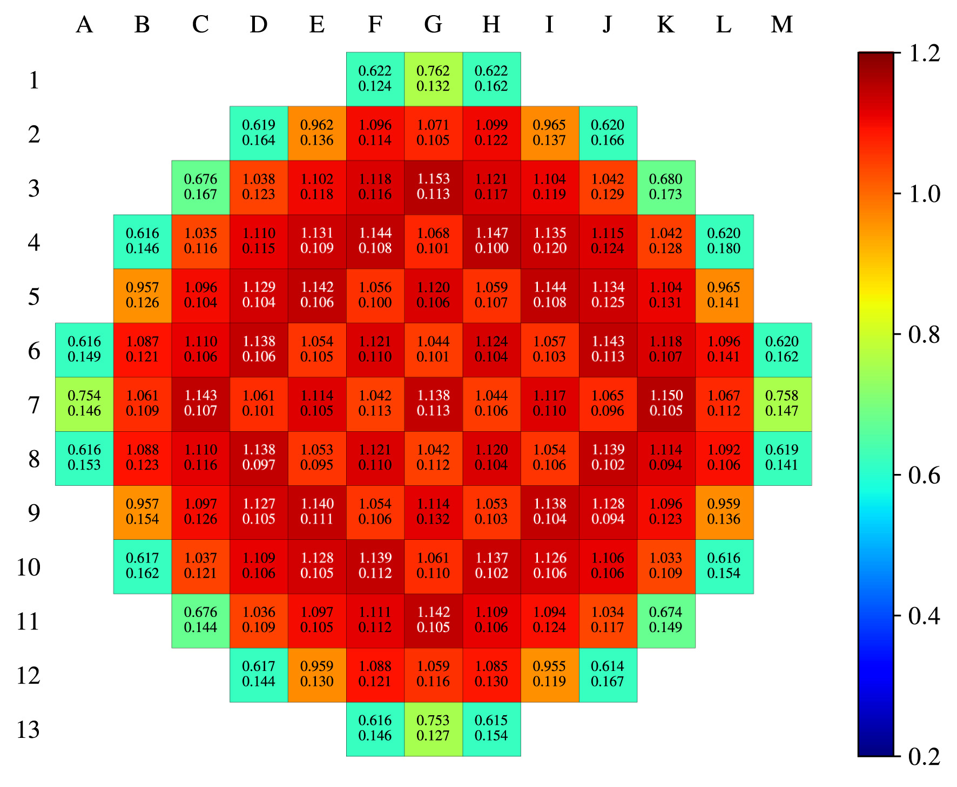
Results and interpretation
Assembly-wise power distribution at BOC: normalized relative power (above) and percent relative uncertainty (below) for each fuel assembly
Overall, the GPR model successfully “learned” the complex power distribution without requiring pre-calculated “calibration factors” from diffusion simulations which can be less accurate than MC methods and unreliable if the reactor's actual state deviates from the simulation

Slide 15
Practical implications and key takeaways
07

Slide 16
Practical implications and key takeaways
Real-time monitoring
Versatility
Reliable uncertainty
estimates
Potential for anomaly detection
The GPR model is computationally efficient: it reconstructs power distributions for 10 depletion steps in just 7.15 seconds, making it suitable for real-time monitoring of reactor safety margins
GPR provides a variance for every prediction, offering operators a built-in measure of confidence: this helps in identifying when the reconstruction might be less reliable due to sensor issues or unusual core conditions
Since the method relies directly on detector data and does not enforce a rigid parametric core model, it can reveal unexpected anomalies (control rod drops, xenon spatial oscillations, fuel assembly failures) that traditional model-based approaches might overlook
The study concludes that this methodology is not limited to power mapping and could be adapted for other critical tasks, such as reconstructing the core temperature distribution using data from fixed thermocouples

Slide 17
Thank you for the attention

