Slide 1
NLP & SDAI
A Multi-Agent System for Monitoring Environmental Changes Using Earth Observation Data
Stefano Infusini

Slide 2
Creative project
Difficulty: hard (15.5 pts)

Slide 3
Objective
Combine Symbolic & Distributed AI (S&DAI) and NLP to provide explainable
interpretation of Earth Observation (EO) data
Approach
Use satellite-derived indicators (wildfires, floods)
Apply symbolic reasoning instead of purely data-driven models
Produce structured, human-readable explanations
Key Idea
Bridge EO data → symbolic reasoning → natural language reports

Slide 4
1. EO Layer
Indicators extracted from Sentinel-2 imagery
Examples: vegetation loss, burned area, water increase
2. Symbolic Multi-Agent System (Reasoning Layer)
Implemented in Jason
ForestAgent, WaterAgent, CoordinatorAgent, ExplanationAgent
Performs rule-based hazard reasoning
3. NLP Layer
Transforms MAS output into semantic JSON
Populates OWL ontology
Generates final reports through deterministic NLG

Slide 5
Motivation
EO analysis is often a black box
Data-driven EO systems lack explainability
Hazard scenarios require explicit reasoning
Explore feasibility of a symbolic EO pipeline

Slide 6
System Overview
A 3-layer architecture
EO
Symbolic MAS
NLP
Sentinel-2 data
Indicators extraction
EO evidence generation
EO indicators → beliefs
Agent-based reasoning
Hazard assessment
Semantic Transformation (JSON)
Ontology population
Report generation

Slide 7
EO Layer - Indicators Extraction
Data
Indicators
Sentinel-2 satellite imagery
Before/after event comparison
Change-based indicators
Population data (ancillary)
Flood: NDWI, water increase
Wildfire: NDVI, dNBR
EO data → structured indicators → input to symbolic reasoning

Slide 8
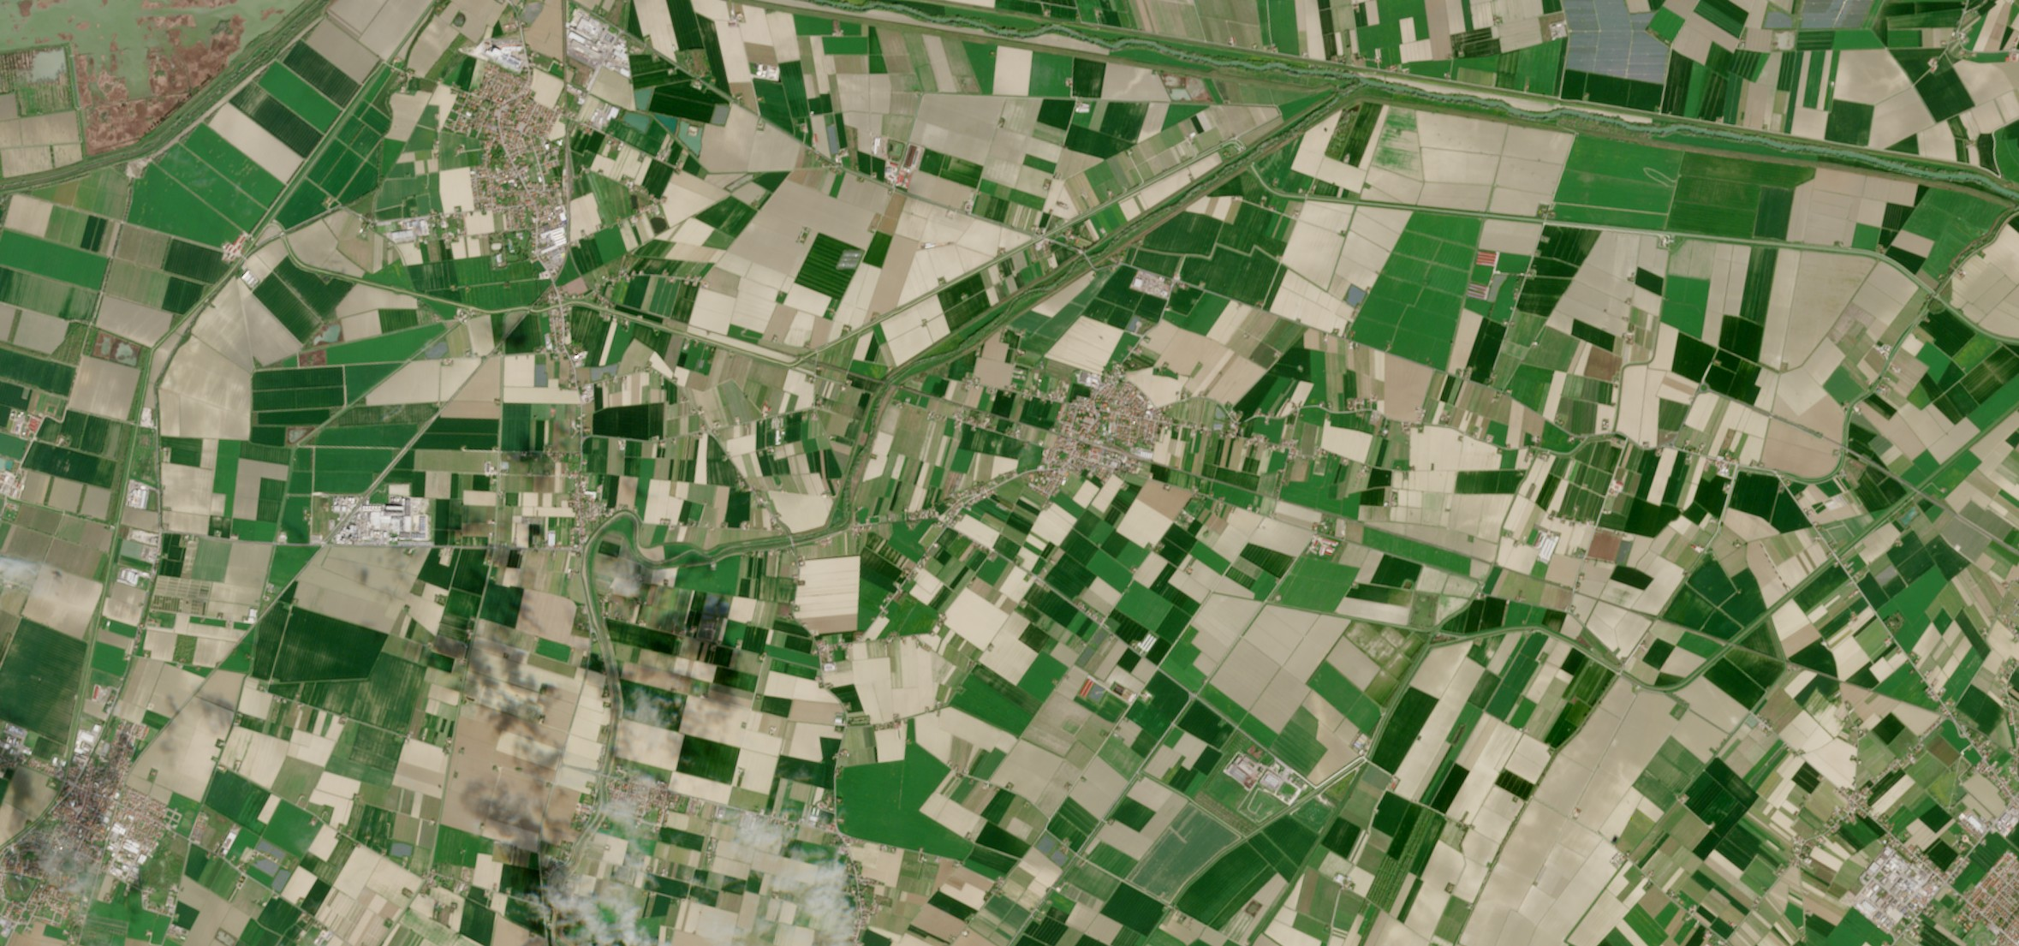
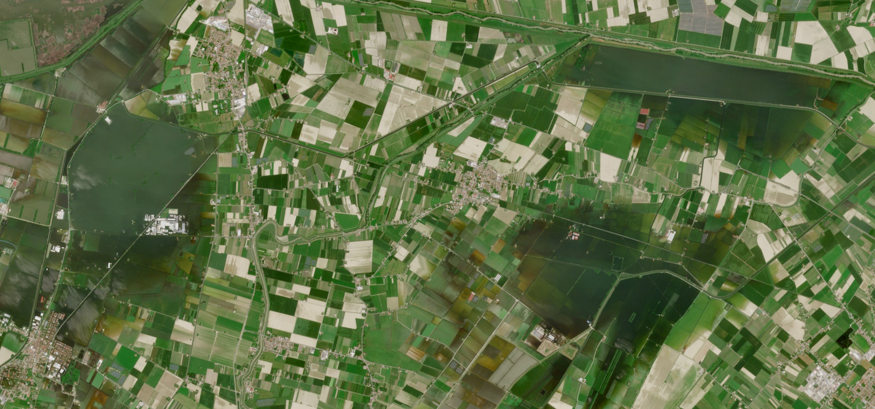
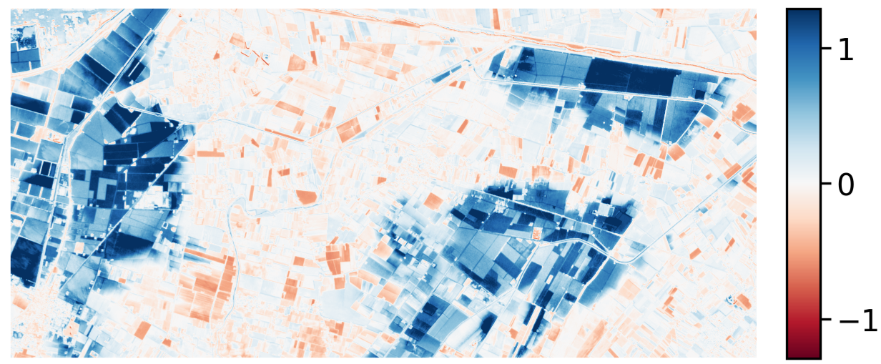
EO Layer - Emilia-Romagna Flood Example
Before
After
NDWI Change
𝞓NDWI

Slide 9


Reasoning Layer
EO indicators → MAS (Agents & Beliefs) → Explanation
Multi-Agent System (MAS)
Agents operate over Beliefs Base
Agents transform EO indicators into semantic assessments using rule-based reasoning
OUTPUT
Semantic Explanation
Beliefs and previous layer output (the EO indicators) are added to the beliefs base to drive hazard analysis.

Slide 10
Reasoning Layer - Beliefs Base
EO indicators → MAS (Agents & Beliefs) → Explanation
The beliefs base is composed of:
EO Indicator beliefs
Event metadata beliefs
  Event identity, location, temporal window…
Context beliefs
  Population exposure, possible late acquisition…
Optional user-input beliefs (from the UI)

Slide 11
Reasoning Layer - Agents
EO indicators → MAS (Agents & Beliefs) → Explanation
Agents role in the MAS:
Coordinator agents
  request hazard assessments and (where needed) clarifications.
  collect and combines results
Hazard agents (Water / Forest)
  produce hazard assessments and transforms EO indicators into semantic concepts using rules
Explanation agents
  organise and prepare the results for the NLP layer

Slide 12
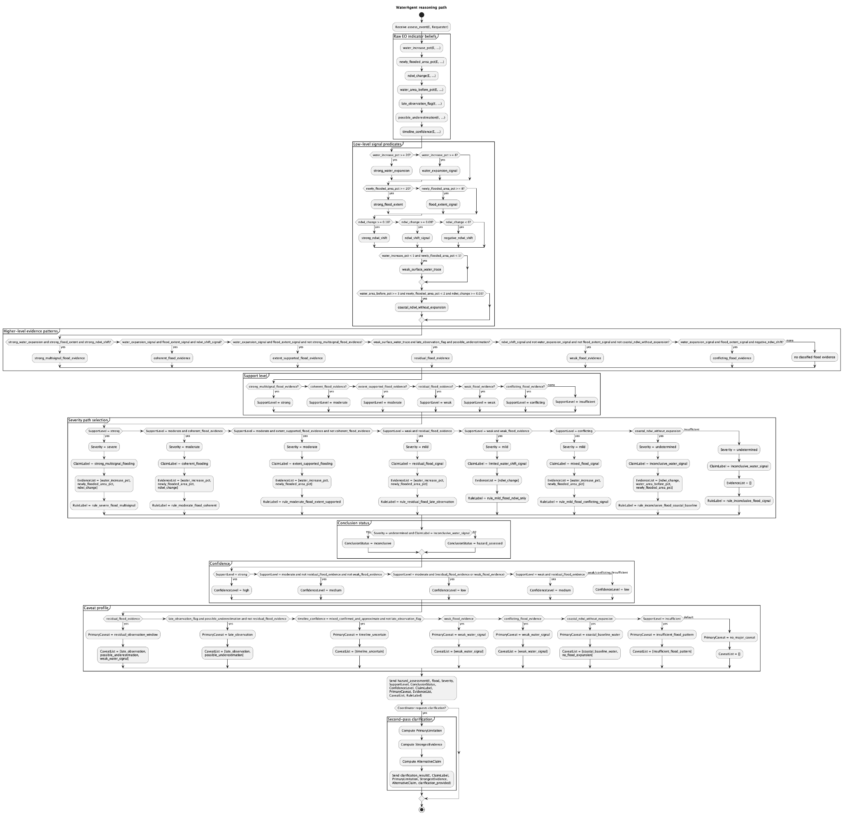
Reasoning Layer- WaterAgent
WaterAgent reasoning path

Slide 13
Reasoning Layer - Hazard Agents
EO indicators → MAS (Agents & Beliefs) → Explanation
Read EO and context beliefs
Derive indicator-level signals
Build higher-level evidence patterns
by combining consistent signals
Determine support level (how strong the evidence is)
weak, medium, strong
Map support to severity (how severe the event is)
mild, medium, severe
Determine conclusion status, confidence and caveats

Slide 14
Reasoning Layer - Semantic Explanation
EO indicators → MAS (Agents & Beliefs) → Explanation
semantic_explanation(
E,
Event_frame,
Assessment_frame,
Evidence_frame,
Clarification_frame,
Provenance_frame,
…
)
→ event metadata
→ severity, confidence, support
→ supporting evidence + caveats
→ limitations, alternative interpretations
→ agent + rule used
The semantic explanation encodes both the decision and the reasoning behind it in a structured, machine-readable form.
Simplified view of the semantic explanation structure

Slide 15
NLP Layer - From Structure to Language
Summary
Emilia-Romagna is assessed as a severe flood event with high confidence.
Supporting Evidence
The flood assessment is supported by a strong multi-signal pattern combining water expansion, newly flooded area, and NDWI change.
Caveats
The main limitation is late observation, which may lead to underestimation of the event extent.
Provenance
This assessment was produced by the water agent using the rule `rule_severe_flood_multisignal`.
semantic_explanation(
E,
Event_frame,
Assessment_frame,
Evidence_frame,
Clarification_frame,
Provenance_frame,
…
)

Slide 16
NLP Layer - From Structure to Language
Semantic transformation and explanation delivery
Semantic explanation normalisation
Ontology population
– validated, queryable semantic layer (not used for text generation)
Natural language report generation

Slide 17
NLP Layer - Report Generation
Normalisation → Ontology Population → Report Generation
Report generation follows a structured NLG pipeline:
Content Selection
extraction of relevant semantic parts
Lexicalisation
mapping of symbolic labels to natural language expressions
Document Planning
Surface Realisation
assembling of the final text

Slide 18
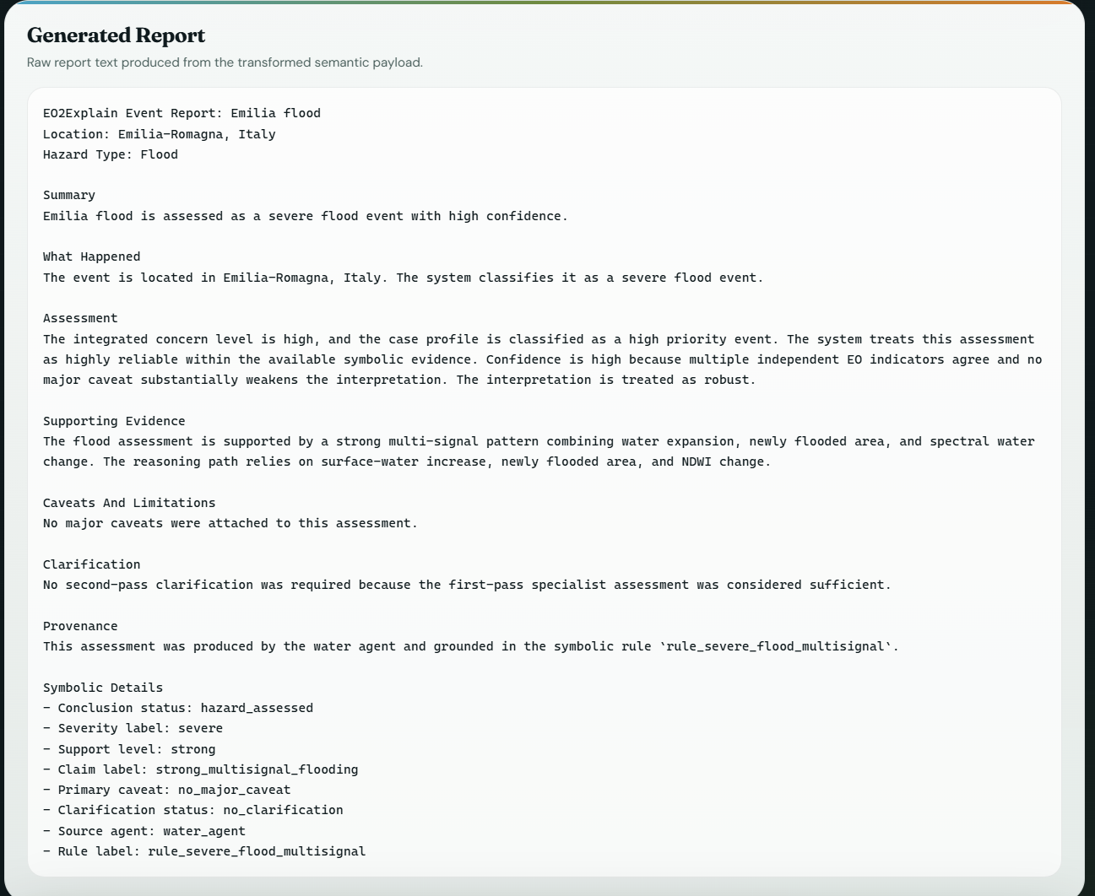
NLP Layer - Example of a Generated Report

Slide 19
Project Extension - Interactive Web UI
Lightweight interactive web interface
Upload Sentinel-2 data
Set contextual assumptions
Explore explanation reports and reasoning trace
From offline pipeline to interactive and inspectable system

Slide 20

System Overview
Satellite Data
Generated Report Output
EO LAYER
Earth Observation Processing
Summary
Emilia-Romagna is assessed as a severe flood event with high confidence.
Supporting Evidence
The flood assessment is supported by a strong multi-signal pattern combining water expansion, newly flooded area, and NDWI change.
Caveats
The main limitation is late observation, which may lead to underestimation of the event extent.
Provenance
This assessment was produced by the water agent using the rule rule_severe_flood_multisignal.
REASONING LAYER
Multi-Agent Symbolic Logic
NLP LAYER
Natural Language Generation

Slide 21
Evaluation
Results overview
Strong performance on flood events
consistent signals → high confidence assessments
More uncertainty in wildfire scenarios
sensitive to EO data quality and timing
System behaves conservatively under uncertainty
Lowers confidence and triggers caveats
Overall: reliable reasoning, but dependent on input data quality

Slide 22
Conclusion
This project integrates EO data with symbolic multi-agent reasoning
Produces structured and explainable hazard assessments
Modular and extensible MAS architecture
Strength: transparency and interpretability
Limitation: rule-based design and dependence on EO data quality

Slide 23
References
Bondarenko et al. (2025) – WorldPop population data
• Bordini, Hübner & Wooldridge (2007)
– Programming Multi-Agent Systems in Jason
• Key & Benson (2006) – dNBR burn severity
• McFeeters (1996) – NDWI index
• Rouse et al. (1974) – NDVI index

