Slide 1
Limitations of DFT
Stefano Borini

Slide 2
Quick recap of DFT - 0
Wavefunction:
a description of our n-particle system that can be probed
with an operator to find physical information about the system
The wavefunction is a function of all electrons coordinates
The electronic density is a spatial (3D) information which
- depends on the wavefunction
- tells us a lot about the ground state

Slide 3
Quick recap of DFT - 1
Hohenberg-Kohn
Universal functional
(not dependent from system)
Non-universal functional
Depends on the system
through external potential
There is a 3D density ρ₀(r) which gives the lowest energy E = E₀
How do we find it ?

Slide 4
Quick recap of DFT - 2
density/potential interaction
“Under the carpet”
AKA J[p] Coulomb interaction of many-charges cloud with itself
kinetic energy of non-interacting electron gas with density
That is: we don't know the
density, but we express it on
a basis of N non-interacting
orbitals

Slide 5
Quick recap of DFT - 3
Let's ignore the problem with E_{xc} for a moment.
Finding the optimal density ρ₀ that minimizes the energy ?
That's easy: derivative with respect to ρ
with constraint
Lagrange multipliers

Slide 6
Quick recap of DFT - 4
Let's do the derivative
Behold ! non-interacting electrons in a black magic potential !

Slide 7
Quick recap of DFT - 6
So, what does that mean?
An effective, mean field potential exists
so that when applied to a system of
non-interacting electrons
it gives the exact same density and energy
as the real system with interacting particles.
We just moved our ignorance around,
but in a more manageable entity

Slide 8
Quick recap of DFT - 5
We can define a one-electron Schroedinger equation using this potential
Which gives us the orbitals.
From the orbitals we get the density
From the density the new potential
From the new potential
a new Schroedinger equation

Slide 9
Final energy

Slide 10

Said in another way...
DFT is an exact and efficient approach
but it sweeps complexity under the rug (XC)
System made
of interacting electrons
in a regular potential
System made
of non-interacting electrons
in a black magic potential
(which includes the XC term)
Limitation n. 1
DFT is successful if the XC is successful
That is
How well the XC functional reproduces all the things we ignore
in a simplified system of non-interacting electrons

Slide 11
Functionals

Slide 12
Functionals
Exchange arises from Pauli exclusion principle
(requirement for antisymmetry of the WF)
Correlation includes complex many-body interactions
In ab-initio approaches
  exchange is addressed through antisymmetric functions (Slater determinants)
  correlation (static+dynamic) through multi-determinant wavefunctions
In DFT, simple XC functionals perform amazingly well in describing those effects.
Errors may occur not from an inexact theory, but a limited XC functional.

Slide 13
Digression: wavefunction QM
In “traditional” wavefunction QM we proceed like this
1. we define one-electron orbitals out of a linear combination of an
atomic basis set
2. we use these orbitals to build a Slater determinant: polyelectronic,
antisymmetric wavefunction (includes exchange energy due to antisymmetry)
optimizing the one-electron orbitals.
3. We define a linear combination of electronic distributions in the orbitals,
building other determinants, and either optimizing the coefficients, or both
the coefficient and the orbitals
We can improve the wavefunction to perfection: infinite atomic basis set with
all possible electronic distributions represented in the MR wavefunction.
Computationally impossible, but conceptually simple

Slide 14
Correlation
Hartree Fock includes exchange, but completely misses correlation
Correlation: how an electron being in x₁ affects the probability of another electron in x₂
Exchange is also a form of correlation, but here
we talk about what is not accounted by exchange
Non-correlated electrons
Correlated electrons
Correlation energy can be divided into
Static: emerging from close degeneracies of configurations
Dynamic: emerging from instantaneous electronic interactions
We can describe both terms with a multireference expansion.
However, while static correlation requires few terms, dynamic requires
a larger amount of them, and it is one of the holy grail of accurate calculations
Classic example: Hydrogen molecule

Slide 15
Correlation
Correlation
Energy

Slide 16
Why the difference ?
Hartree-Fock determinant =
Unpacking the sigmas
and getting rid of the spin
Ionic form
covalent form

Slide 17
Static correlation
Ionic form
covalent form
Covalent form and ionic form have the same weight
This weight cannot change with respect to distance.
A dissociated H2 is covalent (two atoms, one electron each).
Ionic forms should have zero weight at large distances.
We miss this flexibility.
At long distances, the interaction decreases, and so the
splitting between sigma_{g} and sigma_{u}.
Smaller splitting means these two orbitals are getting
more and more degenerate: their energy becomes the same.
If our wavefunction is made of two configurations
Then we gain this flexibility in the coefficients c₁ and c₂

Slide 18
Dynamic correlation
This was just static correlation.
Arises from degeneracy or close degeneracy of orbitals.
Dynamic correlation arises from description of instantaneous
interaction vs. an average field.
We need a large Configuration Interaction to address this.
Final limit: Full CI. Extremely expensive.
However, the direction is clear: a larger basis set
and a larger CI always systematically improve
the energy towards the true energy of the system.
What about DFT?
How does it address correlation (static and dynamic)
Do we have a direction for systematic improvement ?

Slide 19
Improving is hard
In wavefunction based ab-initio methods,
a systematic method to improve the quality of results exists.
Not so in DFT
Limitation n. 2
There is no systematic way of improving a
defective XC functional
However, the XC is technically universal
Find the right one, and it works everywhere
Improvement can be sought in two ways
Rule obedience: build it so that good rules are honored “a priori”
Fitting: parametrize the XC, then “fit” to a set of experimental results.
Fitting values are “magic numbers” in the resulting XC functional

Slide 20
Some rules
Lieb-Oxford bound
satisfied by LDA and some GGA
Size consistency
For two non-overlapping, non-interacting densities
Most functionals are size consistent
Exchange decay
The exchange potential should decay as 1/r
The correlation as 1/r⁴
In LDA they decay exponentially.

Slide 21
Typical Errors in DFT
Underestimate
  barriers of chemical reactions
  band gaps
  ion dissociation energies
  charge transfer
Overestimate
  binding energies of charge transfer complexes
  response to electric fields
Root cause: Delocalization error.
Coulomb term dominates, pushing electrons apart
Fail to describe
  degenerate or near-degenerate states
  bond breaking
  strongly correlated material
Root cause: Static correlation error.
Similar error found in Hartree Fock

Slide 22
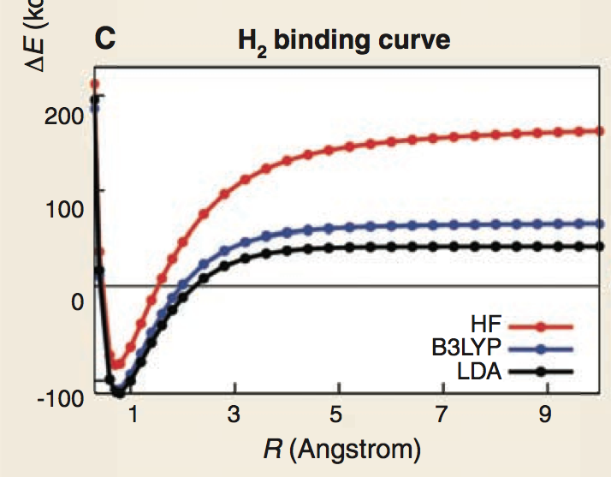
Static Correlation Error
Overestimates energy on dissociation
Root cause: near degeneracies at the wavefunction level
Example: stretching of H₂
Note that the problem is similar to the HF level case.
In a purely ab-initio approach this is a well-known problem
of a single determinant wavefunction.

Slide 23
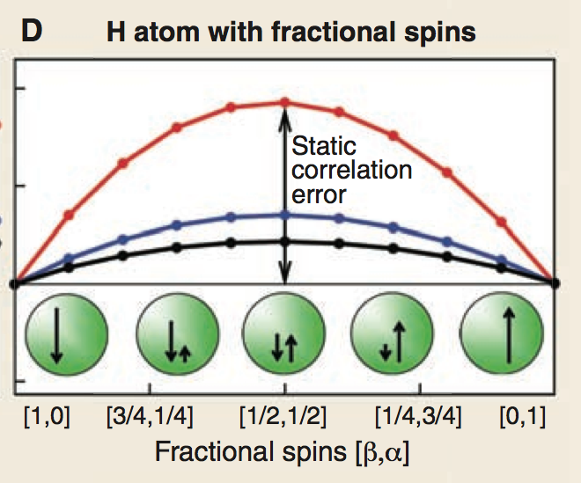
Static Correlation Error
Dissociation limit for H₂: singlet state with separated atoms

Slide 24
Limitations of the functionals
and their origin

Slide 25
Local Density Approximation
So we need a value to put into E_{xc}
We define a box of “jellium” with uniform electron density ρ
Jellium: uniform electronic charge and uniform positive charge,
with volume of the box growing to infinity
For each value k_{p} of the density, there's an analytical expression that gives
the corresponding exchange-correlation value.
We can divide this value by N (total number of electrons) to
get the exchange-correlation “per electron”.

Slide 26
Local Density Approximation
Now, we can use these values in our DFT treatment.
Procedure:
  take our real system
  divide it into small, infinitesimal cubes
  for each cube, put some charge inside
  divide charge by the volume of the cube
  to get density in that cube
  for the density in that cube, get the value
  ε_{xc} for a Jellium having that density
  scale it properly with the actual amount
  of charge in the cube
  sum up all the contributes
That is
Credits: Rubén Pérez
Departamento de Física Teórica de la Materia Condensada, Universidad Autónoma de Madrid, Spain

Slide 27
LDA Performance
Underestimate
Overestimate
Exchange (5-10%)
Bond lengths (1%)
Elastic constants (5%)
Energy barriers (100%)
Correlation (100-200%)
Atomization energies (15%)
Other
Favors close-packed structures
Poor description of magnetic systems
Poor description of van der Waals and Hydrogen bonds
Negative ions unstable
Densities are usually good.
Overestimation of correlation offsets underestimation of exchange, leading to
an overall error of 7% for E_{XC}

Slide 29
So why does LDA work ?
Exact properties of the xc-hole maintained.
The electron-electron interaction depends only
on the spherical average of the xc-hole.
This is reasonably well reproduced
The errors in the exchange and correlation energy
densities tend to cancel
Some things that do not work in this approach
•Van der Waals interactions: due to mutual dynamical charge polarisation
of the atoms not properly included in any existing approximations to Exc
• Excited states: DFT is a ground state theory
(ways forward: time-dependent DFT, GW, ...)
• Non Born-Oppenheimer processes (i.e, non-radiative transitions
between electronic states)
• Self-interaction problem: each electron lives in the field created by all
electrons including itself (ways forward: SIC, hybrid DFT)

Slide 32
Self interaction problem
That contribute does not vanish for a one-electron case
A Coulomb contribute would arise from an electron interacting with itself
In Hartree Fock, self-interaction is canceled
by the equal (and opposite) exchange term
Not necessarily so in DFT
 | Exact | LDA | PBE
Exchange | 0.3125 | 0.2680 | 0.3059
Correlation | 0.0000 | 0.0222 | 0.0060

Slide 33
Self interaction problem
Condition for self-interaction free functional in a one-electron case
In the multi-electron case for each one-electron density:
Can be split:
J is fully non-local
Its contribute cannot be recovered by semi-local functionals

Slide 34
Delocalization Error
H₂⁺
+
(H
H)
HF
B3LYP
LDA

Slide 35
Delocalization Error
H₂⁺
+
(H
H)
HF
B3LYP
LDA

Slide 36
Delocalization Error
H₂⁺
+
(H
H)
A linear combination of two different Slater determinants,
with different occupation and equal (at dissociation limit) coefficient.
Looking only at density, at dissociation limit we have two H atoms with half electron each.
What is the supposed behavior for fractional charge ?

Slide 37
Delocalization Error
For an exact functional, the curve E/N must be a series of linear segments,
with discontinuities in the derivative at integer charges
The better a XC functional approximates the required linear interpolation
between integers charges, the better will reduce the delocalization error.
Error can be convex (above) or concave.
Cancellation may arise if Exchange and Correlation compensate out.

Slide 38
Same error!
Delocalization error and self-interaction error are part of the same problem:
Inability of the functional to behave linearly for fractional charge.
Additional trouble
Functionals that are well behaved for one-electron self-interaction error are not necessarily well-behaved for the N-electron cases.
For any external potential and number of electrons, two conditions must be satisfied:
1. linear variation for non-integer charges
2. realistic energies at integer charges
Semilocal approximations satisfy 2 but not 1.
Hartree-Fock satisfies 1 (but not 2) only for one electron cases.

Slide 39
Delocalization Error
Energy is too low if the electron is delocalized over two centers.
Related to self-interaction error.
Convex errors results in:
Reaction barriers too low
Polarizabilities too high
Overestimate conductance
Underestimate band gaps
Favors delocalization

Slide 40
Delocalization Error
Wrong derivative with respect to charge has strong implications

Slide 41
Meaning of Kohn-Sham energies and orbitals
In Hartree-Fock formalism, orbitals and energies have physical meaning
Koopmans theorem
For closed-shell systems, the orbital energy corresponds to the ionization energy
of an electron from that orbital.
Under a few assumption, it is exact in the context of restricted Hartree-Fock theory.
In fact, orbital energies are qualitatively good approximations of the ionization energies.

Slide 42
Meaning of Kohn-Sham energies and orbitals
What about Hartree Fock orbitals ?
Orbitals where any given electron interacts
with all others electrons seen as an average field
also,
Brillouin theorem
The Hartree Fock orbitals are those orbitals which give an antisymmetrized
wavefunction (Slater determinant) which does not interact with any single excitations.

Slide 43
Meaning of Kohn-Sham energies and orbitals
Kohn Sham energies are not orbital energies.
They have no such physical meaning.
They are not a good approximation to ionization energies.
They are simply Lagrange parameters to fulfill the constraint.
Janak's Theorem
Although technically
if the XC functional is exact
Kohn-Sham orbitals
  Same symmetry of Hartree-Fock
  Identical of HF on all practical purposes for MO considerations

Slide 44
XC Approximation Ladder
Semi-Local
depend on the density at a given point
and its ”immediate proximity”
Non-local methods
“Second derivative”
methods
hyper/hybrid-GGA
Gradient dependent
(density first derivative)
meta-GGA
XC func depends on
the first and second
derivatives of the density
Completely non-local.
Uses exact exchange.
Local Density
GGA
XC func depends
on the density and
its first derivative
fully non local
LDA
XC func depends
only on the density
Bestiary: PW86, BP, LYP,
PW91, PBE, RPBE
Bestiary: TPSS

Slide 45
Exchange Correlation Hole
Conditional probability of finding an electron in r₂
given that there's an electron at r₁
If we had the exact Exchange Correlation hole, it should normalize so that
We can be even more specific

Slide 46
Generalized Gradient Approximation (GGA)
XC Functional depends on the density and the gradient of the density
but actually is Generalized Expansion Approximation with tricks
Exchange:
cutoff at integration
to one

Slide 47
Generalized Gradient Approximation (GGA)
Correlation

Slide 48
Generalized Gradient Approximation (GGA)
Improved exchange
Improved correlation,
but potential artifacts
due to cutoff

Slide 49
GGA Performance
Underestimate
Overestimate
Exchange (0.5%) (LDA 5%)
Elastic constants (5%)
Energy barriers (30%) (LDA 100%)
Correlation (5%) (LDA 100%)
Bond lengths (1%) (LDA 1% shorter)
Atomization energies (4%) (LDA 15%)
Other
Improves van der Waals and Hydrogen bonds
Improve negative ions
Fails
Weak/long range interactions
van der Waals/Hydrogen bonds better, but not good enough.
Better than LDA, but still not chemical accuracy (error = 1kcal/mol)

Slide 50
END

