Slide 1


SOFA
Framework – Class IV
Presented by,
Dr. Shifa Sulaiman
Postdoctoral Researcher
ICAROS
UNINA
Robotica Medica – SOFA

Slide 2
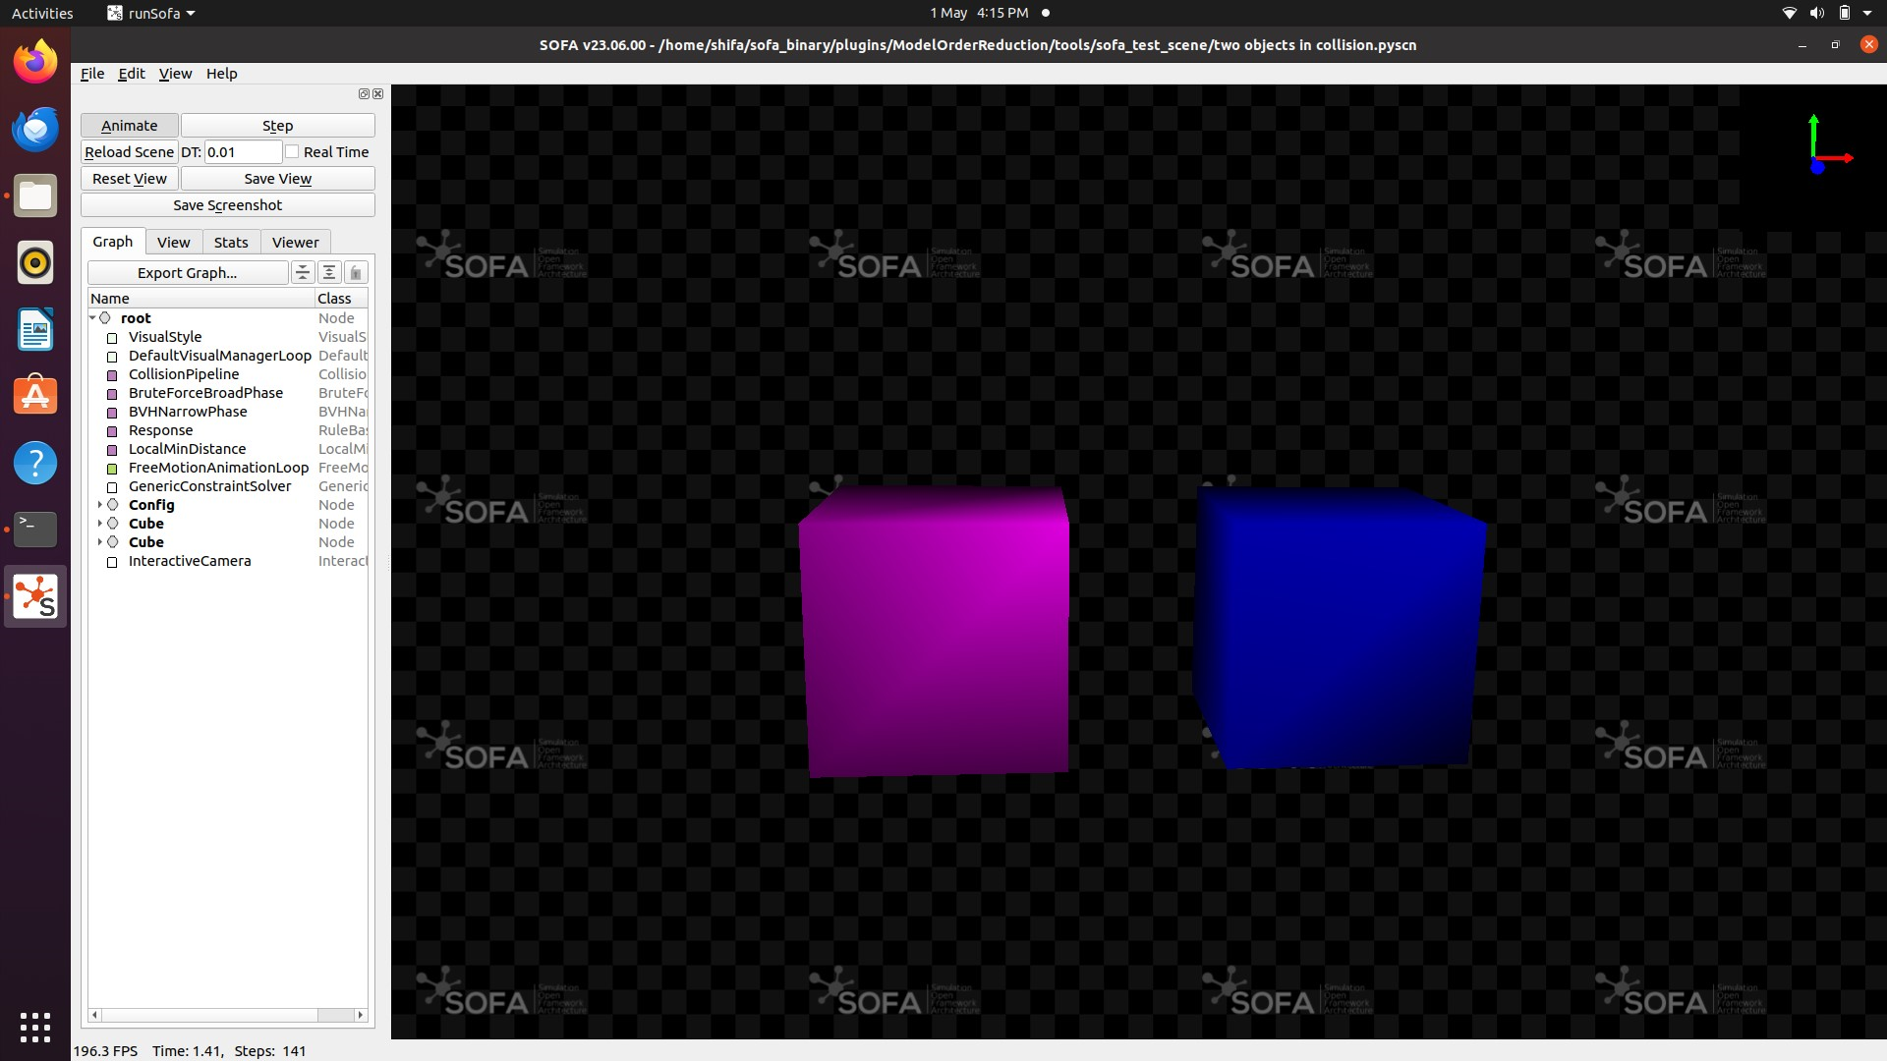
Two objects in collision
Create two rectangular blocks 100 mm apart in x direction
Give forces (50 N) and try to collide the blocks

Slide 3
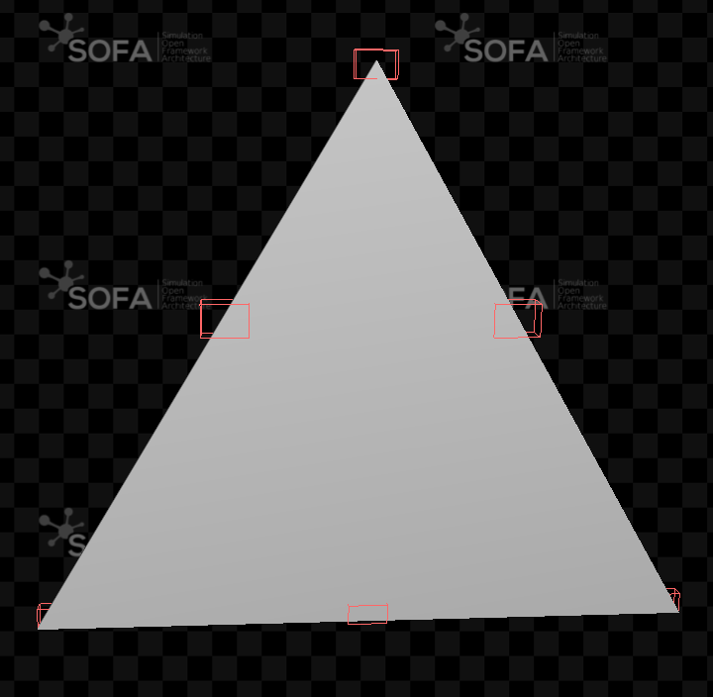
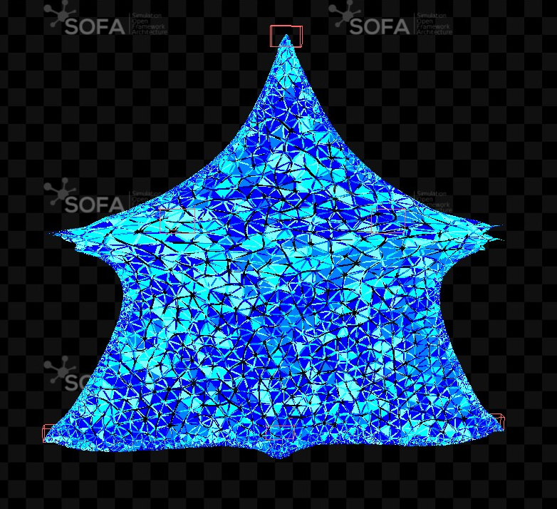
Triangular Membrane Stretch
Create a Triangular block (a. directly use the provided files, 2. try to create vtu from obj file provided.
Give fixed constraints and forces to stretch as shown in below figure
1500000
-1500000
-1500
Fixed points
Direction of forces

