Slide 1


SOFA
Framework – Class II
Presented by,
Dr. Shifa Sulaiman
Postdoctoral Researcher
ICAROS
UNINA
Robotica Medica – SOFA

Slide 2





SOFA - Understand Physics Simulation
Physics Simulation
Define parameters to describe changes in the state (position, orientation, temperature)
Use a model to describe the system
Identify the mathematical background that is based on
differential equations
Use numerical tools to solve the system
Questions to answer in simulation:
What are the degrees of freedom (state of change)?
What physics will be modeled?
Which hypotheses we will consider?
What numerical tools will be used?

Slide 3


SOFA – Mechanical Model
Mechanical Model:
Mesh size: define the geometry of the object, using any CAD software
Define the mechanical properties
Simulate constitutive material laws: allows defining a good representation of the kinematics and dynamic behavior
Understand the Finite Element Analysis (FEA)

Slide 4


SOFA – Continuum Mechanics
Description of physical bodies behavior, when it is subject to
forces
Define the mathematical description of deformation and related stresses
Solid mechanics
It relies on 3 physical principles:
Conservation of mass
Conservation of energy
Conservation of momentum, both angular and linear

Slide 5

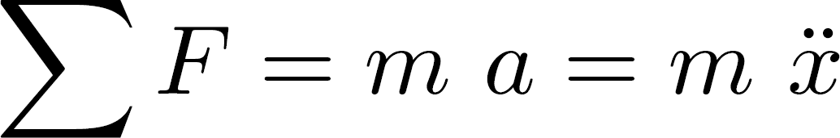
SOFA – Solid Mechanics
First approach considered in SOFA – Classical Newtonian Mechanics
The relationship between the displacement from a net force,
composed of internal and external forces, is:
Different classes of models for solids:
Rigidity: no internal force and no deformation
Elasticity: reversible behavior, return to rest shape after stresses (Linear Elastic or Hyperelastic model)
Viscoelasticity: irreversible behavior, but with a linear stress-deformation relationship
Plasticity: irreversible behavior, permanent deformation after stress

Slide 6


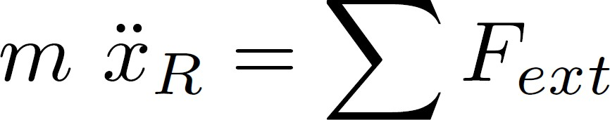
SOFA – Rigid Body
Newton’s law:
No internal forces in the model, and no deformation
The body can be represented as 1 frame
This frame is positioned at the center of mass:

Slide 7
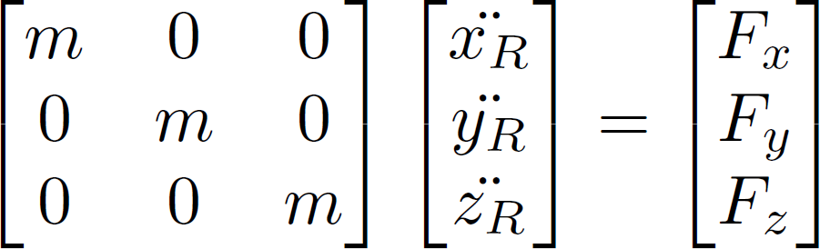

SOFA – Rigid Body
A matrix system can be defined as:
Defining a Mass and a Forcefields matrix
Under specific hypotheses:
No angular velocities considered, i.e no inertia terms
Single body without any articulated system

Slide 8

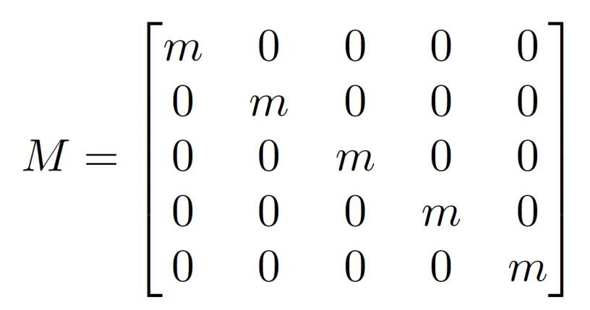
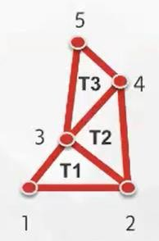
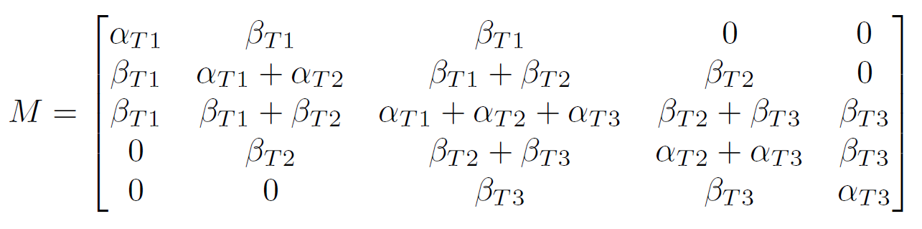
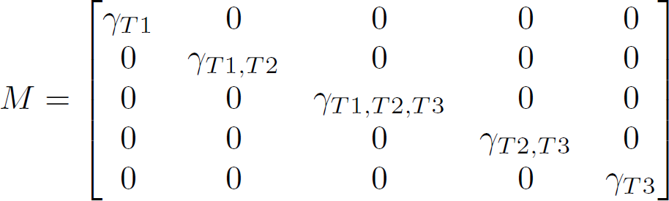
SOFA – Mass in SOFA
UniformMass:
MeshMatrixMass:
DiagonalMass:

Slide 9
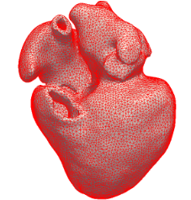
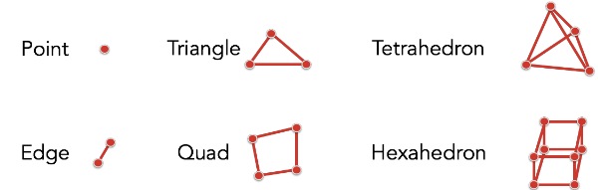
Topology
obj = MeshOBJLoader
vtk = MeshVTKLoader
stl = MeshSTLLoader
off = MeshOffLoader
gmsh = MeshGmshLoader
Fig. 1 – Elements of topology available in SOFA

Slide 10
Topology Containers
PointSetTopologyContainer
EdgeSetTopologyContainer
TriangleSetTopologyContainer
QuadSetTopologyContainer
TetrahedronSetTopologyContainer
HexahedronSetTopologyContainer
<MeshObjLoader name="ObjLoader" filename="path_to_my_mesh.obj" />
<MechanicalObject name="StateVectors" src="@ObjLoader" />
<TetrahedronSetTopologyContainer name="TetraTopologyContainer" src="@meshLoader" />

Slide 11
Animation Loops
DefaultAnimationLoop
MultiTagAnimationLoop: loop of one simulation step is the same as the DefaultAnimationLoop, except that one tag is solved after another.
MultiStepAnimationLoop:given one time step, this animation loop allows for running several collision and several integration time in one step.

Slide 12
Animation Loops
FreeMotionAnimationLoop: loop is used for simulation involving constraints and collisions.
With a FreeAnimationLoop, the loop of one simulation step follows:
build and solve all linear systems in the scene without constraints and save the “free” values of the dofs
collision detection is computed thus generating constraints
constraints are solved as one system to compute a correction term taking into account the collisions & constraints
update the mappings, the bounding box

Slide 13
Mapping
SOFA supports several DataTypes corresponding to the DOFs:
Vec1f or Vec1d: 1 DOF per node is used. Vec1f denotes vectors of float and Vec1d denotes the use of doubles.
Vec2f or Vec2d: 2 DOFs per node are used. For instance, this can be used for cardiac electrophysiology.
Vec3f or Vec3d: 3 DOFs per node are used. For instance, this can be used for mechanics.
Vec6f or Vec6d: 6 DOFs per node are used. For instance, this can be used for beam simulations (3 translations and 3 rotations).

Slide 14
Mapping
Rigid3d: this DataType corresponds to 7 DOFs per node, this can be used to simulate rigid bodies (3 positions and 1 quaternion).
In the MechanicalObject, each of these state vectors can be accessed using (scattered) state vectors, called multi-vectors or MultiVec.
<Node name="root" dt="0.01" >
<DefaultAnimationLoop />
<MechanicalObject template="Vec3d" name="myDOFs" position="0 0 0"/>
</Node>

Slide 15
Mechanical Object
The MechanicalObject (MechanicalState) saves all the state vectors.
These state vectors correspond to the degrees of freedom (DOFs) and their first time derivative.
The vector size is the number of nodes, and the size of each vector entry depends on the template
<Node name="root" dt="0.01" >
<DefaultAnimationLoop />
<MechanicalObject template="Vec3d" name="myDOFs" position="0 0 0"/>
</Node>

Slide 16
Mechanical Object
Integration schemes:
EulerExplicitSolver: This scheme allows to solve dynamic systems explicitly: all forces will be computed based on the state information at the current time step Current position.
node.addObject('EulerExplicitSolver', name='odeExplicitSolver')
EulerImplicitSolver:This scheme builds the system following an implicit scheme: forces are considered based on the state information at the next time step Unknown state, unknown at the current time step.
node.addObject('EulerImplicitSolver', name='ODEsolver', rayleighStiffness='0.1' rayleighMass='0.1')

Slide 17
Mechanical Object
Integration schemes:
StaticSolver: In a static analysis, the inertia and damping effects are ignored, i.e. the dynamic effect of the mass is ignored.
node.addObject('StaticSolver', newton_iterations='10', correction_tolerance_threshold='1e-4', residual_tolerance_threshold='1e-2', should_diverge_when_residual_is_growing='0')
NewmarkImplicitSolver: This scheme is an implicit time integrator for dynamic system using the Newmark scheme.
node.addObject('NewmarkImplicitSolver',rayleighMass='0.01', rayleighStiffness='0.01')

Slide 18




SOFA – Solvers in SOFA
Integration scheme: describe how to compute the value at next
time step
Called Ordinary Differential Equation (ODE) solvers in SOFA:
solving a linear system
Three categories:
Explicit: forces depend on the current position
Implicit: forces depend on the next position
Semi-implicit

Slide 19
Linear solvers
CGLinearSolver: In SOFA, the CGLinearSolver follows the well-known conjugate gradient method
iterations: specified the maximum number of iterations after which the iterative descent of the CGLinearSolver must stop
tolerance: defines the desired accuracy of the Conjugate Gradient solution (ratio of current residual norm over initial residual norm)”
threshold: defines the minimum value of the denominator in the conjugate Gradient solution

Slide 20
Linear solvers
warmStart: this option allows to use the previous solution as initial solution, which improves the initial guess if your system is evolving smoothly
node.addObject('CGLinearSolver', iterations='100', tolerance='1e-5', threshold='1e-5')

Slide 21
Linear solvers
SparseLDLSolver:
the SparseLDLSolver relies on the method of LDL decomposition.
The system matrix will be decomposed LDL decomposition, where Lower part of the matrix is a lower triangular matrix System matrix and Diagonal of the matrix is a diagonal matrix.
This decomposition is an extension of the Cholesky decomposition which reduces its numerical inaccuracy.
node.addObject('SparseLDLSolver')

Slide 22
Linear solvers
SparseCholeskySolver: The Cholesky decomposition
node.addObject('SparseCholeskySolver’)
AsyncSparseLDLSolver:The difference compared to SparseLDLSolver resides in the fact that the factorization of the matrix is performed in a different thread in order to speed up the simulation.
node.addObject('AsyncSparseLDLSolver')

Slide 23
Linear solvers
Preconditioned CG: The ShewchukPCGLinearSolver is an iterative solver using the conjugate gradient method as implemented in the CGLinearSolver in SOFA but it adds the possibility to define a preconditioner.
node.addObject('ShewchukPCGLinearSolver', iterations='1000', tolerance='1e-9', preconditioners='LUSolver'. build_precond='1', update_step='1000')

Slide 24
Force Fields
ForceFields are components that are adding “forces”. These forces will influence the equilibrium of a system by contributing to its change of state.
ConstantForceField
TetrahedronHyperelasticityFEMForceField
PolynomialSpringsForceField
QuadBendingFEMForceField
TetrahedronFEMForceField

Slide 25
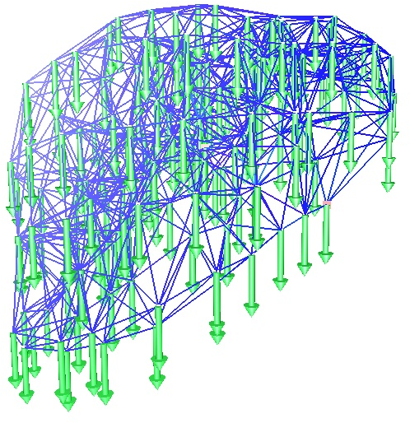
Force Fields
ConstantForceField: The ConstantForceField is a simple force field applying the same constant force on each node. This force field is not integrated over the domain of our object, but simply distributed over the number of nodes.
indices: list of node indices where the forces are applied and distributed
force: single value corresponding to the constant force applied on each node
totalForce: single value corresponding to total force for all points, i.e. the sum of the forces distributed uniformly over the nodes
forces: vector containing the force amplitude applied at each node
node.addObject('ConstantForceField', indices=[0 1 2], forces=[[-1 -1 0] [1 -1 0] [1 1 0]])

Slide 26
Force Fields
TetrahedronHyperelasticityFEMForceField:
TetrahedronHyperelasticityFEMForceField implements – for tetrahedral topology only – several non-linear mechanical constitutive laws, also named as hyperelastic constitutive laws.
Arruda-Boyce model
Costa model
Mooney-Rivlin model
Neo-Hookean model
Ogden model (order 1)
St Venant-Kirchhoff model
Veronda-Westmann model
node.addObject('TetrahedronHyperelasticityFEMForceField', name="HyperElasticMaterial", materialName="StVenantKirchhoff", ParameterSet="3448.2 31034.4")

Slide 27
Force Fields
PolynomialSpringsForceField:
This component allows to simulate springs with Polynomial stress strain behavior.
Spring force the spring force
Cross section the cross section (always 1.0)
Stress-strain non-linear function the stress-strain non-linear function
Original length of the spring the original length and Current length of the spring the current length of the spring
Point displacement the point displacement

Slide 28
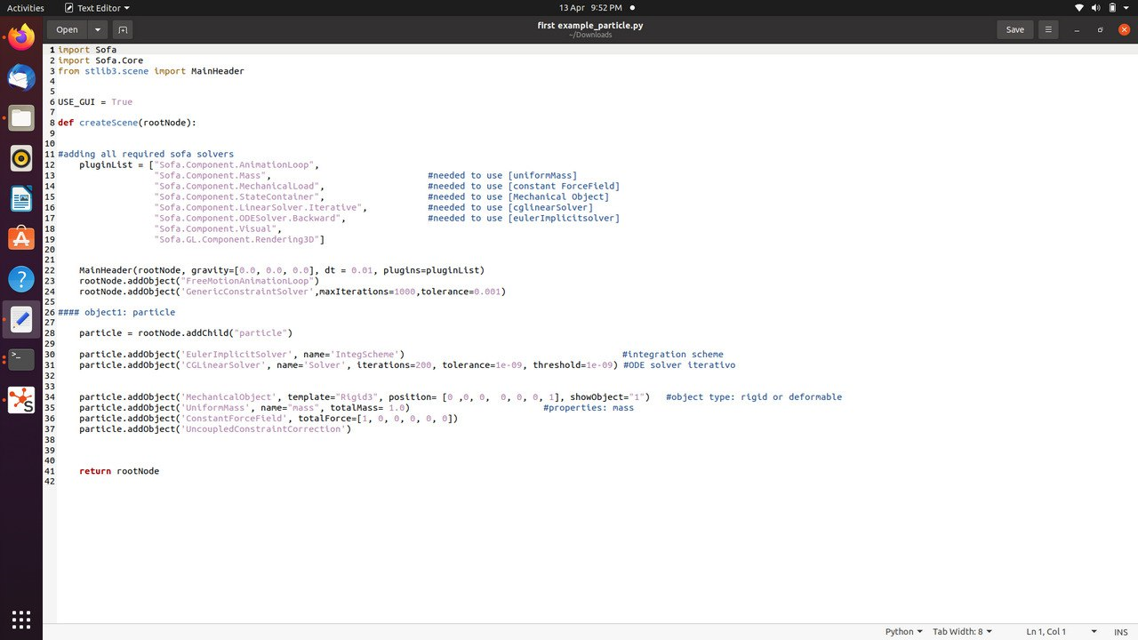
SOFA – Example II

