Slide 1


Autonomous and Mobile Robotics
Project 3
Dipartimento di Ingegneria Informatica, Automatica e Gestionale
Stefano De Filippis
Andrea Tantucci
Andrea Wrona
Professor: Giuseppe Oriolo
Tutor: Nicola Scianca

Slide 2
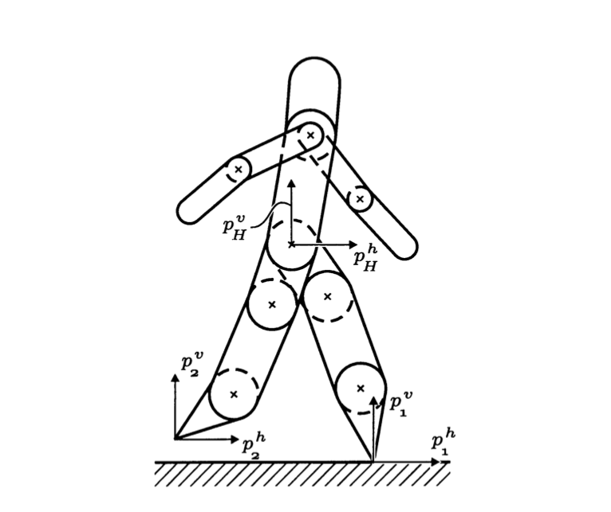
What is a planar Biped Walker?
A planar biped walker is a robot which locomotes via alternation of the contact points of the two legs with the ground in the sagittal plane. The leg which is in contact with the ground is called stance leg, while the other one is called swing leg
The model is a hybrid one
It is assumed that the double support phase is instantaneous

Slide 3
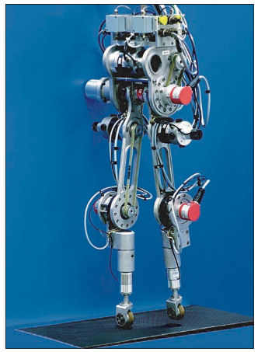
Aim of the project
The aim of this work is to study the gait generation via hybrid trajectory optimization and feedback linearization, and to compare the results with another kind of gait generation, based on Center of Mass (CoM) trajectory and differential kinematics tracking.
The simulations are performed on the prototype RABBIT, which is a 5-link walker.

Slide 4
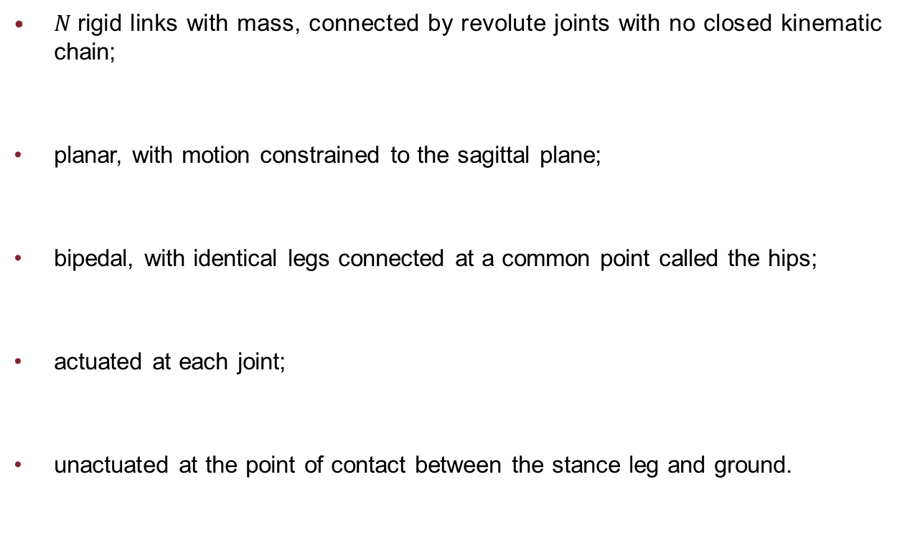
Robot assumptions
$N$rigid links with mass, connected by revolute joints with no closed kinematic chain;
planar, with motion constrained to the sagittal plane;
bipedal, with identical legs connected at a common point called the hips;
actuated at each joint;
unactuated at the point of contact between the stance leg and ground.

Slide 5
Gait assumptions
There are alternating phases of single support and double support;
During the single support phase, the stance leg acts as a pivot joint, that is, through-out the contact, it can be guaranteed that the vertical component of the ground reaction force is positive and that the ratio of the horizontal component to the vertical component does not exceed the coefficient of static friction;
The double support phase is instantaneous and can be modeled as a rigid contact;
At impact, the swing leg neither slips nor rebounds;
In steady state, successive phases of single support are symmetric with respect to the two legs;
Walking is from left to right, so that the swing leg starts from behind the stance leg and is placed strictly in front of the stance leg at impact;

Slide 6

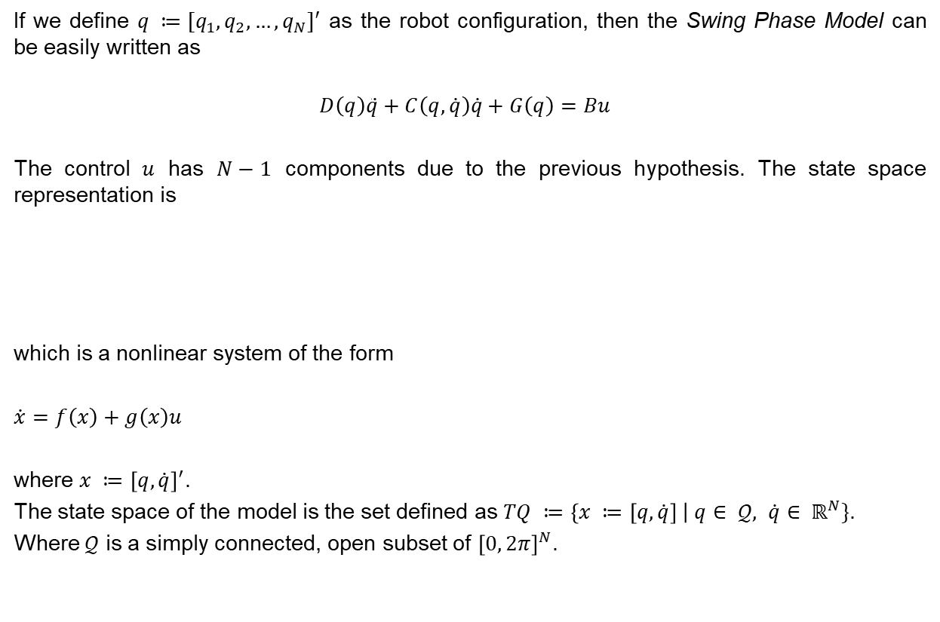
Robot Model – Swing Phase
If we define $q ≔[q_{1}, q_{2},…,q_{N}]′$ as the robot configuration, then the Swing Phase Model can be easily written as
$$D\left(q\right)\ddot{q}+C\left(q,\dot{q}\right)\dot{q}+G\left(q\right)=Bu$$
The control $u$ has $N−1$ components due to the previous hypothesis. The state space representation is
which is a nonlinear system of the form
$\dot{x}=f\left(x\right)+g\left(x\right)u$
where $x ≔{\left[q,\dot{q}\right]}^{′}$.
The state space of the model is the set defined as $TQ ≔\left\{x ≔\left[q,\dot{q}\right] \right| q∈ 𝒬, \dot{q}∈ ℝ^{N}\}$.
Where $𝒬$ is a simply connected, open subset of ${\left[0, 2π\right]}^{N}$.

Slide 7
Robot Model – Impact Model Hypothesis
The contact of the swing leg with the ground results in no rebound and no slipping of the swing leg;
At the moment of impact, the stance leg lifts from the ground without interaction;
The impact is instantaneous;
The external forces during the impact can be represented by impulses;
The impulsive forces may result in an instantaneous change in the velocities, but there is no instantaneous change in the configuration;
The actuators cannot generate impulses and, hence, can be ignored during impact.

Slide 8
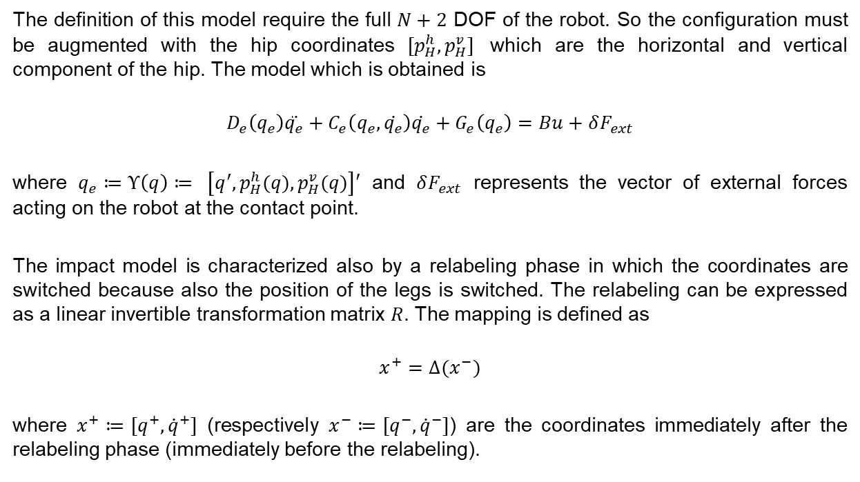
Robot Model – Impact Model (1)
The definition of this model require the full $N+2$ DOF of the robot. So the configuration must be augmented with the hip coordinates $[p_{H}^{h},p_{H}^{v}]$ which are the horizontal and vertical component of the hip. The model which is obtained is
$$D_{e}\left(q_{e}\right)\ddot{q_{e}}+C_{e}\left(q_{e},\dot{q_{e}}\right)\dot{q_{e}}+G_{e}\left(q_{e}\right)=Bu+δF_{ext}$$
where $q_{e}≔Υ\left(q\right)≔ \left[q^{′},p_{H}^{h}(q),p_{H}^{v}(q)\right]′$ and $δF_{ext}$ represents the vector of external forces acting on the robot at the contact point.
The impact model is characterized also by a relabeling phase in which the coordinates are switched because also the position of the legs is switched. The relabeling can be expressed as a linear invertible transformation matrix $R$. The mapping is defined as
$$x^{+}=Δ(x^{−})$$
where $x^{+}≔[q^{+},{\dot{q}}^{+}]$ (respectively $x^{−}≔[q^{−},{\dot{q}}^{−}]$) are the coordinates immediately after the relabeling phase (immediately before the relabeling).

Slide 9

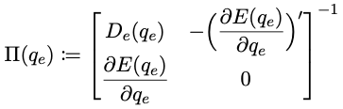
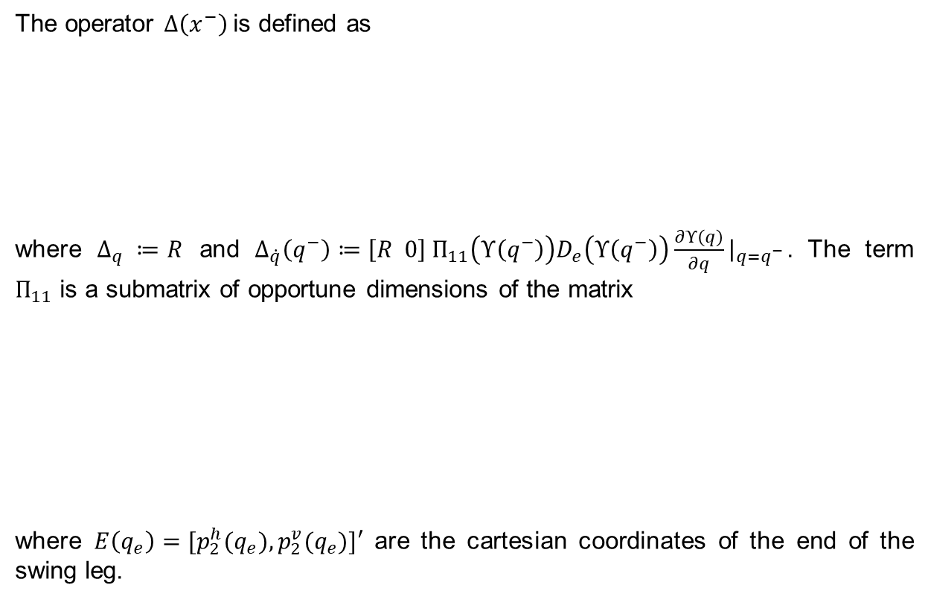
Robot Model – Impact Model (2)
The operator $Δ\left(x^{−}\right)$is defined as
where $Δ_{q} ≔R$ and $Δ_{\dot{q}}\left(q^{−}\right)≔\left[R 0\right] Π_{11}\left(Υ\left(q^{−}\right)\right)D_{e}\left(Υ\left(q^{−}\right)\right)\frac{∂Υ\left(q\right)}{∂q}{\left.​\right|}_{q=q^{−}}$. The term $Π_{11}$ is a submatrix of opportune dimensions of the matrix
where $E\left(q_{e}\right)=[p_{2}^{h}(q_{e}),p_{2}^{v}(q_{e})]′$ are the cartesian coordinates of the end of the swing leg.

Slide 10

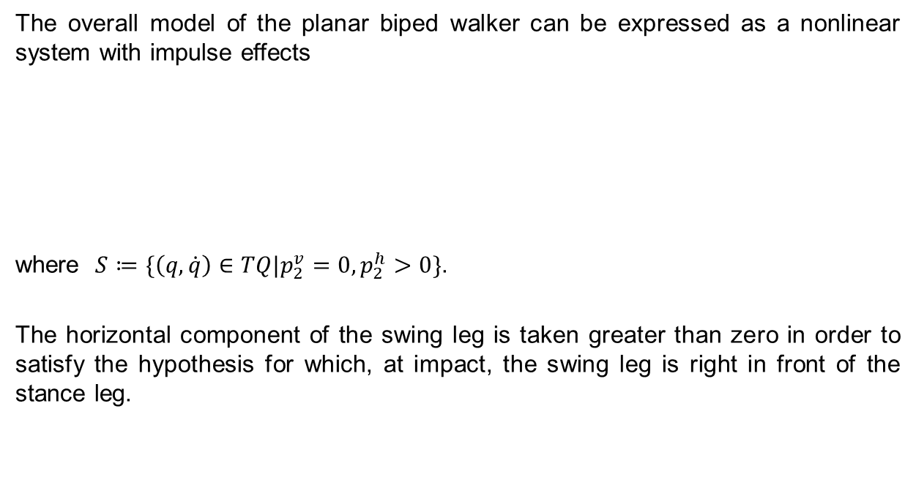
Robot Model – Plant
The overall model of the planar biped walker can be expressed as a nonlinear system with impulse effects
where $S≔\{\left(q,\dot{q}\right)∈TQ|p_{2}^{v}=0,p_{2}^{h}>0\}$.
The horizontal component of the swing leg is taken greater than zero in order to satisfy the hypothesis for which, at impact, the swing leg is right in front of the stance leg.

Slide 11
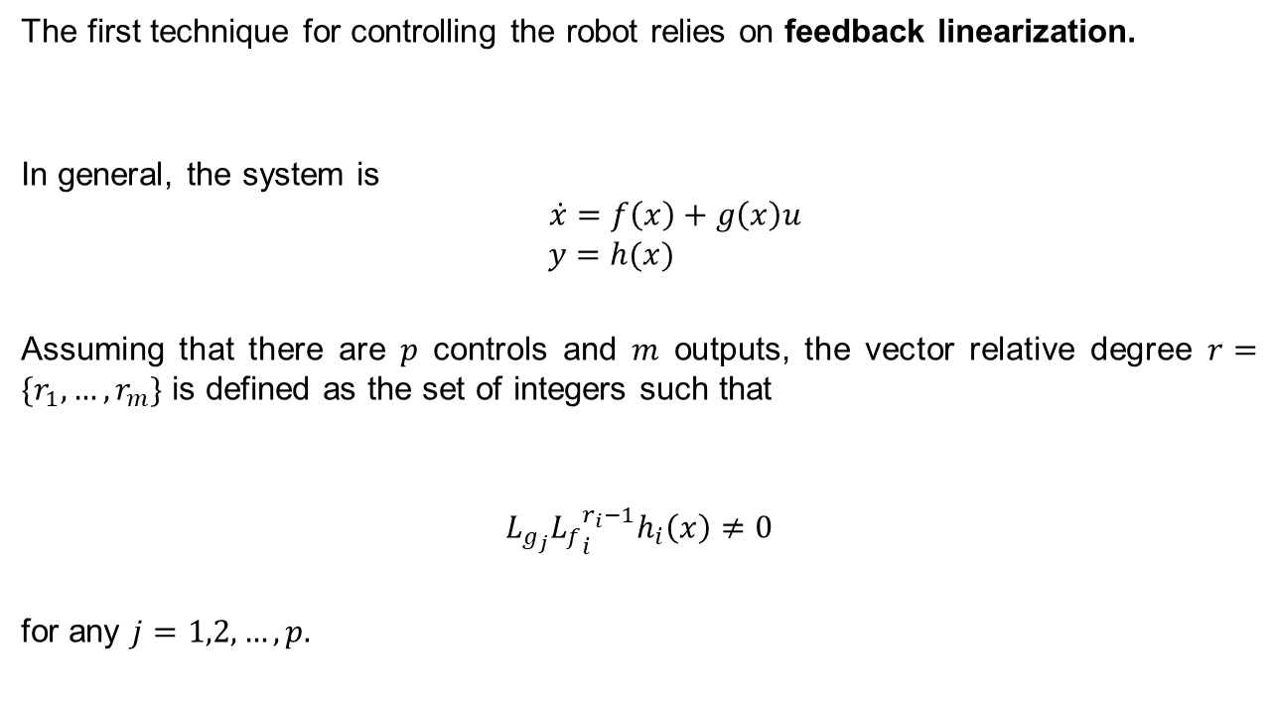
Relative Degree of a MIMO nonlinear system
The first technique for controlling the robot relies on feedback linearization.
In general, the system is
$$\dot{x}=f\left(x\right)+g\left(x\right)u$$
$$y=h(x)$$
Assuming that there are $p$ controls and $m$ outputs, the vector relative degree $r=\{r_{1},…,r_{m}\}$ is defined as the set of integers such that
$$L_{g_{j}}{L_{f}}_{i}^{r_{i}−1}h_{i}\left(x\right)≠0$$
for any $j=1,2,…,p.$

Slide 12
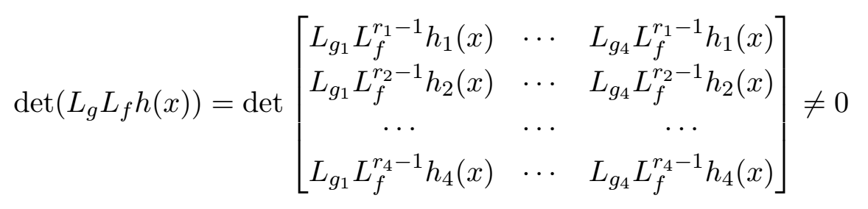
Decoupling Matrix and Noninteracting Control
The robot has four actuators.
The system has four control channels
The output $y=h(x)$ is chosen to be 4-dimensional
The output 𝑦=ℎ(𝑥) is chosen to be 4-dimensional
The noninteracting control problem (each input acts only on one output) can be achieved if the so-called decoupling matrix is invertible.

Slide 13
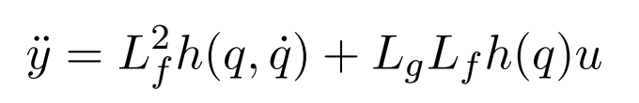
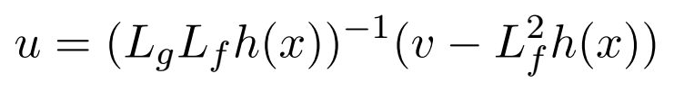

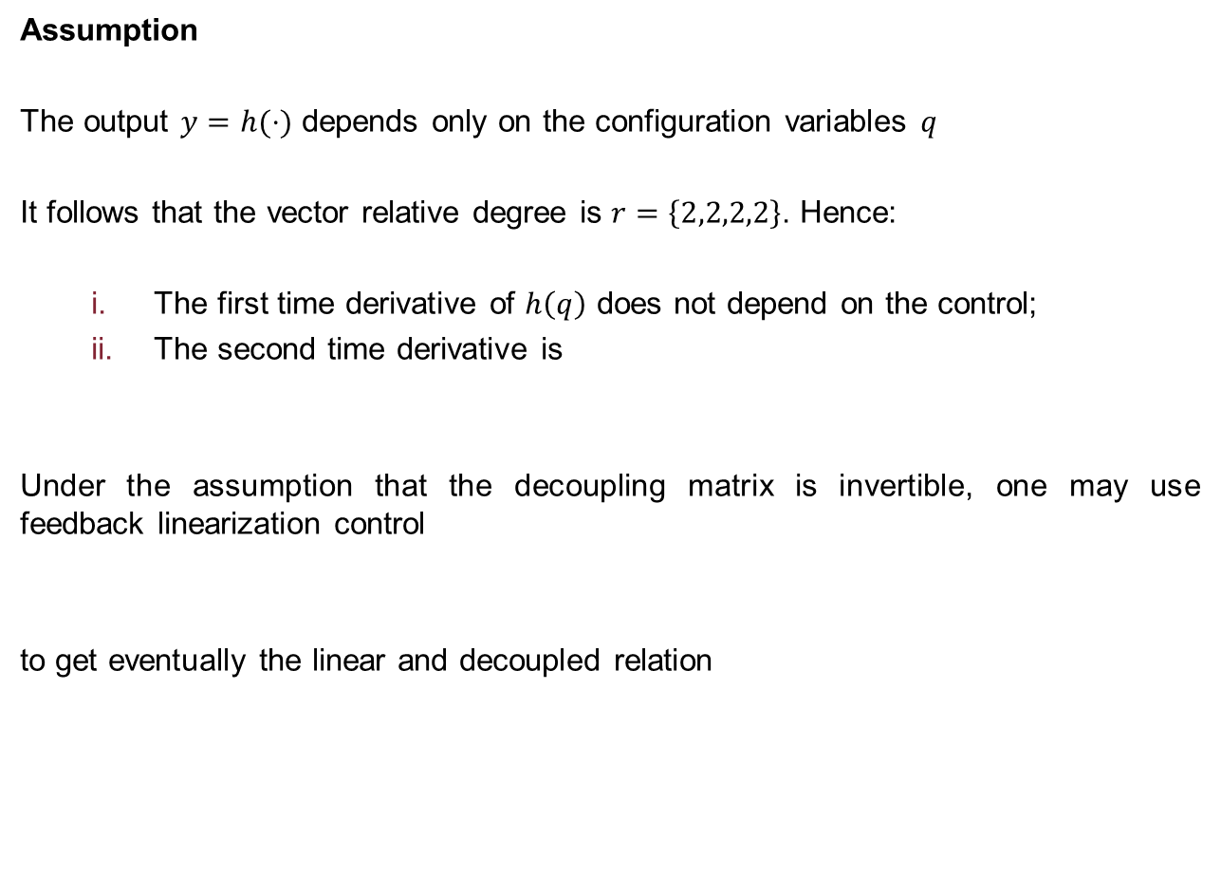
Feedback Linearization
Assumption
The output $y=h(⋅)$ depends only on the configuration variables $q$
It follows that the vector relative degree is $r=\left\{2,2,2,2\right\}$. Hence:
The first time derivative of $h\left(q\right)$ does not depend on the control;
The second time derivative is
Under the assumption that the decoupling matrix is invertible, one may use feedback linearization control
to get eventually the linear and decoupled relation
.
.

Slide 14

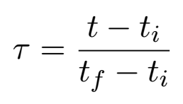
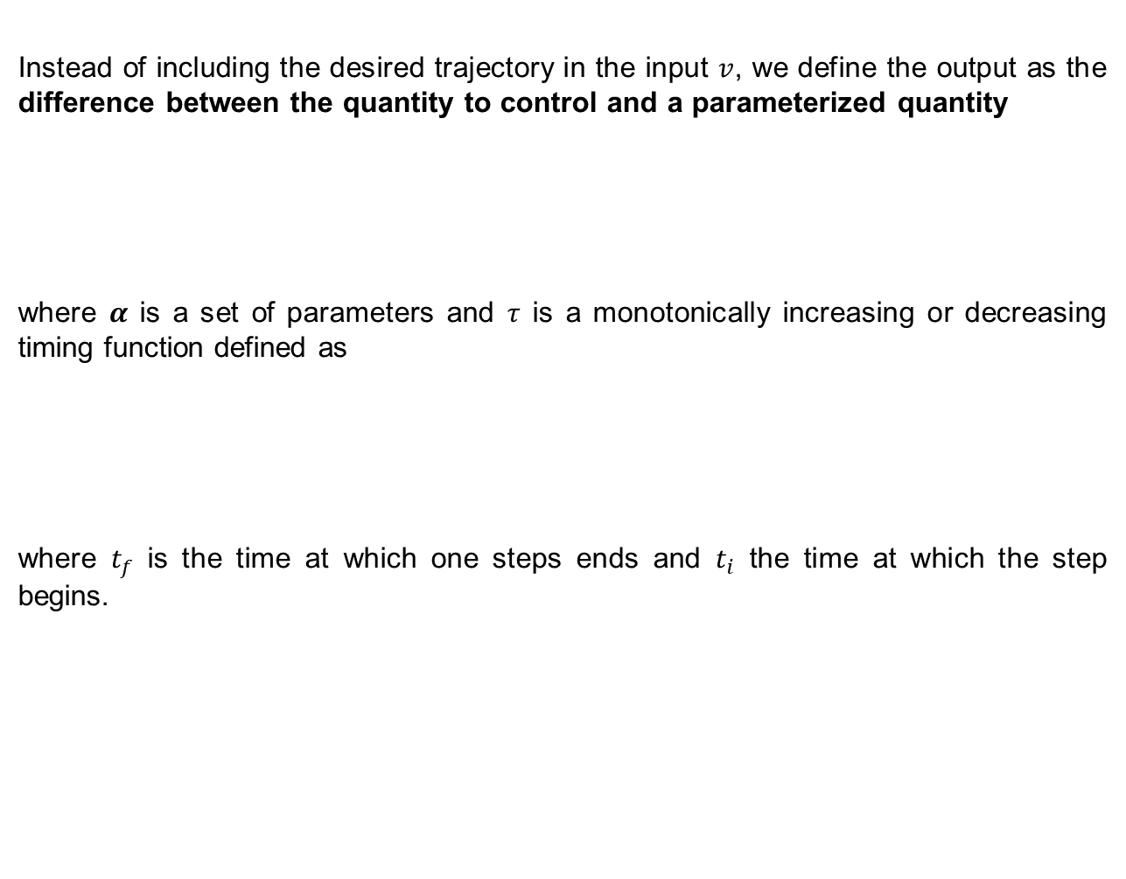
How to define the system output?
Instead of including the desired trajectory in the input $v$, we define the output as the difference between the quantity to control and a parameterized quantity
where $α$ is a set of parameters and $τ$ is a monotonically increasing or decreasing timing function defined as
where $t_{f}$ is the time at which one steps ends and $t_{i}$ the time at which the step begins.

Slide 15
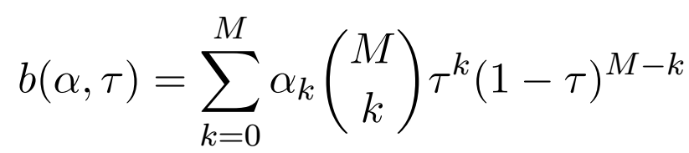
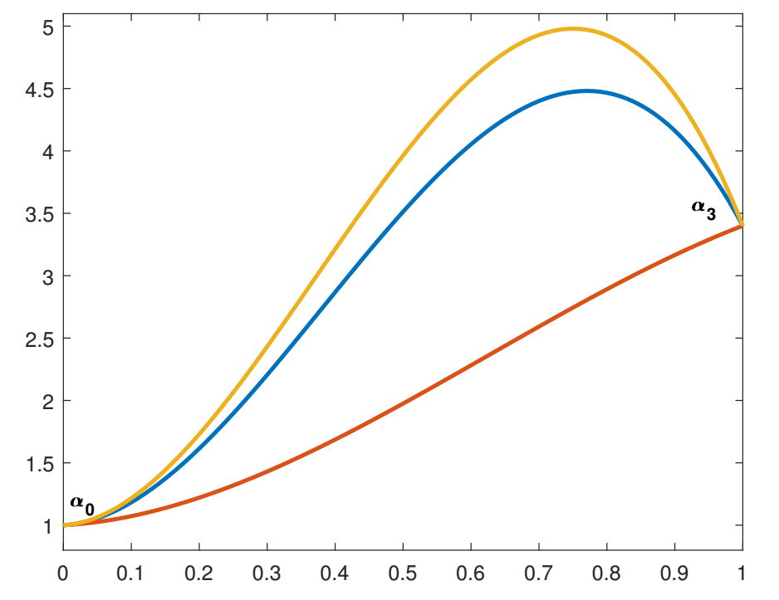

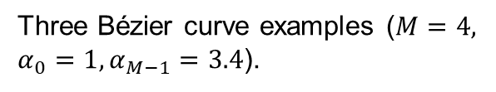
Bézier Polynomial
The chosen structure of the output was the Bézier polynomial. Given $M$ the degree of the polynomial, it is defined as
.
Three Bézier curve examples ($M=4,$
$α_{0}=1, α_{M−1}=3.4$).

Slide 16
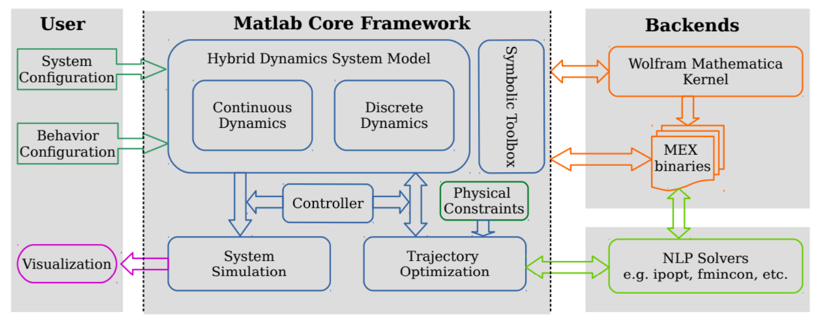
FROST Fast Robot Optimization and Simulation Toolkit
The optimization of the parameters has been done using the MATLAB toolbox FROST, whose mathematical foundation is feedback linearization and hybrid trajectory optimization.
FROST uses a symbolic toolbox and performs the computations using Wolfram Mathematica, not MATLAB. This allows to speed up the heavy calculations.

Slide 17

Hybrid Dynamical System in FROST
The main feature of FROST is the definition of a hybrid dynamical system via a tuple
where $Γ=\left\{V,E\right\}$ is a directed graph with vertices and nodes:
$V$ represents the continuous phase;
$E$ represents the discrete events that trigger the passage from one vertex to the other.
$$V_{1}$$
𝑉_1
$$V_{2}$$
𝑉_2
$$V_{3}$$
𝑉_3
$$V_{4}$$
𝑉_4
$$V_{5}$$
𝑉_5
$$V_{1}$$
𝑉_1
$$V_{2}$$
𝑉_2
$$V_{3}$$
𝑉_3
Cyclic Graph
Acyclic Graph

Slide 18
Constraints in FROST
A hybrid system is in general constrained, and FROST provides three kinds of constraints.
Holonomic Constraints
$$h_{c}\left(x\right)=k$$
ℎ_𝑐 (𝑥)=𝑘
Unilateral Constraints
Used to specify complementarity conditions during the contact with the ground, or control saturation
Used when the robot is not allowed to move in some direction (e.g. wheeled robots)
$$μ\left(⋅\right)≤0$$
𝜇(⋅)≤0
Virtual Constraints
Used to constrain the output to follow the desired one via feedback linearization
$$y=h\left(q\right)=h^{a}\left(q\right)−h^{d}(α,τ)$$

Slide 19
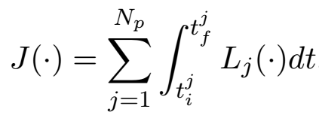
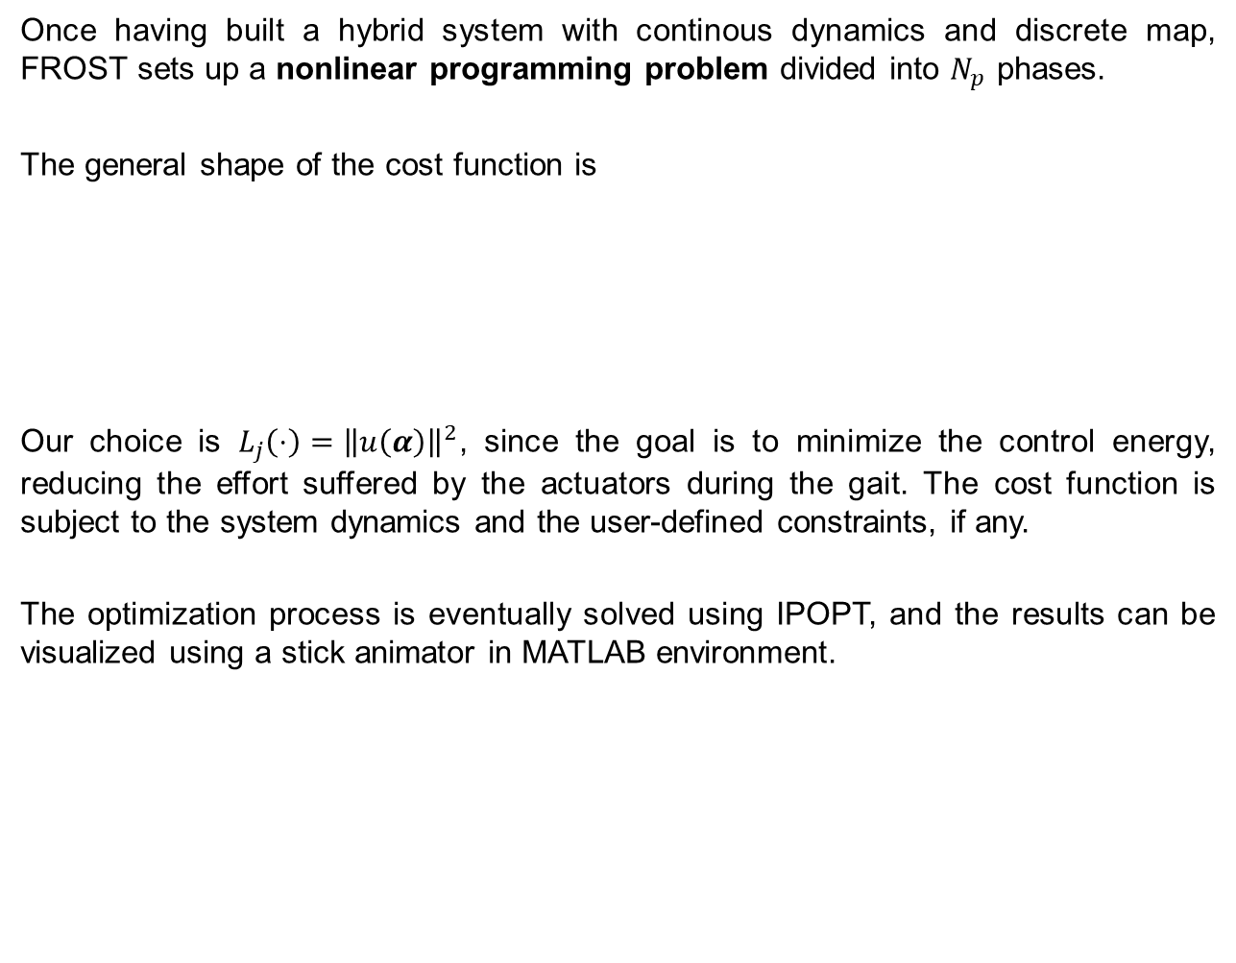
Optimization in FROST
Once having built a hybrid system with continous dynamics and discrete map, FROST sets up a nonlinear programming problem divided into $N_{p}$ phases.
The general shape of the cost function is
Our choice is $L_{j}\left(⋅\right)={\left\|u\left(α\right)\right\|}^{2}$, since the goal is to minimize the control energy, reducing the effort suffered by the actuators during the gait. The cost function is subject to the system dynamics and the user-defined constraints, if any.
The optimization process is eventually solved using IPOPT, and the results can be visualized using a stick animator in MATLAB environment.
.

Slide 20
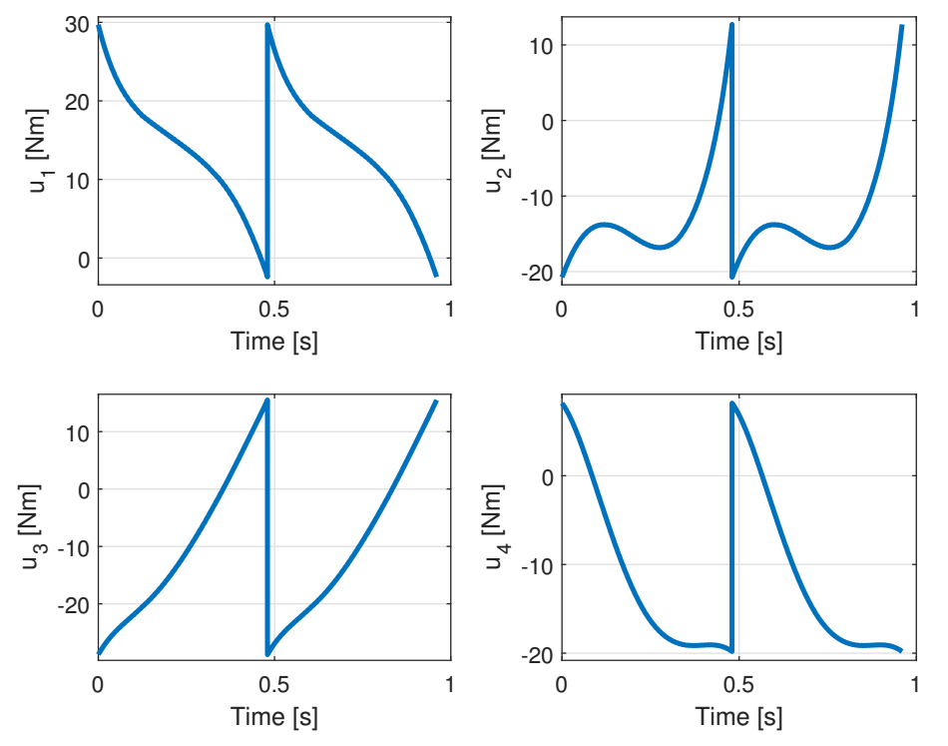
Simulation and control effort
In the simulation on the RABBIT model, the actual output is simply
$$h^{a}\left(q\right)={\left[q_{31} q_{32} q_{41} q_{42}\right]}^{T}.$$
The degree of the Bézier polynomials is $M=6$ and the optimization using IPOPT took about $12$ [s] on a PC with Intel i7 2 GHz CPU.
One steps lasts 0.5 [s] and the distance between the two feet during the double support phase is constant and equal to 0.37 [m].

Slide 21
Bounded CoM Trajectory Tracking
Approximate robot dynamics through the LIP model;
Define a suitable ZMP trajectory;
Generate a CoM trajectory given the ZMP input, satisfying initial conditions that ensures boundedness of the solution;
Track the CoM trajectory using Differential Kinematics.

Slide 22

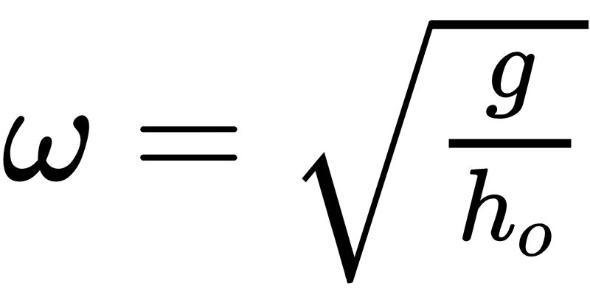
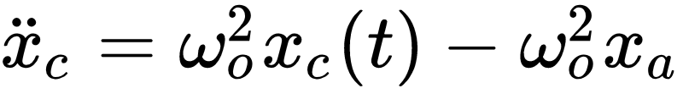
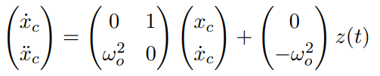
LIP Model
General system in the sagittal plane is defined by
RABBIT has point foots assume no ankle and hip torque and defining
x_{ZMP} = x_{cop} and, if no step is taken, they are fixed in x_{a}
.

Slide 23
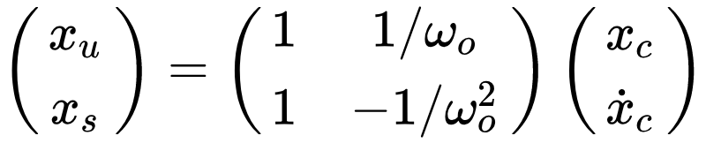
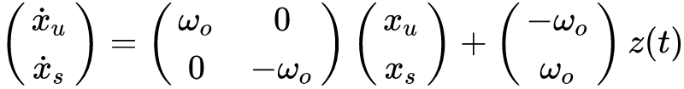
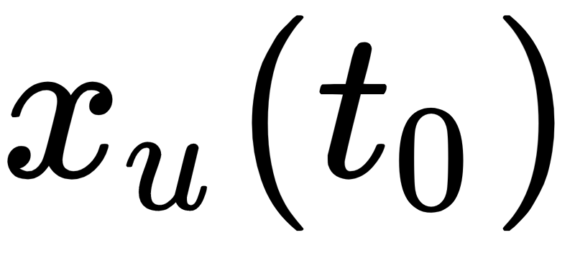
Instability of LIP model
Applying the change of coordinates
the stable and unstable dynamics can be decoupled
GOAL: select trajectories of the system that remain bounded
choose initial
design constraints on the input

Slide 24
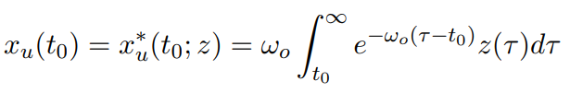
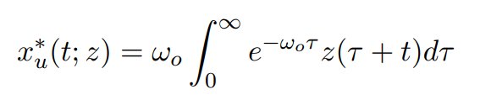
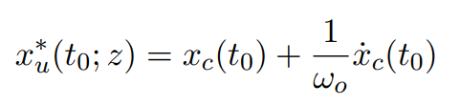
Unstable Subsystem
If we choose
then we have particular evolution
OBSERVATION: under change of coordinates we have constraints on initial conditions of CoM

Slide 25
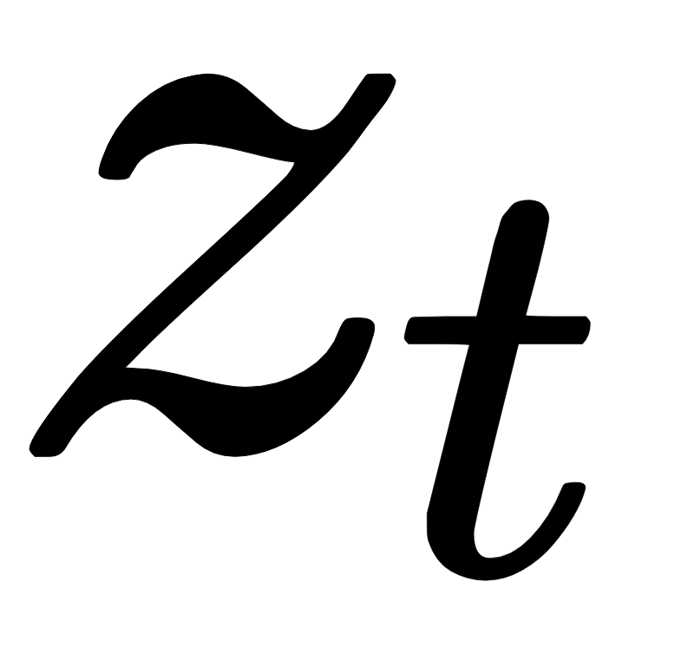
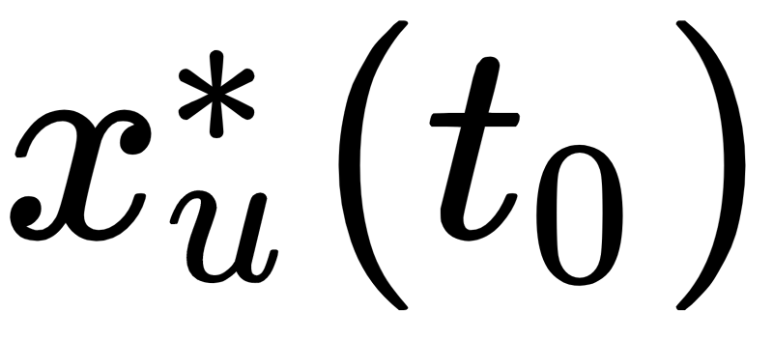
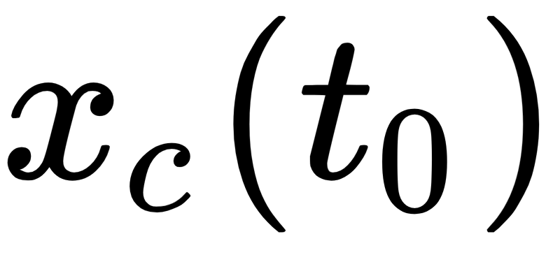
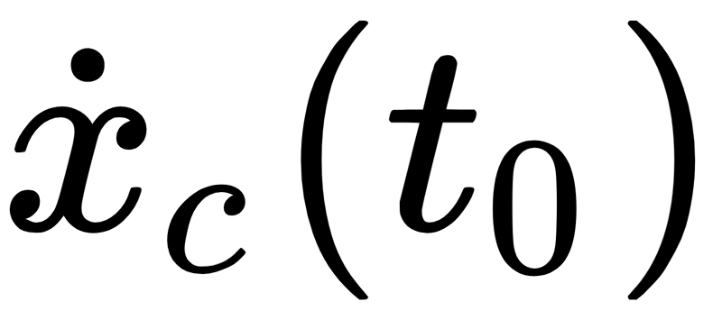

Constraints on Initial Conditions
If defined then we can evaluate linear constraints between and
if is specified then
if is specified then

Slide 26
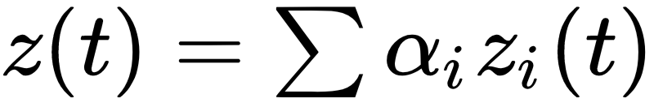


Constraints on Control Design
If and are given design s.t. B.C. is satisfied
Suppose the input is defined as
For a class of inputs we can use linearity properties
Since Boundedness Condition we must have

Slide 27


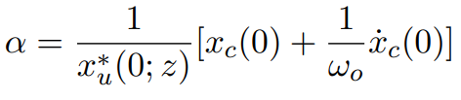
CoM Trajectory Generation in RABBIT
We choose the input as a sum of step functions
For this input we can compute the initial condition of the unstable dynamics
For example, if we suppose to use a single input and to fix initial conditions on $x_{c},\dot{x_{c}}$, then $α$ is obliged to be:

Slide 28
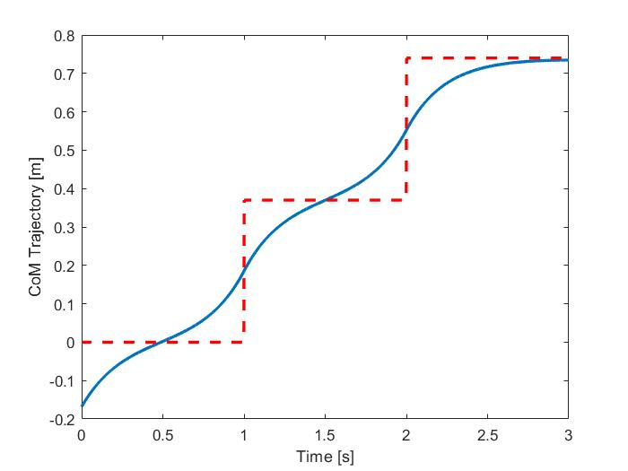
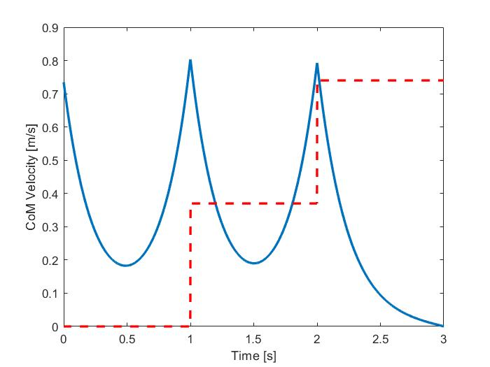
CoM Trajectory
.

Slide 29
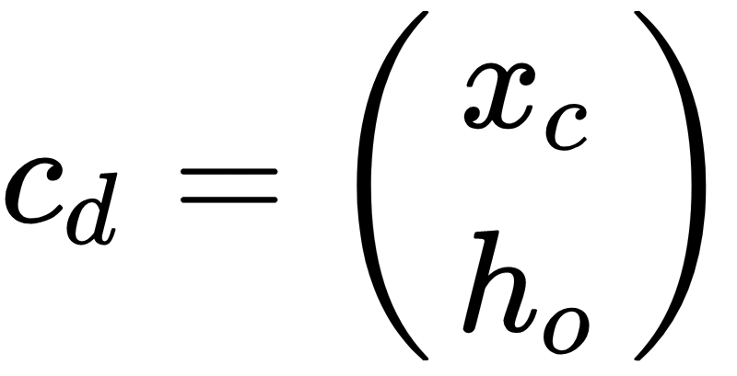
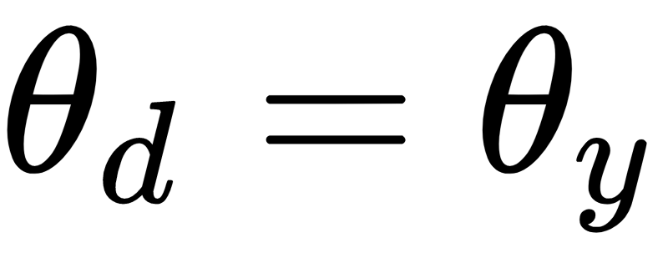
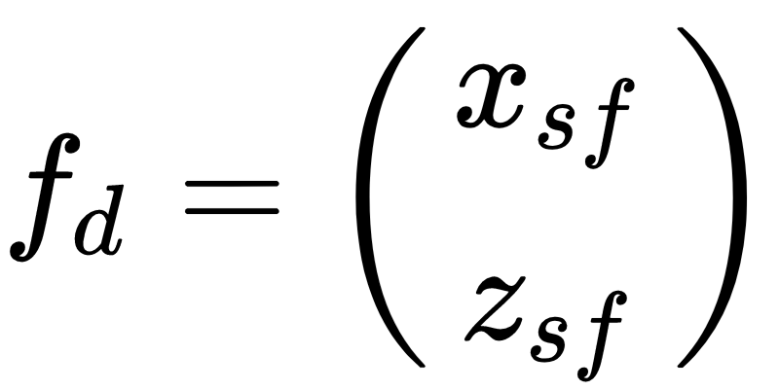
CoM Tracking
3 Tasks to be executed
CoM position
CoM Tracking
Torso Orientation
Swing Foot Position

Slide 30
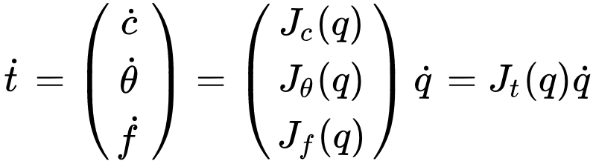
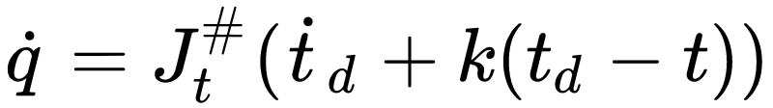
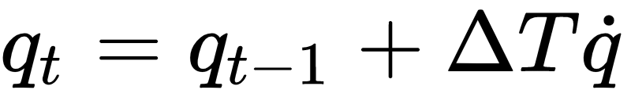
Tracking via Differential Kinematics
Tracking is achieved by solving the task at velocity level
Solve for the joint velocity, plus position error
integrate joint velocity to obtain joint values

Slide 31
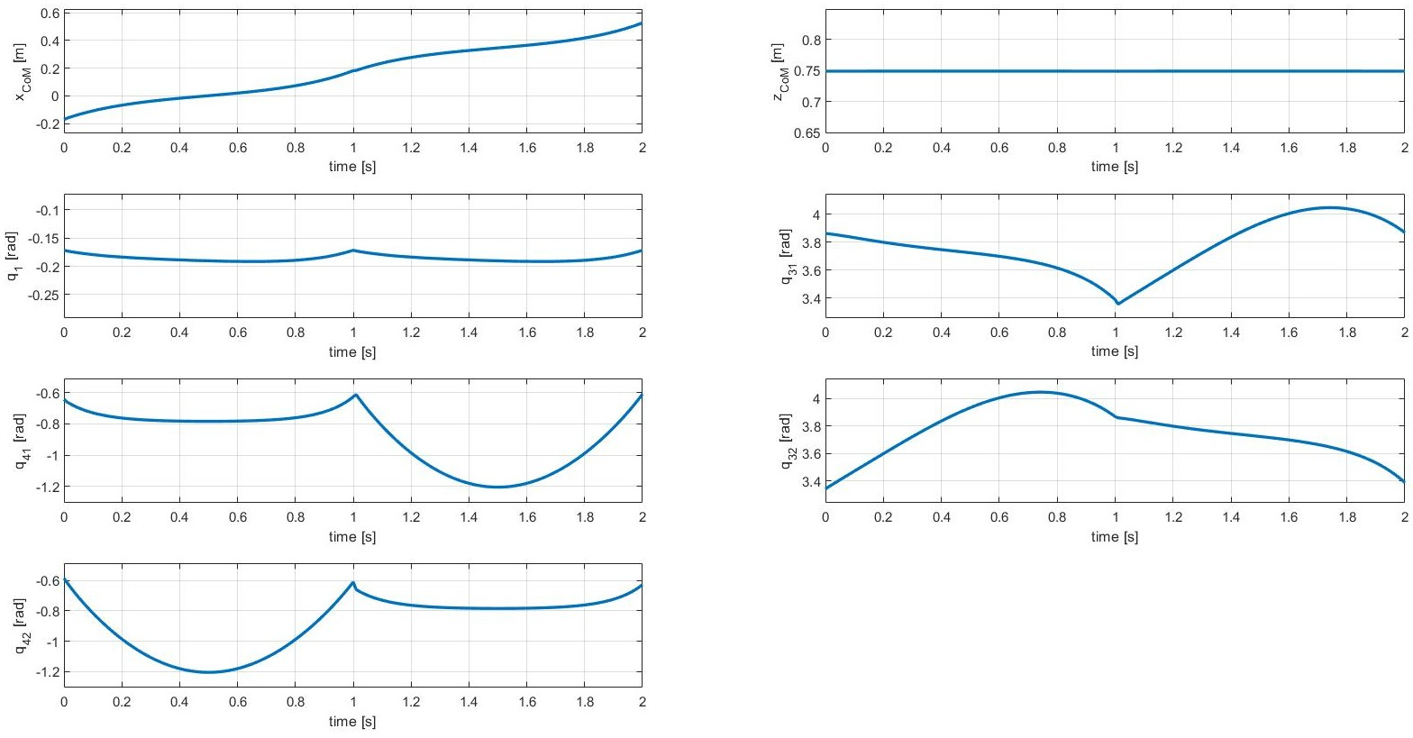
Tracking Results (Generalized Coordinates)
.
Generalized Coordinates

Slide 32
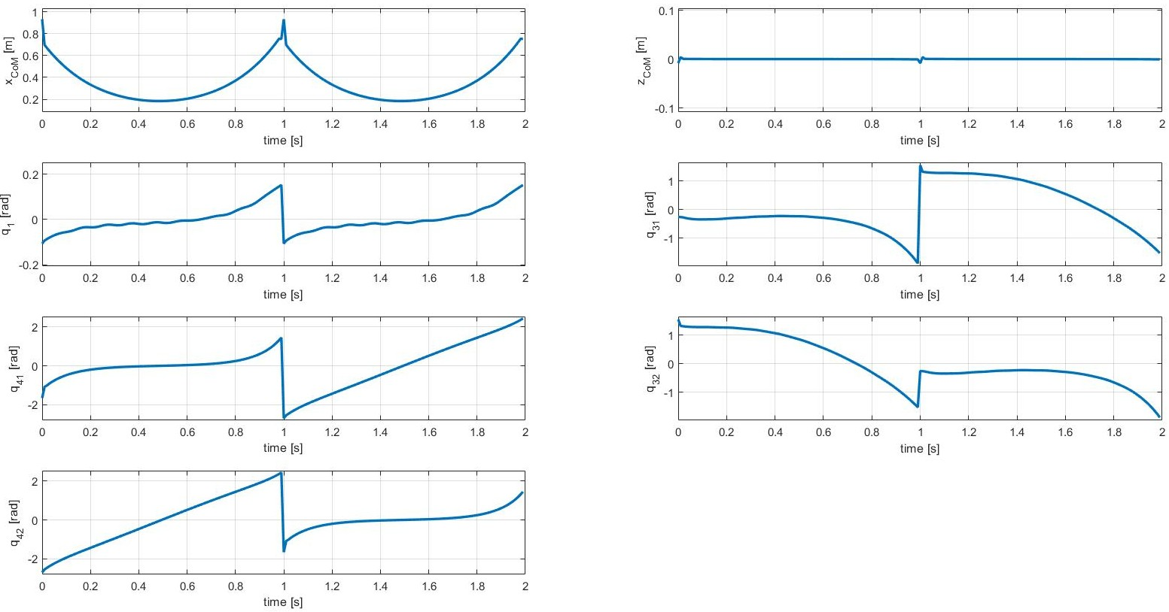
Tracking Results (Generalized Coord. Velocities)
.
Generalized Coordinates Velocities

Slide 33
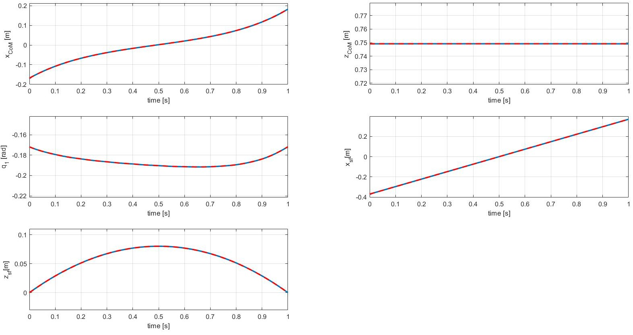
Tracking Results (Trajectory Tracking)
.

Slide 34

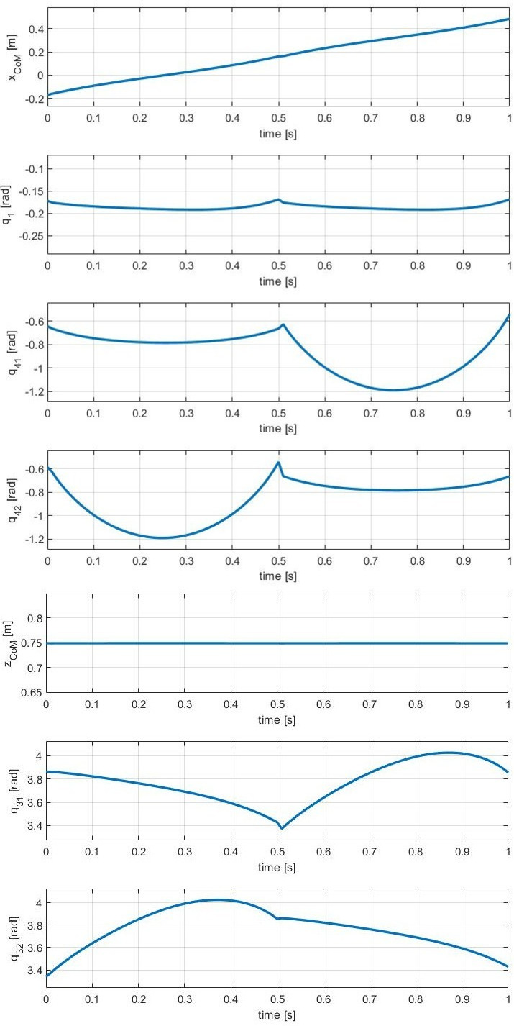

Comparisons (Generalized Coordinates)
.
Bounded CoM Tracking
Trajectory Optimization

Slide 35


Comparisons (Generalized Coord. Velocities)
.
Bounded CoM Tracking
Trajectory Optimization

Slide 36

Hybrid Trajectory Optimization Animation
.

Slide 37

Bounded CoM Trajectory Tracking Animation
.

Slide 38
Conclusions
Two different approaches has been used to generate stable locomotion trajectories.
The first one uses feedback linearization and parameterized output to define an optimization problem. It generates joint trajectories which define a human-like gait.
The second one uses task augmentation and inverse differential kinematics to derive joint velocities, then joint positions by integration, in order to follow a desired bounded CoM trajectory. The obtained gait is far from human-like since the CoM height is kept constant.
The first approach is more powerful because it requires less control effort and provides directly torque commands to the motors instead of velocity commands.

