Slide 1
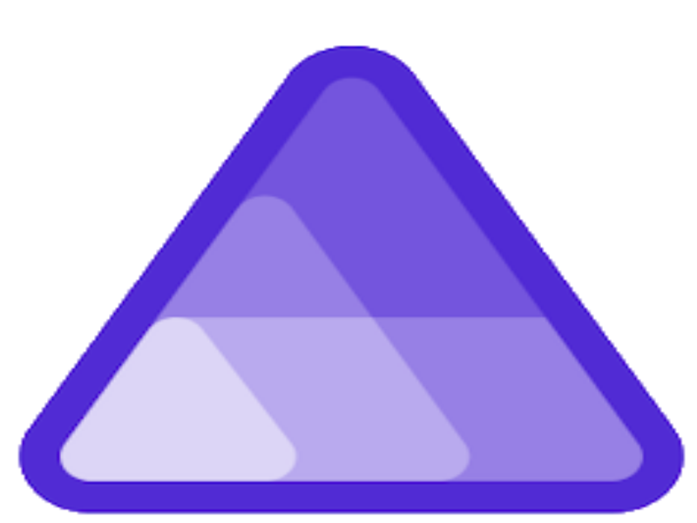
.NET Aspire
Presented by Stefano D'Onofrio
Software Engineer at Redgate

Slide 2

What is .NET Aspire???
Introduced in .NET Conf 2023
Born with the idea of making cloud development easier
Allow to define Application Model via C#
GA went out on May

Slide 3
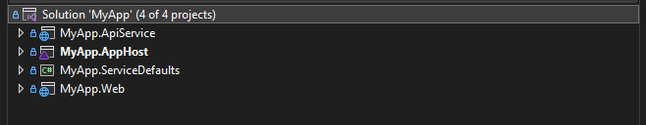
Typical structure of an Aspire solution
AppHost
Is responsible to do the Orchestration
Run and connect multi-project application and their dependencies
Where the Application Model is defined
Everything in the AppHost is considered a Resource
Service Default
Referenced in each project of the solution
It allows to add:
Observability
Health checks
Service Discovery
Resiliency

Slide 4
.NET Aspire Properties
Reliable
Configurable
Understandable
Flexible
Observable

Slide 5
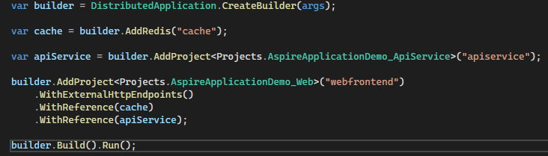
Application Host Example

Slide 6
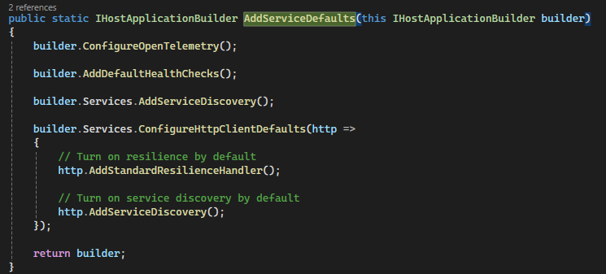
Service Default Example

Slide 7
Demo Time
Notes:
2 mins

Slide 8
Resources
.NET Conf material (https://github.com/red-gate/dotnet/tree/main/.NetConf/2023/Aspire)
Microsoft Learn on Aspire (https://learn.microsoft.com/en-us/training/paths/dotnet-aspire/ )
MS Build Session on Aspire
Demistify cloud-native development with .NET Aspire (https://www.youtube.com/watch?v=jVILDZtuUrI)
.NET Aspire development on any OS with the Visual Studio family (https://www.youtube.com/watch?v=BBGeousUHQU)
MS Aspire Playlist (https://www.youtube.com/playlist?list=PLdo4fOcmZ0oUfIayQMrRqaSL55Rkck-GD)
Pragmatic Microservice with C# and Azure (https://csharp.christiannagel.com/2024/06/05/dotnetaspirebook/)

Slide 9

Key take away
Aspire is mainly used for cloud application
Makes the Application model easy to understand
Is possible to enrich the application with custom resources
Just play with it ☺

Slide 10

Thank you

