Slide 1
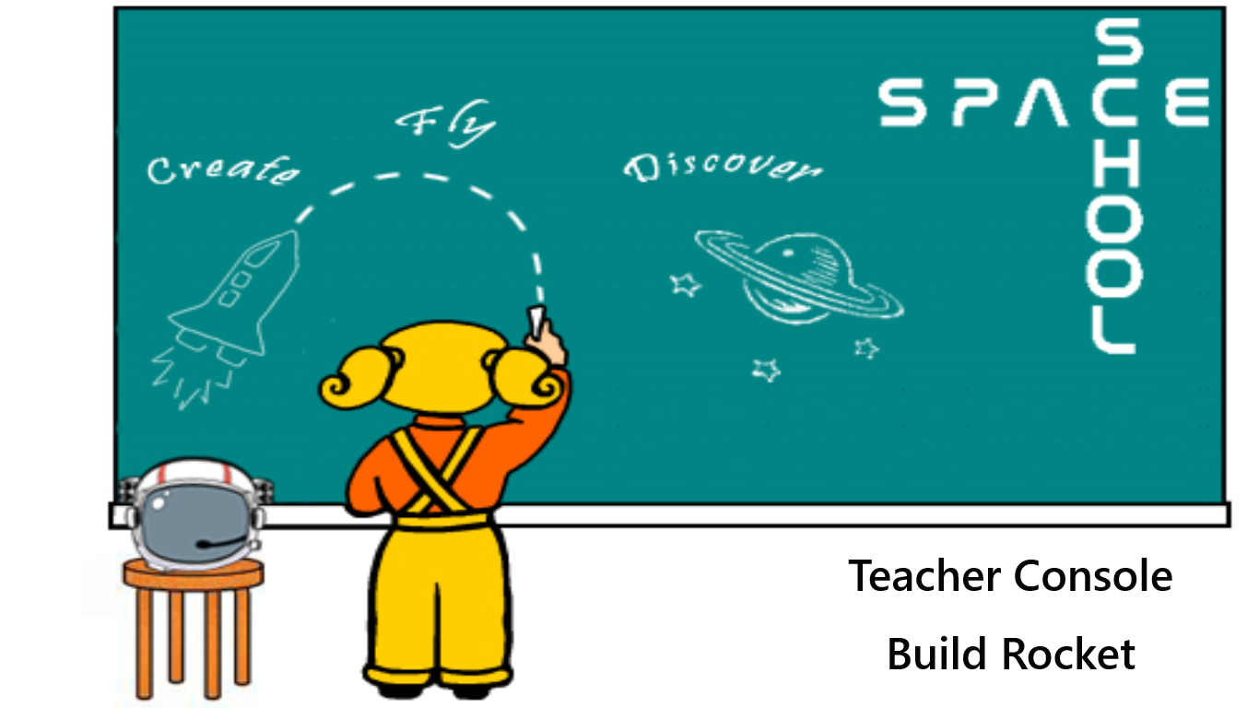

Slide 2
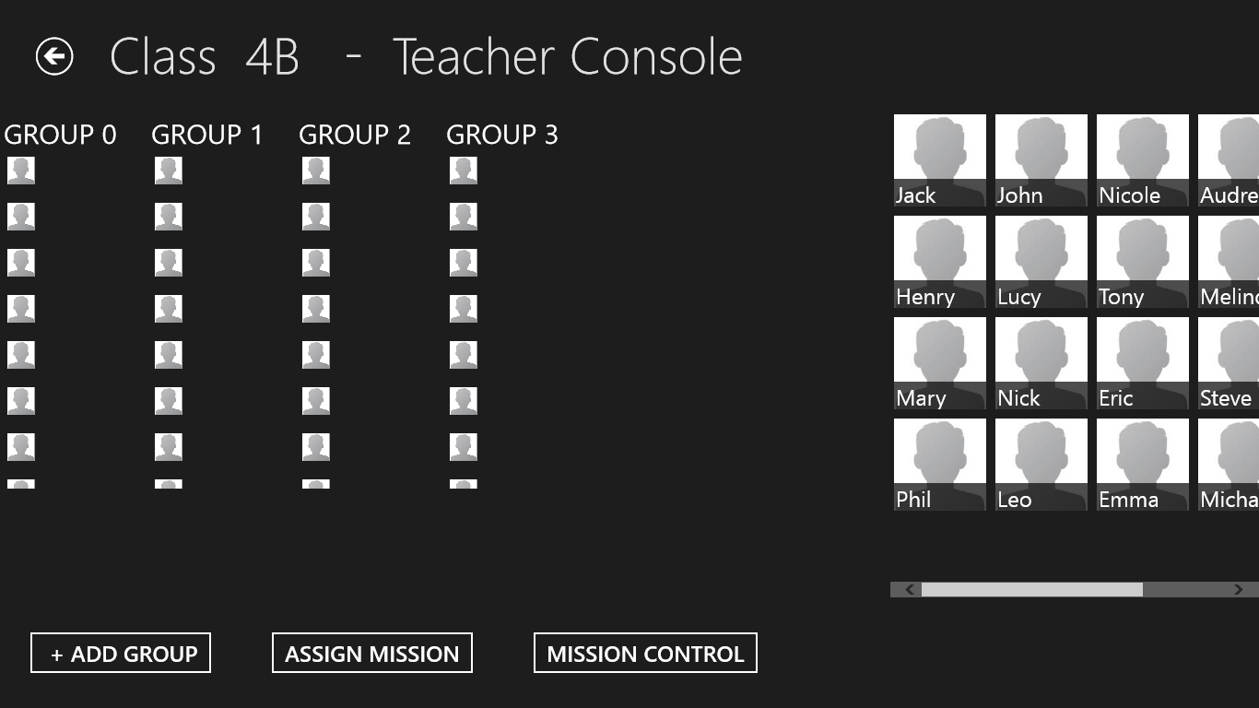

Slide 3
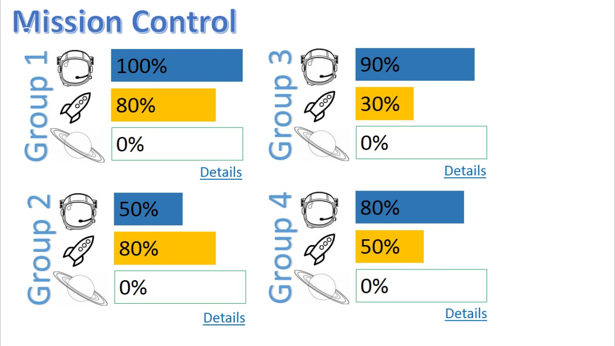

Slide 4
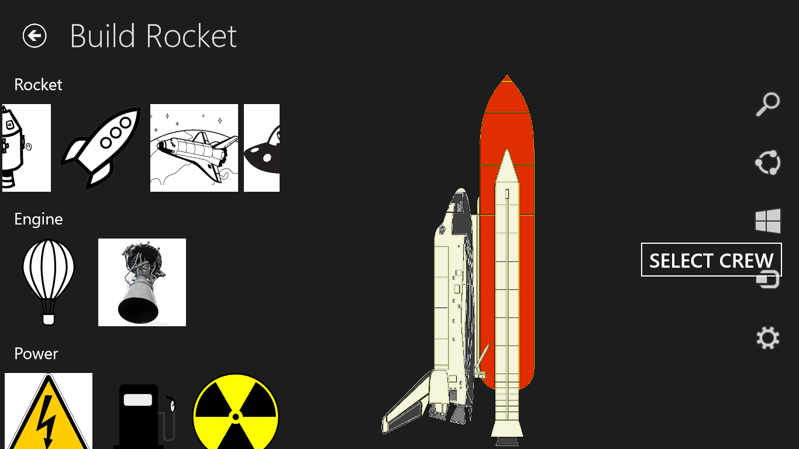

Slide 5
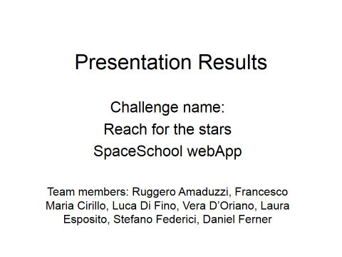

Slide 6
Impact
-Fun
-Simple
-Worldwide

Slide 7
Creativity
-Variety of tasks
-Improving STEM knowledges
-Open kids minds

Slide 8
Complexity
-Structure
-From scratch to space
-Coherent plan

Slide 9
Collaboration
-International team
-Different backgrounds
-Problems and solutions

Slide 10
Product
-Rock our kids
-User friendly
-Work in progress

Slide 11
Sustainability
-Easy to develop
-Fun for kids
-Join us!

