Slide 1
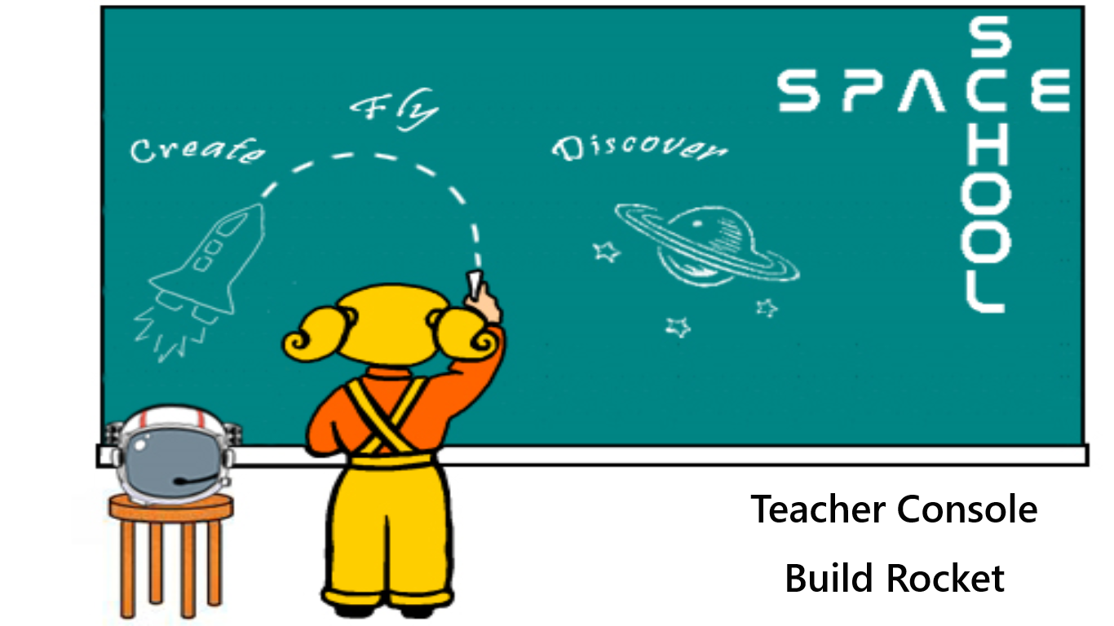

Slide 2
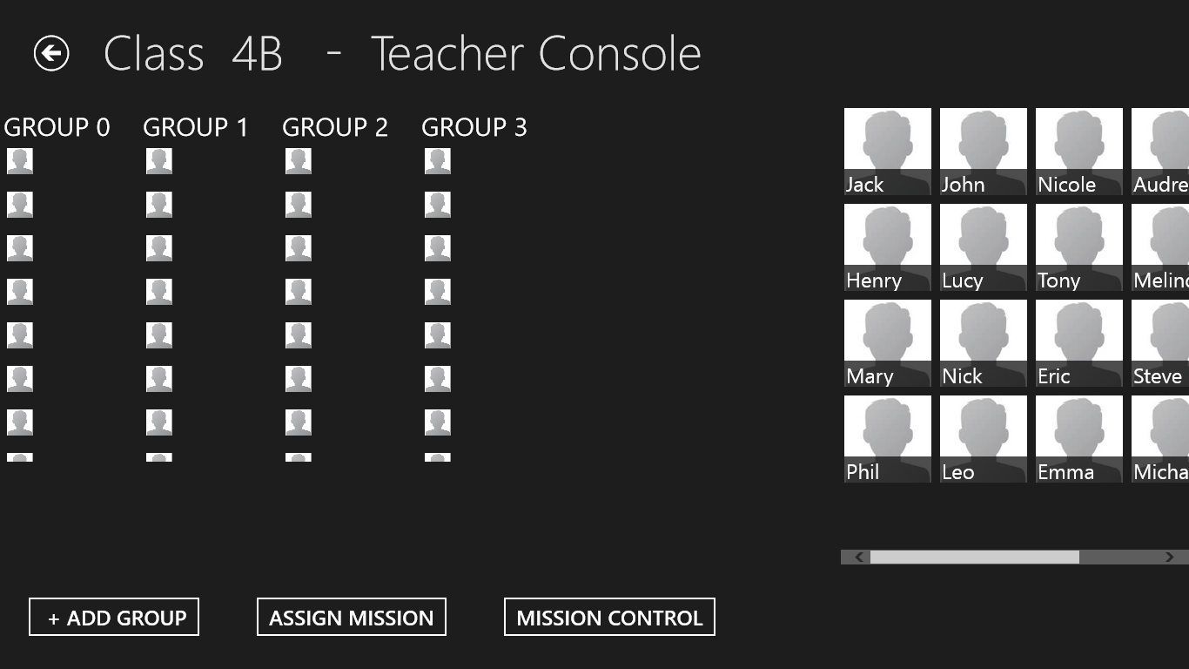

Slide 3
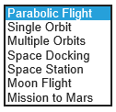
Jack
Henry
Mary
Phil
John
Eric
Emma
Audrey
Melinda
Jack
Henry
Mary
Phil
John
Lucy
Nick
Leo
Nicole
Tony
Eric
Emma
Audrey
Melinda
Steve
Michael
Rob
Bill
Group 1
Group 3
Lucy
Nick
Leo
Nicole
Tony
Steve
Michael
Rob
Bill
Group 2
Group 4
ASSIGN MISSION
Start

Slide 4
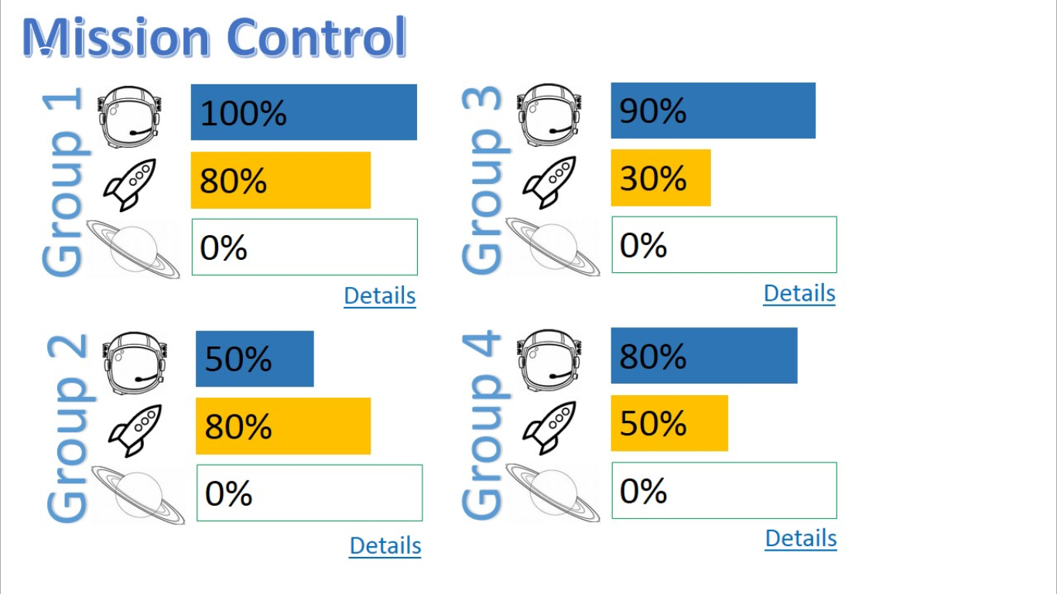

Slide 5
