Slide 1
KNITS
Kuehne Nagel Information Technology School
YOUnicorn
Road map

Slide 2

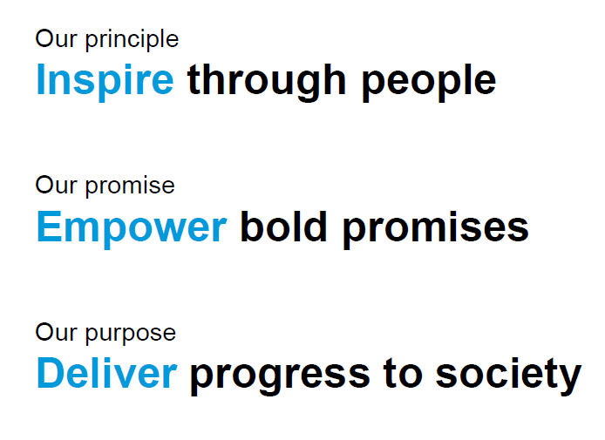

Slide 3




Younicorn Project
Methodology
01 Goals
01
02
02 Resources
Links to learning resources (blogs, video, tutorials)
Learning goals for this session. Every goal should be demonstrable with milestone artifact
04 Plan
03
03 Demo
04
Review of milestone and plan for new milestone delivery
Demo the achieved milestone in private session with mentor
Notes:
© Copyright PresentationGO.com – The free PowerPoint and Google Slides template library

Slide 4







Younicorn Project
Younicorn time line
Product Design
Frontend
MVP
UI Prototype
Backend
Cloud
Notes:
© Copyright PresentationGO.com – The free PowerPoint and Google Slides template library

Slide 5
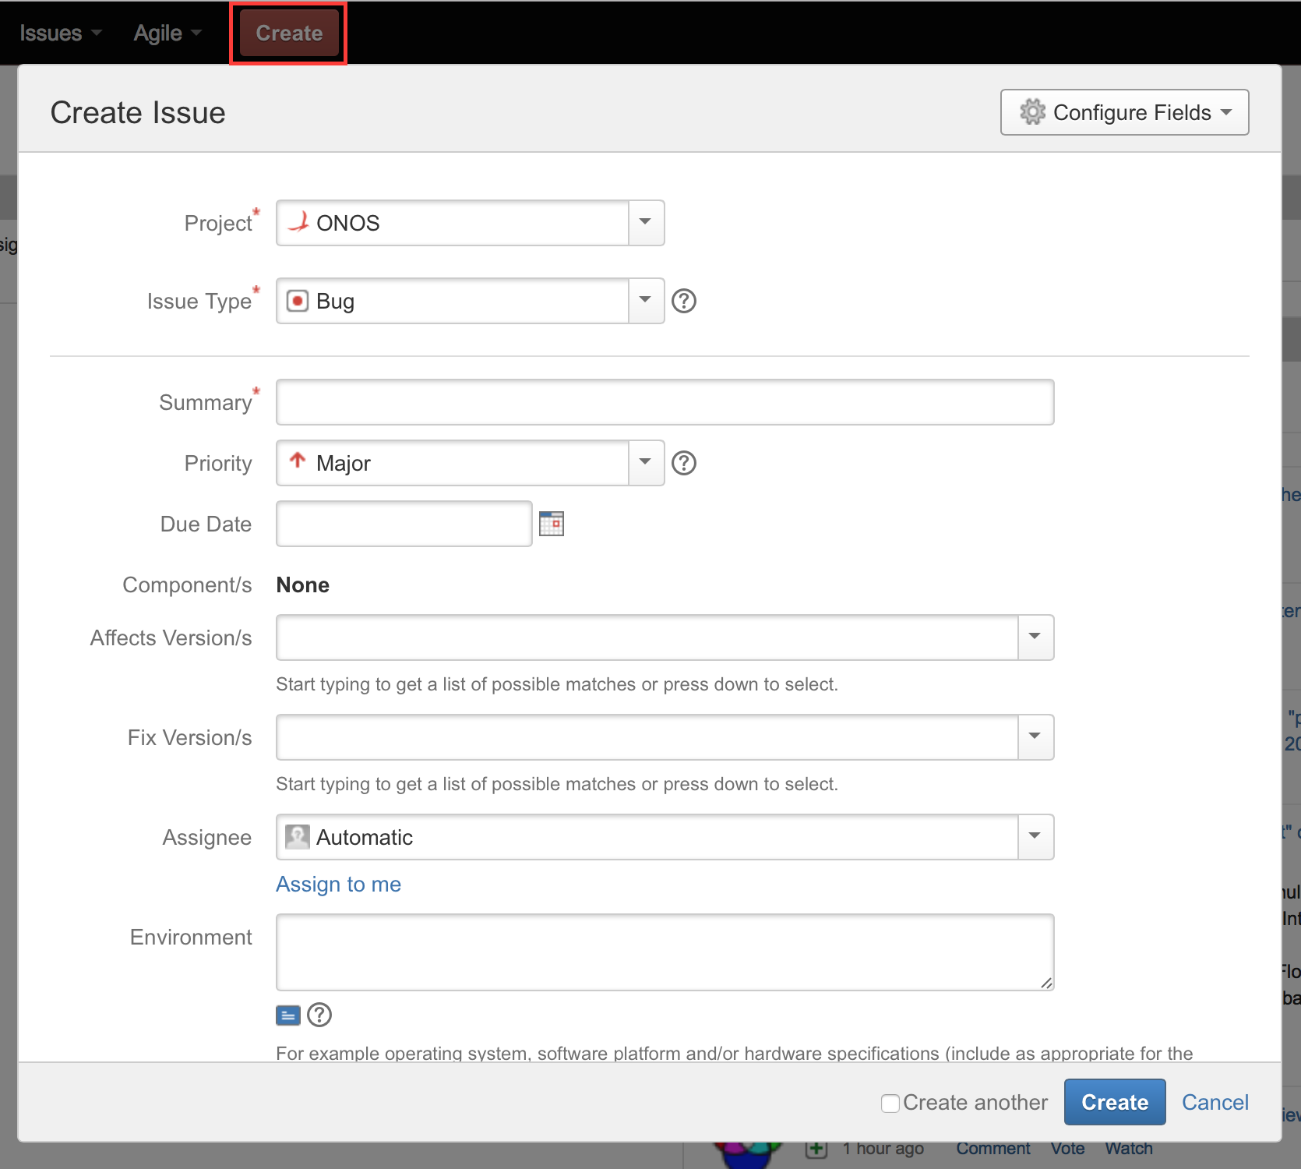
Younicorn Project
Product Owner Goals
Atlassian Jira
Notes:
© Copyright PresentationGO.com – The free PowerPoint and Google Slides template library

Slide 6
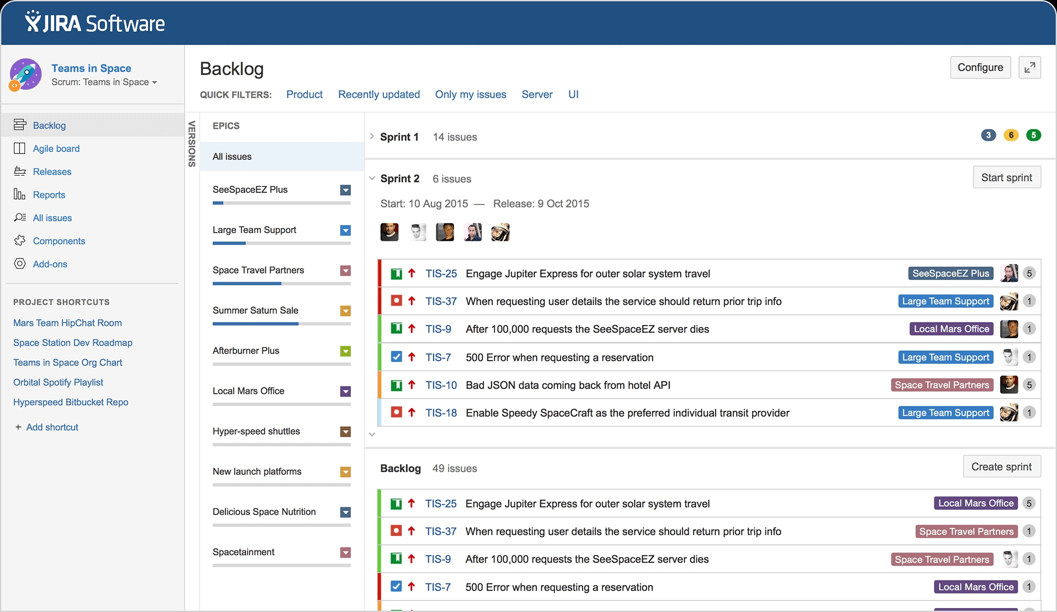
Younicorn Project
Product Owner Goals
Atlassian Jira
Notes:
© Copyright PresentationGO.com – The free PowerPoint and Google Slides template library

Slide 7
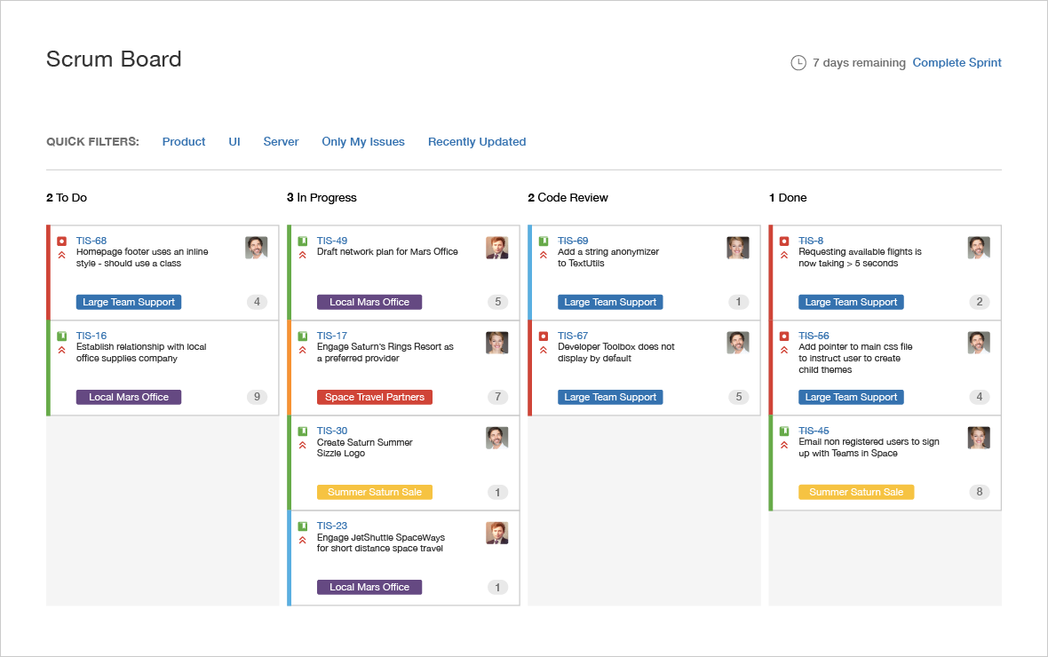
Younicorn Project
Product Owner Goals
Atlassian Jira
Notes:
© Copyright PresentationGO.com – The free PowerPoint and Google Slides template library

Slide 8
Younicorn Project
Product Owner Goals
Atlassian Jira
Describe product with user stories
Manage Issue’s lifecycle and types (Epic, Task, Story)
Manage Sprint lifecycle
Create Jira workflows
Perform Jira Issues Queries
Notes:
© Copyright PresentationGO.com – The free PowerPoint and Google Slides template library

Slide 9
Younicorn Project
Analyst Goals
Visual Paradigm
Notes:
© Copyright PresentationGO.com – The free PowerPoint and Google Slides template library

Slide 10
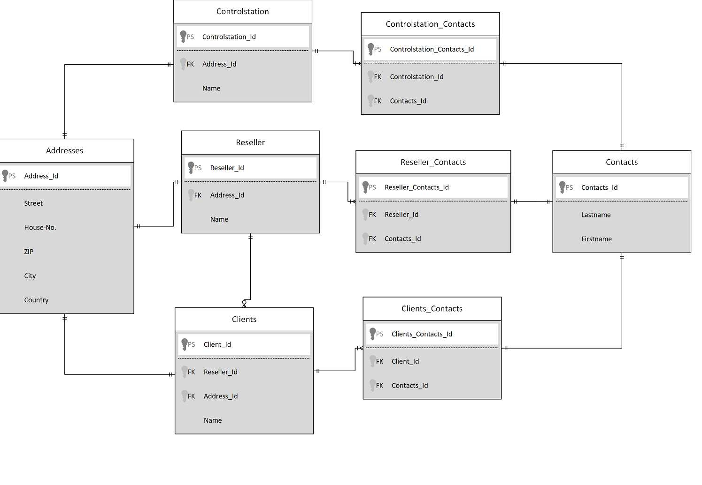
Younicorn Project
Analyst Goals
Visual Paradigm
Entity Relationship Diagram
Notes:
© Copyright PresentationGO.com – The free PowerPoint and Google Slides template library

Slide 11
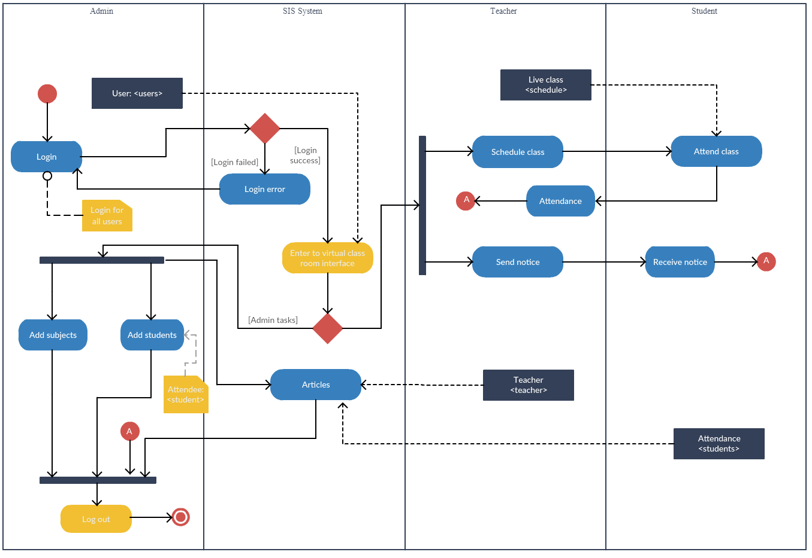
Younicorn Project
Analyst Goals
Visual Paradigm
Entity Relationship Diagram
Activity Diagram
Notes:
© Copyright PresentationGO.com – The free PowerPoint and Google Slides template library

Slide 12
Younicorn Project
Analyst Goals
Visual Paradigm
Document product domain with Entity Relationship Diagram
Describe product main processes with Activity Diagram
Describe system architecture with Deploy Diagram
Notes:
© Copyright PresentationGO.com – The free PowerPoint and Google Slides template library

Slide 13
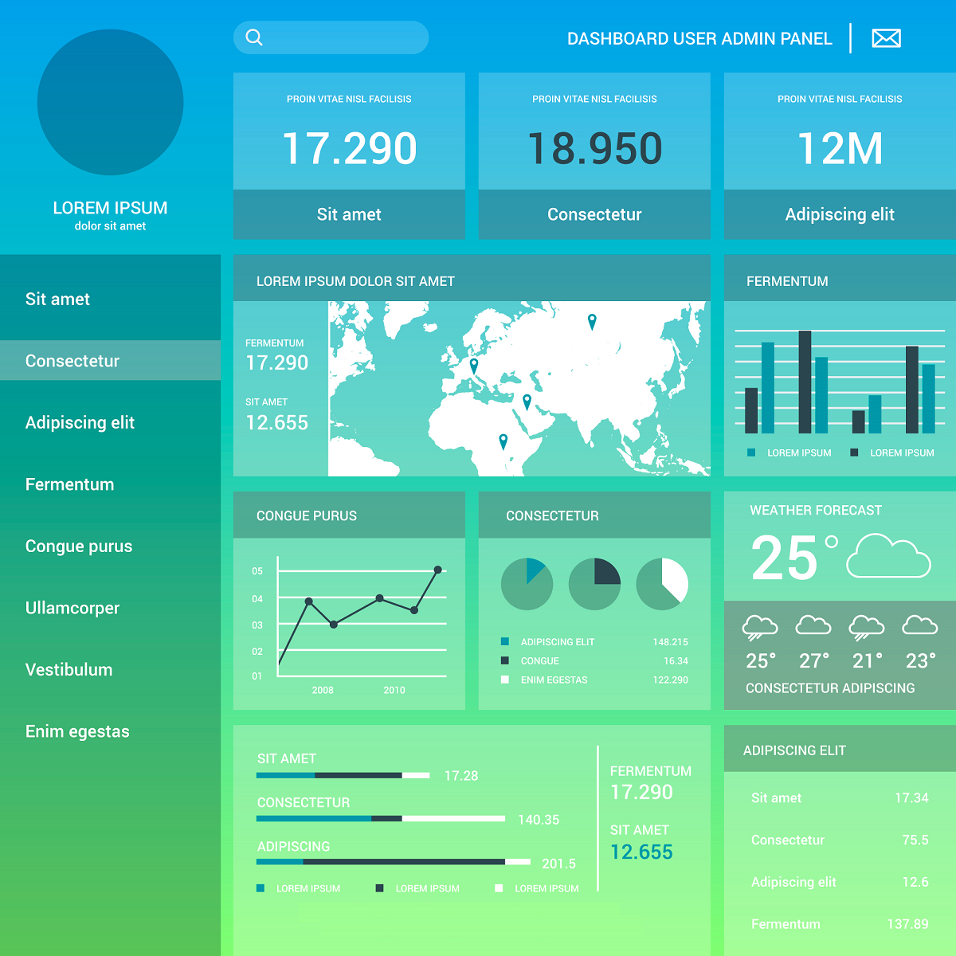
Younicorn Project
Frontend Goals
Prototype from template
Notes:
© Copyright PresentationGO.com – The free PowerPoint and Google Slides template library

Slide 14

Younicorn Project
Frontend Goals
Extract components
html
\css
javascript
html
\css
javascript
html
\css
javascript
Notes:
© Copyright PresentationGO.com – The free PowerPoint and Google Slides template library

Slide 15
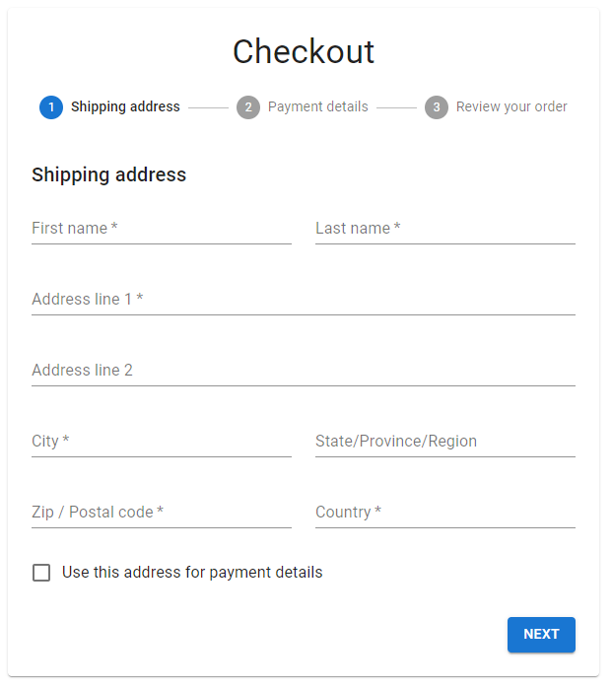

Younicorn Project
Frontend Goals
Handle user actions
Notes:
© Copyright PresentationGO.com – The free PowerPoint and Google Slides template library

Slide 16

Younicorn Project
Frontend Goals
Data management and local state
Backend
Local state
Notes:
© Copyright PresentationGO.com – The free PowerPoint and Google Slides template library

Slide 17

Younicorn Project
Frontend Goals
Test Driven Development and Unit test frameworks
Notes:
© Copyright PresentationGO.com – The free PowerPoint and Google Slides template library

Slide 18
Younicorn Project
Frontend Goals
Implement Frontend with modern js Framework
Create a product prototype starting from UI template
Implement UI leveraging composition of components
Handle user actions
Data Management and Local state
Test Driven Development and Unit Test Frameworks
Notes:
© Copyright PresentationGO.com – The free PowerPoint and Google Slides template library

Slide 19
Younicorn Project
Backend Goals
Backend System
Notes:
© Copyright PresentationGO.com – The free PowerPoint and Google Slides template library

Slide 20

Younicorn Project
Backend Goals
Backend System
Database
Database access
Notes:
© Copyright PresentationGO.com – The free PowerPoint and Google Slides template library

Slide 21
Younicorn Project
Backend Goals
Backend System
Database
Business Logic
Database access
Notes:
© Copyright PresentationGO.com – The free PowerPoint and Google Slides template library

Slide 22
Younicorn Project
Backend Goals
Backend System
Expose service as api
Database
Business Logic
Database access
Notes:
© Copyright PresentationGO.com – The free PowerPoint and Google Slides template library

Slide 23
Younicorn Project
Backend Goals
Backend System
Manage users and roles
Expose service as api
Database
Business Logic
Database access
Notes:
© Copyright PresentationGO.com – The free PowerPoint and Google Slides template library

Slide 24
Younicorn Project
Backend Goals
Backend System
TDD
Manage users and roles
Expose service as api
Database
Business Logic
Database access
Notes:
© Copyright PresentationGO.com – The free PowerPoint and Google Slides template library

Slide 25
Younicorn Project
Backend Goals
Implement Backend with modern Framework
Manage access to Database
Implement business logic
Expose service as Rest api
Manage user roles and security
Test Driven Development and Unit Test Frameworks
Notes:
© Copyright PresentationGO.com – The free PowerPoint and Google Slides template library

Slide 26
Younicorn Project
QA Goals
Tools for Integration Test
Test tools to query to Database
Test tools for Rest Api
Notes:
© Copyright PresentationGO.com – The free PowerPoint and Google Slides template library

Slide 27
Younicorn Project
DevOps Goals
AWS Cloud Services
Notes:
© Copyright PresentationGO.com – The free PowerPoint and Google Slides template library

Slide 28

Younicorn Project
DevOps Goals
AWS Cloud Services
EBS Frontend
EBS Backend
Notes:
© Copyright PresentationGO.com – The free PowerPoint and Google Slides template library

Slide 29
Younicorn Project
DevOps Goals
AWS Cloud Services
EBS Frontend
EBS Backend
RDS Database
Notes:
© Copyright PresentationGO.com – The free PowerPoint and Google Slides template library

Slide 30

Younicorn Project
DevOps Goals
AWS Cloud Services
Manage user and security with IAAM
EBS Frontend
EBS Backend
RDS Database
Notes:
© Copyright PresentationGO.com – The free PowerPoint and Google Slides template library

Slide 31

Younicorn Project
DevOps Goals
AWS Cloud Services
Manage user and security with IAAM
Cloud services costs administration
EBS Frontend
EBS Backend
RDS Database
Notes:
© Copyright PresentationGO.com – The free PowerPoint and Google Slides template library

Slide 32
Younicorn Project
DevOps Goals
AWS Cloud Services
Manage users and permission to AWS Account
Administration of Costs and services
Administration of Database on the cloud
Deploy and Operations of Frontend System on the cloud
Deploy and Operations of Backend System on the cloud
Notes:
© Copyright PresentationGO.com – The free PowerPoint and Google Slides template library

