Slide 1
LOGISTICS

Slide 2
Supply chain
1

Slide 3
A supply chain is
a network of facilities and distribution options
that performs the functions of
procurement of materials,
transformation of these materials into products,
and the distribution of these finished products to customers.”
from Ganeshan and Harrison, 1995, “An Introduction to Supply Chain Management,”

Slide 4















Network of facilities
and distribution options

Slide 5
Procurement of materials
Transformation into products
Distribution
to customers

Slide 6
Management
2
Goals and drivers in supply chain management

Slide 7
Supply chain management
Price of sale to customer
Supply chain value
Goal of supply chain management is to maximize the supply chain value.
Cost of distribution
Cost of transportation
Cost of manifacture
Cost of raw material

Slide 8

Goals of a supply chain
Network of facilities
and distribution options
Efficiency
Responsiveness
Product focused
Requires stability and predictability of markets
Resource optimization
Standard products
Small profit per product
Few big markets
Customer focused
Reactive to market demand changes
Fast to market
High customization
High profit per product
Many segmented markets

Slide 9
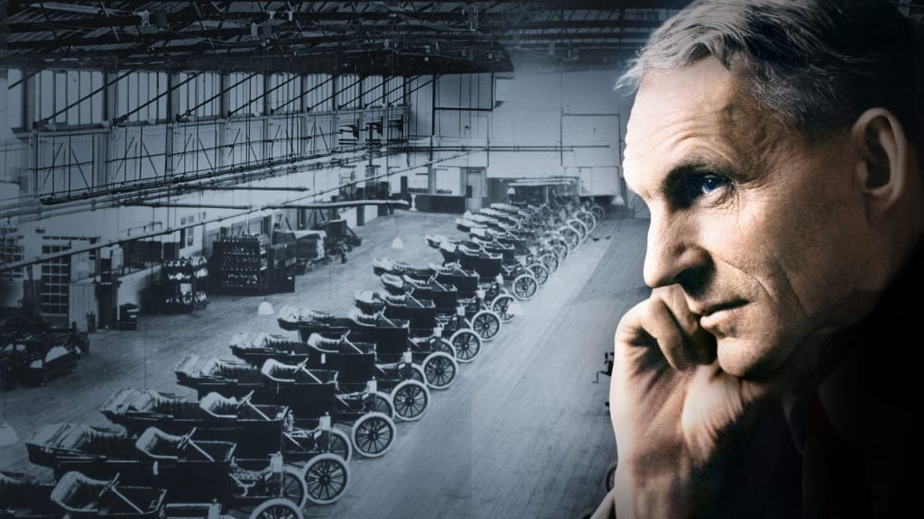
Efficiency
From iron ore to car in 81 hours

Slide 10
Efficiency
Our customers can choose whatever colour they like for their car as long as it is black

Slide 11
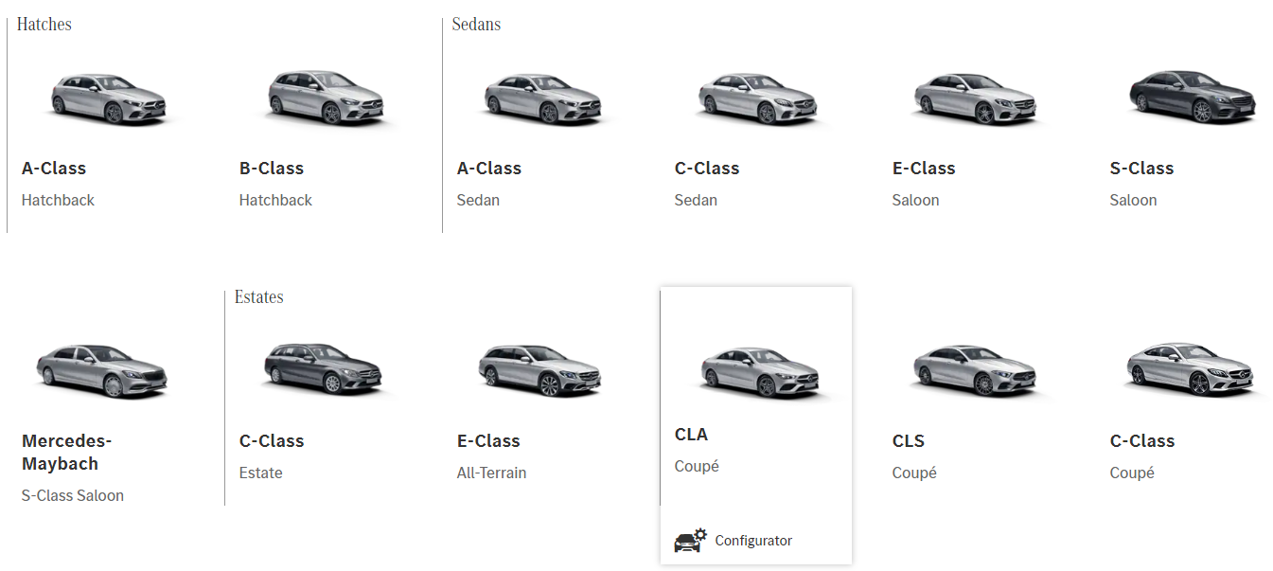
Responsiveness Configure your car

Slide 12
Responsiveness
Order a car what will be built for you in months

Slide 13





Supply chain management:
Drivers
PRODUCTION
LOCATION
INVENTORY
TRANSPORTATION
INFORMATION
Qualities of products
Quantity of products
Cycle
Scheduling
Price
Innovation
Where to produce
Where to store
Where to distribute
Quantity of product to store
Cycle inventory
Season inventory
Safety inventory
How to move products
Time vs costs
Outsourcing
Size of cargo
Frequency
What info to collect
How often
Metrics & Kpi
Automation
Security

Slide 14
Efficiency vs Responsiveness
 | Responsiveness | Efficiency
Production | Excess capacity Flexible manifacturing Few central production plants | Full capacity Narrow focus Few central production plants
Location | Many locations Close to customer Small area coverage | Few central locations serve wide areas
Inventory | High inventory levels Wide range of products | Low inventory levels Small product’s range
Transportation | Frequent shipment Small quantity Fast and expensive | Few shipments Large quantities Slow and cheaper
Information | Collect and evaluate timely large amount of data | Information costs are balanced with other resources following economy scale

Slide 15
Efficiency
Responsiveness
Raw material Company
Raw materials
Manifacture Plants
Manifacture Company
Transportation
Transportation Company
Distribution
Distribution Company

Slide 16
Supply chain operations
3
The APICS SCOR model

Slide 17



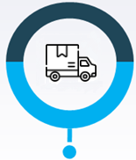

Supply Chain Operation Reference model
PLAN
SOURCE
MAKE
DELIVER
RETURN
Assess supply resources,
Demand Forecasting;
Inventory management
Product Pricing
Purchasing
Materials management
Vendor selection
Contract management
Product Management
Facility Management
Production Scheduling
Quality Control
Sales and promotion
Distribution channels
Import/Export
Defective
Warranty
EOL
Replacement

Slide 18







PLAN
Supplier’s suppliers..
Suppliers
Company
Customers
Customer’s customers..
ENABLE

Slide 19
Global Supply Chain
4

Slide 20
Supply chain services
5

