Slide 1

Execution Environment

Slide 2
Boot
Hardware
Memory Manager

Slide 3

Boot
Hardware
Memory Manager

Slide 4

Boot
Hardware
Memory Manager

Slide 5

Boot
Hardware
Memory Manager

Slide 6

Boot
Hardware
Memory Manager

Slide 7
Boot
Hardware
Operative System
Services
Utilities
Kernel
Memory Manager
User Interface
Standard Libraries

Slide 8
Boot
Hardware
Operative System
Services
Utilities
Kernel
Memory Manager
User Interface
Standard Libraries

Slide 9
Kernel
Kernel
Hardware
Memory Manager

Slide 10

Kernel
Kernel
Hardware
Running application
Memory Manager

Slide 11
Kernel
Kernel
Hardware
Running application
Memory Manager

Slide 12
Kernel
Kernel
Hardware
Running application
Memory Manager

Slide 13
Kernel
Kernel
Hardware
Running application
Process Manager
Memory Manager
Memory Manager

Slide 14

Kernel
Kernel
Hardware
Running application
Process Manager
Running application
Memory Manager
Memory Manager

Slide 15
Kernel
Kernel
Hardware
Running application
Process Manager
Running application
Memory Manager
Memory Manager

Slide 16
Kernel
Kernel
Hardware
Process Manager
Memory Manager
Memory Manager
File Subsystem

Slide 17
Kernel
Kernel
Hardware
Process Manager
Memory Manager
Memory Manager
File Subsystem

Slide 18
Kernel
Kernel
Hardware
Process Manager
Memory Manager
Memory Manager
File Subsystem
Network Subsystem

Slide 19

Kernel
Kernel
Process Manager
Memory Manager
File Subsystem
Network Subsystem

Slide 20
Kernel
Kernel
Hardware
Process Manager
Memory Manager
Memory Manager
File Subsystem
Network Subsystem

Slide 21

Kernel
Kernel
Hardware
Process Manager
Memory Manager
Memory Manager
File Subsystem
Driver
Network Subsystem
Driver

Slide 22
Kernel
Kernel
Hardware
Process Manager
Running application
Memory Manager
Memory Manager
File Subsystem
Driver
Network Subsystem
Driver

Slide 23
Kernel
Kernel
Hardware
Process Manager
Running application
Memory Manager
Running application
Memory Manager
File Subsystem
Driver
Network Subsystem
Driver

Slide 24

Kernel
Kernel
Hardware
Process Manager
Running application
Memory Manager
Running application
Memory Manager
File Subsystem
Running application
Driver
Network Subsystem
Driver

Slide 25
Kernel
Kernel
Hardware
Process Manager
Running application
Memory Manager
Running application
Memory Manager
File Subsystem
Running application
Driver
Running application
Network Subsystem
Driver

Slide 26
Kernel
Kernel
Hardware
Process Manager
Running application
Memory Manager
Running application
Memory Manager
File Subsystem
Running application
Driver
Running application
Network Subsystem
Driver

Slide 27
Kernel
Kernel
Hardware
Process Manager
Running application
Memory Manager
Running application
Memory Manager
File Subsystem
Running application
Driver
Running application
Network Subsystem
Driver

Slide 28
Kernel
Kernel
Hardware
Process Manager
Running application
Memory Manager
Running application
Memory Manager
System call interface
File Subsystem
Running application
Driver
Running application
Network Subsystem
Driver

Slide 29
Kernel
Kernel
Hardware
User Space
Process Manager
Running application
Memory Manager
Running application
Memory Manager
System call interface
File Subsystem
Running application
Driver
Running application
Network Subsystem
Driver

Slide 30
Shell interpreter
Let’s open terminal and try out some commands
username@hostname:~$ ls –l username@hostname:~$ mkdir testDir username@hostname:~$ ifconfig username@hostname:~$ vmstat username@hostname:~$ top
...
username@hostname:~$ $( expr 2 + 3)

Slide 31
Kernel
Binaries
Kernel
Hardware
Process Manager
top
vmstat
Memory Manager
Memory Manager
System call interface
mkdir
File Subsystem
Driver
ifconfig
Network Subsystem
Driver

Slide 32
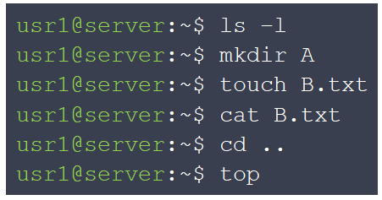

Shell interpreter
Commands and args from terminal
Binary & args Bash Syntax
/bin/binaries
Shell Interpreter
kernel
Hardware

Slide 33


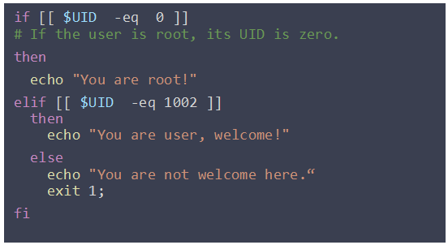

Shell interpreter
Commands and args from terminal
Terminal
Shell Interpreter
Binaries
Bash file
System call interface

