Slide 1
Kuehne + Nagel
Internships

Slide 2



Sustainable workforce growth
Recruitment scalability
Employee Development
Employer Branding

Slide 3
KNITS Internship 2021
2021
Applications
856
2021
64/51
123
Software Analyst
2020
123
123
123
14
14
14
2019
2020
2021
2019
204
123
14
13
2019
2020
6(3)
Applications
Internships
Recruited
Notes:
Title Font: Arial bold 24pt KN Dark blue Subtitle Font: Arial bold 18pt black Body Text Font: Arial 18pt black

Slide 4
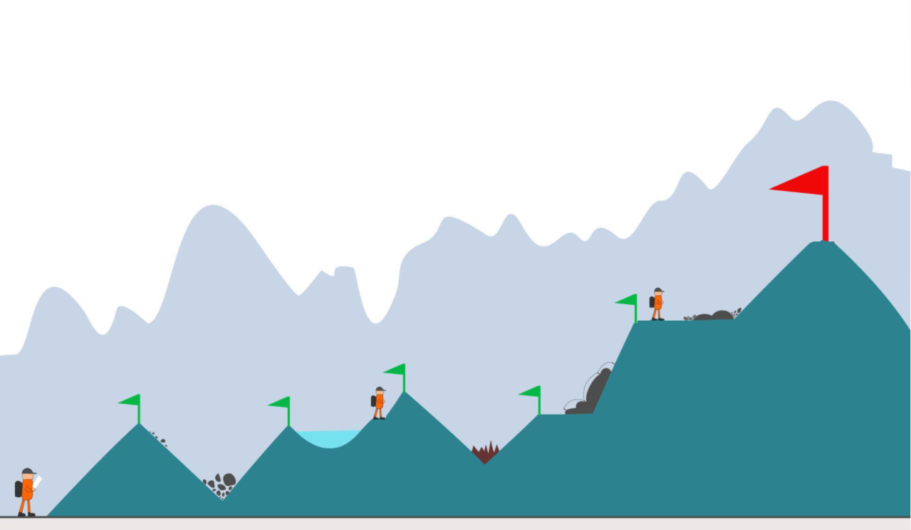
Early connection with talents

Slide 5
Our challenges
Mentoring culture
Onboarding
Growth perspective
Time-to-offer
Notes:
Title Font: Arial bold 24pt KN Dark blue Case study section font: Arial bold 18pt black Text Font: Arial 14pt black
Change the icons: You may swap the icons for ones you prefer in Frontify

Slide 6
Our challenges
Mentoring culture
Onboarding
Growth perspective
Time-to-offer
KN teams
KNITS
JR Talent Pool
Notes:
Title Font: Arial bold 24pt KN Dark blue Case study section font: Arial bold 18pt black Text Font: Arial 14pt black
Change the icons: You may swap the icons for ones you prefer in Frontify

Slide 7
Our challenges
Mentoring culture
Onboarding
Growth perspective
Time-to-offer
KN teams
Team mentor
KNITS
Mentor rewards
JR Talent Pool
Notes:
Title Font: Arial bold 24pt KN Dark blue Case study section font: Arial bold 18pt black Text Font: Arial 14pt black
Change the icons: You may swap the icons for ones you prefer in Frontify

Slide 8
Our challenges
Mentoring culture
Onboarding
Growth perspective
Time-to-offer
KN teams
Team mentor
Learning path
KNITS
Mentor rewards
Specialization
JR Talent Pool
Notes:
Title Font: Arial bold 24pt KN Dark blue Case study section font: Arial bold 18pt black Text Font: Arial 14pt black
Change the icons: You may swap the icons for ones you prefer in Frontify

Slide 9
Our challenges
Mentoring culture
Onboarding
Growth perspective
Time-to-offer
KN teams
Team mentor
Learning path
KNITS
Mentor rewards
Specialization
JR Talent Pool
Mentor network
Notes:
Title Font: Arial bold 24pt KN Dark blue Case study section font: Arial bold 18pt black Text Font: Arial 14pt black
Change the icons: You may swap the icons for ones you prefer in Frontify

Slide 10
Our challenges
Mentoring culture
Onboarding
Growth perspective
Time-to-offer
KN teams
Team mentor
Learning path
Tech development
KNITS
Mentor rewards
Specialization
Salary review
JR Talent Pool
Mentor network
Notes:
Title Font: Arial bold 24pt KN Dark blue Case study section font: Arial bold 18pt black Text Font: Arial 14pt black
Change the icons: You may swap the icons for ones you prefer in Frontify

Slide 11
Our challenges
Mentoring culture
Onboarding
Growth perspective
Time-to-offer
Notes:
Title Font: Arial bold 24pt KN Dark blue Case study section font: Arial bold 18pt black Text Font: Arial 14pt black
Change the icons: You may swap the icons for ones you prefer in Frontify

Slide 12
Our challenges
Mentoring culture
Onboarding
Growth perspective
Time-to-offer
KN teams
Tech development
KNITS
Salary review
JR Talent Pool
Notes:
Title Font: Arial bold 24pt KN Dark blue Case study section font: Arial bold 18pt black Text Font: Arial 14pt black
Change the icons: You may swap the icons for ones you prefer in Frontify

Slide 13
Our challenges
Mentoring culture
Onboarding
Growth perspective
Time-to-offer
KN teams
Team mentor
Learning path
Tech development
KNITS
Mentor rewards
Specialization
Salary review
JR Talent Pool
Mentor network
Notes:
Title Font: Arial bold 24pt KN Dark blue Case study section font: Arial bold 18pt black Text Font: Arial 14pt black
Change the icons: You may swap the icons for ones you prefer in Frontify

Slide 14
Junior Talent Pool
Team of junior developers
Skilled on common technologies in KN
Compensated internship with 6/12 month contract
Full time with a customized training/work balance
Available to join product teams within 1 week
No need for additional SR from teams
Constantly refilled according to hires in teams and resignations
Retains promising talents while actively onboarding them into our teams
Work on KNITS mentored projects until they are onboarded into teams
Hackathon, Gate project(s) (see next slide)
Notes:
Title Font: Arial bold 24pt KN Dark blue Case study section font: Arial bold 18pt black Text Font: Arial 14pt black
Change the icons: You may swap the icons for ones you prefer in Frontify

Slide 15





Junior Talent Pool contribution
Gate Project
Development Team
Knits Products
Project
Project
Project
Hackathon products. Interns product ideas Technical research
KN product. KN common technology stack Small team size High attrition
KN Product(s)
Mentoring
Mentoring
Mentoring
KNITS Mentor
KNITS mentor
TEAM Mentor

Slide 16





Junior Talent Pool workflow
Junior
Talent Pool
Selection
KN Team
KNITS prototypes
Gate Project
KN Team
Seasonal Internships
KN Team
Notes:
Title Font: Arial bold 24pt KN Dark blue Case study section font: Arial bold 18pt black Text Font: Arial 14pt black
Change the icons: You may swap the icons for ones you prefer in Frontify

Slide 17
Financing & Mentoring
Junior
Talent Pool
Finance & Mentoring
KNITS prototypes
KN Team
KNITS budget
KNITS mentor
Gate Project
KN Team
Team budget
KNITS mentor
Team budget
KN Team
Team mentor
Notes:
Compensated Internships. Whose budget and mentoring responsibility? Junior Talent Pool: KNITS budget /IA
KNITS Prototypes: KNITS budget & mentor
Gate project: Team budget, KNITS mentoring
KN Team: Team budget & mentor

Slide 18
Internship Seasons
Jan-Feb
Talent Pool
Selections
Mar-May
Spring Internships
Inspire / Enpower programs
June
Seasonal internships are not compensated. Talent Pool internships are compensated by KNITS until candidate join teams
Talent Pool
Selections
July-Aug
Summer Internships
Inspire / Enpower programs
September
Talent Pool
Selections
Oct-Dec
Autumn Internships
Inspire / Enpower programs

Slide 19


Mentorship program
Cultivate a mentoring culture in our teams
- Company value and reward mentoring skills
- Reward mentor time and success
- Small but regular time engagement (max 1h/daily)
Mentors network
Share learning road map
Best practices
Specializations
Notes:
Title Font: Arial bold 24pt KN Dark blue Case study section font: Arial bold 18pt black Text Font: Arial 14pt black
Change the icons: You may swap the icons for ones you prefer in Frontify

