Slide 1
Kuehne + Nagel
Internships

Slide 2



Sustainable workforce growth
Employee Development
Employer Branding
Recruitment scalability
Notes:
Employee Development
By improving the way we grow interns into professional we also...
..improve how to grow our employees to their next level
Employer Branding: Become among best 5 employers for everybody who applied with us.
Recruitment scalability If the previous 2 are success then...
Ability to growh FTE by scaling junior development budget

Slide 3
KNITS Internship 2021
2021
Applications
856
2021
64/51
123
Software Analyst
2020
123
123
123
14
14
14
2019
2020
2021
2019
204
123
14
13
2019
2020
6(3)
Applications
Internships
Recruited
Notes:
KN IT School in numbers: Amount of applications received
Amount of interns we took in our programs (started/completed in 2021 figure)
Recruited in our teams. (Total/From IT School)
Why such a small conversion between completed internships and FTE?
(see next slide)

Slide 4
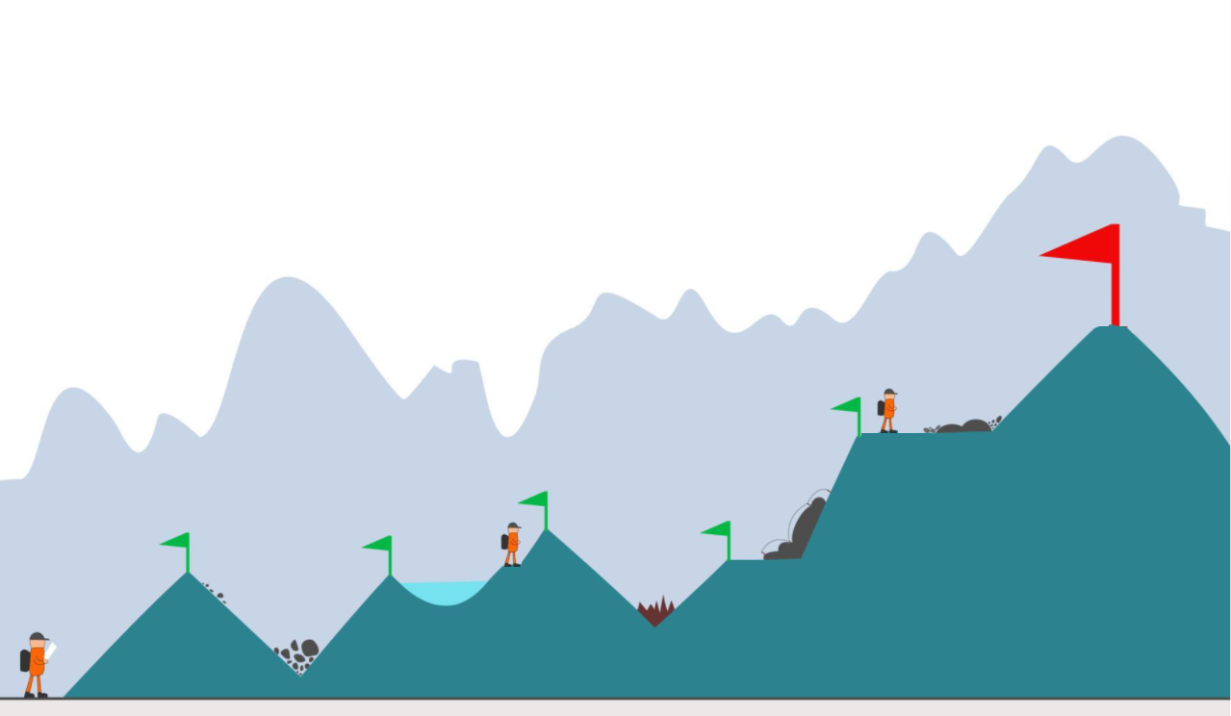

Early connection with talents
Notes:
Not all trainees we take are supposed to land in our teams.
We have different programs according to starting skills:
Inspire
Enpower
Deliver (ready to work)
Our competitors are able to onboard trainees earlier than we do (around the small red flag). Let’s try to understand why..

Slide 5
Our challenges
Mentoring culture
Onboarding
Growth perspective
Time-to-offer
Notes:
Why such a small conversion between interns and FTE? We need to accept those challenges and improve on those areas

Slide 6
Our challenges
Mentoring culture
Onboarding
Growth perspective
Time-to-offer
KN teams
KNITS
JR Talent Pool
Notes:
How can we reduce our time to offer and retain best talent?
3/6/12 months full time compensated internship.
3 possible destinations: 1) Our teams 2) KN IT School projects 3) Talent pool

Slide 7
Our challenges
Mentoring culture
Onboarding
Growth perspective
Time-to-offer
KN teams
Team mentor
KNITS
Mentor rewards
JR Talent Pool
Notes:
Foster a mentoring culture in our company:
Promote and reward mentor role in our team
Define clear engagement rules to protect mentor working time

Slide 8
Our challenges
Mentoring culture
Onboarding
Growth perspective
Time-to-offer
KN teams
Team mentor
Learning path
KNITS
Mentor rewards
Specialization
JR Talent Pool
Notes:
Optimize some technical onbording path
Build and constantly improve
A path of learning resources for remote learning
A path of tasks increasing junior impact in teams
A network of specialists willing to share their knowledge in KN

Slide 9
Our challenges
Mentoring culture
Onboarding
Growth perspective
Time-to-offer
KN teams
Team mentor
Learning path
KNITS
Mentor rewards
Specialization
JR Talent Pool
Mentor network
Notes:
Title Font: Arial bold 24pt KN Dark blue Case study section font: Arial bold 18pt black Text Font: Arial 14pt black
Change the icons: You may swap the icons for ones you prefer in Frontify

Slide 10
Our challenges
Mentoring culture
Onboarding
Growth perspective
Time-to-offer
KN teams
Team mentor
Learning path
Tech development
KNITS
Mentor rewards
Specialization
Salary review
JR Talent Pool
Mentor network
Notes:
Tech development
Promote learning possibilities and team mobility among Juniors
Salary review
Be ready to recognize Junior growth with salary

Slide 11
Our challenges
Mentoring culture
Onboarding
Growth perspective
Time-to-offer
Notes:
Other way to present.
Challenges here (see next)

Slide 12
Our challenges
Mentoring culture
Onboarding
Growth perspective
Time-to-offer
KN teams
Tech development
KNITS
Salary review
JR Talent Pool
Notes:
Other way to present.
Green: What we can do immediately Red: ..and what will take time, and we just need to start to invest into it

Slide 13
Our challenges
Mentoring culture
Onboarding
Growth perspective
Time-to-offer
KN teams
Team mentor
Learning path
Tech development
KNITS
Mentor rewards
Specialization
Salary review
JR Talent Pool
Mentor network
Notes:
Full Picture with both Challages and Solutions (see slides before for details)

Slide 14
Junior Talent Pool
Team of junior developers
Skilled on common technologies in KN
Compensated internship with 6/12 month contract
Full time with a personalized training/work balance
Available to join product teams within 1 week
No need for additional Staff Request from teams
Constantly refilled according to hires in teams and resignations
Retains promising talents while actively onboarding them into our teams
Work on KNITS mentored projects until they are onboarded into teams
Hackathon, Gate project(s) (see next slide)
Notes:
Junior Talent Pool:
Group of interns available to join our teams on demand, on short notice.

Slide 15





Junior Talent Pool contribution
Gate Project
Development Team
Knits Products
Project
Project
Project
Hackathon products. Interns product ideas Technical research
KN product. KN common technology stack Small team size High attrition
KN Product(s)
Mentoring
Mentoring
Mentoring
KNITS Mentor
KNITS mentor
TEAM Mentor
Notes:
What Junior Talent Pool team do until team request them?
Work on KNITS prototypes, work on Gate project
Gate Project:
Project in KN with following characteristics:
Project technology is very common in KN Small team/complexity size Historically high attrition

Slide 16





Junior Talent Pool workflow
Junior
Talent Pool
Selection
KN Team
KNITS prototypes
Gate Project
KN Team
Seasonal Internships
KN Team
Notes:
Workflow:
Selection and internship enrollment are carried by KNITS
Team can request trainees from pool at any time, and KNITS will provide possibilities
LEGEND Yellow Mentor: KNITS
Blue Mentor: Team Mentor

Slide 17
Financing & Mentoring
Junior
Talent Pool
Finance & Mentoring
KNITS prototypes
KN Team
KNITS budget
KNITS mentor
Gate Project
KN Team
Team budget
KNITS mentor
Team budget
KN Team
Team mentor
Notes:
Compensated Internships.
Whose budget and mentoring responsibility? Junior Talent Pool: KNITS budget /IA
KNITS Prototypes: KNITS budget & mentor
Gate project: Team budget, KNITS mentoring
KN Team: Team budget & mentor

Slide 18
Internship seasons
Seasonal Internships
Talent Pool
January
Not compensated
Compensated by KNITS budget
Autumn
Spring
October
May
Summer
Notes:
Internships seasons in the year:
Seasonal:
Not compensated & Part time. 20+ Interns
Talent Pool: (at the end of every Seasonal)
Compensated & full time
~5 Interns

Slide 19
Internship seasons
Seasonal Internships
Talent Pool
January
Not compensated
Compensated by KNITS budget
Autumn
1 month Selection
1 month Selection
Spring
2/3 months Enrollment
3/6 months Enrollment
October
Inspire/Enpower programs
Deliver programs
May
Summer
Notes:
Internships seasons in the year: (Details)
Seasonal:
3 months (selection & enrollment)
Talent Pool: (at the end of every Season)
1 months selection
3/6/12 months enrollment

Slide 20


Mentorship program
Cultivate a mentoring culture in our teams
- Company value and reward mentoring skills
- Reward mentor time and success
- Small but regular time engagement (max 1h/day)
Mentors network
Share learning road map
Best practices
Specializations
Notes:
SUCCESS! We have a junior in our team.
But... are we ready?
Let’s find a way to :
Promote mentoring culture in teams
Reward mentors
Optimize working routines to be Junior inclusive
Identify clear time engagement rules to protect mentor working time
Share experience between mentors

