Slide 1
Kuehne + Nagel
Internships

Slide 2



Sustainable workforce growth
Recruitment scalability
Employee Development
Employer Branding

Slide 3
KNITS Internship 2021
2021
Applications
856
2021
64/51
123
Software Analyst
2020
123
123
123
14
14
14
2019
2020
2021
2019
204
123
14
13
2019
2020
6(3)
Applications
Internships
Recruited
Notes:
Title Font: Arial bold 24pt KN Dark blue Subtitle Font: Arial bold 18pt black Body Text Font: Arial 18pt black

Slide 4
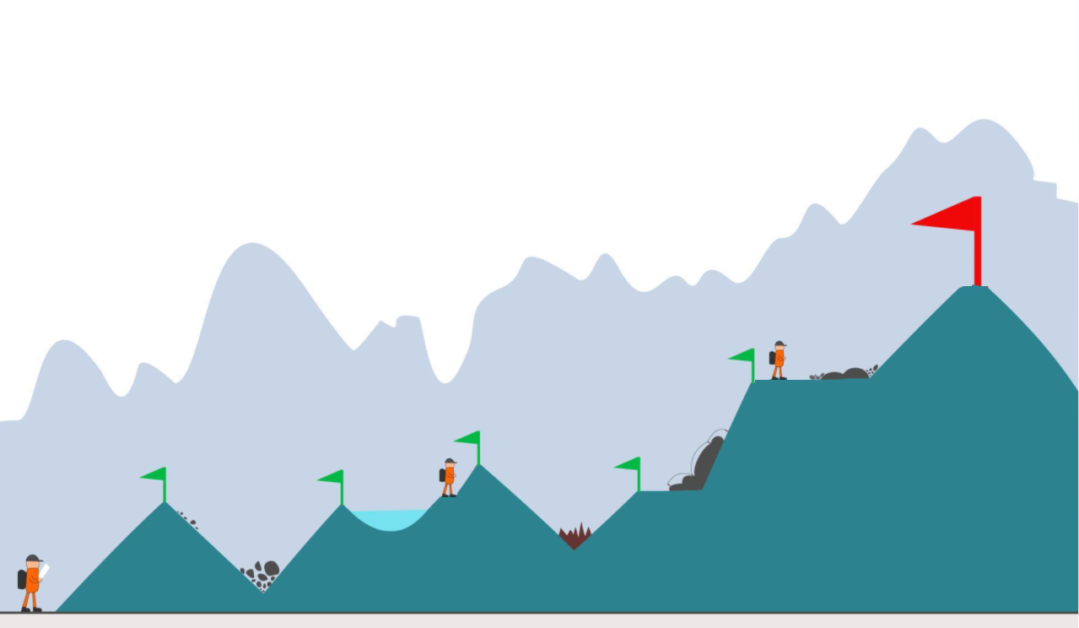
Early connection with talents

Slide 5
Our challenges
Mentoring culture
Onboarding
Growth perspective
Time-to-offer
Notes:
Title Font: Arial bold 24pt KN Dark blue Case study section font: Arial bold 18pt black Text Font: Arial 14pt black
Change the icons: You may swap the icons for ones you prefer in Frontify

Slide 6
Our challenges
Mentoring culture
Onboarding
Growth perspective
Time-to-offer
KN teams
KNITS
JR Talent Pool
Notes:
Title Font: Arial bold 24pt KN Dark blue Case study section font: Arial bold 18pt black Text Font: Arial 14pt black
Change the icons: You may swap the icons for ones you prefer in Frontify

Slide 7
Our challenges
Mentoring culture
Onboarding
Growth perspective
Time-to-offer
KN teams
Team mentor
KNITS
Mentor rewards
JR Talent Pool
Notes:
Title Font: Arial bold 24pt KN Dark blue Case study section font: Arial bold 18pt black Text Font: Arial 14pt black
Change the icons: You may swap the icons for ones you prefer in Frontify

Slide 8
Our challenges
Mentoring culture
Onboarding
Growth perspective
Time-to-offer
KN teams
Team mentor
Learning path
KNITS
Mentor rewards
Specialization
JR Talent Pool
Notes:
Title Font: Arial bold 24pt KN Dark blue Case study section font: Arial bold 18pt black Text Font: Arial 14pt black
Change the icons: You may swap the icons for ones you prefer in Frontify

Slide 9
Our challenges
Mentoring culture
Onboarding
Growth perspective
Time-to-offer
KN teams
Team mentor
Learning path
KNITS
Mentor rewards
Specialization
JR Talent Pool
Mentor network
Notes:
Title Font: Arial bold 24pt KN Dark blue Case study section font: Arial bold 18pt black Text Font: Arial 14pt black
Change the icons: You may swap the icons for ones you prefer in Frontify

Slide 10
Our challenges
Mentoring culture
Onboarding
Growth perspective
Time-to-offer
KN teams
Team mentor
Learning path
Tech development
KNITS
Mentor rewards
Specialization
Salary review
JR Talent Pool
Mentor network
Notes:
Title Font: Arial bold 24pt KN Dark blue Case study section font: Arial bold 18pt black Text Font: Arial 14pt black
Change the icons: You may swap the icons for ones you prefer in Frontify

Slide 11
Our challenges
Mentoring culture
Onboarding
Growth perspective
Time-to-offer
KN teams
Team mentor
Learning path
Tech development
KNITS
Mentor rewards
Specialization
Salary review
JR Talent Pool
Mentor network
Notes:
Title Font: Arial bold 24pt KN Dark blue Case study section font: Arial bold 18pt black Text Font: Arial 14pt black
Change the icons: You may swap the icons for ones you prefer in Frontify

Slide 12
Junior Talent Pool
Team of junior developers
Skilled on common technologies in KN
Hired with 6/12 month contract
Full time with a customized training/work balance
Available to join product teams within 1 week
No need for additional SR from teams
Constantly refilled according to hires in teams and resignations
Retains promising talents while actively onboarding them into our teams
Work on KNITS mentored projects until they are onboarded into teams
Hackathon, Gate project(s) See next slide
Notes:
Title Font: Arial bold 24pt KN Dark blue Case study section font: Arial bold 18pt black Text Font: Arial 14pt black
Change the icons: You may swap the icons for ones you prefer in Frontify

Slide 13





Junior Talent Pool workflow
Junior
Talent Pool
Overqualifiedcandidates
KN Team
KNITS prototype
Gate Project
KN Team
Seasonal Internships
KN Team
Notes:
Title Font: Arial bold 24pt KN Dark blue Case study section font: Arial bold 18pt black Text Font: Arial 14pt black
Change the icons: You may swap the icons for ones you prefer in Frontify

Slide 14





Junior Talent Pool contributions
Gate Project
Development Team
Knits Products
Project
Project
Project
Hackathon products. Interns product ideas Technical research
KN product. KN common technology stack Small team size High attrition
KN Product(s)
Mentoring
Mentoring
Mentoring
KNITS Mentor
KNITS mentor
TEAM Mentor

Slide 15


Mentorship program
Cultivate a mentoring culture in our teams
- Company value and reward mentoring skills
- Reward mentor time and success
- Small but regular time engagement (max 1h/daily)
Mentors network
Share learning road map
Best practices
Specializations
Notes:
Title Font: Arial bold 24pt KN Dark blue Case study section font: Arial bold 18pt black Text Font: Arial 14pt black
Change the icons: You may swap the icons for ones you prefer in Frontify

