Slide 1
Kuehne + Nagel
Internships

Slide 2
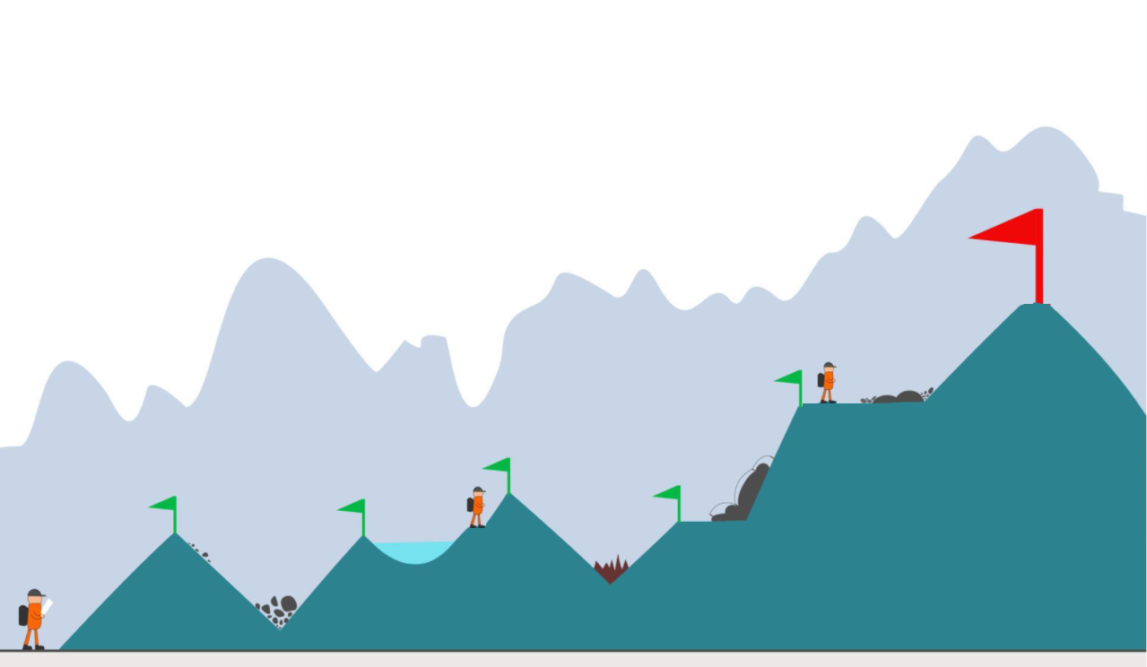
Early connection with talents

Slide 3
Sustainable workforce growth
Recruitment scalability
Foster self development
employer branding
Notes:
Title Font: Arial bold 24pt KN Dark blue Case study section font: Arial bold 18pt black Text Font: Arial 14pt black
Change the icons: You may swap the icons for ones you prefer in Frontify

Slide 4

Our challenges
High time-to-offer
Mentoring culture
Onboarding process
Growth perspective
Notes:
Title Font: Arial bold 24pt KN Dark blue Case study section font: Arial bold 18pt black Text Font: Arial 14pt black
Change the icons: You may swap the icons for ones you prefer in Frontify

Slide 5
Junior Talent Pool
5 full stack developers
- Backend Framework
- Frontend technologies
- Database
Hired with 6/12 month contract
Full time
No need for additional SR from teams
Available to join product teams within 1 week
Full time
No need for additional SR from teams
Optimized work and training balance
Resized according to hires in teams and resignations
Notes:
Title Font: Arial bold 24pt KN Dark blue Case study section font: Arial bold 18pt black Text Font: Arial 14pt black
Change the icons: You may swap the icons for ones you prefer in Frontify

Slide 6
Gate project candidate
Small team
High Attrition
KN common technology stack
Notes:
Title Font: Arial bold 24pt KN Dark blue Case study section font: Arial bold 18pt black Text Font: Arial 14pt black
Change the icons: You may swap the icons for ones you prefer in Frontify

Slide 7

Mentorship program
Cultivate a mentoring culture in our teams
- Company value and reward mentoring skills
- Reward mentor time and success
- Small but regular time engagement
Mentors network
Share learning road map
Best practices
Specializations
Notes:
Title Font: Arial bold 24pt KN Dark blue Case study section font: Arial bold 18pt black Text Font: Arial 14pt black
Change the icons: You may swap the icons for ones you prefer in Frontify

Slide 8
How to engage with
Small team
High Attrition
KN common technology stack
Notes:
Title Font: Arial bold 24pt KN Dark blue Case study section font: Arial bold 18pt black Text Font: Arial 14pt black
Change the icons: You may swap the icons for ones you prefer in Frontify

Slide 9



Junior Talent Pool contributions
Technology onboarding
Additional workforce
Contribute to KN Project
Prototypes for Hackathon ideas
Research sandboxes
Contribute to our teams working routines
Learning common KN technology
Contribute to KN product development
KNITS Product Prototypes
Join Development Teams
Join GATE Project
Notes:
Main title font: Arial bold 24pt Dark blue Box title font: Arial 16pt bold black
Box body text font: Arial 12pt black Dark blue text boxes: Arial 16pt bold white
Replace the icons: Click an existing image and delete it. Then click on the icon and select a
new image to insert. Using the Picture Change option is not recommended as it doesn’t crop images to
fit the space properly. Important: Swapping images automatically brings them to the front of all
elements on the slide. If your new picture is covering up other objects on the page, right click on
the image and choose Send to Back.

Slide 10




Junior Talent Pool contributions
Gate Project
Development Team
Knits Products
Project
Project
Hackathon products. Interns product ideas Technical research
A project where trainee learns about most common KN technology stack, while providing immediate value to a critical product/team.
Elite
Team of trainees. Work on KN product prototype.
Mentoring
Workforce
Mentoring
Join KN team in their working routines on production project.
Mentored in KNITS
Mentorship in KNITS

