Slide 1
KNITS
Kuehne Nagel Information Technology School
Portfolio Project
Road map

Slide 2

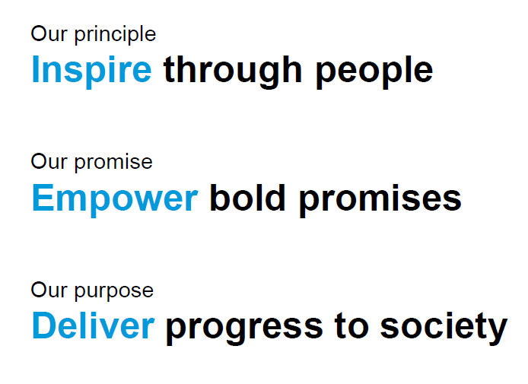

Slide 3


People
Teamwork is dreamwork
Challenged by Technology
Passion for Logistics
Notes:
© Copyright PresentationGO.com – The free PowerPoint and Google Slides template library

Slide 4
Portfolio Project
Product Owner Goals
Atlassian Jira
Describe product with user stories
Manage Issue’s lifecycle and types (Epic, Task, Story)
Manage Sprint lifecycle
Create Jira workflows
Perform Jira Issues Queries
Notes:
© Copyright PresentationGO.com – The free PowerPoint and Google Slides template library

Slide 5
Portfolio Project
Analyst Goals
Visual Paradigm
Document product domain with Entity Relationship Diagram
Describe product main processes with Activity Diagram
Describe system architecture with Deploy Diagram
Notes:
© Copyright PresentationGO.com – The free PowerPoint and Google Slides template library

Slide 6
Portfolio Project
Frontend Goals
Implement Frontend with modern js Framework
Create a product prototype starting from UI template
Implement UI leveraging composition of components
Handle user actions
Data Management and Local state
Test Driven Development and Unit Test Frameworks
Notes:
© Copyright PresentationGO.com – The free PowerPoint and Google Slides template library

Slide 7
Portfolio Project
Backend Goals
Implement Backend with modern Framework
Manage access to Database
Implement business logic
Expose service as Rest api
Manage user roles and security
Test Driven Development and Unit Test Frameworks
Notes:
© Copyright PresentationGO.com – The free PowerPoint and Google Slides template library

Slide 8
Portfolio Project
QA Goals
Tools for Integration Test
Test tools to query to Database
Test tools for Rest Api
Notes:
© Copyright PresentationGO.com – The free PowerPoint and Google Slides template library

Slide 9
Portfolio Project
DevOps Goals
AWS Cloud Services
Manage users and permission to AWS Account
Administration of Costs and services
Administration of Database on the cloud
Deploy and Operations of Frontend System on the cloud
Deploy and Operations of Backend System on the cloud
Notes:
© Copyright PresentationGO.com – The free PowerPoint and Google Slides template library

