Slide 1
Kuehne Nagel Information Technology School
PORTFOLIO

Slide 2

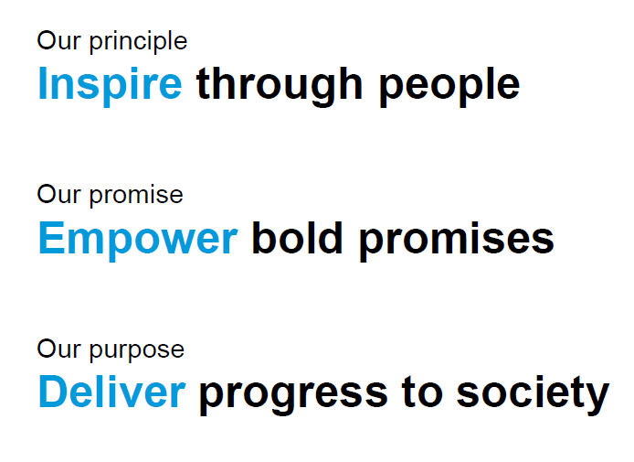

Slide 3


People
Teamwork is dreamwork
Challenged by Technology
Passion for Logistics
Notes:
© Copyright PresentationGO.com – The free PowerPoint and Google Slides template library

Slide 4


Choose the role that closely matches your goals
Product Owner
Software Analyst
Software Analyst
Frontend Developer
Backend Developer
Backend Developer
Quality Assurance
Devops Engineer
Notes:
Title Font: Arial bold 24pt KN Dark blue Subtitle Font: Arial bold 18pt black Body Text Font: Arial 18pt black

Slide 5
Product Owner
Atlassian Jira
Describe product with user stories
Manage issues lifecycle for each type ( epic, story)
Manage Agile Sprint lifecycle
Create Workflows
Perform JIRA Issues Queries

Slide 6
Software Analyst
Visual Paradigm / Lucid Charts / Visual tools
Analyze domain model with Entity Relationship Diagram
Describe process with Activity Diagram
Describe system architecture with Deploy Diagram
Query Database with SQL
Analyze logs

Slide 7
Frontend Developer
Javascript Frameworks (Angular / React / Vue)
Create a product prototype starting from UI template
Implement UI with composition of components
Handle user actions
Data Management and Local state
Test Driven Development and Unit Test Frameworks

Slide 8
Backend Developer
Spring Boot Framework
Manage access to Database
Implement business logic
Expose service as Rest api
Manage user roles and security
Test Driven Development and Unit Test Frameworks

Slide 9
Quality Assurance Engineer
QA Tools
SQL Tools
Rest Api Test Tools
UI Test Tools
Test Automation
Stress Test

Slide 10
DevOps Engineer
AWS Cloud Services
Manage users and permission to AWS Account
Administration of Costs and services
Administration of Database on the cloud
Deploy and Operations of Frontend System on the cloud
Deploy and Operations of Backend System on the cloud

