Slide 1
KN
Hypersense

Slide 2


Challenges for every IT role
Product Owner
Software Analyst
Frontend Developer
Software Analyst
Backend Developer
Backend Developer
Quality Assurance
Devops Engineer
Notes:
Title Font: Arial bold 24pt KN Dark blue Subtitle Font: Arial bold 18pt black Body Text Font: Arial 18pt black

Slide 3


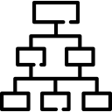


















Technology challenges
Architecture
Analytics
Streaming
High Concurrency
High performances
Distributed System
Large Datasets
Analytics
Analytics
Big Data
Machine Learning
Data Visualization
Distributed Caches
Device management
Integration endpoints
Real time analytics
Rules Engine
Storage
Big Data
Integration
Protocols
Edge Server
Data Acquisition System
Hardware/Electronics
Sensors
Microcontroller Unit Board
Single Board Computer
Notes:
Analytics: Big data, Machine Learning, Microservices
Hardware/Electronics: Arial 18pt black
Integration: Large datasets, Streaming, Performances, High Throughput
Hardware/Electronics: Arial 18pt black

Slide 4

















Technology Solutions
Architecture
Analytics
Analytics
Device management
Integration endpoints
Real time analytics
Rules Engine
Storage
Big Data
Integration
Protocols
RabbitMq
Kafka
Amazon SQS
Mosquitto
Californium
Edge Server
Data Acquisition System
Hardware/Electronics
Notes:
Analytics: Big data, Machine Learning, Microservices
Hardware/Electronics: Arial 18pt black
Integration: Large datasets, Streaming, Performances, High Throughput
Hardware/Electronics: Arial 18pt black

Slide 5



















Kn Hypersense Smart Factory
Applications
Smart Factory
Asset management
Fleet Management
Smart Contracts
Energy Management
Smart cities
…
Platforms
Device management
Integration endpoints
Real time analytics
Rules Engine
Storage
Big Data
Devices
Micro Controller Board
Single Board Computer
Network Gateway
Edge Server
Data Acquisition System
Sensors/Actuators
temperature
humidity
pressure
proximity
level
accelerometer
Optical
gyroscope
infrared
…
Notes:
Title Font: Arial bold 24pt KN Dark blue Body Text Font: Arial 18pt black

Slide 6



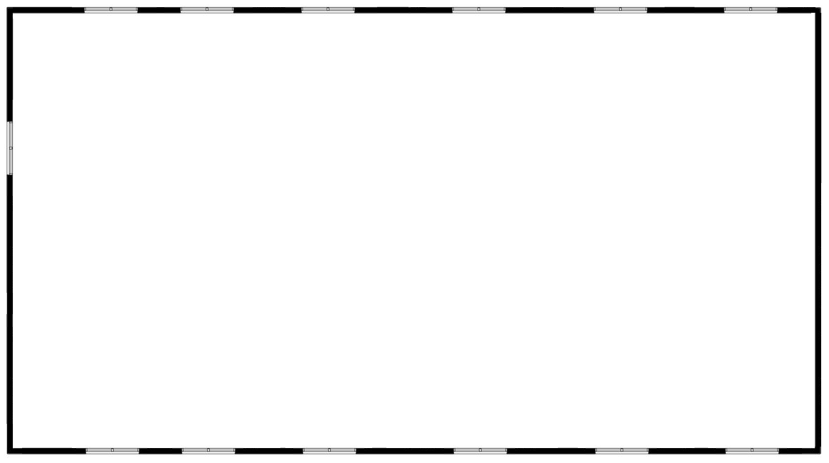
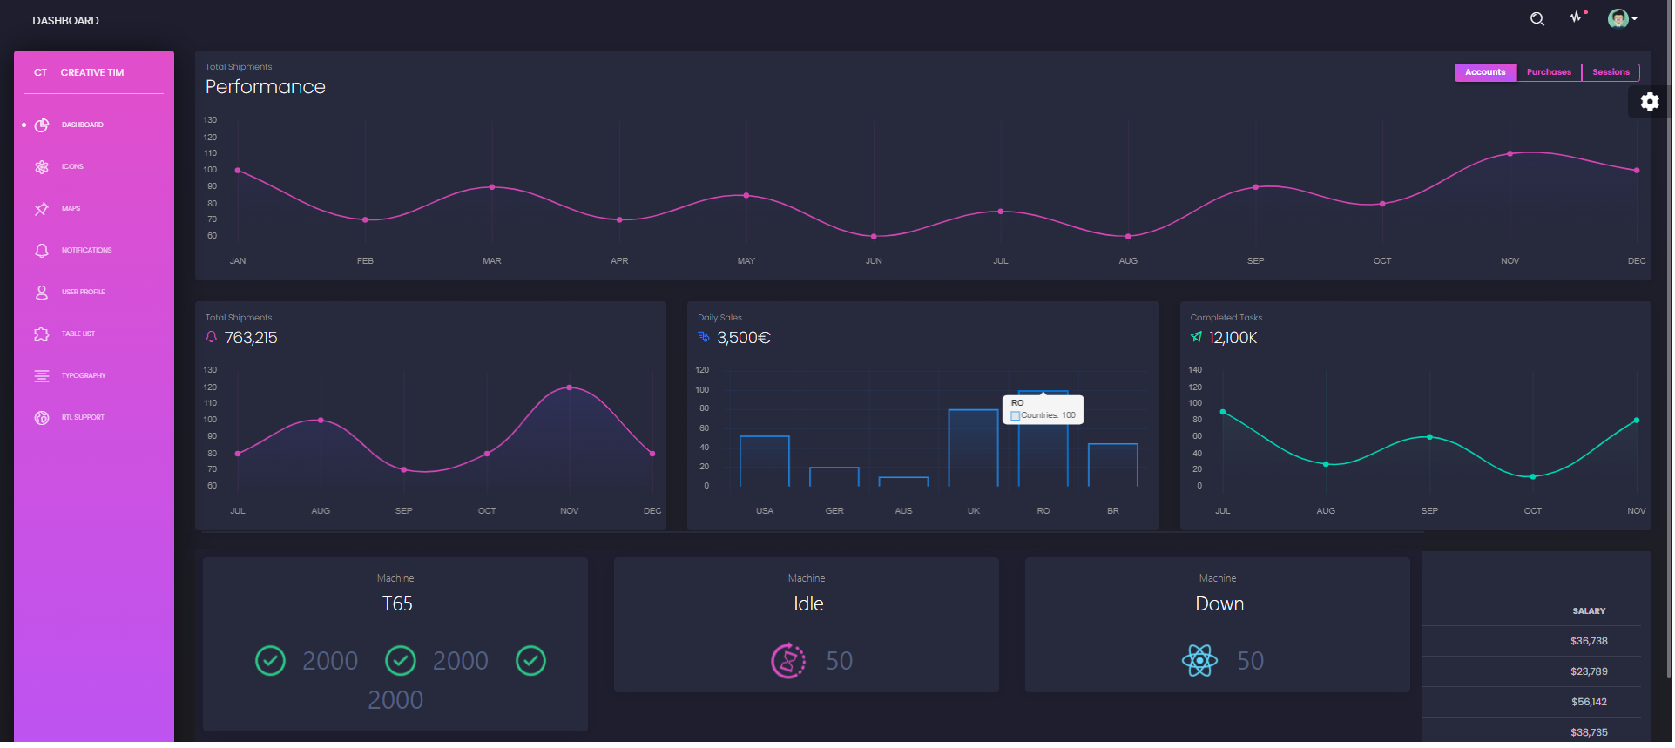





Software Architecture
Kn Hypersense Core
KN Smart Factory
REST
MQTT
COAP
REST
REST
KN Smart Factory Web

Slide 7
Manufacturing Plants
One Factory needs my immediate attention
Notes:
Title Font: Arial bold 24pt KN dark blue Map Body Text Font: Arial 18pt black
Map Colour: Accent Grey #5, 60% lighter Map Markers: KN Dark blue, light blue, light green and coral red
Change Map: You may swap the map for another you prefer from Frontify

Slide 8
Zoom on country level
MP1
Berlin
Anomaly reported
MP3
Bremen
MP2 Munich
Notes:
Main title font: Arial bold 24pt Dark blue
Number font: Arial bold 24pt white Text font: Arial 16pt white
Map location titles: Arial bold 14pt light blue Map location names: Arial bold 12pt black
Change the map and icons: You may swap the icons and map for ones you prefer in Frontify

Slide 9







Notes:
Key Message Font: Arial bold 36pt black Body Text Font: Arial 24pt black

Slide 10






Slide 12






Wireless Sensors
Edge Server / Gateway

