Slide 1
MQTT Protocol

Slide 2
Section 2
Agenda

Slide 3
Agenda
Item 1 18pt
Item 2
Item 3
Item 4
Item 5
Item 6
Item 7
Item 8
Item 9
Item 10
Item 11
Item 12
Item 13
Item 14
Item 15
Item 16
Notes:
Agenda Title Font: Arial bold 36pt white Agenda Item Font: Arial bold 18pt white

Slide 4
Section 3
Text-based
slides

Slide 5

Enter body text 18pt
Notes:
Title Font: Arial bold 24pt KN Dark blue Body Text Font: Arial 18pt black

Slide 6
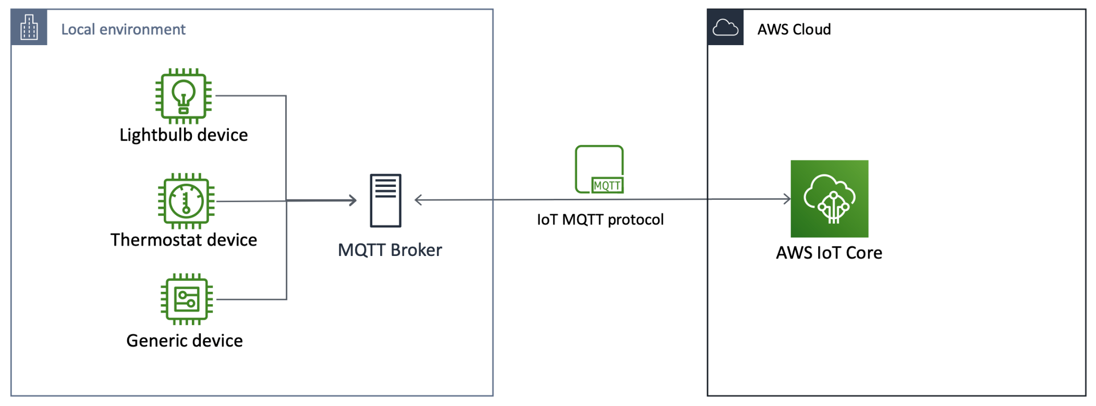
Notes:
Title Font: Arial bold 24pt KN Dark blue Body Text Font: Arial 18pt black

Slide 7



Enter body text 18pt
Mosquitto
MQTT Broker
Notes:
Title Font: Arial bold 24pt KN Dark blue Body Text Font: Arial 18pt black

Slide 8



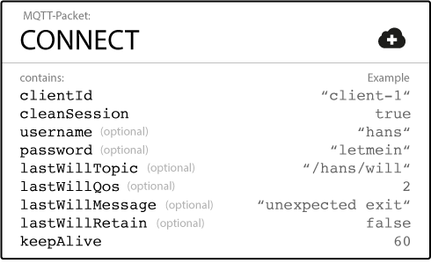
MQTT CONNECT
Notes:
Title Font: Arial bold 24pt KN Dark blue Subtitle Font: Arial bold 18pt black Body Text Font: Arial 18pt black

Slide 9

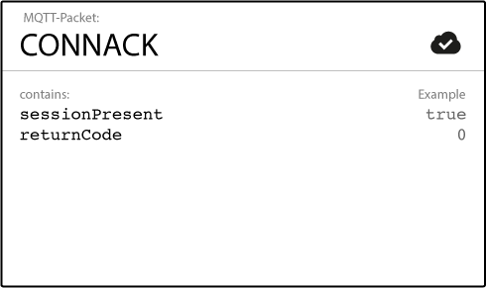
MQTT CONNACK
Notes:
Title Font: Arial bold 24pt KN Dark blue Subtitle Font: Arial bold 18pt black Body Text Font: Arial 18pt black

Slide 10
MQTT CONNACK: Response Codes
Return Code | Meaning
0 | Connection accepted
1 | Connection refused, unacceptable protocol version
2 | Connection refused, identifier rejected
3 | Connection refused, server unavailable
4 | Connection refused, bad user name or password
5 | Connection refused, not authorized
Notes:
Title Font: Arial bold 24pt KN Dark blue Subtitle Font: Arial bold 18pt black Body Text Font: Arial 18pt black

Slide 11

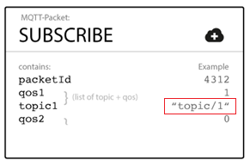
Notes:
Title Font: Arial bold 24pt KN Dark blue Subtitle Font: Arial bold 18pt black Body Text Font: Arial 18pt black

Slide 12

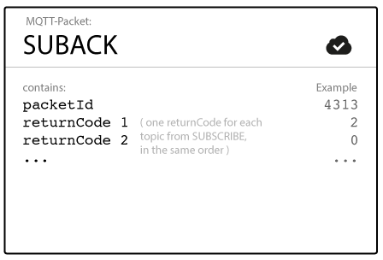
Notes:
Title Font: Arial bold 24pt KN Dark blue Subtitle Font: Arial bold 18pt black Body Text Font: Arial 18pt black

Slide 13
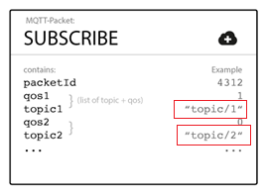
Notes:
Title Font: Arial bold 24pt KN Dark blue Subtitle Font: Arial bold 18pt black Body Text Font: Arial 18pt black

Slide 14
Notes:
Title Font: Arial bold 24pt KN Dark blue Subtitle Font: Arial bold 18pt black Body Text Font: Arial 18pt black

Slide 15


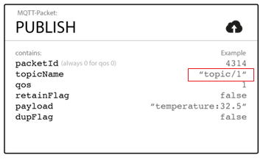
Notes:
Title Font: Arial bold 24pt KN Dark blue Subtitle Font: Arial bold 18pt black Body Text Font: Arial 18pt black

Slide 16
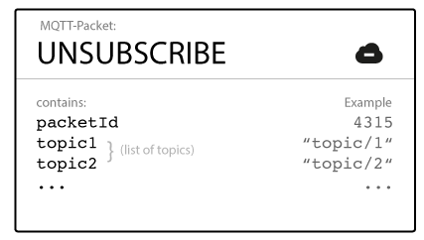
Notes:
Title Font: Arial bold 24pt KN Dark blue Subtitle Font: Arial bold 18pt black Body Text Font: Arial 18pt black

Slide 17

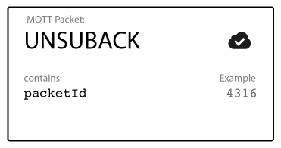
Notes:
Title Font: Arial bold 24pt KN Dark blue Subtitle Font: Arial bold 18pt black Body Text Font: Arial 18pt black

Slide 18
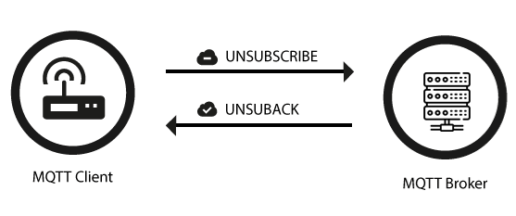
Notes:
Key Message Font: Arial bold 36pt black Body Text Font: Arial 24pt black

Slide 19
Notes:
Key Message Font: Arial bold 36pt black Body Text Font: Arial 24pt black

Slide 20
Enter key message 36pt
Enter body text 24pt
Notes:
Key Message Font: Arial bold 36pt white Body Text Font: Arial 24pt white

Slide 21
Enter key message text in this area. You can highlight specific words or phrases to make them stand out by changing the colour to light blue.
Text is 36pt
Notes:
Key Message Font: Arial bold 36pt white

Slide 22
Enter key message 36pt
Enter body text 24pt
Notes:
Key Message Font: Arial bold 36pt black Body Text Font: Arial 24pt black

Slide 23
Enter key message 36pt
Enter body text 24pt
Notes:
Key Message Font: Arial bold 36pt white Body Text Font : Arial 24pt white

Slide 24
02
01
Enter key message on these two lines 36pt
Enter body text 24pt
Main title,
Arial bold 36pt
Subtitle, Arial regular 24pt
Notes:
Number Font: Arial bold 180pt white Key Message Font: Arial bold 36pt white Body Text Font: Arial 24pt white

Slide 25
02
02
Enter key message on these two lines 36pt
Enter body text 24pt
Main title,
Arial bold 36pt
Subtitle, Arial regular 24pt
Notes:
Number Font: Arial bold 180pt white Key Message Font: Arial bold 36pt white Body Text Font: Arial 24pt white

Slide 26
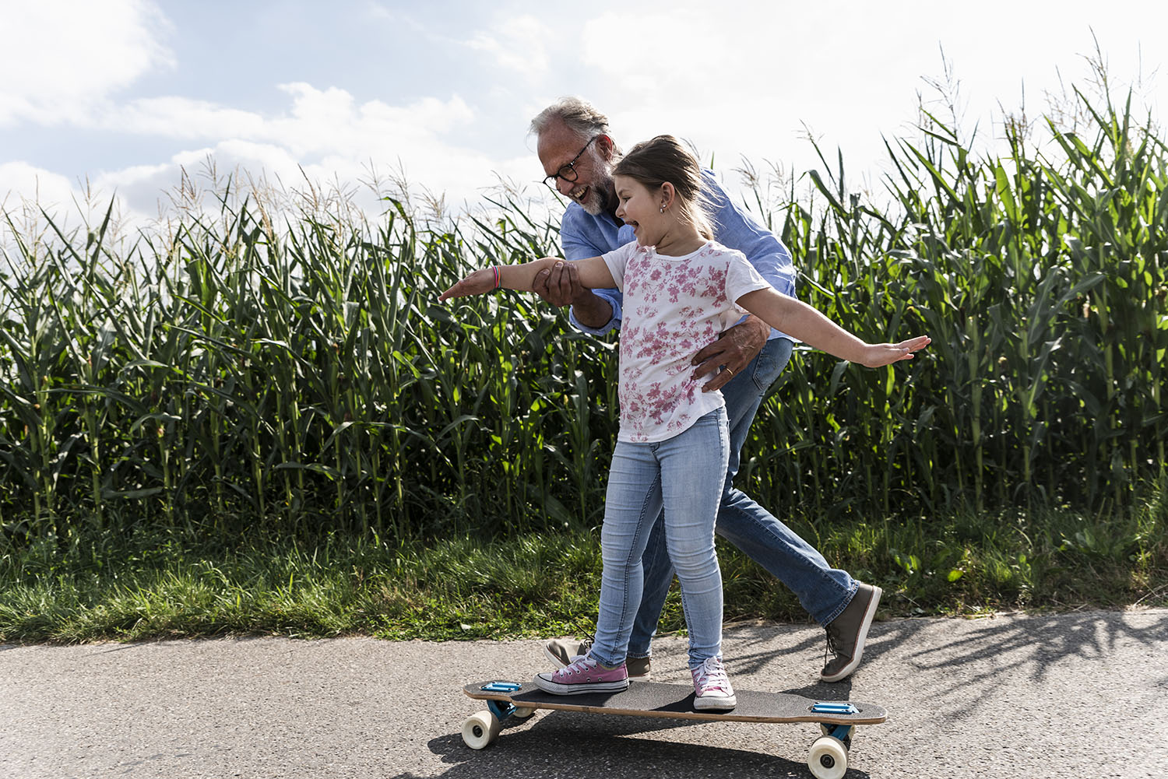
Enter key message text 36pt
Enter body text 24pt
Notes:
Key Message Font: Arial bold 36pt black Body Text Font: Arial 24pt black
Replace the picture: Click the existing picture and delete it. Then click on the icon and select a
new picture to insert. Using the Picture Change option is not recommended as it doesn’t crop images to
fit the space properly. Important: Swapping images automatically brings them to the front of all
elements on the slide. If your new picture is covering up other objects on the page, right click on
the image and choose Send to Back.

Slide 27
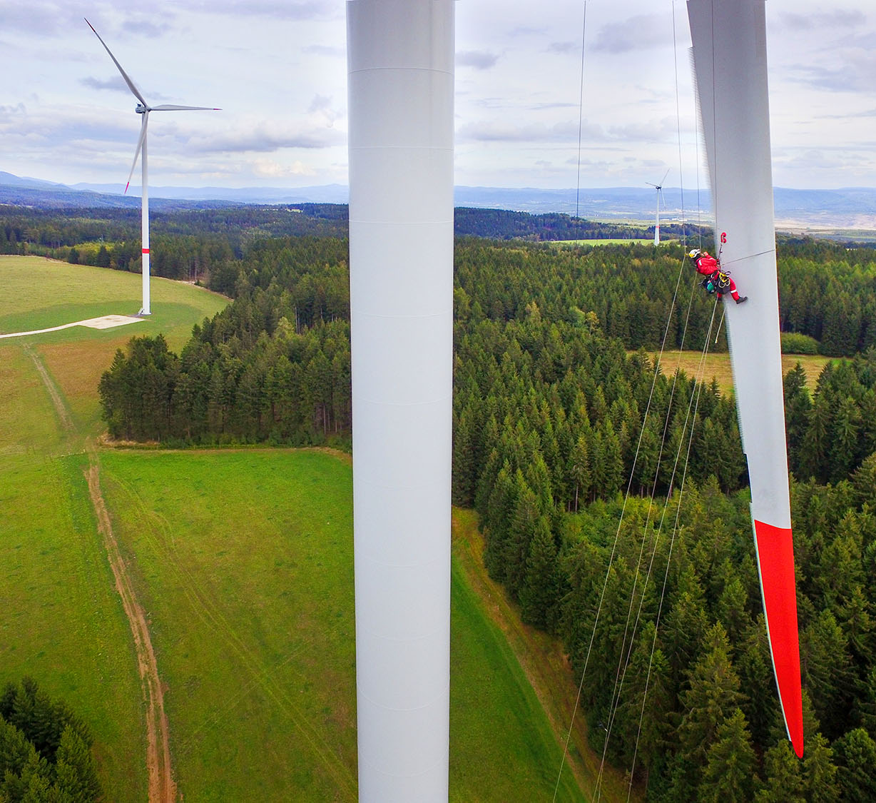
Enter key message 36pt
Enter body text 24pt
Notes:
This layout is designed with a standard logo for images with light colour tones
Key Message Font: Arial bold 36pt white Body Text Font: Arial 24pt white
Replace the picture: Click the existing picture and delete it. Then click on the icon and select a
new picture to insert. Using the Picture Change option is not recommended as it doesn’t crop images to
fit the space properly. Important: Swapping images automatically brings them to the front of all
elements on the slide. If your new picture is covering up other objects on the page, right click on
the image and choose Send to Back.

Slide 28
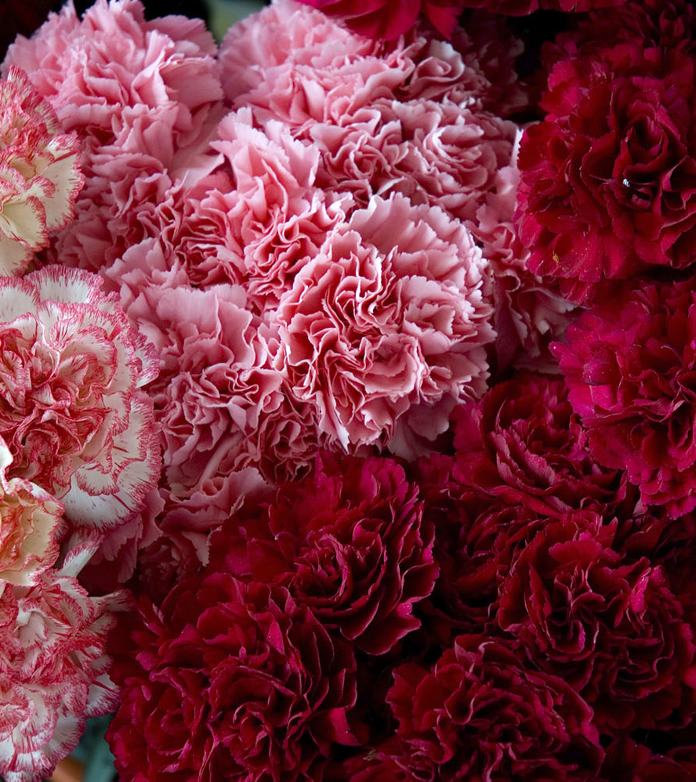



Challenge
Solution
Results
Notes:
This layout is designed with a white logo for images with dark colour tones
Title Font: Arial bold 24pt KN Dark blue Case study section font: Arial bold 18pt black Text Font: Arial 14pt black
Change the icons: You may swap the icons for ones you prefer in Frontify
Replace the picture: Click the existing picture and delete it. Then click on the icon and select a
new picture to insert. Using the Picture Change option is not recommended as it doesn’t crop images to
fit the space properly. Important: Swapping images automatically brings them to the front of all
elements on the slide. If your new picture is covering up other objects on the page, right click on
the image and choose Send to Back.

Slide 29
Section 5
Tables and
charts

Slide 30
Org chart body text 18pt
Text
Text
Text
Text
Text
Text
Text
Text
Text
Text
Text
Text
Text
Text
Text
Notes:
Title Font: Arial bold 24pt KN Dark blue Org Chart Body Text: Arial 18pt black
Org Chart Boxes Text Font: Arial 10pt white

Slide 31
Text
Text
Text
Text
Text
Text
Text
Text
Text
Text
Text
Text
Text
Text
Text
Notes:
Title Font: Arial bold 24pt KN Dark blue Org Chart Boxes Text Font: Arial 10pt white

Slide 32
Name
Title
Name
Title
Name
Title
Name
Title
Name
Title
Name
Title
Name
Title
Name
Title
Name
Title
Name
Title
Name
Title
Name
Title
Name
Title
Name
Title
Name
Title
Name
Title
Name
Title
Notes:
Title Font: Arial bold 24pt KN Dark blue Org Chart Boxes Text Font: Arial 10pt white

Slide 33
Text
Text
Text
Text
Text
Text
Text
Text
Text
Text
Text
Text
Text
Text
Text
Text
Text
Notes:
Title Font: Arial bold 24pt KN Dark blue Org Chart Boxes Text Font: Arial 10pt white

Slide 34
Section 6
Information
graphics

Slide 35
Notes:
Main title font: Arial bold 24pt Dark blue Box title font: Arial 24pt bold black + white
Box description font: Arial 14pt black + white

Slide 36
Notes:
Main title font: Arial bold 24pt Dark blue Box title font: Arial 24pt bold black + white
Box description font: Arial 14pt black + white

Slide 37
Notes:
Main title font: Arial bold 24pt Dark blue Box title font: Arial 24pt bold black + white
Box description font: Arial 18pt black + white

Slide 38
SWOT slide
Notes:
Main title font: Arial bold 24pt KN dark blue SWOT letters: Arial bold 60pt white
SWOT titles font: Arial bold 18pt black Text details font: Arial 16pt black

Slide 39
65%
35%
15%
75%
Enter text up to 5 lines
Enter text up to 5 lines
Enter text up to 5 lines
Enter text up to 5 lines
Notes:
This is an animated slide. To remove, click on the Animations tab and open the Animation Pane.
Click on each of the activities in the pane to delete or press SHIFT+A to select all and delete.
Main title font: Arial bold 24pt KN dark blue Circle text font: Arial 14pt black
Ring colours: Light gray with 1. dark blue 2. light blue 3. Light Green 4. Gray accent 6
Circle number font: Arial bold 24pt black
Changing the circle charts: Click to on the outermost bounding box of each chart.
(do not select the smaller inner square) Right click and choose Edit Data.
Enter data in the 2 rows as indicated so they equal 100, then close the data window.
Change the text box in the middle of the circle to match your percentage.

Slide 40
Status scale:
On schedule
In progress
On hold
Activity
Status
Line item
Line item
Line item
Line item
Line item
Line item
Line item
Line item
Line item
Notes:
Main title font: Arial bold 24pt KN dark blue
Column font: Arial bold 18pt white Line item font: Arial 14pt black
Using the status buttons: Option 1: Click on each of the coloured circles
you do not need and change the Shape Fill colour to KN Gray 25%
Option 2: Delete the coloured circles you do not need for each line item.
If you want align the remaining circles, hold down the SHIFT key and click on
each until all are selected. At the top of your screen, select the DRAWING TOOLS
tab and select ALIGN tab and Align Center from the drop-down options.
CHANGE STATUS SCALE TEXT: Each is grouped with the colour circle.
Click on the text to change so it represents your own scale

Slide 41
Activities | Col 1 | Col 2 | Col 3 | Col 4 | Col 5 | Col 6 | Col 7 | Col 8 | Col 9
Activity 1
Activity 2
Activity 3
Activity 4
Activity 5
Activity 6
Activity 7
Activity 8
Notes:
Title Font: Arial bold 24pt KN Dark blue Table font title row: Arial 12pt bold white
Table font remaining rows: Arial 12pt black

Slide 42
Enter text to a maximum
of 2 lines.
Enter text to a maximum
of 2 lines.
2016
2018
2020
2017
2019
Enter text to a maximum
of 2 lines.
Enter text to a maximum
of 2 lines.
Enter text to a maximum
of 2 lines.
Notes:
Main title font: Arial bold 24pt KN dark blue
Circle colours / outlines: 1. dark blue, 2. light blue 3. light green
4. dark blue, 5. light blue + other outlines in gray accent 6
Timeline font: Arial bold 32pt (colours match circles)
Timeline details font: Arial 12pt black

Slide 43







Enter text to a maximum of 3 lines.
Enter text to a maximum of 3 lines.
Enter text to a maximum of 3 lines.
Enter text to a maximum of 3 lines.
Enter text to a maximum of 3 lines.
Enter text to a maximum of 3 lines.
Enter text to a maximum of 3 lines.
Notes:
Main title font: Arial bold 24pt KN dark blue
Timeline details font: Arial 12pt black
Change the icons: You may swap the icons for ones you prefer in Frontify

Slide 44






Notes:
Main title font: Arial bold 24pt KN dark blue Section title font: Arial bold 24pt black
Section description font: Arial 12pt black
Change the icons: You may swap the icons for ones you prefer in Frontify

Slide 45





Enter information for first section up to a maximum of 5 lines.
Enter information for first section up to a maximum of 5 lines.
Enter information for first section up to a maximum of 5 lines.
Enter information for first section up to a maximum of 5 lines.
Enter information for first section up to a maximum of 5 lines.
Notes:
Main title font: Arial bold 24pt Dark blue
Text font: Arial 12pt black
Change the icons: You may swap the icons for ones you prefer in Frontify

Slide 46
Enter information for first section up to a maximum of 5 lines.
Enter information for first section up to a maximum of 5 lines.
Enter information for first section up to a maximum of 5 lines.
Enter information for first section up to a maximum of 5 lines.
Enter information for first section up to a maximum of 5 lines.
Notes:
Main title font: Arial bold 24pt Dark blue
Text font: Arial 12pt black
Change the icons: You may swap the icons for ones you prefer in Frontify

Slide 47
Notes:
Title Font: Arial bold 24pt KN dark blue Map Body Text Font: Arial 18pt black
Map Colour: KN Light green Map Markers: KN Dark blue and white
Change Map: You may swap the map for another you prefer from Frontify

Slide 48
Notes:
Title Font: Arial Bold 24pt KN Dark Blue Map Colour: KN Dark Blue Map Markers: KN Light Green
Change Map: You may swap the map for another you prefer from Frontify

Slide 49
Map body text 18pt
Notes:
Title Font: Arial bold 24pt KN dark blue Map Body Text Font: Arial 18pt black
Map Colour: Accent Grey #5, 60% lighter Map Markers: KN Dark blue, light blue, light green and coral red
Change Map: You may swap the map for another you prefer from Frontify

Slide 50
Map body text 18pt
Notes:
Title Font: Arial bold 24pt KN dark blue Map Body Text Font: Arial 18pt black
Map Colour: KN light blue Map Markers: white
Change Map: You may swap the map for another you prefer from Frontify

Slide 51
123
123
text description
text description
123
text description
123
text description
Notes:
@ Presenter: choose between this photo and the next one.
To ensure your product receives the care it requires, we have over 3500 GxP-trained staff working from 230+ operations globally, as well as 90 trained auditors who continuously validate our network. Our CareTeam provides 24/7 proactive intervention for your peace of mind.
Start presenting the benefits of KN PharmaChain
We have a large network and contacts worldwide.
No matter the type of product, we have a solution for you.
Even if you have unusual requests, we have a solution for you.
We are still feature rich and not 100% selling customer value.

Slide 52



Location title
Location name
Location title
Location name
Location title
Location name
Notes:
Main title font: Arial bold 24pt Dark blue
Number font: Arial bold 24pt white Text font: Arial 16pt white
Map location titles: Arial bold 14pt light blue Map location names: Arial bold 12pt black
Change the map and icons: You may swap the icons and map for ones you prefer in Frontify

Slide 53
23%
Location name
Enter information for this section to a maximum of 4 lines.
26%
Factory
55%
Enter information for this section to a maximum of 4 lines.
Location name
Enter information for this section to a maximum of 4 lines.
Notes:
Main Title Font: Arial bold 24pt KN dark blue Location Percentage: Arial bold 18pt black
Location Name: Arial bold 14pt white Location Details Font: Arial 14pt black
Location Box+line Colour: KN dark blue Line Adjustment: Lines may be repositioned from
the end dots. The Location text boxes will remain in the same place.
Map Colour: Accent Grey #5, 60% lighter + highlighted countries in KN light green
Colouring Map: Each country is a separate piece within the group. Click on the section
you want and change the colour within the palette range.
Change Map: You may swap the map for another you prefer from Frontify

Slide 54
Location name
Enter information for this section to a maximum of 2 lines.
Location name
Enter information for this section to a maximum of 2 lines.
Location name
Enter information for this section to a maximum of 2 lines.
Notes:
MAIN TITLE FONT: Arial bold 24pt KN dark blue LOCATION NAME: Arial bold 14pt white
LOCATION DETAILS FONT: Arial 14pt black LOCATION BOX+LINE COLOUR: KN dark blue
LINE ADJUSTMENT: Lines may be repositioned from the end dots. The location text boxes
will remain in the same place.
MAP COLOUR: Accent Grey #5, 60% lighter + highlighted countries in KN light blue
COLOURING MAP: Each country is a separate piece within the group. Click on the section you
want and change the colour within the palette range.
Change Map: You may swap the map for another you prefer from Frontify

Slide 55




Safety moment
Location, City, Country
Smoking areas outside of reception and cafeteria
In case of an evacuation, do not use the elevators
In case of an evacuation, follow the instructions
of KN staff and signed. Meeting point
First aid kit is in room 06, opposite Reception,
dial internal number 511

