Slide 1
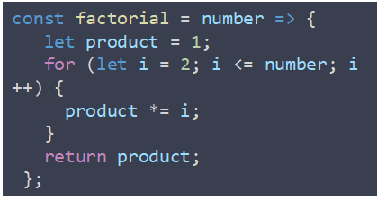

Web Application
Single Page Application
Browser
JAVASCRIPT
CSS
HTML
Pages
State
Logic
event

Slide 2

Web Application
SPA: Single Page Application
Browser
Server
Frontend
UI layer
Backend System
Application Layer
Data Layer

Slide 3

Software
Devices and domains
Server
Web
Desktop
Mobile
IOT
MQTT
Browser
Native UI
Native UI
C/C++
System calls
System calls
LUA

Slide 4
javascript
Mobile Development
Native
Web App
Hybrid
Bridge
Native App
Js Code
Native UI
Browser
WebView
System calls
Js Code
Js Engine
Js Code
Bridge
System calls
System calls

Slide 5





javascript
Mobile Development
Meteor
Native
Web App
Hybrid
Bridge
Native UI
Browser
Cordova
Native
System calls
Js Code
Flutter

Slide 6


javascript
Desktop Development
Native
Hybrid
Bridge
Native UI
Chromium
+ Node.js
System calls
Electron

Slide 7
DashBoardPage
ReportPage
UserDetails

Slide 8
Web Application
Single Page Application
Browser
JAVASCRIPT
CSS
HTML
Pages
State
Logic

Slide 9
Web Application
Single Page Application
Browser
JAVASCRIPT
CSS
HTML
Pages
State
Logic

Slide 10
Web Application
Single Page Application
Browser
JAVASCRIPT
CSS
HTML
Pages
State
Logic

Slide 11
Web Application
Single Page Application
Browser
JAVASCRIPT
CSS
HTML
Pages
State
Logic

Slide 12
Web Application
Single Page Application
Browser
JAVASCRIPT
CSS
HTML
Pages
State
Logic

Slide 13
Web Application
Single Page Application
Browser
JAVASCRIPT
CSS
HTML
Pages
State
Logic

Slide 14
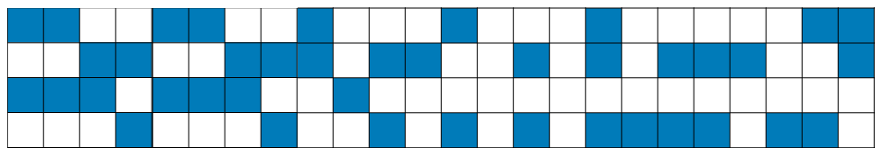
Web Application
Single Page Application
Browser
JAVASCRIPT
CSS
HTML
Pages
State
Logic

Slide 15
Web Application
Single Page Application
Browser
JAVASCRIPT
CSS
HTML
Pages
State
Logic
Page

Slide 16
Web Application
Single Page Application
Browser
JAVASCRIPT
CSS
HTML
Pages
State
Logic
Page
Page

Slide 17
Web Application
Single Page Application
Browser
JAVASCRIPT
CSS
HTML
Pages
State
Logic
Page
Page
Page
Page

Slide 18
Web Application
Single Page Application
Browser
JAVASCRIPT
CSS
HTML
Pages
State
Logic
Page
Page
Page
Page

Slide 19
Web Application
Single Page Application
Browser
JAVASCRIPT
CSS
HTML
Pages
State
Logic

Slide 20
Web Application
Single Page Application
Browser
JAVASCRIPT
CSS
HTML
Pages
State
Logic
event

Slide 21
Web Application
Single Page Application
Browser
JAVASCRIPT
CSS
HTML
Pages
State
Logic
event

Slide 22
Web Application
Single Page Application
Browser
JAVASCRIPT
CSS
HTML
Pages
State
Logic
event

Slide 23
Web Application
Single Page Application
Browser
JAVASCRIPT
CSS
HTML
Pages
State
Logic
event

