Slide 1
KNITS
Kuehne Nagel Information Technology School
Javascript
Technology Overview

Slide 2
Javascript
Agenda
Ajax
Future
Introduction
01
02
03
04
05
DHTML
Node.js
Notes:
© Copyright PresentationGO.com – The free PowerPoint and Google Slides template library

Slide 3
Introduction
1
An historical review

Slide 4
Introduction
Evolution toward standard
Developed by Brendan Eich from Netscape
ECMA Script 1.0 Standard
ECMA Script 3.0 Standard
XmlHttpRequest component AJAX
ECMA Script 6.0 Standard
ECMA Script 8.0 Standard
1996
1998
2004
2009
2016
2018
1995
1997
1999
2005
2015
2017
JavaScript 1.1 in Netscape Navigator 3.0 (Aug), JScript 1.0 in Internet Explorer 3.0 (Aug).
ECMA Script 2.0 Standard
ECMA Script 4.0 Standard
ECMA Script 5.0 Standard
ECMA Script 7.0 Standard
ECMA Script 9.0 Standard

Slide 5
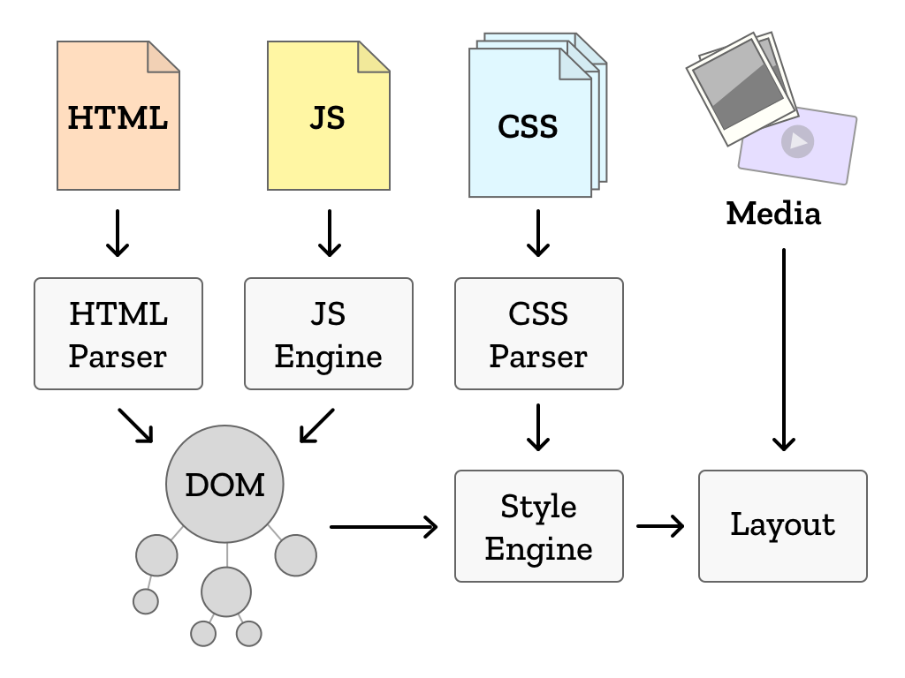
Introduction
Browser runtime

Slide 6
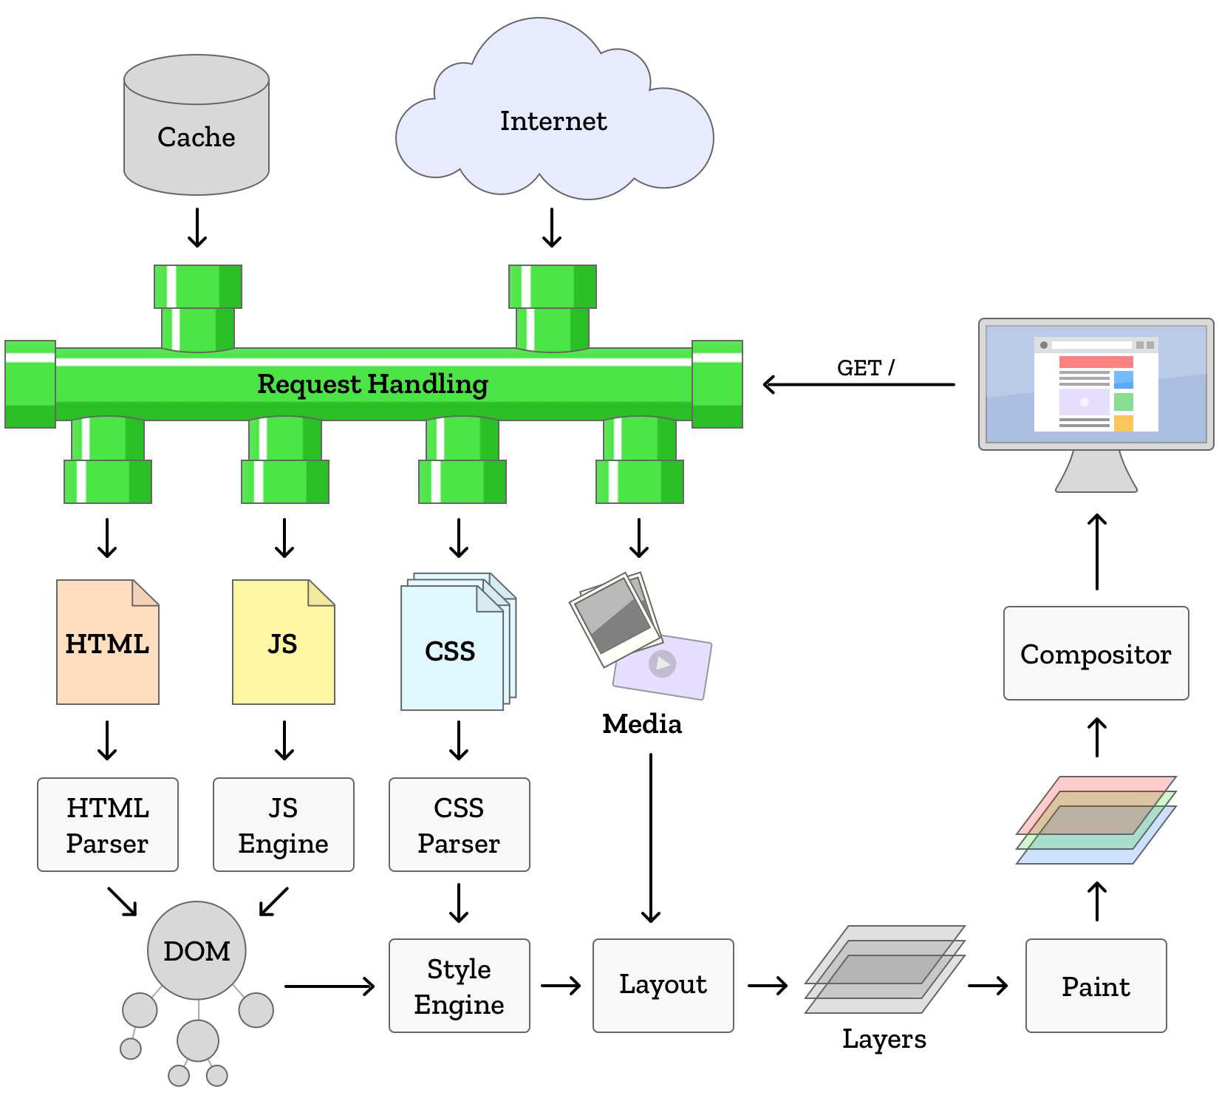
Introduction
Browser runtime

Slide 7
Introduction
Web Application: Html
<!DOCTYPE html>
<html>
<head>
<meta charset="utf-8">
<meta name="viewport" content="width=device-width, initial-scale=1, shrink-to-fit=no">
<title>404</title>
</head>
<body class="app">
<p class=“warning”>There is no <em>download link</em> on this page. </p>
</body>
</html>

Slide 8
Introduction
Web Application: Css
Css to define styles to apply to selected elements from html page
.warning { color: red; }
Javascript to apply some logic on selected html elements
<script type="text/javascript" >
window.alert(document.getElementsByClassName(“warning”)[0].innerHTML);
</script>

Slide 9
Introduction
Web Application: Server side
Data and UI are merged on the server
Every new request from UI to the server involves
Whole page is recalculated, delivered to client to replace previous one
User can’t perform any action while waiting for new page to render
Embedded Javascript code is restricted to :
Implement some logic on data already loaded on UI
Perform validations on data submitted by user
Copy data between UI fields
DHML effects (images rollout, sort tables, change layout elements)

Slide 10
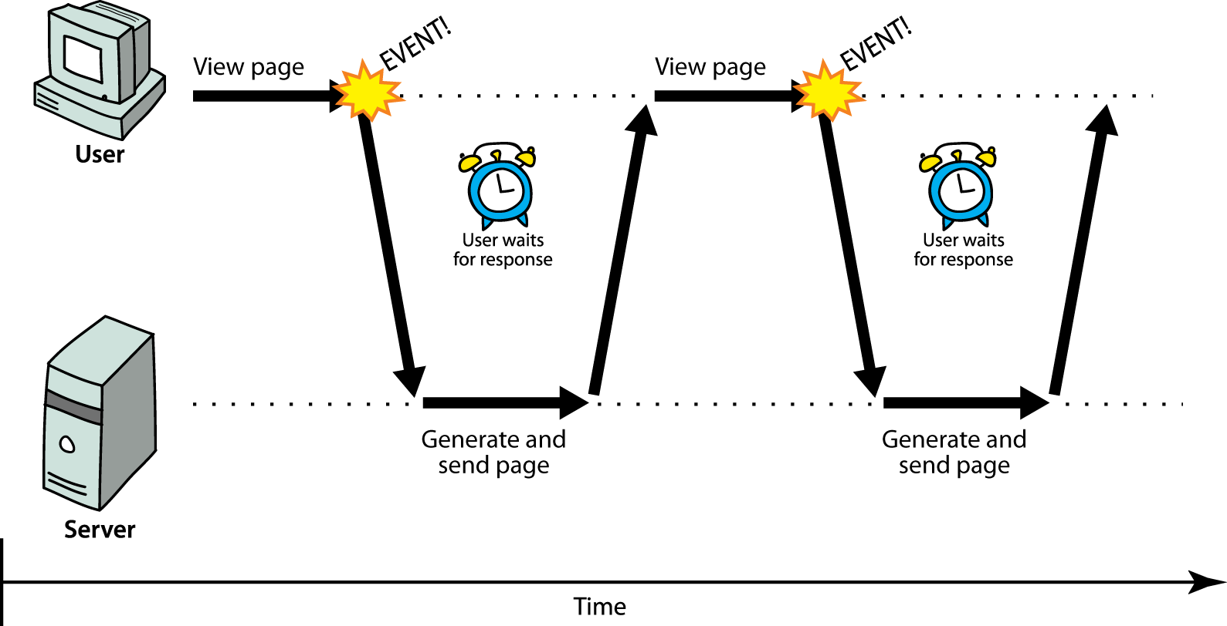
Introduction
Web Application: Server side

Slide 11
Introduction
Web Application: Ajax
In early nineties:
Every update in data to display requires generation of a new stream of html + css to be delivered to browsers on client side.
From 1996 :
1996, Internet Explorer introduces the iframe tag what is able to load data in asynchronous way.
1999, evolution of idea into a new component ActiveX named XMLHTTP
Standardizzato come oggetto XmlHttpRequest in tutti i browser
2005 termine AJAX menzionato in un articolo di Jesse James Garret

Slide 12
AJAX: XmlHttpRequest Object
Per larga parte degli anni 90 le pagine web dovevano essere completamente ricaricate ad ogni aggiornamento dei dati.
1996, the iframe tag introdotto da Internet Explorer per caricare contenuti in modo asincrono.
1999 evoluzione del componente in un ActiveX chiamato XMLHTTP
Standardizzato come oggetto XmlHttpRequest in tutti i browser
2005 termine AJAX menzionato in un articolo di Jesse James Garret

Slide 13
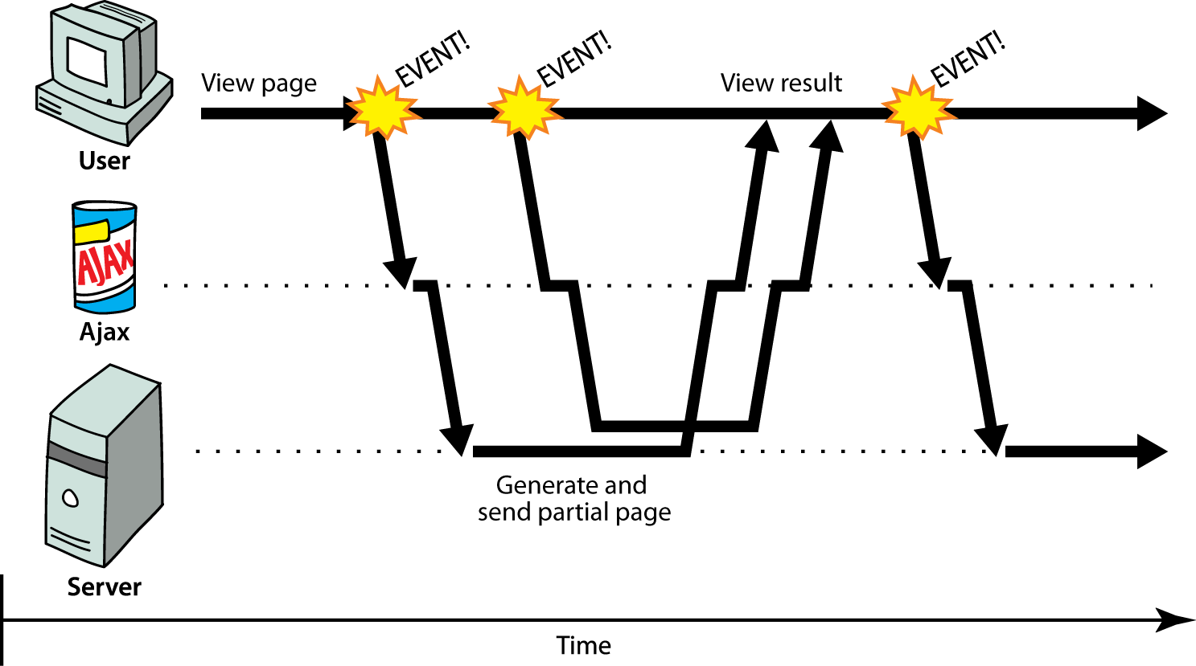
JS: web page richieste Ajax

Slide 14
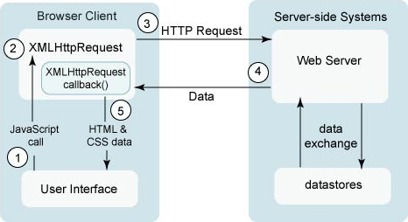
JS: web page richieste Ajax stati

Slide 15
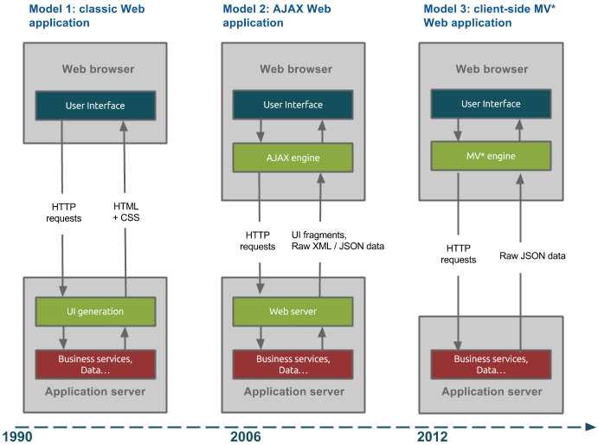
XmlHttpRequest Object

Slide 16

JS Frameworks: Rich Internet Applications (RIA)

Slide 17
AJAX Frameworks funzionalita
Supporto per api crossbrowser
Api Selettori (DOM, CSS, BOM)
Manipolazione del DOM avanzata
Semplificazione per gestione eventi
Supporto per animazioni
UI e Drag and Drop

Slide 18
Applicazioni Web II generazione (RIA)
Simulano applicazioni Desktop, ma sono gestite da browser
Dialogo con server in asincrono per caricamento/update dati
Codice JS permette di creare applicazioni client side
Frameworks JS gestire compatibilita crossbrowser
Limiti:
Gestione templates UI
Navigazione tra N pagine
Mantenimento stato tra N pagine
Difficile gestione dipendenze tra librerie

Slide 19
NodeJS: Javascript Engine
V8 open source JavaScript engine sviluppato da Google.
Scritto in C++ ed usato in Google Chrome Browser
Ambiente di esecuzione di JS
NodeJs Creato da Ryan Dahl in 2009
Open Source e multipiattaforma (Win, Mac e Linux)

Slide 20
JS: Web Application III generazione (SPA)
Possibilita di creare librerie e di gestire import da js
Npm dependency management tool
Repository centrale librerie
Server side js (NodeJS)
Storage locale client side (HTML5)
Librerie basate su SVG che permettono grafici dinamici
Web api per JS (GoogleMap, Flickr, Youtube)

Slide 21
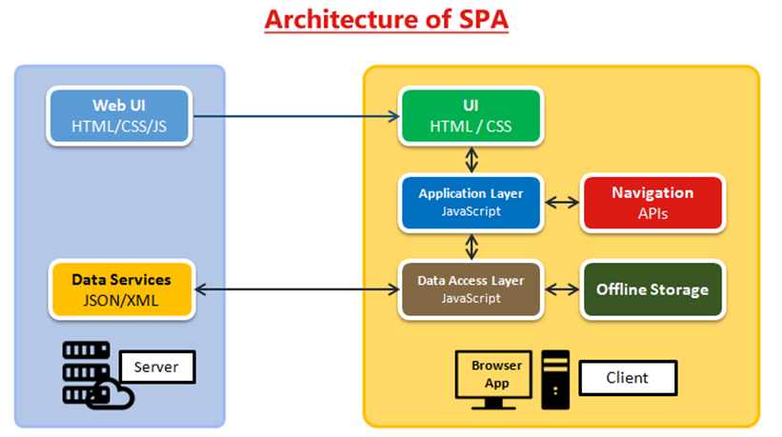
Single Page Application

Slide 22
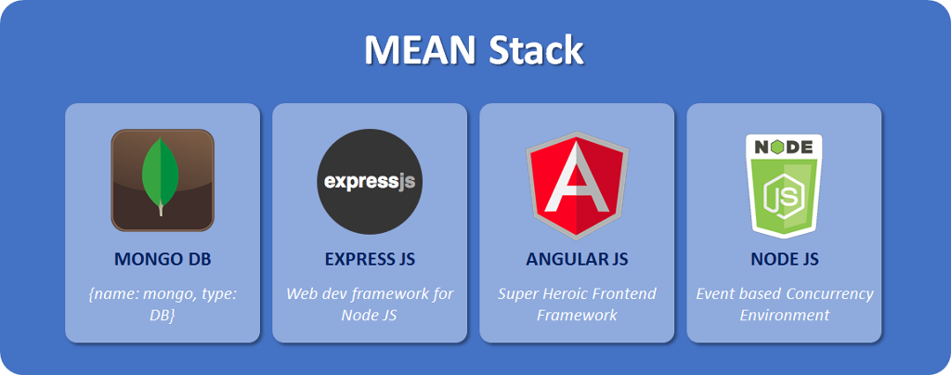
JS: WebApp Full Javascript

Slide 23
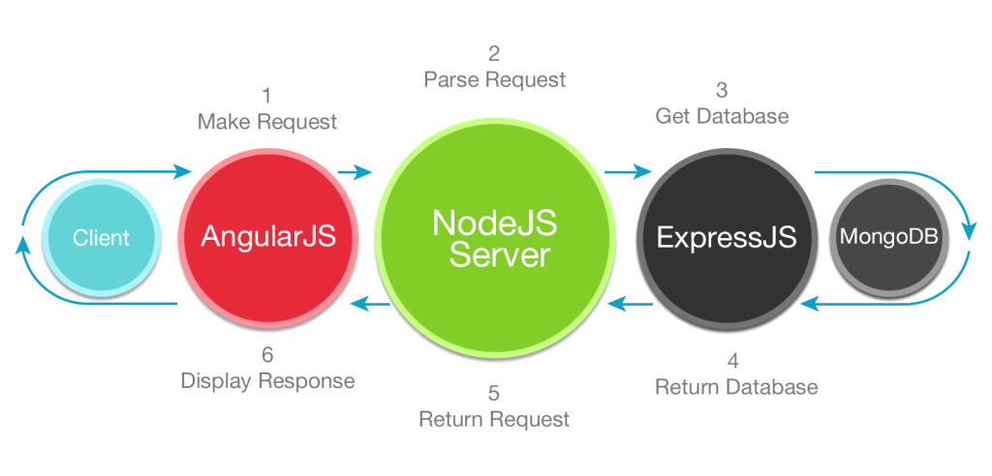
JS: Frameworks II generazione (post Node.js)

Slide 24




JS: Frameworks II generazione (post Node.js)

Slide 25







JS: Toolset Applicazioni Js

Slide 26
JS: Toolset Applicazioni Js
Caricare librerie js da un repository dipendenze
Preprocessing (SASS, LESS, JSX)
Lanciare UTest
Compressione librerie
Offuscamento codice
Deploy (copia files)

Slide 27
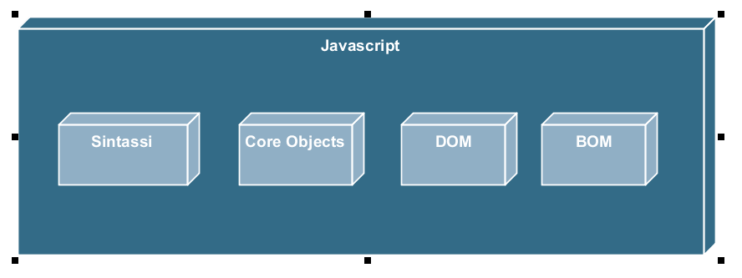
Javascript

Slide 28
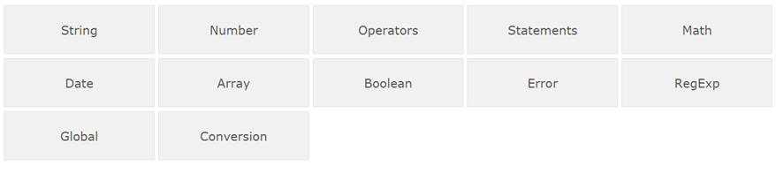
JS: Core Objects

Slide 29
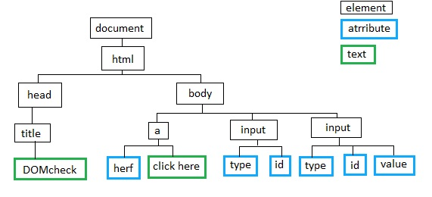
JS. Standard DOM

Slide 30
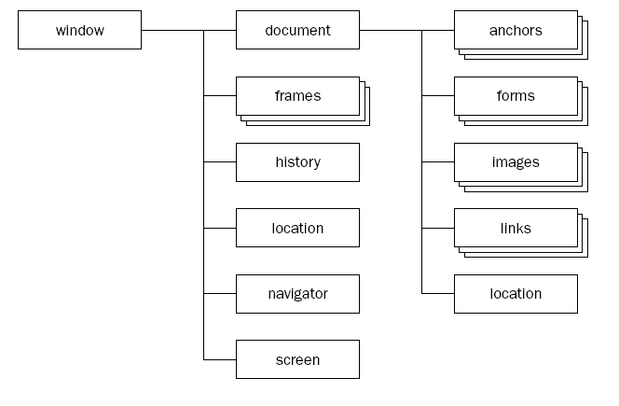
JS: Browser Object Model

