Slide 1
KNITS
Kuehne Nagel Information Technology School
Javascript
Technology Overview

Slide 2
Javascript
Agenda
Node.js
Future
Browser
01
02
03
04
05
DHTML to AJAX
SPA
Notes:
© Copyright PresentationGO.com – The free PowerPoint and Google Slides template library

Slide 3
Javascript
Evolution in timeline
Isomorphic Web App
Mobile frameworks
Desktop app
Hybrid app
Script language
Standards war
DHTML
Ajax
RIA
Js Frameworks
Node.js
HTML5
SPA frameworks
1995-1998
1999-2009
2009 - 2013
2013-2020

Slide 4
Javascript
Evolution in timeline
XmlHttpRequest standard
component
Electron
Brendan Eich from Netscape
ECMA Script 1.0 Standard
ES 3
ES 5
ES 6
ES 8
1996
1998
2004
2016
2018
1995
1997
1999
2005
20 09
2013
2015
2017
ES 4
ES 7
ES 9
ES 2
JavaScript 1.1 in Netscape Navigator 3.0 (Aug), JScript 1.0 in Internet Explorer 3.0 (Aug).
Node.js

Slide 5
Browser
1
Javascript Runtime in Browsers

Slide 6
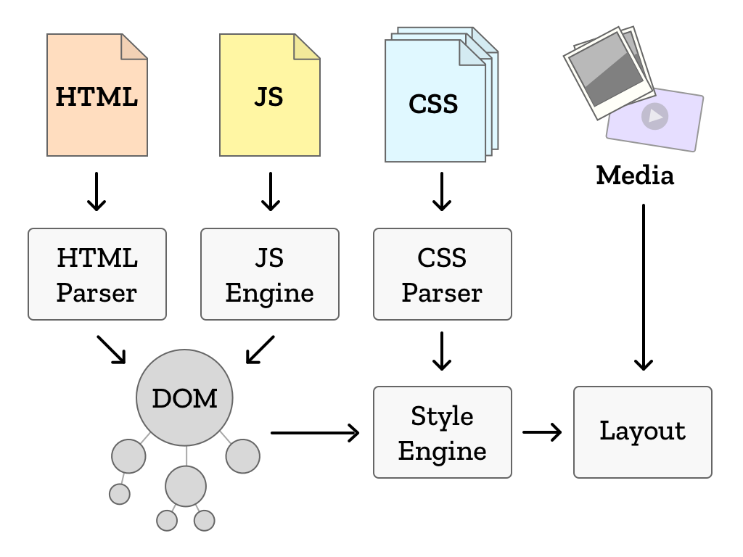
Introduction
Browser runtime

Slide 7
Introduction
Browser runtime: html
<!DOCTYPE html>
<html>
<head>
<meta charset="utf-8">
<meta name="viewport" content="width=device-width, initial-scale=1, shrink-to-fit=no">
<title>404</title>
</head>
<body class="app">
<p class=“warning”>There is no <em>download link</em> on this page. </p>
</body>
</html>

Slide 8
Introduction
Browser runtime: css and javascript
Css to define styles to apply to selected elements from html page
.warning { color: red; }
Javascript to apply some logic on selected html elements
<script type="text/javascript" >
window.alert(document.getElementsByClassName(“warning”)[0].innerHTML);
</script>

Slide 9
Browser
DOM
html: element
head: element
body: element
p: element
meta: element
title: element
charset:attribute
text
text
text
em: element
text

Slide 10
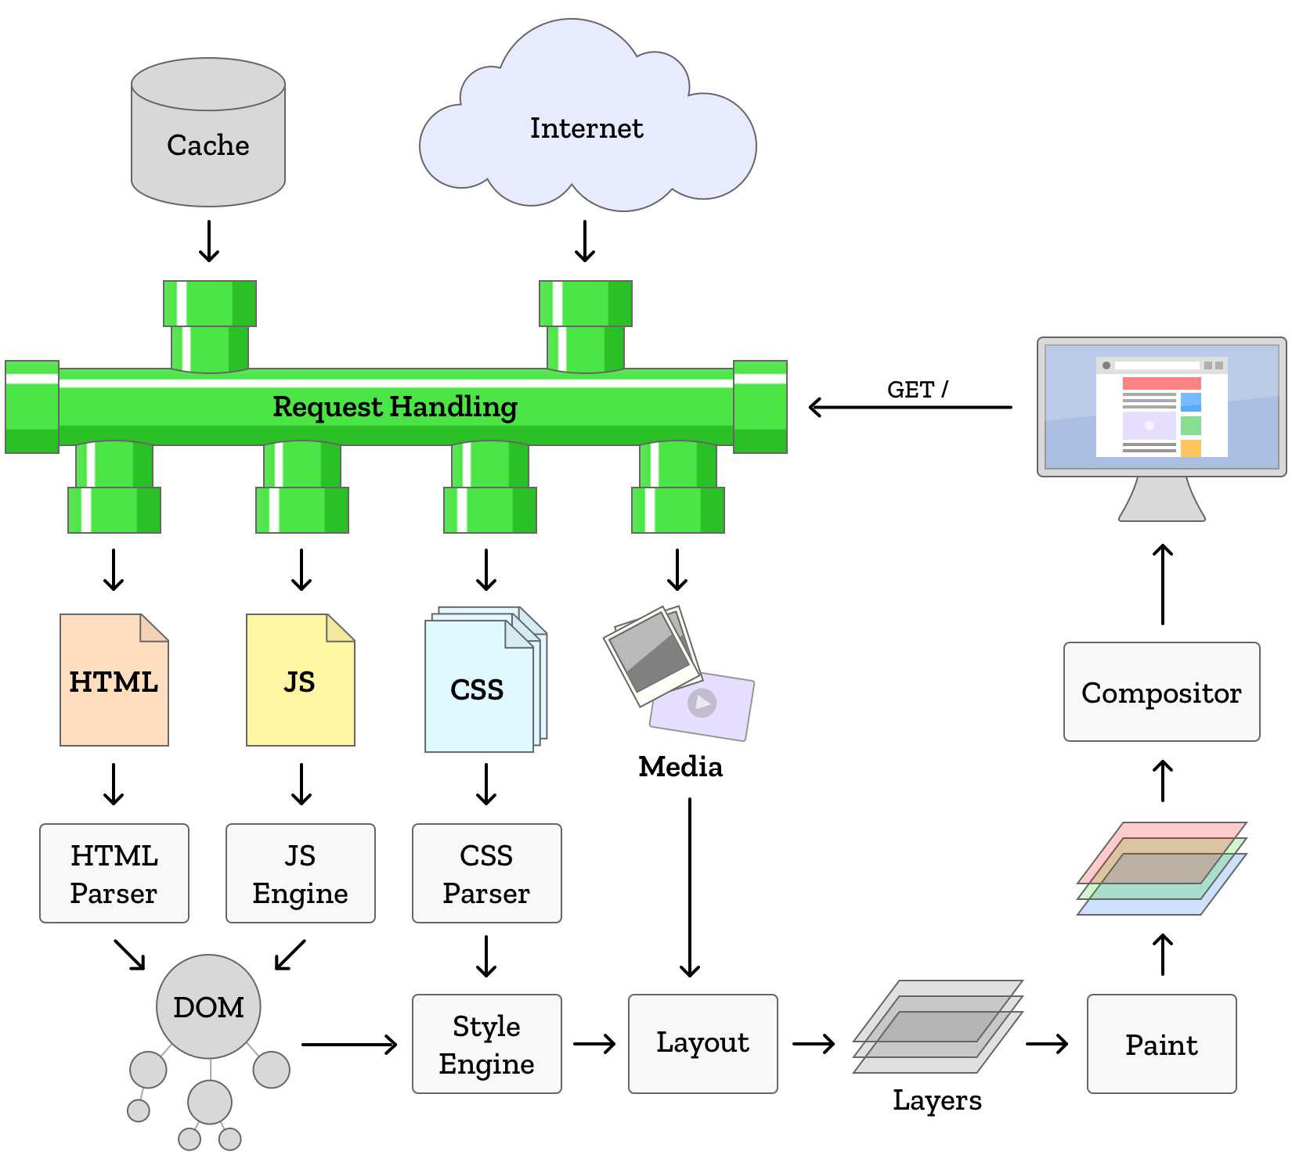
Introduction
Browser runtime

Slide 11
Web Applications
2
From server side and DHTML to
Rich Internet Application with Ajax

Slide 12


Web Application
Standard: Server side
Browser
Server
Database
Browser http call
Backend System
response http

Slide 13
Web Application
Standard: Server side
Data and UI are merged on the server
Every new request from UI to the server create new Page
Whole page is recalculated, delivered to client to replace previous one
User can’t perform any action while waiting for new page to be rendered
Javascript code embedded in page is restricted to :
Implement some logic on data already loaded on UI
Perform validations on data submitted by user
Copy data between UI fields
DHML effects (images rollout, sort tables, change layout elements)

Slide 14
Introduction
Web Application: Ajax
Early nineties:
Every update in data to display requires generation of a new stream of html + css to be delivered to browsers on client side.
From 1996 : Ajax
1996, Internet Explorer introduces the iframe tag what is able to load data in asynchronous way.
1999, evolution of idea into a new component ActiveX named XMLHTTP
2000 Standard object XmlHttpRequest available for all browsers
2005 AJAX acronym mentioned in essay from Jesse James Garret

Slide 15
Web Application
Ajax: Rich Internet Application
Browser
Server
Database
Ajax http call
Backend System
http response

Slide 16
Web Application
Ajax: Rich Internet Application
Server
1
avoid unnecessary network calls
database
2
state management client side
…
…
Client
Client
Client
Client
Client
Client
Client

Slide 17
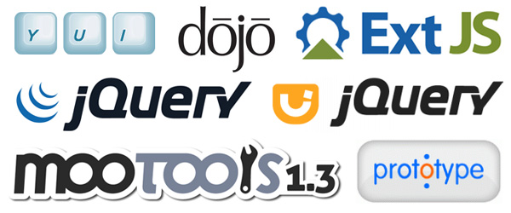
Web Application
Ajax: Rich Internet Application

Slide 18
Web Application
Ajax: Rich Internet Application
Common features:
Crossbrowser support
Selectors Api (DOM, CSS, BOM)
Advanced DOM manipulation
Simplified event management
Animation support
UI libraries
Drag and Drop

Slide 19
Web Application
Ajax: Rich Internet Application
Limits for complex UI with many pages:
Weak support for navigation
State management
High cohesion of code
Limits of javascript as language:
Hard to manage dependency between libraries
No professional IDE

Slide 20
Node.js
3
A new runtime environment

Slide 21






Web Application
New technologies available
Browser Storage
Javascript Runtime
IDE

Slide 22
Node.js
A new runtime engine
V8 open source JavaScript engine developed by Google.
Written in C++ and used in Google Chrome Browser
Could be used outside of browser as runtime for js
Node.js created by Ryan Dahl in 2009 use V8 as js engine
Open Source and multiplatform (Win, Mac e Linux)

Slide 23
Node.js
New technical possibilities
Importing and exporting js libraries (NPM)
Server side in javascript (Node.js)
Web Storage (HTML 5)
SVG libraries to generate dynamic graphics (D3.js, Raphael, SVG.js)
Public data and web api (Google Map, Flickr, Youtube)

Slide 24
Node.js
Dependency management
Library Central Repository
Developer Machine
package.json
Library B
Library A
Library A
Library G
Library C
Library H
Library D
npm
Library F
Library G
/node__ modules
Library H

Slide 25
Node.js
Build Process
package.json
Library A
+
Library G
node.js
bundler
Library H
bundle
/node__ modules
js
/assets
html
html
css
css

Slide 26
Node.js
Application in production
Production Machine
bundle
html
js
css
Browser
html
Web server
js
css

Slide 27
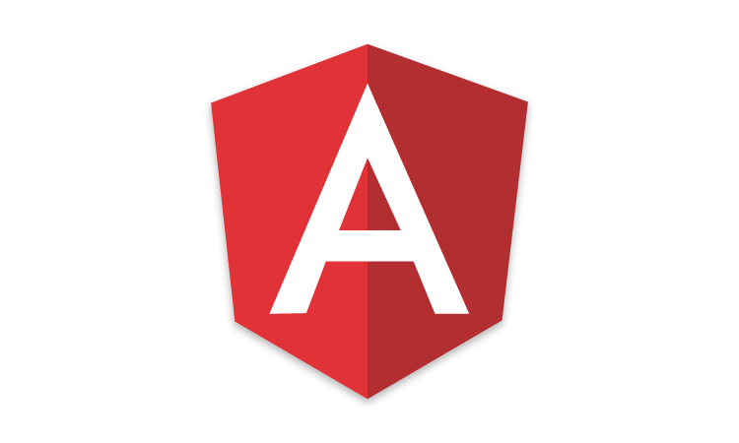


Node.js
New Javascript Frameworks for SPA

Slide 28
Node.js
New Frameworks for SPA
Components (js, html, cssx)
Dependency management
Data bindings
State management
Template engine
DOM management
Support for Navigation and routing

Slide 29







Node.js
New Javascript Tools

Slide 30
Node.js
New Tools for javascript
Code Quality (JsLint)
Preprocessor (Jsx, sass, less)
Tools and libraries for unit test (Mocha, Jest, Enzime)
Bundlers (Webpack, Browserify)
Task managers (Gulp, Grunt)
Dependency management (npm, yarn, bower)
Project setup (Yeoman)

Slide 31

Node.js
New tech stack

Slide 32

Node.js
New tech stack

Slide 33
Single Page Application
4
Introduction to architecture

Slide 34
Web Application
Single Page Application
Web Server
Browser
JAVASCRIPT
HTML
Pages
State
Logic
CSS

Slide 35
Web Application
Single Page Application
Browser
JAVASCRIPT
CSS
HTML
Pages
State
Logic

Slide 36
Web Application
Single Page Application
Browser
JAVASCRIPT
CSS
HTML
Pages
State
Logic

Slide 37
Web Application
Single Page Application
Browser
JAVASCRIPT
CSS
HTML
Pages
State
Logic

Slide 38
Web Application
Single Page Application
Browser
JAVASCRIPT
CSS
HTML
Pages
State
Logic

Slide 39
Web Application
Single Page Application
Browser
JAVASCRIPT
CSS
HTML
Pages
State
Logic

Slide 40
Web Application
Single Page Application
Browser
JAVASCRIPT
CSS
HTML
Pages
State
Logic

Slide 41
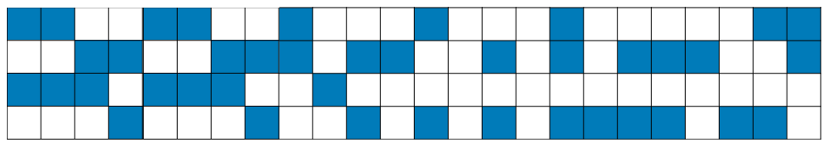
Web Application
Single Page Application
Browser
JAVASCRIPT
CSS
HTML
Pages
State
Logic

Slide 42
Web Application
Single Page Application
Browser
JAVASCRIPT
CSS
HTML
Pages
State
Logic
Page

Slide 43
Web Application
Single Page Application
Browser
JAVASCRIPT
CSS
HTML
Pages
State
Logic
Page
Page

Slide 44
Web Application
Single Page Application
Browser
JAVASCRIPT
CSS
HTML
Pages
State
Logic
Page
Page
Page
Page

Slide 45
Web Application
Single Page Application
Browser
JAVASCRIPT
CSS
HTML
Pages
State
Logic
Page
Page
Page
Page

Slide 46
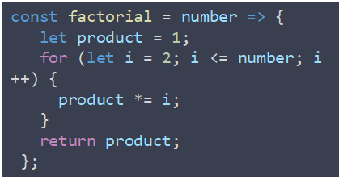
Web Application
Single Page Application
Browser
JAVASCRIPT
CSS
HTML
Pages
State
Logic

Slide 47

Web Application
Single Page Application
Browser
JAVASCRIPT
CSS
HTML
Pages
State
Logic
event

Slide 48
Web Application
Single Page Application
Browser
JAVASCRIPT
CSS
HTML
Pages
State
Logic
event

Slide 49
Web Application
Single Page Application
Browser
JAVASCRIPT
CSS
HTML
Pages
State
Logic
event

Slide 50
Web Application
Single Page Application
Browser
JAVASCRIPT
CSS
HTML
Pages
State
Logic
event

Slide 51
Web Application
SPA: Single Page Application
Browser
Server
Frontend
UI layer
Backend System
Application Layer
Data Layer

Slide 52
Javascript and beyond
5
Javascript is a full-fledged language

Slide 53
General purpose programming language
is a programming language designed
to be used for writing software
in the widest variety of application domains.

Slide 54

Software
Devices and domains
Server
Web
Desktop
Mobile
IOT
MQTT
Browser
Native UI
Native UI
C/C++
System calls
System calls
LUA

Slide 55
javascript
Mobile Development
Native
Web App
Hybrid
Bridge
Native App
Js Code
Native UI
Browser
WebView
System calls
Js Code
Js Engine
Js Code
Bridge
System calls
System calls

Slide 56




javascript
Mobile Development
Meteor
Native
Web App
Hybrid
Bridge
Native UI
Browser
Cordova
Native
System calls
Js Code
Flutter

Slide 57


javascript
Desktop Development
Native
Hybrid
Bridge
Native UI
Chromium
+ Node.js
System calls
Electron

Slide 58




javascript
Many new frameworks

Slide 59
javascript
Many more to come….

