Slide 1
Kuehne Nagel Information Technology School
SUMMER 2021

Slide 2





Internship Programs 2021
Startup
Open Source
Corporate
Portfolio
Educational
Elite
One trainee for each project. From idea to release.
Hybrid team employees/trainees Supply chain service product
Team of trainees. Work on KN product prototype.
Smart Society
Workforce
Guild
Team of trainees. From design to release.
Hybrid team employees/trainees NGO & Open data cooperation
.
Join KN team in their working routines on production project.
Guild

Slide 3
Internship Programs 2021
Startup
Open Source
Corporate
Portfolio
Educational
Elite
One trainee for each project. From idea to release.
Hybrid team employees/trainees Supply chain service product
Team of trainees. Work on KN product prototype.
Smart Society
Workforce
Guild
Team of trainees. From design to release.
Hybrid team employees/trainees NGO & Open data cooperation
.
Join KN team in their working routines on production project.
Guild

Slide 4



Summer School 2021
182
63
9
Applications
Software Analyst
Interviews
Selected
Notes:
Title Font: Arial bold 24pt KN Dark blue Subtitle Font: Arial bold 18pt black Body Text Font: Arial 18pt black

Slide 5
Internship Programs 2021
Startup
Open Source
Corporate
Portfolio
Educational
Elite
One trainee for each project. From idea to release.
Hybrid team employees/trainees Supply chain service product
Team of trainees. Work on KN product prototype.
Smart Society
Workforce
Guild
Team of trainees. From design to release.
Hybrid team employees/trainees NGO & Open data cooperation
.
Join KN team in their working routines on production project.
Guild

Slide 6
Devops internship
202
9
1
Applications
Software Analyst
Interviews
Selected
Notes:
Title Font: Arial bold 24pt KN Dark blue Subtitle Font: Arial bold 18pt black Body Text Font: Arial 18pt black

Slide 7
Skills developed in Summer School
Backend
Frontend
3
Spring auto configuration
Spring MVC
Json Views
Mapstruct
ORM
JPQL
Dynamic Queries (Criteria)
Liquibase
React Components
Hooks
State management
Axios
Redux
Middlewares
React-Thunk
SDA
Notes:
Title Font: Arial bold 24pt KN Dark blue Subtitle Font: Arial bold 18pt black Body Text Font: Arial 18pt black

Slide 8
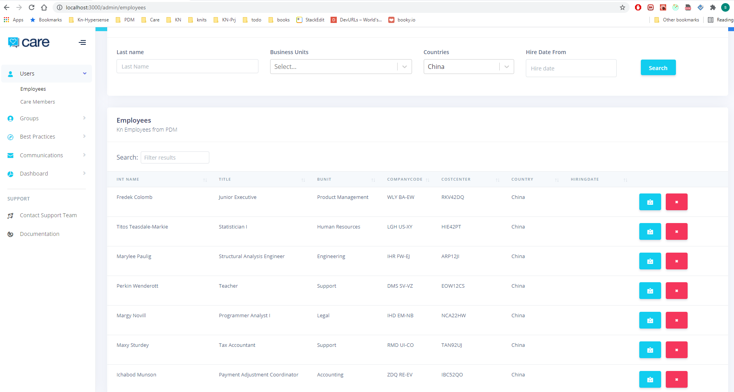
KN Care Product developed in Summer School

Slide 9
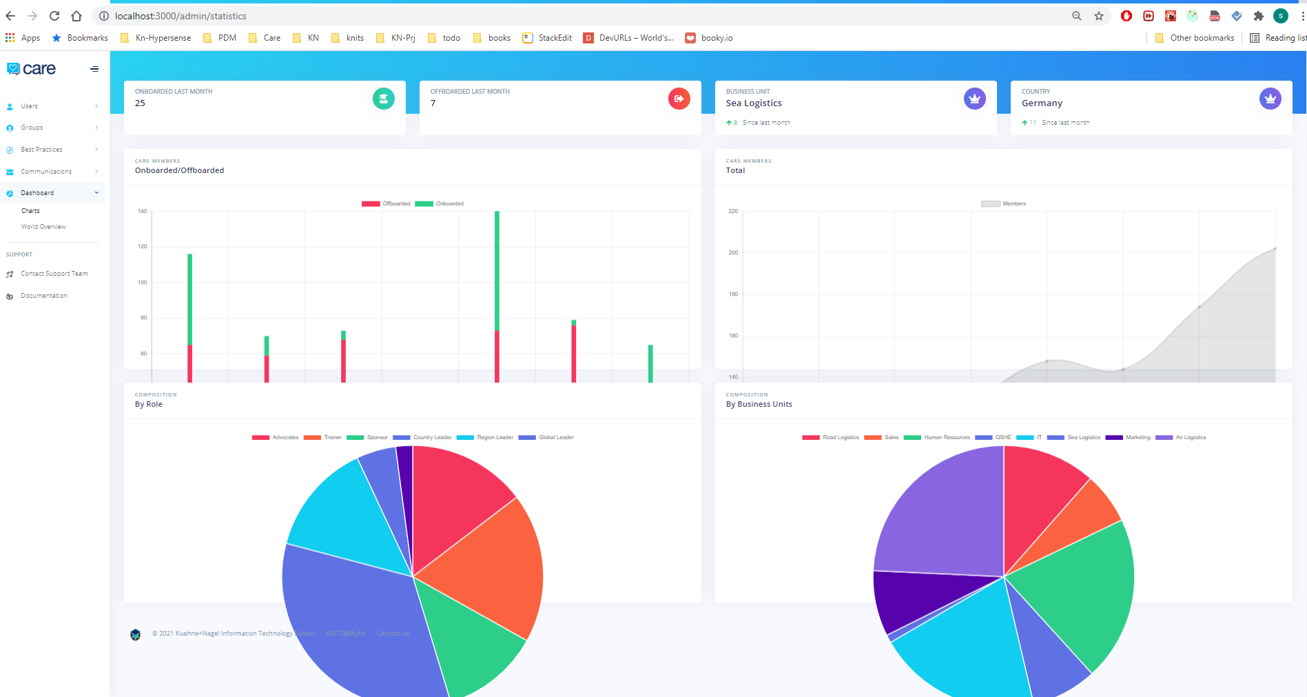
KN Care Product developed in Summer School

Slide 10
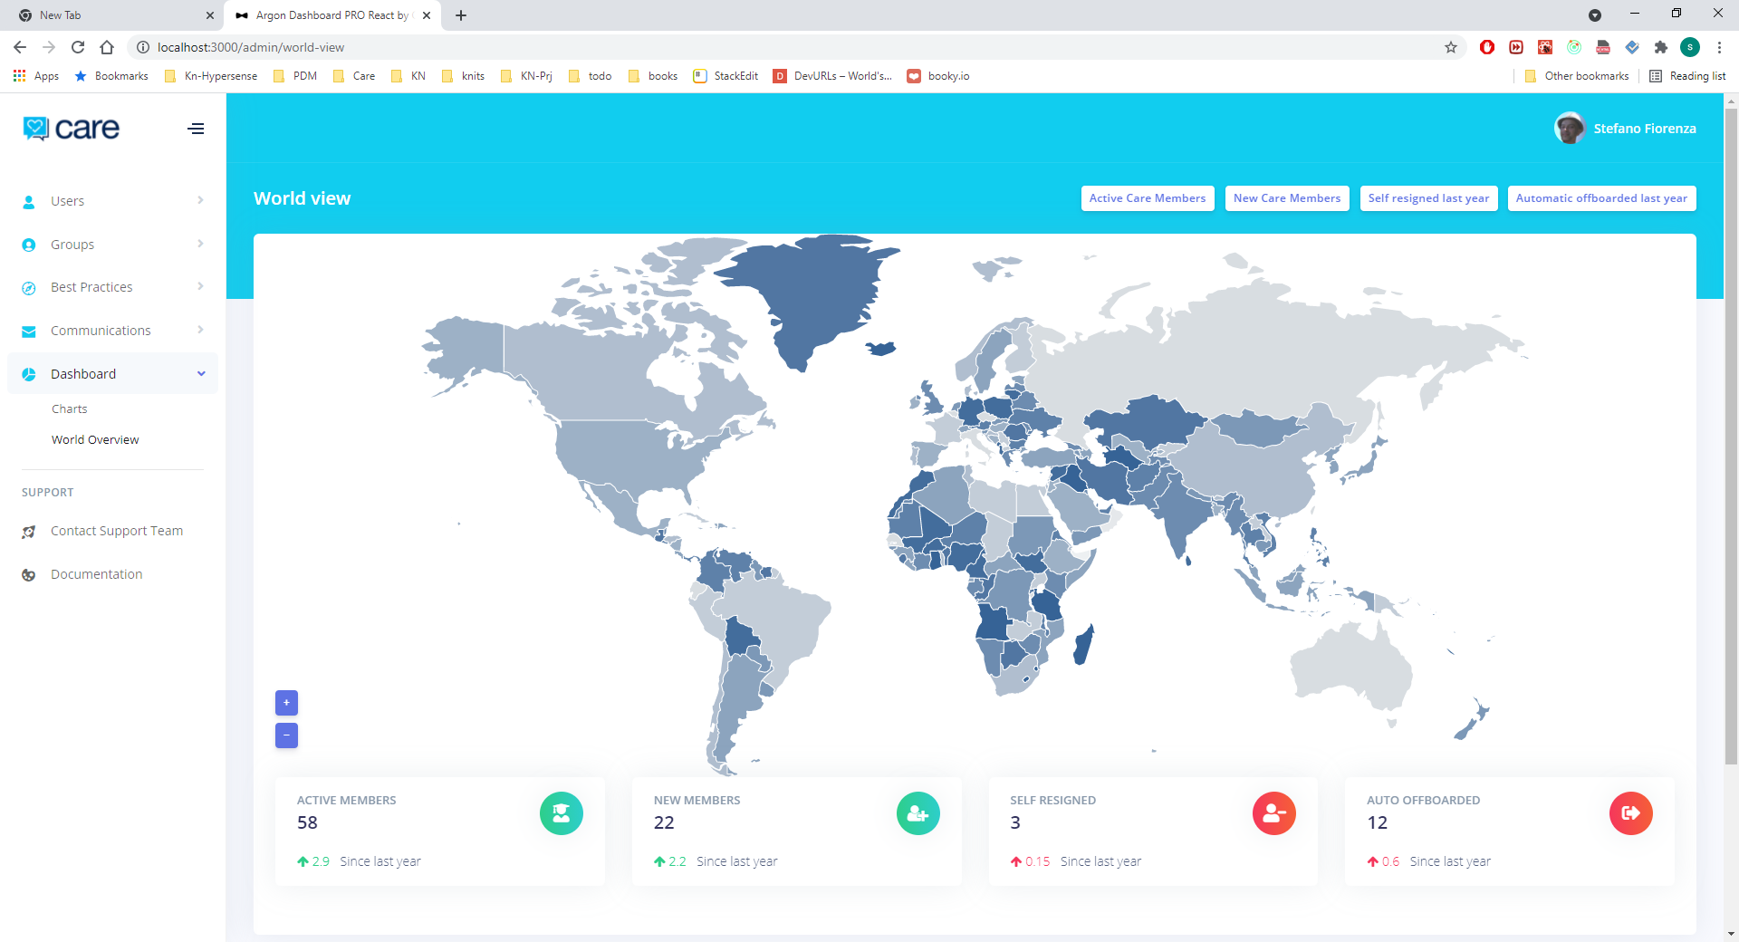
KN Care Product developed in Summer School

