Slide 1
Using the Corporate Presentation
These slides are designed to tell a specific story and are not meant to be used as a template for other presentations. The KN Slide Library is available for that purpose.
There are 2 versions of the title and end slides: KN logo in English or with the German spelling. Please select the one required and delete the other.
Footer / Slide Number
In keeping with our simplified design, we no longer have footers at the bottom of the slides. If you wish to insert slide numbers, please do so manually through Insert > Header & Footer and check the Slide Number box. Check the Apply box to add to a single slide. Check Apply All if you want the number to appear on all slides.
Delete this slide to use the presentation.

Slide 2
Enter Presentation title to a maximum 3 lines of text
Presenter name
Event / occasion / location
Date
Notes:
MAIN TITLE FONT: Corbel bold 42pt white DETAILS FONT: Corbel bold 16pt Light blue
This is the standard title slide. It’s used as the very first slide of every Kuehne + Nagel presentation. See next slide for alternative version with space for customer logos when needed.

Slide 3
Enter Presentation title to a maximum 3 lines of text
Presenter name
Event / occasion / location
Date
Notes:
[GERMAN VERSION OF LOGO NAME]
This is the standard title slide. It’s used as the very first slide of every Kuehne + Nagel presentation. See next slide for alternative version with space for customer logos when needed.
MAIN TITLE FONT: Corbel bold 42pt white PRESENTATION DETAILS FONT: Corbel bold 18pt Light blue

Slide 4

Today, consumers expect everything to be available anytime and anywhere.

Slide 5

This creates a multitude of challenges…

Slide 6


… fuelled by instant information, the fast pace of innovation, evolving technology and advancing economies.

Slide 7
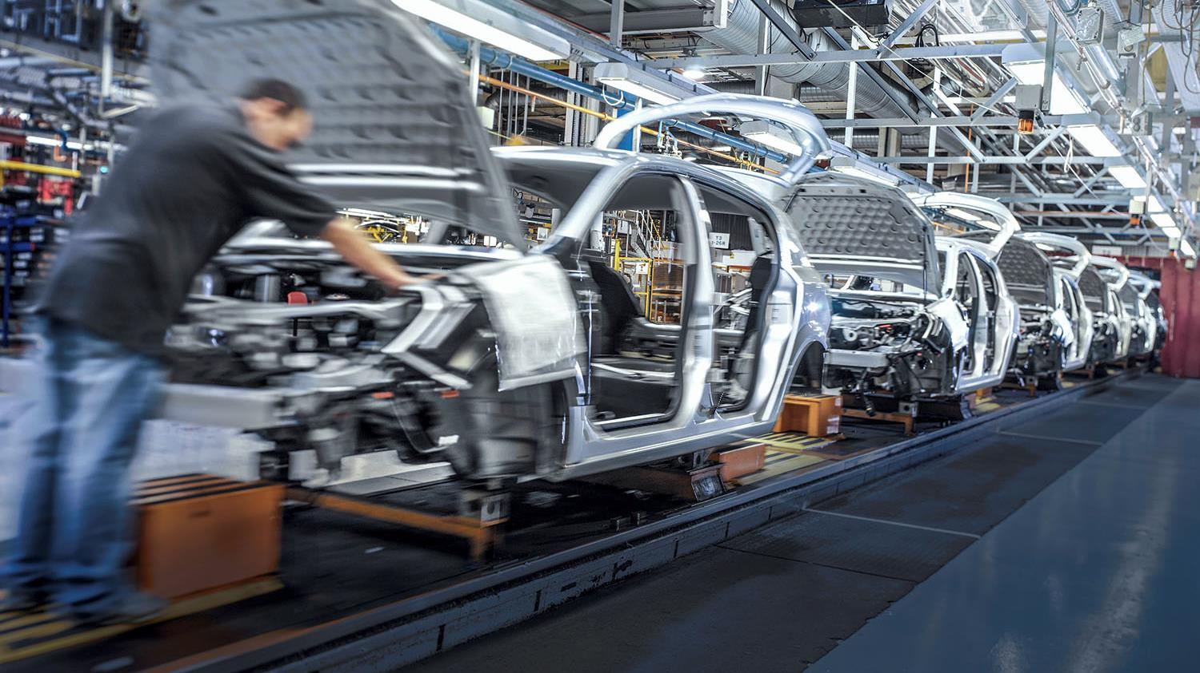
Our customers must convert these challenges …

Slide 8

Immediate response time
Customisation of products
Need to reduce complexity
Measurability
Our customers must convert these challenges …

Slide 9

… and turn them into fruitful business opportunities.

Slide 10
… and turn them into fruitful business opportunities.
Access new markets
Continuously improve customer experience
Innovate
Enhance operational performance
And keep their promises to their customers.

Slide 11
Our Role
We enable our customers to realise these opportunities because we are dedicated to the progress of people and organisations.

Slide 12
Our Mission
We improve our customers’ performance by driving value chains through people, expertise, and technology.

Slide 13

PEOPLE
Collaborate with a leading logistics provider …
At Kuehne + Nagel, we work closely with our customers, no matter their size, to understand their specific needs. Our partnerships are based on trust and a unique system of competences and infrastructures. Together, we grow competitive advantages in a dynamic world.

Slide 14

PEOPLE
… because we are entrepreneurs too.
Working proactively and far-sighted thinking are integral to our culture. We dedicate ourselves to our customers by constantly taking responsibility, challenging the status quo, innovating, and improving our skills. This philosophy forms the bedrock of our long-term customer relationships.

Slide 15
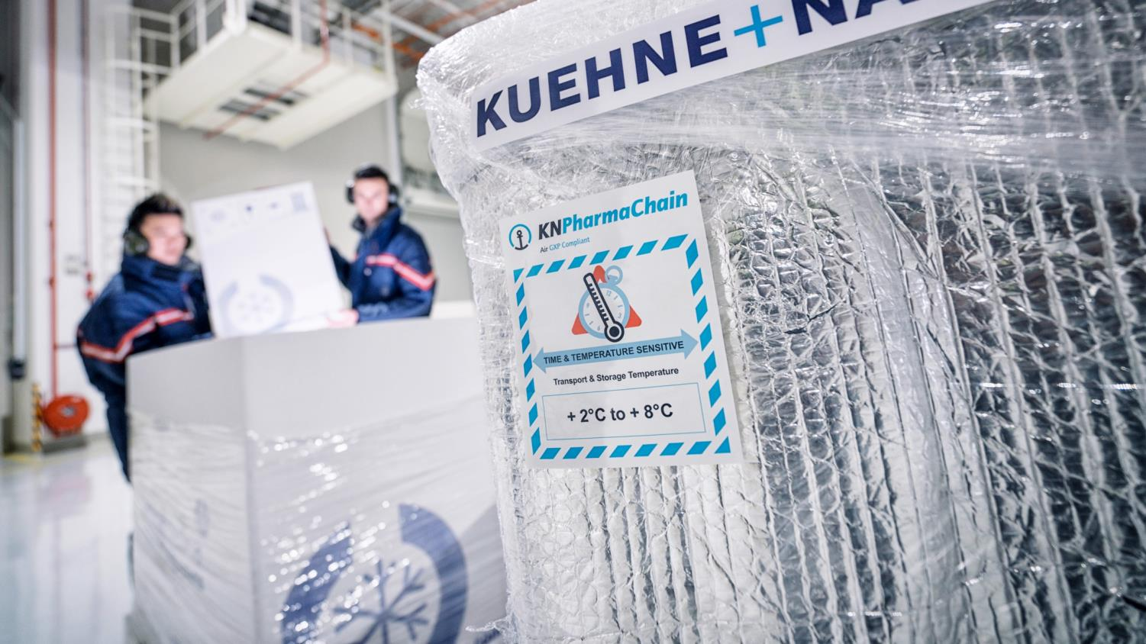
EXPERTISE
Get the right solution …
Take advantage of our wide range of services and specialist know-how and get tailor-made solutions for any need: from standard shipping to complex value chain integrations.

Slide 16

EXPERTISE
… because we are the most powerful logistics network.
Our unique combination of industry expertise, visionary technology, strong market relationships, and global presence, blended with local know-how, allow us to act flexibly and independently and guarantee outstanding quality and operational excellence – even for the most demanding needs.

Slide 17
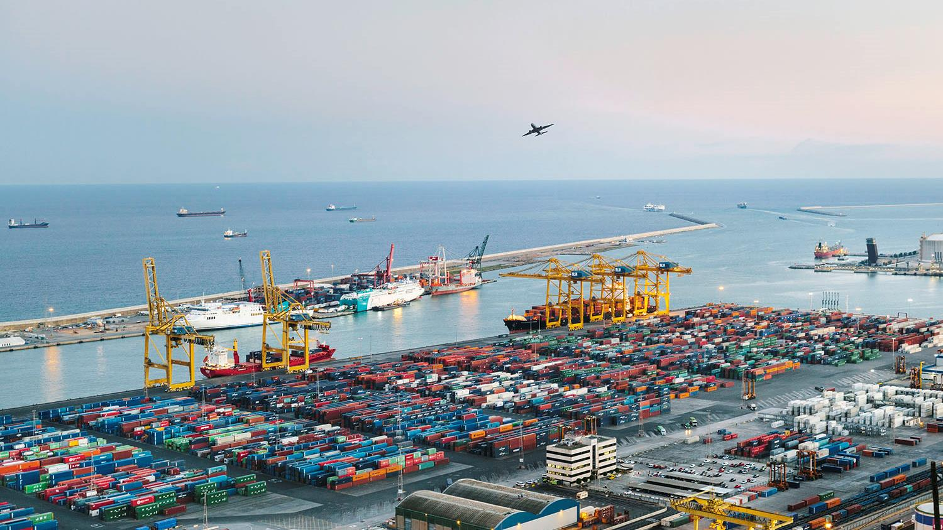
83,000 logistics experts
SEA LOGISTICS
AIR LOGISTICS
More than 4.9 million TEUs handled
1.6 million tons handled
ROAD LOGISTICS
CONTRACT LOGISTICS
32 500 departures from Europe
Over 11.4 million m² warehousing & logistics space
Note: All figures relate to 2019

Slide 18
All our experts are committed to compliance and sustainability.

Slide 19

TECHNOLOGY
Realise measurable value chain improvements …
Make decisions based on customised forecasts and predictive information relevant to the specific situation. Seamless integration makes our data instantly accessible, creating measurable value for our customers’ business.

Slide 20

TECHNOLOGY
… because we are technology-enabled.
We combine cutting-edge technological advances with excellence in data analysis to provide customer-specific insights. Our information systems deliver tailor-made reports, end-to-end transparency, high usability, and guarantee absolute data integrity and security.

Slide 21
We improve our customers’ performance by driving value chains through people, expertise, and technology.

Slide 23
Notes:
[GERMAN VERSION OF NAME]

