Slide 1
KNITS
Kuehne Nagel Information Technology School
Javascript
Technology Overview

Slide 2
Javascript
Agenda
Ajax
Future
Introduction
01
02
03
04
05
DHTML
Node.js
Notes:
© Copyright PresentationGO.com – The free PowerPoint and Google Slides template library

Slide 3
Introduction
1
An historical review

Slide 4
Introduction
Evolution toward standard
Developed by Brendan Eich from Netscape
ECMA Script 1.0 Standard
ECMA Script 3.0 Standard
XmlHttpRequest component AJAX
ECMA Script 6.0 Standard
ECMA Script 8.0 Standard
1996
1998
2004
2009
2016
2018
1995
1997
1999
2005
2015
2017
JavaScript 1.1 in Netscape Navigator 3.0 (Aug), JScript 1.0 in Internet Explorer 3.0 (Aug).
ECMA Script 2.0 Standard
ECMA Script 4.0 Standard
ECMA Script 5.0 Standard
ECMA Script 7.0 Standard
ECMA Script 9.0 Standard

Slide 5
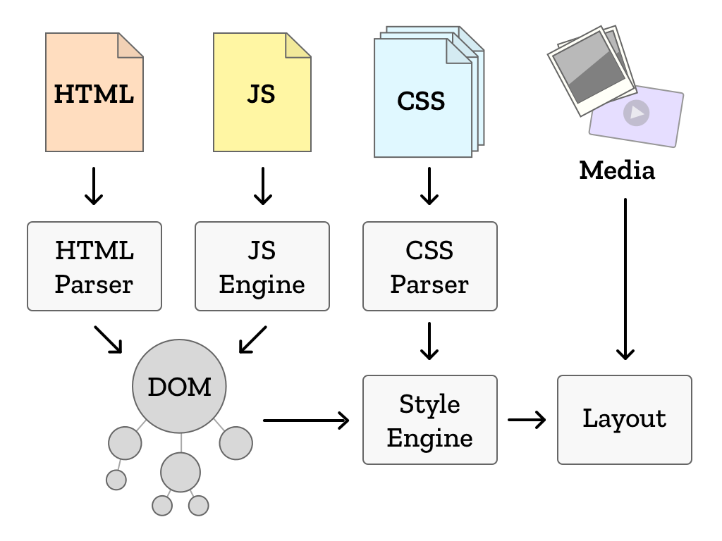
Introduction
Browser runtime

Slide 6
Introduction
Browser runtime: html
<!DOCTYPE html>
<html>
<head>
<meta charset="utf-8">
<meta name="viewport" content="width=device-width, initial-scale=1, shrink-to-fit=no">
<title>404</title>
</head>
<body class="app">
<p class=“warning”>There is no <em>download link</em> on this page. </p>
</body>
</html>

Slide 7
Introduction
Browser runtime: css and javascript
Css to define styles to apply to selected elements from html page
.warning { color: red; }
Javascript to apply some logic on selected html elements
<script type="text/javascript" >
window.alert(document.getElementsByClassName(“warning”)[0].innerHTML);
</script>

Slide 8
Browser
DOM
html: element
head: element
body: element
p: element
meta: element
title: element
charset:attribute
text
text
text
em: element
text

Slide 9
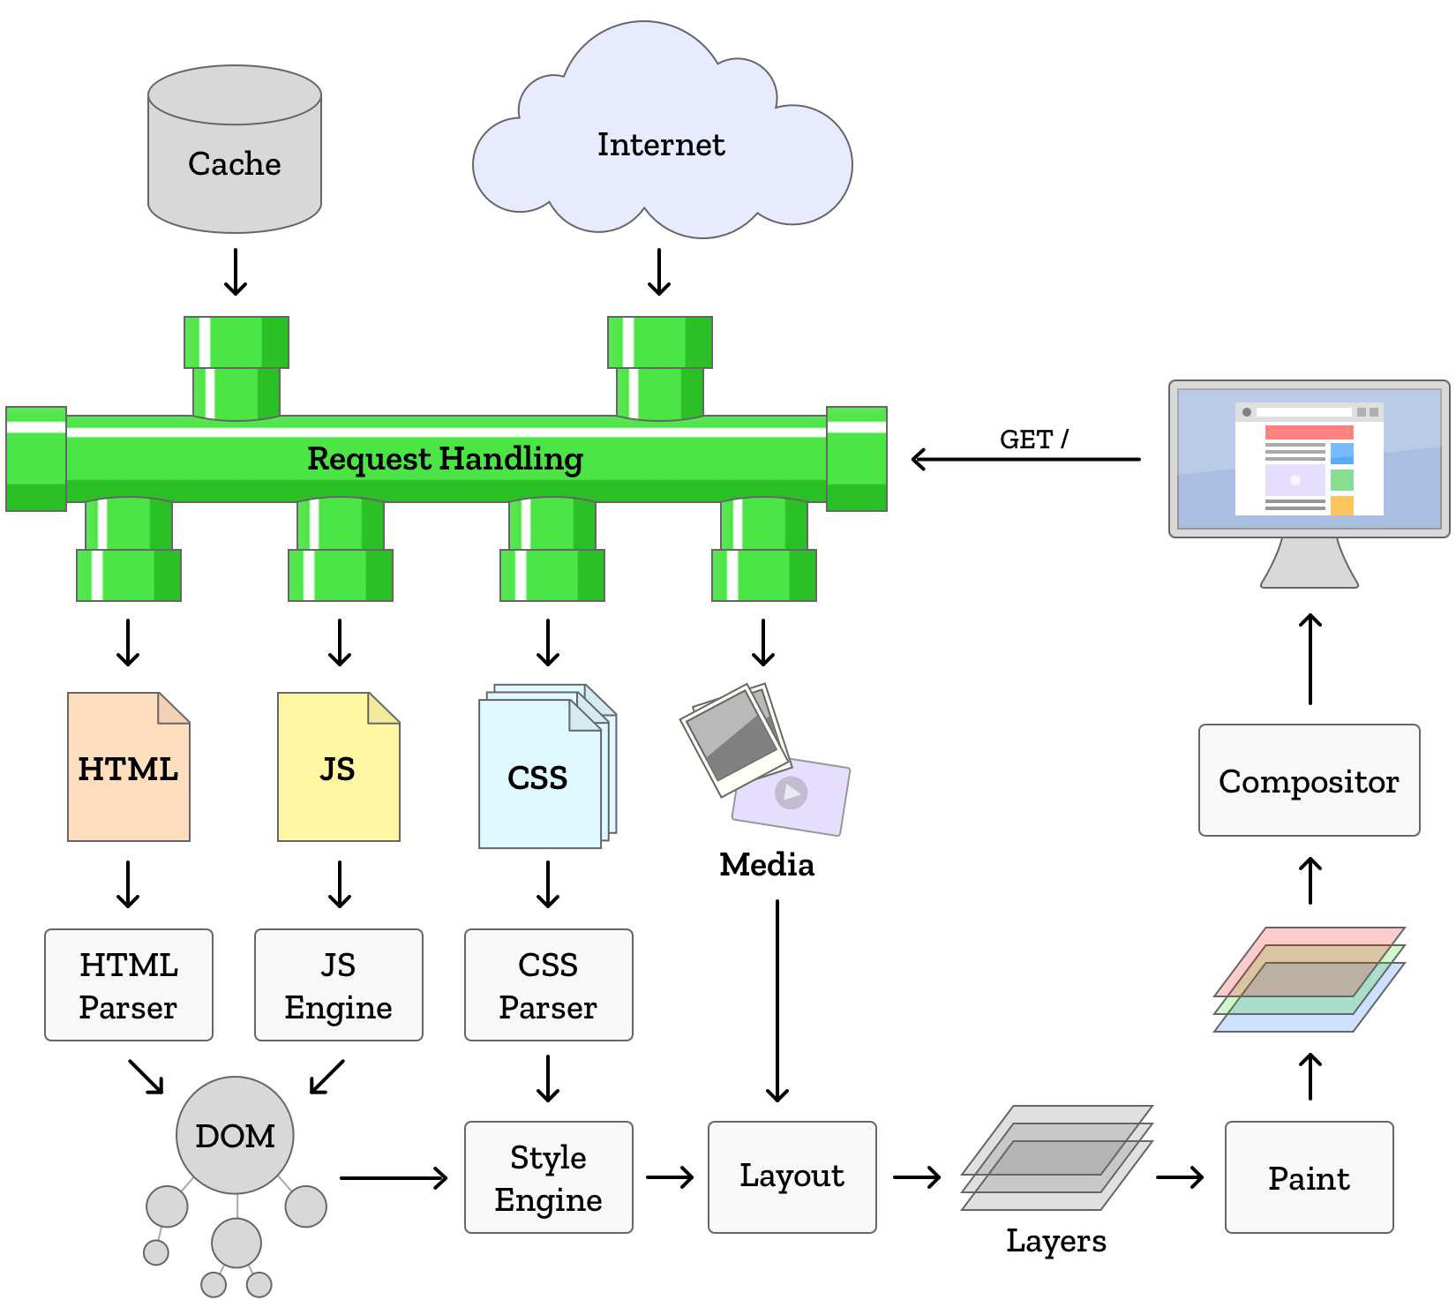
Introduction
Browser runtime

Slide 10
Web Application
Standard: Server side
Data and UI are merged on the server
Every new request from UI to the server create new Page
Whole page is recalculated, delivered to client to replace previous one
User can’t perform any action while waiting for new page to be rendered
Javascript code embedded in page is restricted to :
Implement some logic on data already loaded on UI
Perform validations on data submitted by user
Copy data between UI fields
DHML effects (images rollout, sort tables, change layout elements)

Slide 11


Web Application
Standard: Server side
Browser
Server
Database
Browser http call
Backend System
response http

Slide 12
Introduction
Web Application: Ajax
Early nineties:
Every update in data to display requires generation of a new stream of html + css to be delivered to browsers on client side.
From 1996 : Ajax
1996, Internet Explorer introduces the iframe tag what is able to load data in asynchronous way.
1999, evolution of idea into a new component ActiveX named XMLHTTP
2000 Standard object XmlHttpRequest available for all browsers
2005 AJAX acronym mentioned in essay from Jesse James Garret

Slide 13
Web Application
Ajax: Rich Internet Application
Browser
Server
Database
Ajax http call
Backend System
http response

Slide 14
Web Application
Ajax: Rich Internet Application
Server
1
avoid unnecessary network calls
database
2
state management client side
…
…
Client
Client
Client
Client
Client
Client
Client

Slide 15

Web Application
Ajax: Rich Internet Application

Slide 16
Web Application
Ajax: Rich Internet Application
Common features:
Crossbrowser support
Selectors Api (DOM, CSS, BOM)
Advanced DOM manipulation
Simplified event management
Animation support
UI libraries
Drag and Drop

Slide 17
Web Application
Ajax: Rich Internet Application
Limits for complex UI with many pages:
Weak support for navigation
State management
Limits of javascript as language:
Hard to manage dependency between libraries
No professional IDE

Slide 18






Web Application
SPA: New Technologies available
Browser Storage
Javascript Runtime
IDE

Slide 19
Web Application
Single Page Application
Web Server
Browser
JAVASCRIPT
HTML
Pages
State
Logic
CSS

Slide 20
Web Application
Single Page Application
Browser
JAVASCRIPT
CSS
HTML
Pages
State
Logic

Slide 21
Web Application
SPA: Single Page Application

Slide 22
Web Application
SPA: Single Page Application

Slide 23
V8 open source JavaScript engine sviluppato da Google.
Scritto in C++ ed usato in Google Chrome Browser
Ambiente di esecuzione di JS
NodeJs Creato da Ryan Dahl in 2009
Open Source e multipiattaforma (Win, Mac e Linux)

Slide 24
JS: Web Application III generazione (SPA)
Possibilita di creare librerie e di gestire import da js
Npm dependency management tool
Repository centrale librerie
Server side js (NodeJS)
Storage locale client side (HTML5)
Librerie basate su SVG che permettono grafici dinamici
Web api per JS (GoogleMap, Flickr, Youtube)

Slide 25
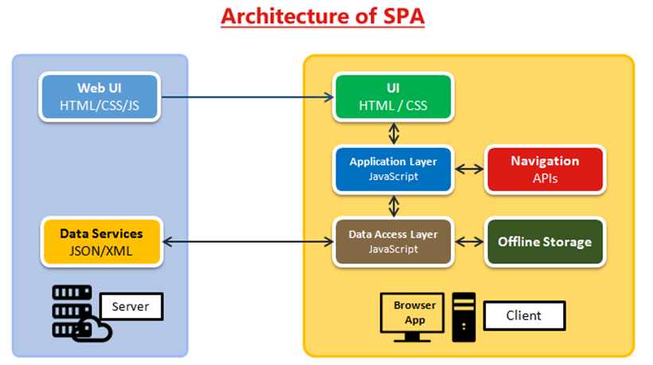
Single Page Application

Slide 26
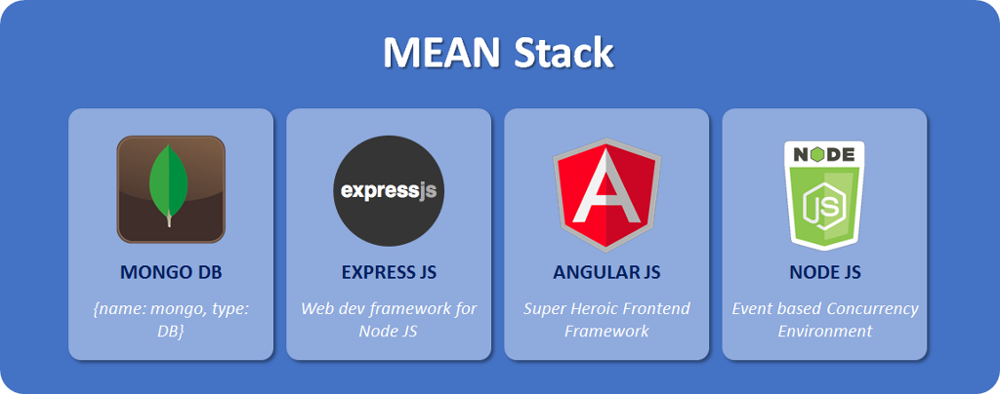

Slide 27
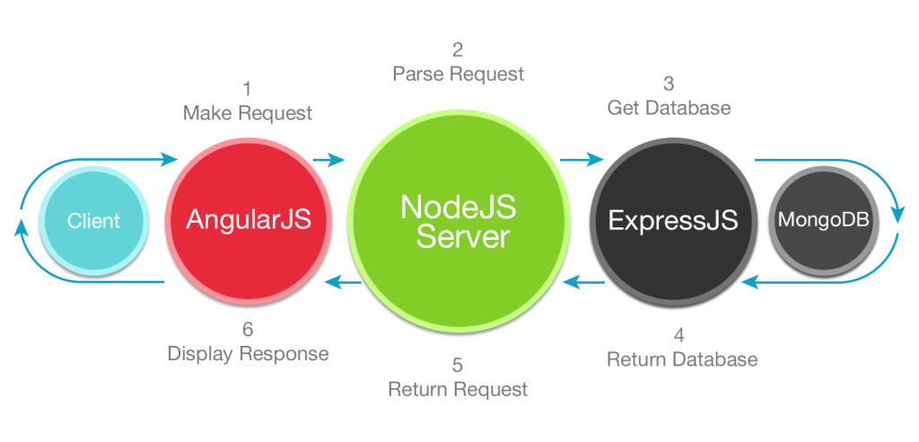

Slide 28





Slide 29








Slide 30
Caricare librerie js da un repository dipendenze
Preprocessing (SASS, LESS, JSX)
Lanciare UTest
Compressione librerie
Offuscamento codice
Deploy (copia files)

