Slide 1
JMS
Notes:
30/07/2009

Slide 2
JMS: Indice argomenti
Sistemi di messaging (introduzione)
Messaggio JMS
Modelli comunicazione
Architettura ed Api
Tipi di consumers
Acks e guaranted delivery
Transazioni
Notes:
30/07/2009

Slide 3
JMS
Java message service (JMS) è l’insieme di API che consentono lo scambio
di messaggi tra applicazioni Java distribuite sulla rete.
La prima specifica JMS è stata rilasciata nel 1998, mentre l’ultima
versione delle API è la 1.1 pubblicata nel 2002
Obiettivi specifica:
Standard per trasmissione/consumo di messaggi tra due (o n) sistemi indipendente da piattaforma e da implementazione
Integrazione loosely coupled tra sistemi
Modalita di trasmissione/consumo messaggi asincrono
Delivery messaggio garantita
Reliable Delivery
Notes:
30/07/2009

Slide 4
JMS: Messaging Systems
Messaging is a method of communication between software components or applications.
A messaging system is a peer-to-peer facility:
A messaging client can send messages to, and receive messages from, any other client.
Each client connects to a messaging agent that provides facilities for creating, sending, receiving, and reading messages.
Notes:
30/07/2009

Slide 5
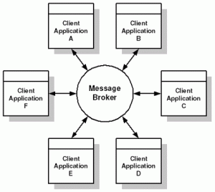
JMS: Message Broker
Message Oriented Middleware (MOM)
Message Broker
Message Provider
Notes:
30/07/2009

Slide 6
JMS: loosely coupled.
Messaging enables distributed communication that is loosely coupled.
A component sends a message to a destination, and the recipient can retrieve the message from the destination.
However, the sender and the receiver do not have to be available at the same time in order to communicate.
In fact, the sender does not need to know anything about the receiver; nor does the receiver need to know anything about the sender.
The sender and the receiver need to know only which message format and which destination to use.
Notes:
30/07/2009

Slide 7
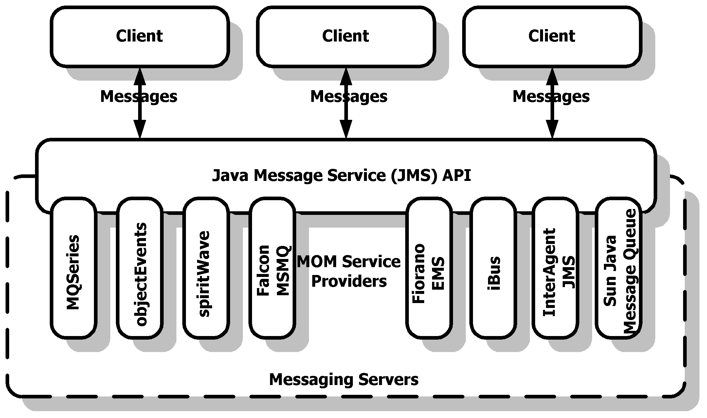
JMS: Indipendenza piattaforma
Notes:
30/07/2009

Slide 8
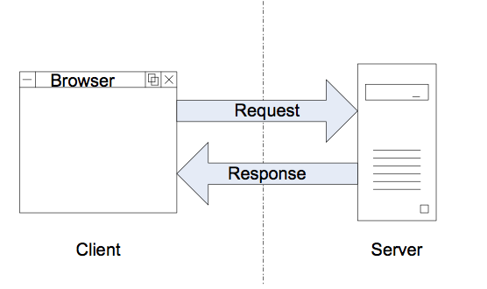
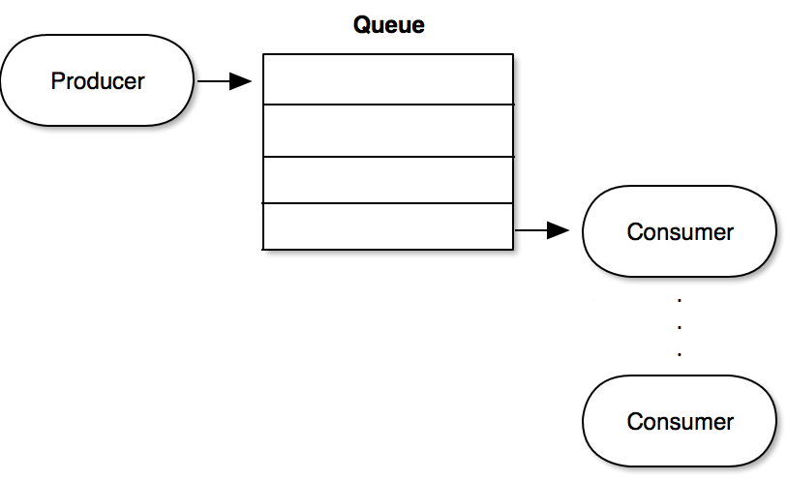
JMS: Comunicazione asincrona
Comunicazione sincrona:
Esempio protocollo Http
Comunicazione asincrona:
Notes:
30/07/2009

Slide 9
JMS: What Is the JMS API?
The JMS API enables communication that is not only loosely coupled but also
Asynchronous: A JMS provider can deliver messages to a client as they arrive; a client does not have to request messages in order to receive them.
Reliable: The JMS API can ensure that a message is delivered once and only once. Lower levels of reliability are available for applications that can afford to miss messages or to receive duplicate messages.
Notes:
30/07/2009

Slide 10
JMS: Scenari e Use cases
The provider wants the components not to depend on information about other components’ interfaces, so that components can be easily replaced.
The provider wants the application to run whether or not all components are up and running simultaneously.
The application business model allows a component to send information to another and to continue to operate without receiving an immediate response.
Notes:
30/07/2009

Slide 11
JMS: Scenari e Use cases
Esempio
Sistema invio Ordini automatico
Compravendita Titoli OnLine
Sistema Betting On line
Notes:
30/07/2009

Slide 12
JMS: Messaggio
In ambito JMS, un messaggio è un raggruppamento di dati che viene
inviato da un sistema ad un altro
I dati sono solitamente utilizzati per notificare eventi e sono pensati per
essere utilizzati da un programma su una macchina e non
direttamente da un utente umano
In un scenario distribuito un messaging service può essere pensato
come un sistema distribuito di notifica di eventi
Notes:
30/07/2009

Slide 13
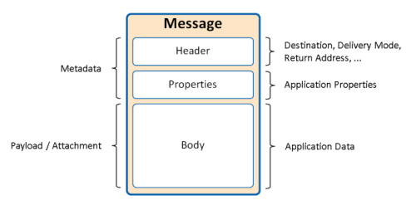
JMS: Struttura Messaggio
dfsdf
Notes:
30/07/2009

Slide 14
JMS: Struttura Messaggio
Message Headers standard:
Header Field | Set By
JMSDestination | send or publish method
JMSDeliveryMode | send or publish method
JMSExpiration | send or publish method
JMSPriority | send or publish method
JMSMessageID | send or publish method
JMSTimestamp | send or publish method
JMSCorrelationID | Client
JMSReplyTo | Client
JMSType | Client
JMSRedelivered | JMS provider
Notes:
30/07/2009

Slide 15
JMS: Struttura Messaggio
Message Type | Body Contains
TextMessage | A java.lang.String object (for example, the contents of an XML file).
MapMessage | A set of name-value pairs, with names as String objects and values as primitive types in the Java programming language. The entries can be accessed sequentially by enumerator or randomly by name. The order of the entries is undefined.
BytesMessage | A stream of uninterpreted bytes. This message type is for literally encoding a body to match an existing message format.
StreamMessage | A stream of primitive values in the Java programming language, filled and read sequentially.
ObjectMessage | A Serializable object in the Java programming language.
Message | Nothing. Composed of header fields and properties only. This message type is useful when a message body is not required.
Notes:
30/07/2009

Slide 16
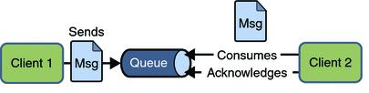
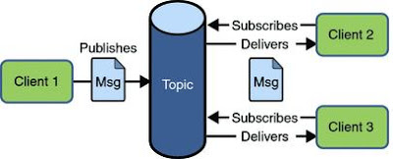
JMS: Modelli comunicazione
Queue: Point to Point
Topic: Publish- Subscribe
Notes:
30/07/2009

Slide 17
JMS: Modelli Comunicazione
Point-to-point:
Più client JMS possono condividere la stessa
destination (queue)
Un messaggio può essere processato in modo esclusivo da un unico consumer
Permette una comunicazione uno-a-uno
Publish/Subscribe:
Un messaggio inserito nella destinazione (topic)
e’ inviato a tutti i destinatari (subscriber) che si sono dichiarati interessati a riceverlo
Consente una comunicazione uno-a-molti
Notes:
30/07/2009

Slide 18
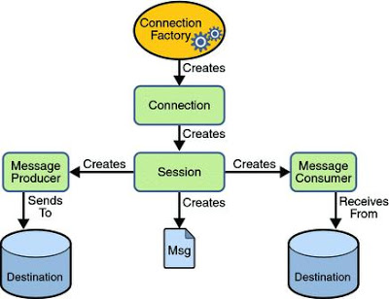
JMS: Architettura Api
Notes:
30/07/2009

Slide 19
JMS: API Architecture
JMS API Architecture
A JMS provider is a messaging system that implements the JMS interfaces and provides administrative and control features. An implementation of the Java EE platform includes a JMS provider.
JMS clients are the programs or components, written in the Java programming language, that produce and consume messages. Any Java EE application component can act as a JMS client.
Messages are the objects that communicate information between JMS clients.
Administered objects are preconfigured JMS objects created by an administrator for the use of clients. The two kinds of JMS administered objects are destinations and connection factories.
Notes:
30/07/2009

Slide 20
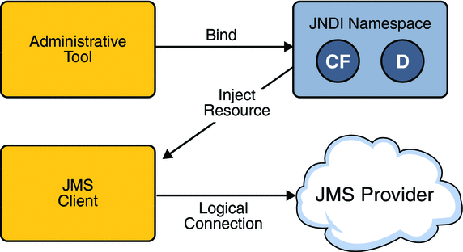
JMS: Administered Objects
Notes:
30/07/2009

Slide 21
JMS: Consumo messaggi
The JMS API Programming Model
The basic building blocks of a JMS application consist of
Administered objects: connection factories and destinations
Connections
Sessions
Message producers
Message consumers
Messages
Notes:
30/07/2009

Slide 22
JMS: Connections
JMS Connections
A connection encapsulates a virtual connection with a JMS provider. A connection could represent an open TCP/IP socket between a client and a provider service daemon. You use a connection to create one or more sessions.
Connections implement the Connection interface. When you have a ConnectionFactory object, you can use it to create a Connection:
Connection connection = connectionFactory.createConnection(); Before an application completes, you must close any connections that you have created. Failure to close a connection can cause resources not to be released by the JMS provider. Closing a connection also closes its sessions and their message producers and message consumers.
connection.close(); Before your application can consume messages, you must call the connection’s start method; for details, see JMS Message Consumers. If you want to stop message delivery temporarily without closing the connection, you call the stop method.
Notes:
30/07/2009

Slide 23
JMS: Destinations
JMS Destinations
A destination is the object a client uses to specify the target of messages it produces and the source of messages it consumes.
In the PTP messaging domain, destinations are called queues. In the pub/sub messaging domain, destinations are called topics.
A JMS application can use multiple queues or topics (or both).
To create a destination using the Application Server, you create a JMS destination resource that specifies a JNDI name for the destination.
In the Application Server implementation of JMS, each destination resource refers to a physical destination.
You can create a physical destination explicitly, but if you do not, the Application Server creates it when it is needed and deletes it when you delete the destination resource.
Notes:
30/07/2009

Slide 24
JMS: Session
A session is a single-threaded context for producing and consuming messages.
You use sessions to create the following:
Message producers
Message consumers
Messages
Queue browsers
TemporaryQueue e TemporaryTopic
A session provides a transactional context with which to group a set of sends and receives into an atomic unit of work.
Notes:
30/07/2009

Slide 25
JMS: Session
A session provides a transactional context with which to group a set of sends and receives into an atomic unit of work. For details, see Using JMS API Local Transactions.
Sessions implement the Session interface.
After you create a Connection object, you use it to create a Session:
Session session = connection.createSession(false, Session.AUTO_ACKNOWLEDGE);
The first argument means that the session is not transacted; the second means that the session automatically acknowledges messages when they have been received successfully.
To create a transacted session, use the following code:
Session session = connection.createSession(true, 0); Here, the first argument means that the session is transacted; the second indicates that message acknowledgment is not specified for transacted sessions.
Notes:
30/07/2009

Slide 26
JMS: Consumo messaggi
Message Consumption
Messaging products are inherently asynchronous: There is no fundamental timing dependency between the production and the consumption of a message. However, the JMS specification uses this term in a more precise sense. Messages can be consumed in either of two ways:
Synchronously: A subscriber or a receiver explicitly fetches the message from the destination by calling the receive method. The receive method can block until a message arrives or can time out if a message does not arrive within a specified time limit.
Asynchronously: A client can register a message listener with a consumer. A message listener is similar to an event listener. Whenever a message arrives at the destination, the JMS provider delivers the message by calling the listener’s onMessage method, which acts on the contents of the message.
Notes:
30/07/2009

Slide 27
JMS: Ack e guaranted delivery
Client runtime:
Before we discuss these parts, we need to review and define some new terms.
A JMS client application uses the JMS API.
Each JMS vendor provides an implementation of the JMS API on the client, which we call the client runtime.
Jms Provider:
In addition to the client runtime, the JMS vendor provides some kind of message "server" that implements the routing and delivery of messages. The client runtime and the message server are collectively referred to as the JMS provider.
Notes:
30/07/2009

Slide 28
JMS: Ack e guaranted delivery
"Provider failure"
refers to any failure condition that is outside the domain of the application code.
It could mean a hardware failure that occurs while the provider is entrusted with the processing of a message, an unexpected exception, the abnormal end of a process due to a software defect, or network failures.
Notes:
30/07/2009

Slide 29
JMS: Ack e guaranted delivery
Message lifecycle:
Once a JMS client sends a message, its role is completed.
The JMS provider guarantees that any other interested parties will receive the message.
This contract between a sending JMS client and the JMS provider is much like the contract between a JDBC client and a database. Once the data is delivered, it is considered "safe" and out of the hands of the client.
Notes:
30/07/2009

Slide 30
JMS: Ack e guaranted delivery
Store-and-Forward Messaging
When messages are marked persistent, it is the responsibility of the JMS provider to utilize a store-and-forward mechanism to fulfill its contract with the sender.
The storage mechanism is used for persisting messages to disk to ensure that the message can be recovered in the event of a provider failure or a failure of the consuming client. The forwarding mechanism is responsible for retrieving messages from storage, and subsequently routing and delivering them.
Notes:
30/07/2009

Slide 31
JMS: Ack e guaranted delivery
Message Acknowledgments
The message acknowledgment protocol is key to guaranteed messaging, and support for acknowledgment is required by the semantics of the JMS API. The acknowledgment protocol allows the JMS provider to monitor the progress of a message so that it knows whether the message was successfully produced and consumed. With this knowledge the JMS provider can manage the distribution of messages and guarantee their delivery.
Notes:
30/07/2009

Slide 32
JMS: Ack e guaranted delivery
L’ack e’ un messaggio inviato come risposta alla spedizione/ricezione messaggio tra un client ed un MOM
Ack producer:
Inviato dal MOM al producer.
Conferma al producer che il messaggio e’ stato salvato sul MOM.
Ack consumer:
Inviato dal consumer al MOM.
Solo alla ricezione del ack il MOM e’ autorizzato a cancellare dal DB il corrispondente messaggio.
Se il messaggio non risulta ricevuto (unacked) il MOM effettuera’ altri tentativi.
(visibili nel JMSHeader redelivered=true)
Notes:
30/07/2009

Slide 33
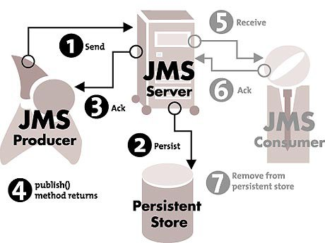
JMS: Producer Ack
Notes:
30/07/2009

Slide 34
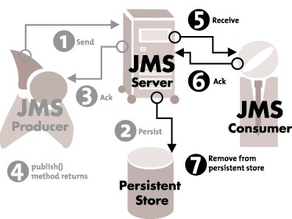
JMS: Consumer Ack
Notes:
30/07/2009

Slide 35
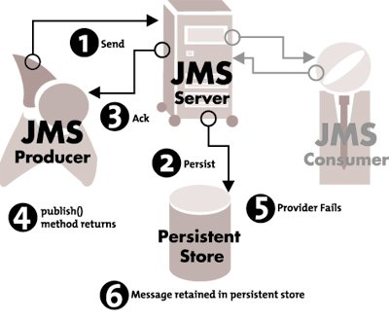
JMS: Durable Message Provider failure Recovery
Notes:
30/07/2009

Slide 36
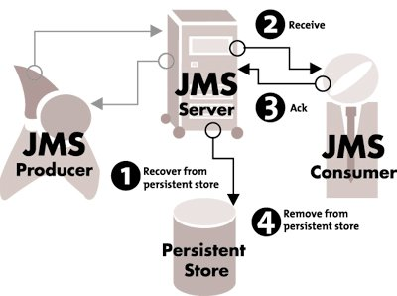
JMS: Durable message acked da Consumer
Notes:
30/07/2009

Slide 37
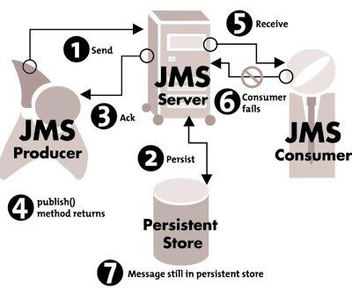
JMS: Consumer failure (Ack non spedito)
Notes:
30/07/2009

Slide 38
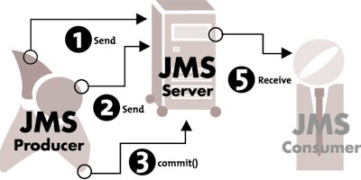
JMS: Transazioni Locali Producer (Ack spedito al commit)
Notes:
30/07/2009

Slide 39
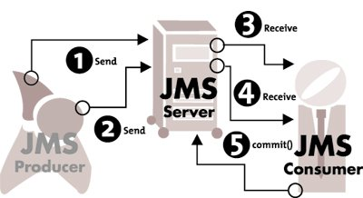
JMS: Transazioni Locali Consumer (Ack spedito al commit)
Notes:
30/07/2009

Slide 40
JMS: Tipi di Ack
AUTO_ACKNOWLEDGE
DUPS_OK_ACKNOWLEDGE
CLIENT_ACKNOWLEDGE
SESSION_TRANSACTED
Notes:
30/07/2009

Slide 41
JMS: Tipi di Ack
AUTO_ACKNOWLEDGE
Producer
Ack viene mandato in automatico al momento del
TopicPublisher.publish()
QueueSender.send()
Metodi sincroni che bloccano il thread fino alla ricezione dell Ack dal MOM.
Se si verifica un’eccezione in questa operazione, questa deve essere gestita dal thread del producer ed il messaggio non verra’ inoltrato al MOM.
Consumer:
Ack viene mandato in automatico al momento del
1) uscita onMessage del Listener
2) receive del Poller
Non Ack (Redelivery) se:
1) onMessage va in eccezione
2) errore delivery del MOM sul metodo receive
Notes:
30/07/2009

Slide 42
JMS: Tipi di Ack
CLIENT_ACKNOWLEDGE
Producer:
Non cambia nulla, l’ack viene spedito dal MOM.
Consumer:
Ack viene mandato esplicitamente con message.acknowledge()
ED: si puo’ indicare un punto precedente al default (uscita onMessage)
PL: si puo’ indicare un punto successivo al default (receive restituisce)
Notes:
30/07/2009

Slide 43
JMS: Tipi di Ack
DUPS_OK_ACKNOWLEDGE
Premessa:
La gestione dei duplicati da parte del MOM ha un suo costo in termini di performances.
Questo tipo di Ack sulla session, permette di evitare questo overhead, evitando il check.
TradeOff: Trasmissione piu veloce / Client deve gestire eventuali duplicati.
SESSION_TRANSACTED
Delegato alla commit sulla transazione
Notes:
30/07/2009

Slide 44
JMS: Transazioni locali
Transazioni JMS: (se transacted=true, default = false)
Scopo: Raggruppare il destino di N messaggi tra loro.
Tutti vengono spediti (prod) o ricevuti( cons)
Quando:
Raro dal lato consumer.
Lato producer puo’ accadere che il send di un messaggio sia parte di una transazione per cui sia necessario che N operazioni si completino prima di poter dare la commit a N messaggi.
Come:
Ogni transazione e’ demarcata dalla commit successiva. Si attende una session.commit
Alla commit:
Producer: il MOM salva i messaggi. (Prima se li tiene in cache e non si considerano acquisiti dal MOM)
Consumer:
Il MOM e’ autorizzato a cancellare gli N messaggi spediti tutti in una volta.
Notes:
30/07/2009

Slide 45
JMS: Transazioni distribuite
Transazioni XA:
Se la ConnectionFactory supporta lo standard XA e’ possibile partecipare ad una transazione distribuita.
Gestite da un TransactionManager come coordinatore e da N ResourceAdapters compatibili con specifica XA.
Transazione distruibuita consiste in due fasi:
voting phase:
Il Tm inoltra a tutti i RA gli updates da eseguire in transazione.
Sia il TM che gli RA scrivono gli updates nel loro log.
Ogni RA verifica la fattibilita dell’update richiesto e restituisce al TM un messaggio di commit o rollback.
termination phase:
Alla ricezione di tutti i messaggi di feedback dai RA coinvolti il TM autorizza la commit o la rollback per tutti i RA.
Notes:
30/07/2009

Slide 46
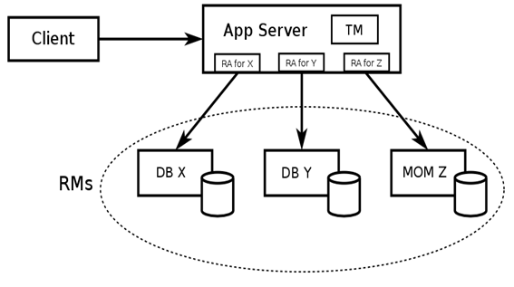
JMS: Transazioni distribuite
Notes:
30/07/2009

Slide 47
JMS: Transazioni distribuite
Transazioni XA e Crash:
Una volta che il TM o il RA salva sul suo log gli updates da eseguire, in caso di crash, l’operazione verra’ ritentata in conseguenza della sua procedura di recovery.
Se il crash si verifica sul TM o sul RA prima di aver scritto sul suo log la transazione andra’ invece in rollback.
Notes:
30/07/2009

