Slide 1

KNITS
SPRING SECURITY

Slide 2
OVERVIEW
  Features
  Architecture
  Security Domain Concepts
  Configuration
  Authentication methods
  Authorization management
p. <number>

Slide 3
FEATURES
  Designed and updated to prevent some of the
  common attacks to web applications
  Easy to integrate in any web application.
  Support many authentication methods
  Authorization by URL patterns, role,
  Authorization tags, EL
  Support for groups and roles.
p. <number>

Slide 4
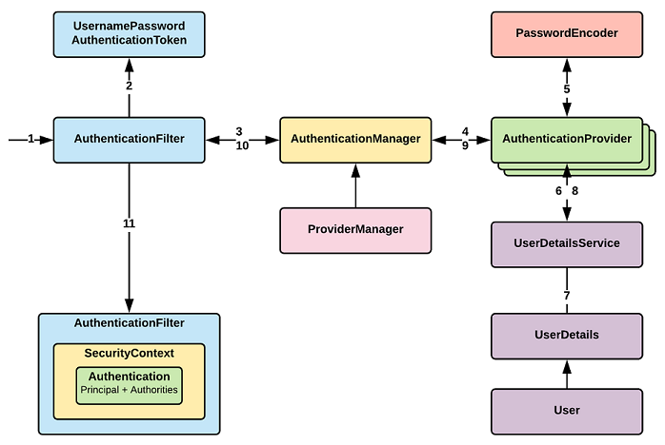
Security Domain
p. <number>

Slide 5
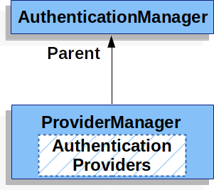
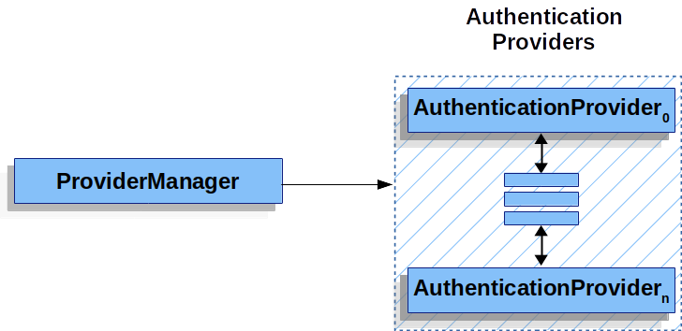
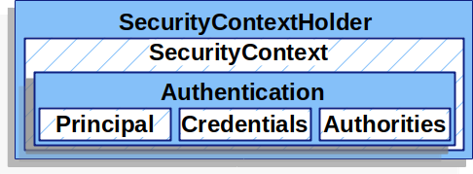
Architecture
p. <number>

Slide 6
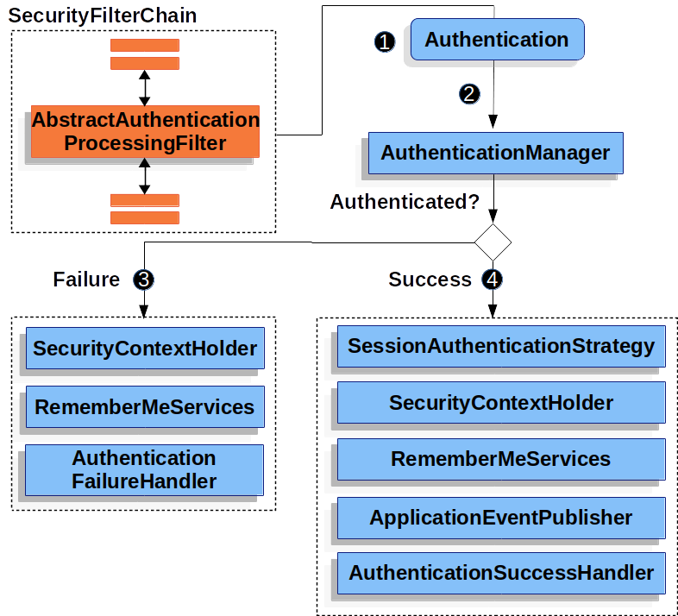
Http Request Lifecycle
p. <number>

Slide 7
Enable security in Spring Boot
  Add dependency spring-boot-starter-security
  Default Spring Boot setup:
    All url paths are secured and trigger authentication
    Default User is created with username user and random password
    Default login form is provided
  Override default configuration with:
    Override default user from application.properties:
      spring.security.user.name=aNiceUsername
      spring.security.user.password=someSecurePassword
      spring.security.user.roles=manager
    Override default url to secure by
      Annotate config class with @EnableWebSecurity annotation,
      Extend WebSecurityConfigurerAdapter,
      Override configure(HttpSecurity http)
      Override configure(AuthenticationManagerBuilder auth)
p. <number>

Slide 8
Spring Boot : Basic Authentication
p. <number>

Slide 9
Authentication Methods
  In Memory
  Basic
  Form Based
  DB Jdbc
  LDAP
  JWT
  X509
  SAML
  Oauth
  Custom
p. <number>

Slide 10
Authorization
  Identify:
  Which resources should be restricted
  By Roles
  By Authorities
p. <number>

Slide 11
Authorization
  Identify:
  Spring Security Expression Language
  Method level Authorization
  Spring Security Tags
p. <number>

