Slide 1
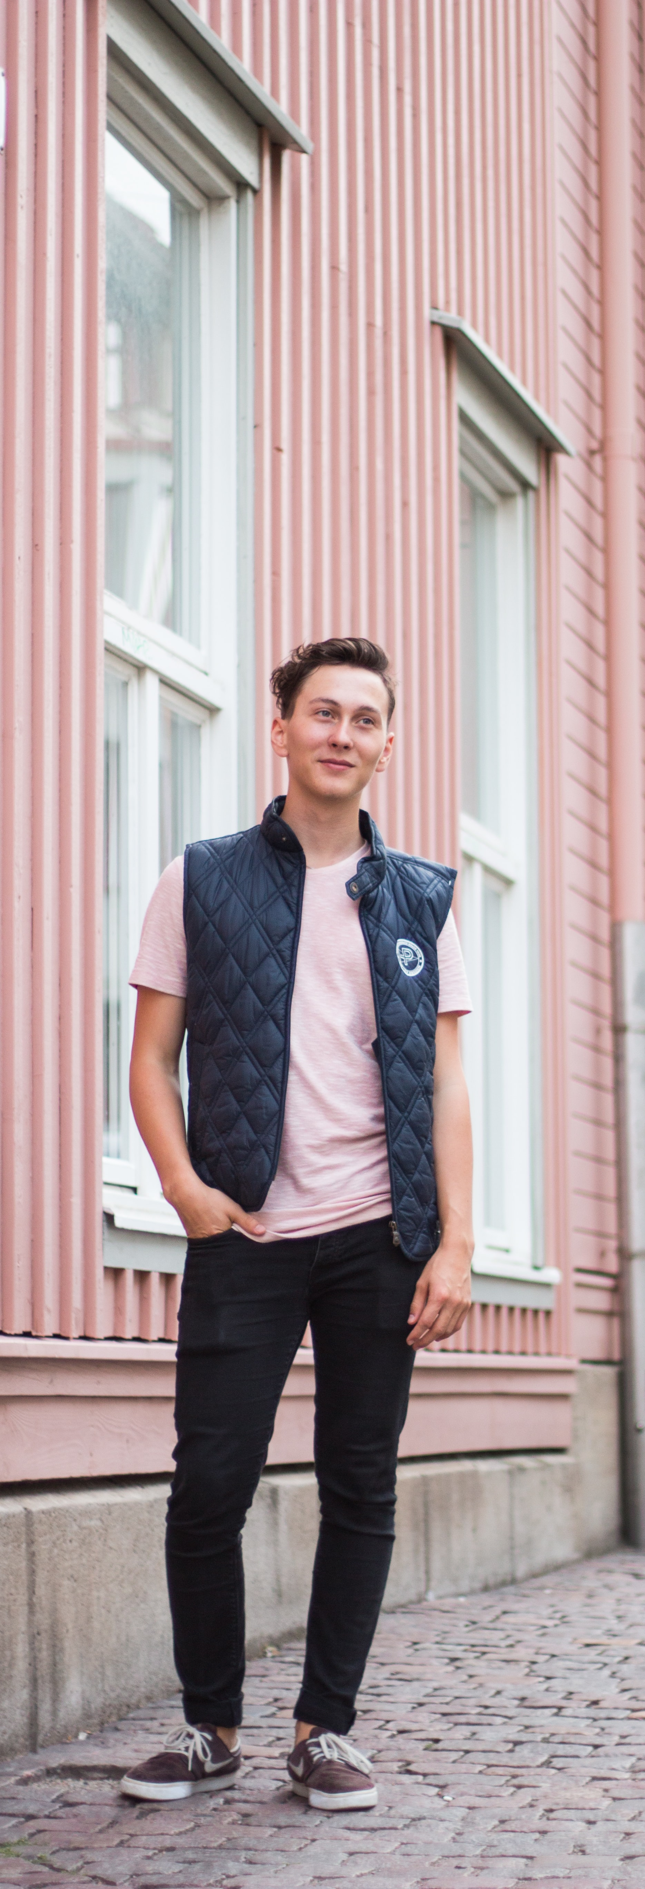






ABOUT ME
BIO
“
Shy
Curious
Thinker
Empath
Ettore Verdi is an off-site student. He studies Architecture, he is at 5th year. He spends most of his time into the Sapienza Campus, also known as “Città Universitaria”. He lives with other four students in a tiny apartment in San Lorenzo, so when he needs some relax he loves to find new quite places around the city. He also loves to swims twice a week. He is a calm person but if he has the opportunity to try new experiences he catches them.
“Order is power”
“
Personality
Introvert
Extrovert
Analytical
Creative
Loyal
Fickle
Motivations
Passive
Active
STUDY
RELAX
ACCOMPANY
SOMEONE
BEING
ENTERTAINED
Goals
Frustrations
Find peaceful places to chill out
Give an order to everything
Get rich
Cohabit with too many people
Deal with asymmetric things
ETTORE VERDI
San Lorenzo, Roma
STUDENT
^{· STATUS}
^{SINGLE}
^{· ARCHETYPE}
^{PERFECTIONIST}
^{· AGE}
²⁴

Slide 2
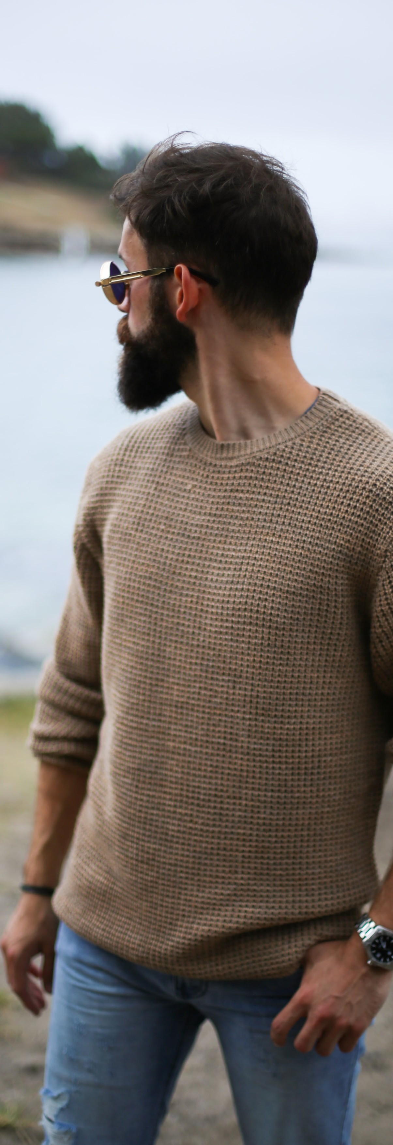
ABOUT ME
BIO
“Learn the rules like a pro, so you can break them like an artist”
Funny
Smart
Self confident
Hyperactive
Enea Bianchi works as software developer in a small company. He studied Engineering in Computer Science at Sapienza, University of Rome. His girlfriend Lavinia is 24 years old and studies Biology. He is wondering to go to live together with her even if he would like to have some experiences abroad. He always wants to try new things due to his hyperactivity.
“
“
Personality
Introvert
Extrovert
Analytical
Creative
Loyal
Fickle
Motivations
Passive
Active
STUDY
RELAX
ACCOMPANY
SOMEONE
BEING
ENTERTAINED
Goals
Frustrations
Have fun
An abroad experience
Make is friends happy
Become a parachutist
Low salary
Does not like to wait
ENEA BIANCHI
Ostiense, Roma
EMPLOYEE
^{· STATUS}
^{ENGAGED}
^{· ARCHETYPE}
^{FUNNY GUY}
^{· AGE}
²⁸

Slide 3
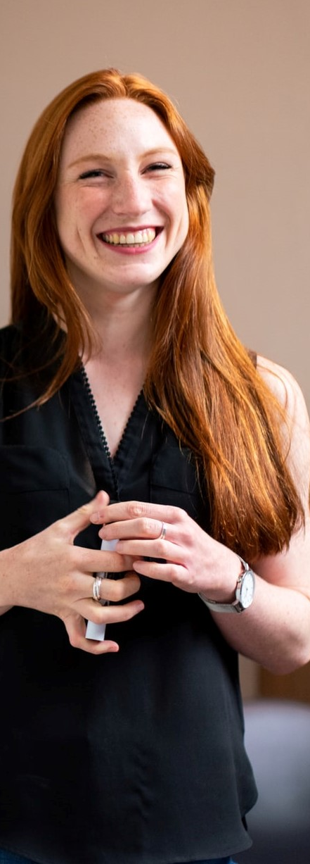
ABOUT ME
BIO
“If you change the way you look at things, the things you look at change”
Organized
Practical
Dreamer
Creative
Elena Rossi teaches Literature at "Liceo Artistico Giorgio De Chirico". Literature is her great passion but during the years she discovered the love for art. Her husband is a computer engineer. They have two kids, Silvia and Stefano. She spends most of her free time studying art, even if it is not so much time. A colleague suggested her to visit "Museo dell'Arte Classica della Sapienza". She loves to stay there since there are lots of replicas of very famous pieces of art. She does not need to be entertained or guided during the visit: she knows what to see.
“
“
Personality
Introvert
Extrovert
Analytical
Creative
Loyal
Fickle
Motivations
Passive
Active
STUDY
RELAX
ACCOMPANY
SOMEONE
BEING
ENTERTAINED
Goals
Frustrations
Study pieces of art according to a schedule
Transmit her passions
She does not want to be disturbed during her tours
Few free time
ELENA ROSSI
Re Di Roma, Roma
TEACHER
^{· STATUS}
^{MARRIED}
^{· ARCHETYPE}
^{ART LOVER}
^{· AGE}
³⁸

