Slide 1

Delta
Radiomics
AIE1903
LIU Chang (125090409)

Slide 2
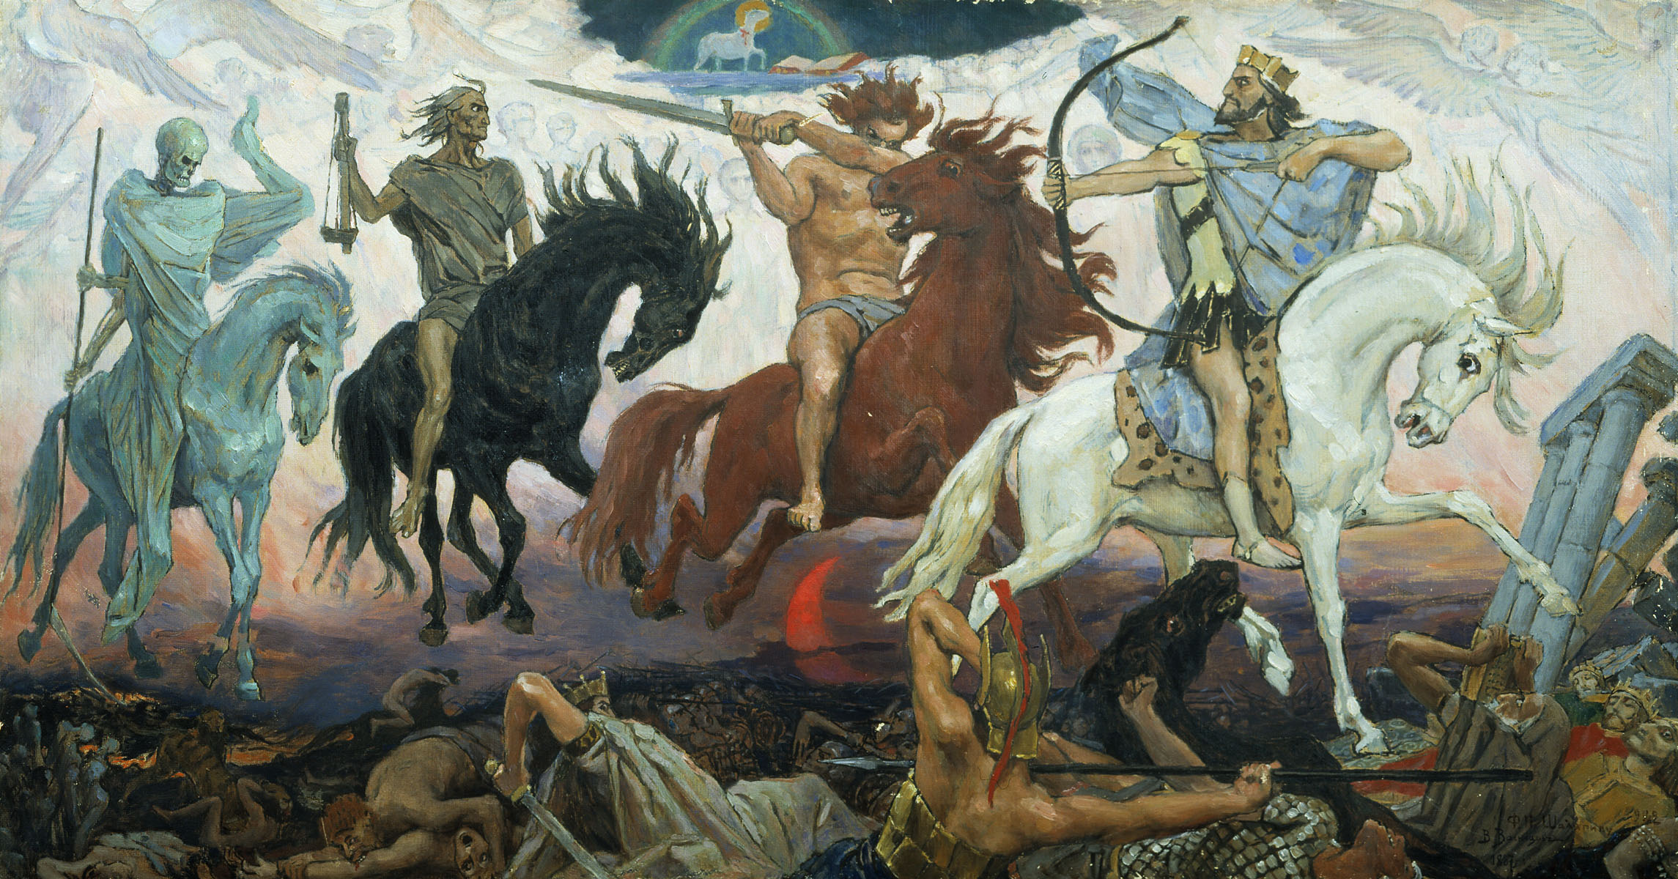

      Definition and Significance
Delta-radiomics measures changes in quantitative imaging features between scans taken at different time points.
It can help assess treatment response or disease progression earlier by detecting changes beyond tumor size alone.

Slide 3

Workflow

Slide 4

1. Serial image acquisition
Collect baseline and follow-up scans at defined treatment times.
2. Image preprocessing
Improve comparability through appropriate registration, resampling, and intensity normalization.
3. ROI segmentation
Delineate the tumor region at each time point.
4. Radiomic feature extraction
Extract corresponding shape, intensity, and texture features using consistent settings.

Slide 5

5. Delta feature calculation
Calculate the change in each corresponding feature.

Slide 6
6. Feature selection
Select stable and informative features, and remove redundant features using training data.
7. Model development
Train a prediction model for treatment response, survival, or recurrence.

Slide 7
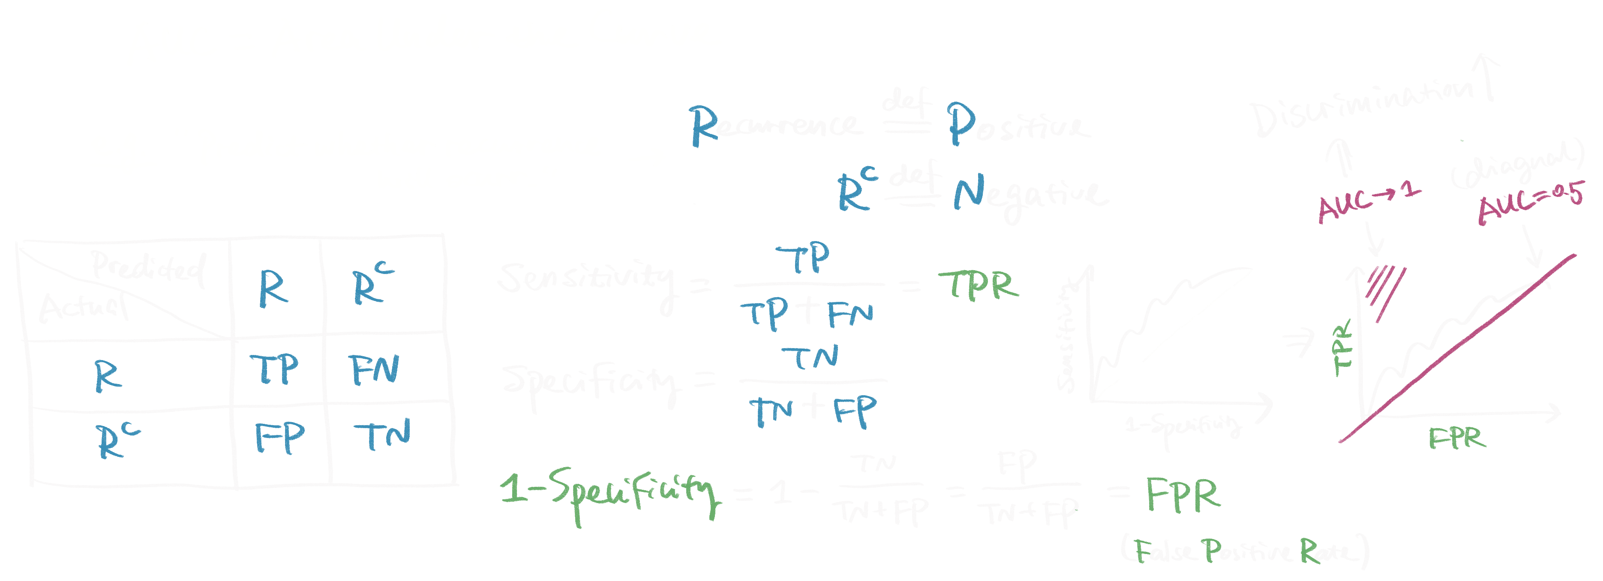
8. Model evaluation
Evaluate model performance using AUC, accuracy, sensitivity, and specificity, then validate it on independent data.

Slide 8
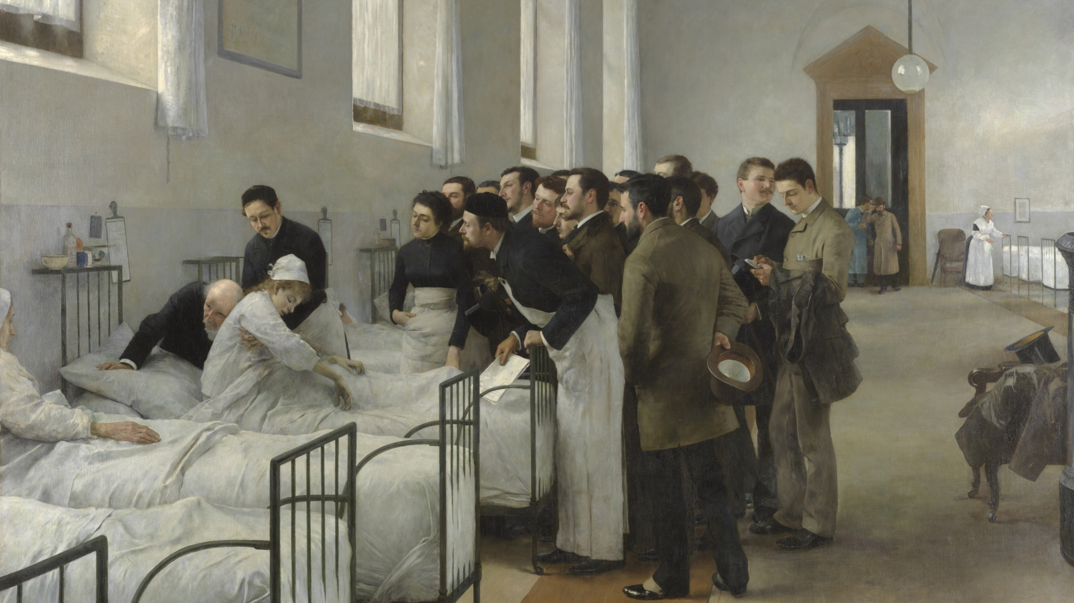
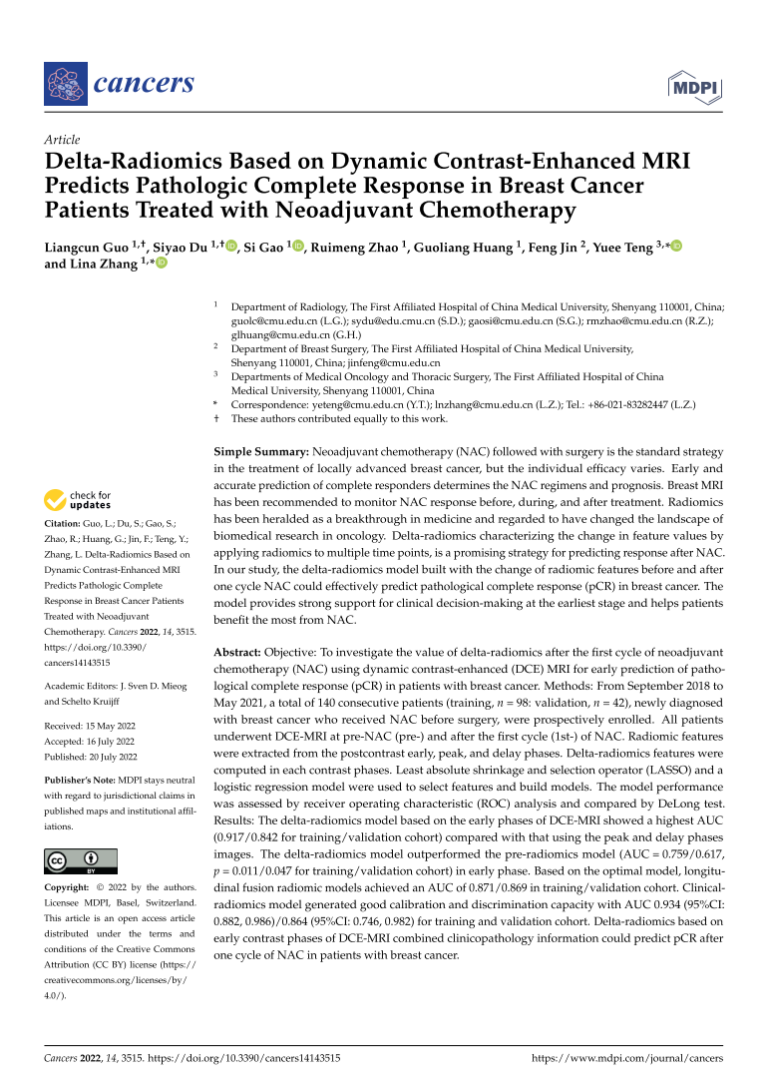
Guo et al. (2022)

Slide 9
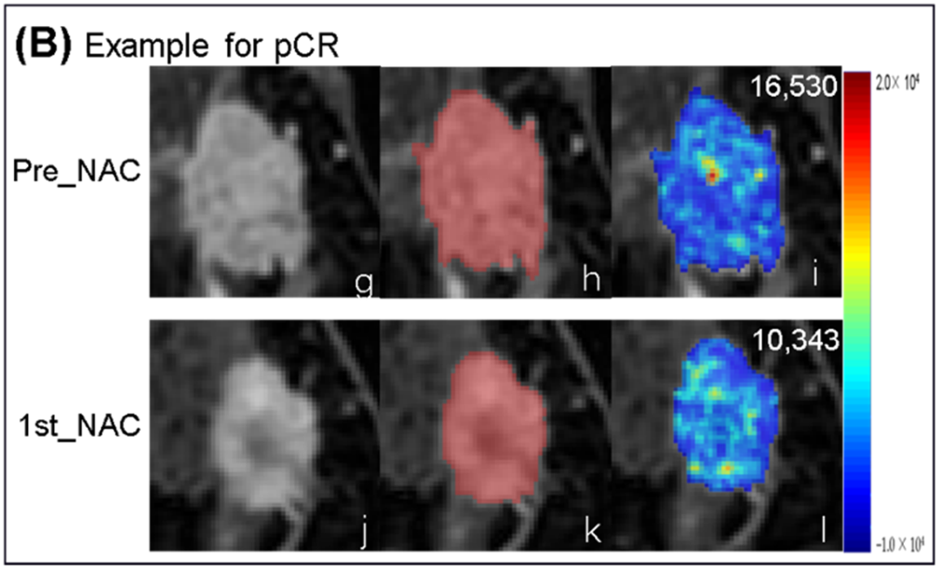

Predicting response after one chemotherapy cycle
Guo et al. used early MRI changes to predict pathological complete response (pCR) at surgery after treatment.
$$ΔF=F_{before NAC}−F_{after cycle 1}$$
140 women — 98 training, 42 internal validation

Slide 10
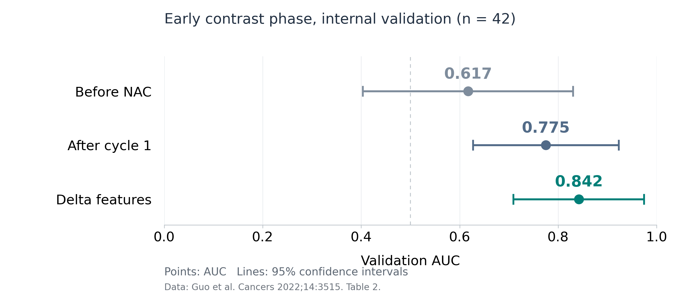
Delta features improved prediction over baseline
Delta outperformed baseline (p = 0.047); while the difference from cycle 1 was not significant (p = 0.500).
Single-center evidence; external validation is needed.

Slide 11
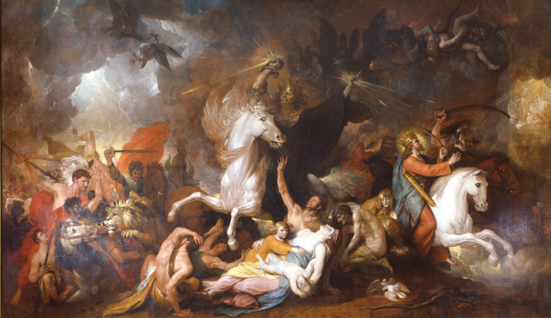
Challenges
Changes in scan settings or tumor boundaries can look like treatment effects.
Guo’s results are encouraging, but validation in 42 patients from one hospital leaves a question: how well would the model work elsewhere?

Slide 12
Future development
I would first test whether the same feature changes remain useful across hospitals.
For me, the key question is whether an early prediction helps doctors make a better treatment decision.

Slide 13
Thanks for Listening!
AIE1903
LIU Chang (125090409)

