Slide 1
Best neighborhoods in NYC for a new dentist office
Applied Data Science Capstone Assignment: Capstone Project - The Battle of Neighborhoods
Unrestricted

Slide 2
Business problem
A (hypothetical) client is a dentist who would like to open a new dental office in the New York (NYC) area
The client has two requirements:
The business must be located in an area that presents good business opportunities and allow him to get enough patients
Ideally, the location would be (or not far from) a nice place to live for a family, as he would like to live near his work.

Slide 3
Data
Primary source for this analysis: Foursquare Places API
Provides data about existing dental offices and neighborhood data like the presence of schools, shopping, parks etc.
For other demographic and social data we use government sources:
NYU Furman Center: http://app.coredata.nyc

Slide 4
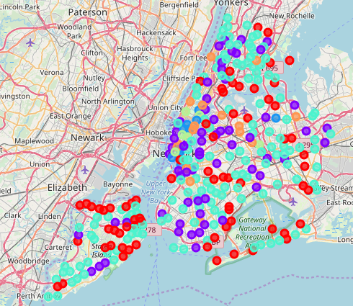
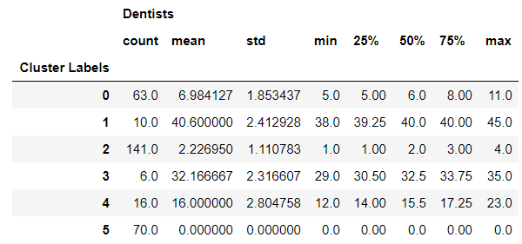
Analysis
We used Foursquare’s API to get the list of dentists in each neighborhoods
We used ML algorithm k-means to cluster the neighborhood into 5 clusters, according to the number of dentists.
All neighborhoods with no dentist office where identified as an additional cluster (cluster label 5).
Cluster 2 and 5 represent the best business opportunity, having no or low number of established businesses

Slide 5
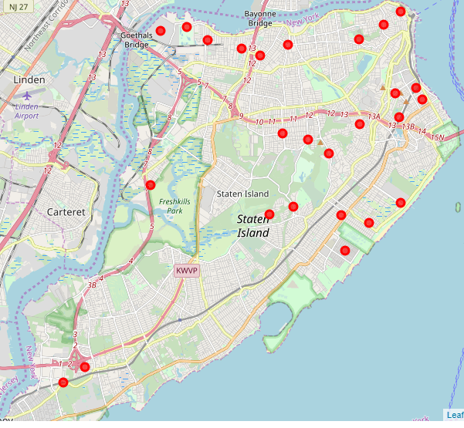
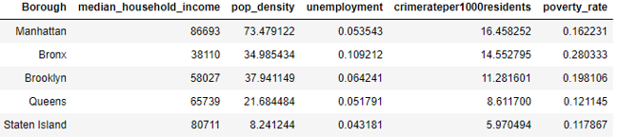
Analysis
Staten Island offers most neighborhoods in cluster 5 (no established businesses) coupled with high household income, lowest unemployment, crime rate and poverty rate
Based on client’s preference for Staten Island borough, we further focused analysis on it.

Slide 6
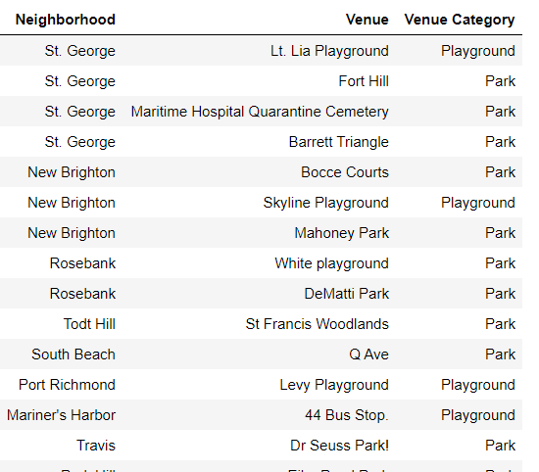
Results and Conclusions
We identified the neighborhoods in Staten Island cluster 5 with highest number of family-oriented venues, i.e. parks, playground and sport centers
The short list of neighborhoods presenting best business opportunities and environment for family living has been delivered to the client
The client is now able to finalize his choice on the shortlisted neighborhoods, by checking them out and evaluating other aspects (e.g. appealing of the neighbourhood, quality of local schools, housing market, etc)

