Slide 1
Project work in machine learning: OSMI Mental Health in Tech Prediction
Master’s Degree in artificial intelligence
university of bologna
Stefano poggi cavalletti
0000982439

Slide 2
DATASET
OSMI Mental Health in Tech
collected by the Open Sourcing Mental Health corporation and available on Kaggle
measures the attitude and frequency towards mental health disorders in the context of tech workplace
aimed to understand whether any factor can affect the employee to get treatment or not

Slide 3
TASK
Analyze the data and predict individual’s mental health seek of treatment based on different features (e.g. age, gender, country and a variety of answers about their mental health related with work) through the deployment of machine learning models

Slide 4
CONTENT: 24 features (1)
Timestamp
Age
Gender
Country state: If you live in the United States, which state or territory do you live in?
self_employed: Are you self-employed?
family_history: Do you have a family history of mental illness?
treatment: Have you sought treatment for a mental health condition? (Yes/No)
work_interfere: If you have a mental health condition, do you feel that it interferes with your work?
no_employees: How many employees does your company or organization have?
remote_work: Do you work remotely (outside of an office) at least 50% of the time?
tech_company: Is your employer primarily a tech company/organization?
benefits: Does your employer provide mental health benefits?

Slide 5
CONTENT: 24 features (1i)
care_options: Do you know the options for mental health care your employer provides?
wellness_program: Has your employer ever discussed mental health as part of an employee wellness program?
seek_help: Does your employer provide resources to learn more about mental health issues and how to seek help?
anonymity: Is your anonymity protected if you choose to take advantage of mental health or substance abuse treatment resources?
leave: How easy is it for you to take medical leave for a mental health condition?
mental_health_consequence: Do you think that discussing a mental health issue with your employer would have negative consequences?
phys_health_consequence: Do you think that discussing a physical health issue with your employer would have negative consequences?
coworkers: Would you be willing to discuss a mental health issue with your coworkers?
phys_health_interview: Would you bring up a physical health issue with a potential employer in an interview?
mental_vs_physical: Do you feel that your employer takes mental health as seriously as physical health?
obs_consequence: Have you heard of or observed negative consequences for coworkers with mental health conditions in your workplace?
comments: Any additional notes or comments

Slide 6
DATA PRE-PROCESSING
Removal of NaN values and not useful features (comments, State, Timestamp) and replacement of empty values
Data cleaning:
Encoding of gender values
Removal of meaningless age values (negative or too high)

Slide 7
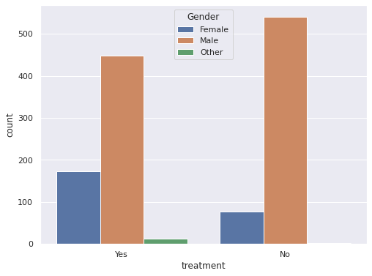
EXPLORATORY DATA ANALYSIS
Relationship between gender and treatment: in the dataset, the number of male individuals is much higher compared to the other genders

Slide 8
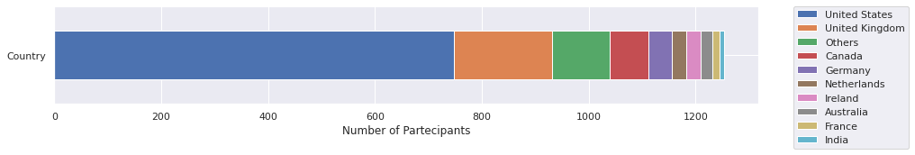
EXPLORATORY DATA ANALYSIS
Distribution of individuals across the countries: the number of participants from the USA is much higher
compared to any other country

Slide 9
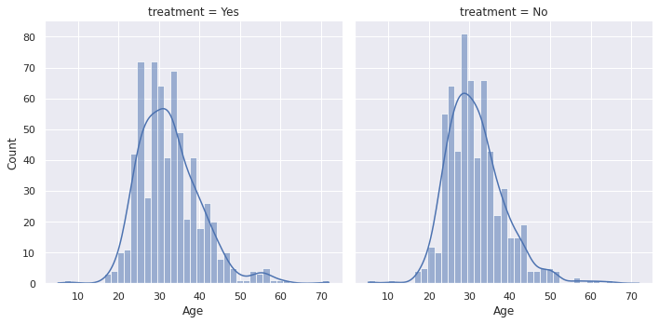
EXPLORATORY DATA ANALYSIS
Relationship between age and treatment status among the respondants: peak around 30

Slide 10
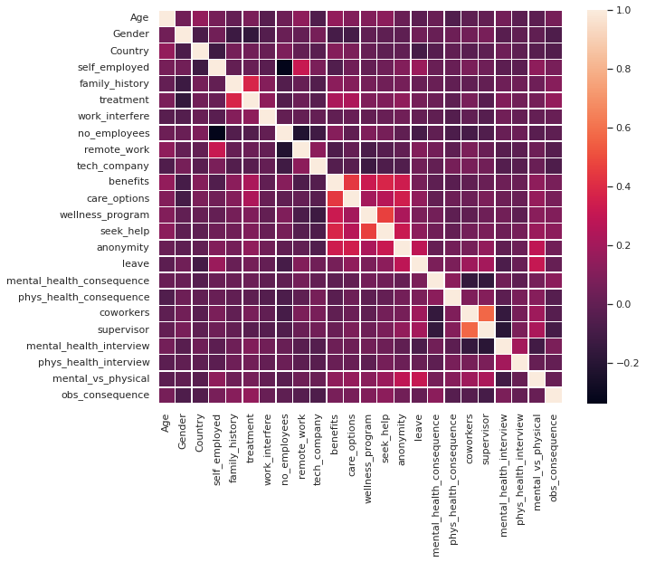
EXPLORATORY DATA ANALYSIS
Correlation heatmap to see the correlation
between variables and cause-effect relationships,
computed using DataFrame.corr from Pandas library and sns.heatmap from seaborn
Interesting correlation between family_history and seek of treatment

Slide 11
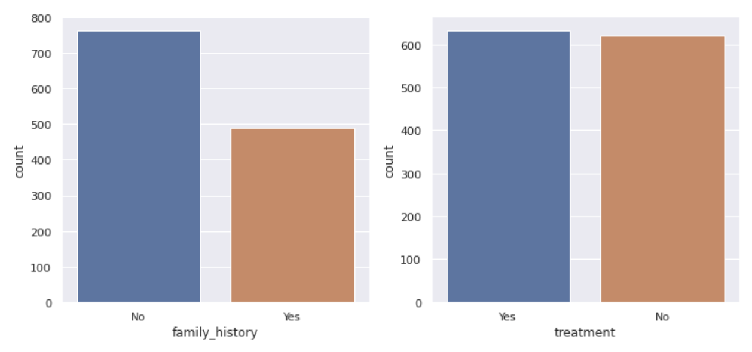
EXPLORATORY DATA ANALYSIS
The percentages of respondents who want and do not want to get treatment are balanced and nearly equal to 50
Fewer respondents claim to have a family history of mental illness but it is more likely that they want to get treatment compared to those without a family history, as they are more correlated

Slide 12
DATA encoding
Features are encoded using LabelEncoder from sklearn.preprocessing, which encodes target labels with value between 0 and n_classes-1
Scaling: the Age attribute is scaled to normalize values in the range [0,1] with the MinMax scaler
Splitting dataset into train and validation set with train_test_split function

Slide 13
PREDICTION MODELS
Five models were used and tuned with their hyperparameters:
Support Vector Machine
Logistic Regressor
K-Nearest Neighbor
Random Forest
XGB Classifier

Slide 14
PREDICTION MODELS
Cross validation is applied on the defined models, tuning them for both accuracy and F1-score, while the best models are saved
For each model, the best parameters found are printed in output, as well as their:
Accuracy
F1-score (harmonic mean of precision and recall)
ROC-Curve plot with AUC score (performance metric for classification problems: it gives an indication of how much the model is capable of distinguishing between classes: the higher the better the model is at predicting the right class)

Slide 15
Results of classifiers (i)
1) Support Vector Machine
Best parameters found: {'C': 10, 'cache_size': 8000, 'gamma': 'scale', 'kernel': 'rbf', 'probability': True}
Accuracy: 0.71
F1-score: 0.70
ROC-AUC score: 0.78
2) Logistic Regressor
Best parameters found: {'C': 3, 'max_iter': 100, 'solver': 'lbfgs'}
Accuracy: 0.72
F1-score: 0.71
ROC-AUC score: 0.78

Slide 16
Results of classifiers (II)
3) K-Nearest Neighbor
Best parameters found: {'metric': 'manhattan', 'n_neighbors': 9}
Accuracy: 0.68
F1-score: 0.64
ROC-AUC score: 0.73
4) Random Forest
Best parameters found: {'max_depth': 25}
Accuracy: 0.77
F1-score: 0.77
ROC-AUC score: 0.83

Slide 17
Results of classifiers (III)
5) XGB Classifier
Best parameters found: {'learning_rate': 0.05, 'max_depth': 3, 'n_estimators': 50}
Accuracy: 0.77
F1-score: 0.78
ROC-AUC score: 0.84

Slide 18
CONCLUSIONS
The results of the predictions show that the best performing models in terms of accuracy, F1-score and AUC score were:
Random Forest
XGB Classifier
On the other hand, the model which showed the worst results was K-Nearest Neighbors

