Slide 1
This is how we made the radar screen in DSP.
It may not be the right way.
You may not like it.
But this is what we could come up with.
Enjoy!
(9/2/2013)
All images in slides 3 and 4 are from Wikipedia.

Slide 2
2 stages
1) Find the objects in space
2)Visualize them

Slide 3
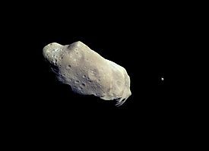
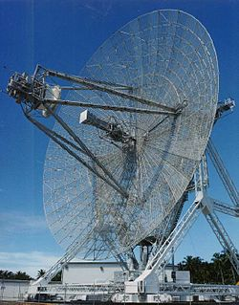
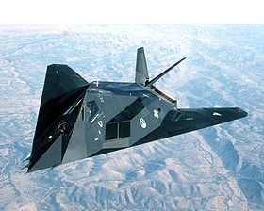
Stage 1: a real radar..
Reflections
"Stuff"
Waves
Antenna
"Cool stuff!"
<----------Space----------->

Slide 4
Stage 1: dsp...
Details in
the next slide
Struct RadarContact
Class RadarVisibleInterface
Struct RadarBeam
Class Radar
...not implemented yet.
<----------Class SensorBus----------->

Slide 5
Stage 1 dsp: the details
This is the pipeline:
The radar activates (Radar::scan())
The radat prepares a struct RadarBeam (very easy, it is empty!)
The radar get a reference to the sensor bus from the goManager
The radar calls SensorBus::scan(RadarBeam, std::vector<RadarContact>)
The sensor bus calls radarScan on all of its subscriber and saves the "echoes" in the vector.
The radar reads the positions of every visible object.
The Sensor but knows all the objects that can be seen by radar. Its task is to "propagate the waves"; in fact it is a publisher that can tell to all the subscribers "a radar is sending you waves".
The subsctibers (implementing RadarVisibleObject) "reflect the waves" using: virtual RadarContact radarScan(const RadarBeam& incomingRadar)
IncomingRadar=data about the radar (empty by now!).
Return: data about themselves (e.g. Their position).

Slide 6
...for the future...
The objects may use RadarBeam to know that a sensor is "painting" them.
The RadarBeam can be adapted to represent any kind of sensor, also with a "type" property.
The objects can "cheat" to jam the radar (e.g. give back a wrong position).
The RadarContact could return more information (e.g. Type of contact, speed, team...)

Slide 7

Stage 2: visualize the contacts
In the layman terms, from this to this
std::vector<Vector3d> positions
{ <0,0,1>,
<0.987,122.223,232>,
...}

Slide 8
Think about it: is the graphic pipeline
1)The positions are in WC
2)Convert in local spaceship coordinates
3)Now the postion of each target with respect to the spaceship is known: project it
4)Map to projection coordinates:
4.1)if x>0, the contact is in front of the ship
4.2)normalize the position vector
4.3)discard the X coordinate
5)Map to device coordinates:
5.1)scale the position vector to fit it into the screen
5.2)Translate the vector in the screen.

Slide 9
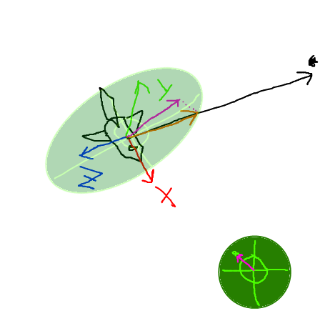
Thinking about it, the graphic of the pipeline is better...
"Virual" radar screen
(to show how the points of space map on the screen)
1) Point in WC
4) Discard the X coordinate to "compress" the vector on the screen.
2)local coordinates
(== position vector with respect to the spaceship)
3)Normalize
(to keep things between +1 and - 1)
X>0 = in front
5)Scale+translate
(...constants found by trial and error...)
6)Ogre::Overlay to draw a dot.

