Slide 1

Automated System Development for Examination Timetabling
Stefanos Chatzileftheris 1909248
Automated System Development for Examination Timetabling
Stefanos Chatzileftheris 1909248
Supervisor-Kate Han and John McCall

Slide 2
Introduction to Examination timetabling problems
What is the problem?
1) A set of Exams
2)A set of Timeslots
3) A set of Students
Objective function
Hard Contraints which must be satisfied
Soft Constraints which may not be satisfied.
The problem will be different from university to university
The Size
Capacitated and un-capacitated

Slide 3
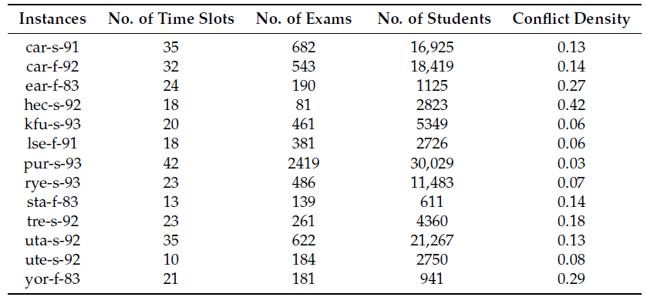
Benchmark of Toronto
<- Big number of Conflict Density
<- Big Size of dataset

Slide 4
Aim and Objective
Objective function: Satisfy the hard constrain and minimize the soft constrain
Hard constraint: Each exam scheduling once during the period
Soft constraint: Conflicting exams are not scheduled in the same timeslot It is better to spread exams as far as possible to get better quality results.
Develop a system that can solve the problem using Java. The developed application would be able to compare the results from three different Techniques (Hill Climbing and Simulated Annealing and Tabu Search technique) and compare them in order to check which technique has the best possible outcome.
A simple Interface using JDialog
Visualize the results using RStudio.

Slide 5
Design and Implementation
We split the problem into two subproblem:
The Constructor: Low-level-graph-colouring
1)Large Degree
2)Saturation Degree
The aim is to take an initial Solution
The Optimizer: Use three different local search algorithms
1)Hill-climbing
2)Simulated annealing
3)Tabu search
The aim is to minimize the soft constrain

Slide 6
Local search Algorithms
Hill climbing: The idea of hill climbing is to moves only the new solution is better than the previous, in case of improvement is there in solution quality.
Simulated Annealing: The idea is to assigns a random search that accepts not only the positive changes but also negative changes with certain probability range, which is decreased as the search continues.
Tabu Search: Basically, the idea of this tabu search algorithm is to study the search space by keeping the last n visited solutions in a tabu list to avoid duplicating search on those solutions while producing new solutions

Slide 7
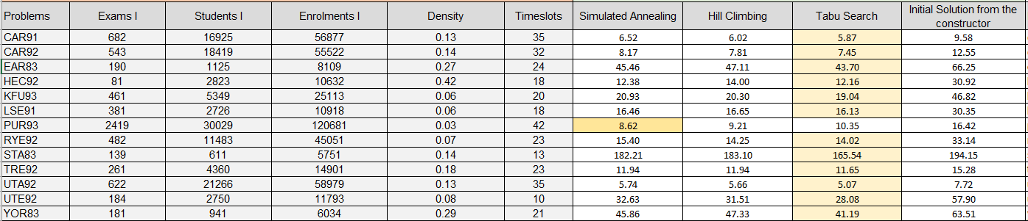
Results
<- with big conflict density the gap is 1.7%
<- because of the big size
<- because of the small size
with gap 10%

Slide 8
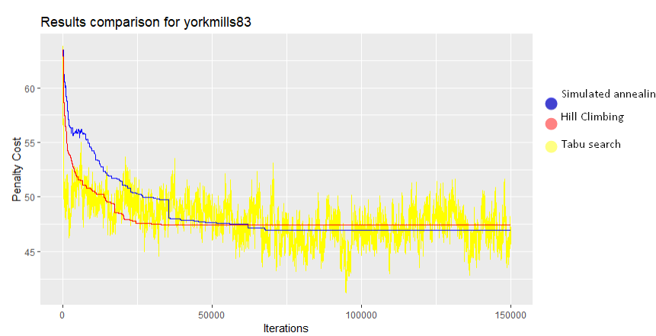
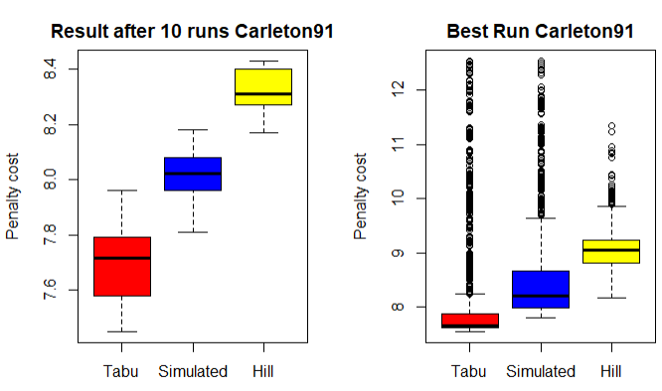
Graphical Evaluation
100%maximum cost->
<- stuck in local optimal simulated annealing
7,7 the average->
<- stuck in local optimal hill climbing
<- best solution from tabu search

Slide 9
In Summary
1)Hill climbing: One of the biggest disadvantages of this method is that it can stuck local optimal, but it can give fast results compared to the other algorithms.
2)Simulated annealing: These algorithm ca be give a good solution but when the temperature is cooling it can stuck in local optimal as the hill climbing.
3)Tabu search: These algorithms can be really slow but it can produce some good quality results.
Overall the can stuck in local optimal after sometime but the can obtain feasible solutions
Improvements
1)Genetic Algorithms
2)Memetic Algorithms

Slide 10
Thank you for your attention
And now the Demonstration of the system

