Slide 1
Aktina
Solar power.
Water for later.
Desalination with otherwise curtailed solar
Pafos 2.0 University category, October 2026
Prototype. Actual curtailment recovery remains unproven.
01 / 12
Notes:
SLIDE 1: Aktina
Aktina
Aktina starts with a simple idea: use solar electricity that would otherwise be curtailed to make drinking water, then store the water for later. Our current demonstration shows the retained model and schedule output and the evidence behind it. Recovering curtailed solar still needs a suitable plant, storage and grid coordination.
Data and artifact provenance: delivery/Aktina-Deck-Source/inputs.sha256.json. Historical original remains unchanged.

Slide 2
Why water storage matters
Production can move between hours
Solar power
Desalination
Water storage
Water demand
Available to the plant
Production within limits
Supply carried forward
Delivery when needed
Grid coordination determines whether curtailed electricity can reach a plant.
02 / 12
Notes:
SLIDE 2: Why water storage matters
Why storage matters
Water demand and available solar do not arrive at the same time. A tank lets an operator move some water production between hours while keeping water available. We need to check both sides: whether the plan supplies water, and whether its electricity use actually helps the grid. Radiation is useful context, but a sunny hour is not proof of curtailed electricity available to a particular plant.
Data and artifact provenance: delivery/Aktina-Deck-Source/inputs.sha256.json. Historical original remains unchanged.

Slide 3
Grid and Sites
Grid
Sites
Desalination and stored water
Irrigation and unusual night flow
Supplied model and schedule
Operator review
Separate prototype
Synthetic meter examples
Today’s supplied evidence covers Grid. Neither prototype controls equipment.
03 / 12
Notes:
SLIDE 3: Grid and Sites
Grid and Sites
The roadmap has two parts. Grid compares production for a desalination unit and its tank. Sites explores garden water budgets and unusual overnight meter readings. Today's supplied model and schedule cover Grid. Sites remains a separate prototype; its synthetic examples are not field results. Neither part controls equipment.
Data and artifact provenance: delivery/Aktina-Deck-Source/inputs.sha256.json. Historical original remains unchanged.

Slide 4
The supplied demonstration
296
7,104 rows
Forecast column matches
persistence in every row
complete schedule days
6 December 2025 to 28 September 2026
Original LightGBM shown separately
Intended schedule version pending
The demo runs offline with its retained data, scripts and fonts.
04 / 12
Notes:
SLIDE 4: The supplied demonstration
What the demonstration loads
The demo loads 7,104 supplied schedule rows, covering 296 complete days from 6 December 2025 to 28 September 2026. Each day shows radiation, production, tank level and illustrative cost. The data, scripts and fonts are local, so the presentation does not need an API or internet connection.
We checked which forecast generated the supplied export. Its forecast column matches persistence in every row, and that version reproduces byte for byte. Stefanos's LightGBM forecast appears separately. The unchanged model-driven scheduler also runs, but produces a different schedule. We have kept both outputs; the intended submission version still needs confirmation.
Source cue: `app/handoff/README.md` and `app/handoff/scheduler-reproduction/README.md`. Do not call the displayed schedule a demonstrated LightGBM saving.
Data and artifact provenance: delivery/Aktina-Deck-Source/inputs.sha256.json. Historical original remains unchanged.

Slide 5
3 July 2026
Hourly production, m³
12.23%
Lower illustrative tariff cost
Tank, m³ at hour endpoints. Minimum 800 m³.
5,658 m³
19,237.2 kWh
Equal water and energy
Start and end: 966 m³
Tank limit: 4,000 m³
€101/MWh above 600 W/m², otherwise €183/MWh. No field saving or recovered-solar claim.
05 / 12
Notes:
SLIDE 5: 3 July 2026
A matched day
On 3 July, flat and supplied production both make 5,658 cubic metres of water and use 19,237.2 kilowatt-hours. The supplied tank starts and ends at 966 cubic metres. Under the illustrative prices, the supplied plan costs about 2,628 euros versus 2,995 euros for flat production: 12.23 percent less. The comparison moves electricity use between differently priced hours; it does not demonstrate lower energy use or recovered solar.
This equal-stock result is specific to the day. The scheduler carries water between days and does not enforce equal daily ending stock. A cost comparison must retain production and stock change, especially at the separate validation/test resets.
Source cue: original `eval/schedule_hourly.csv`, 3 July 2026. Discount is €101/MWh when actual radiation is strictly above 600 W/m²; otherwise €183/MWh. Specific electricity is 3.4 kWh/m³. These are assumptions, not bills or a market tariff.
Data and artifact provenance: delivery/Aktina-Deck-Source/inputs.sha256.json. Historical original remains unchanged.

Slide 6
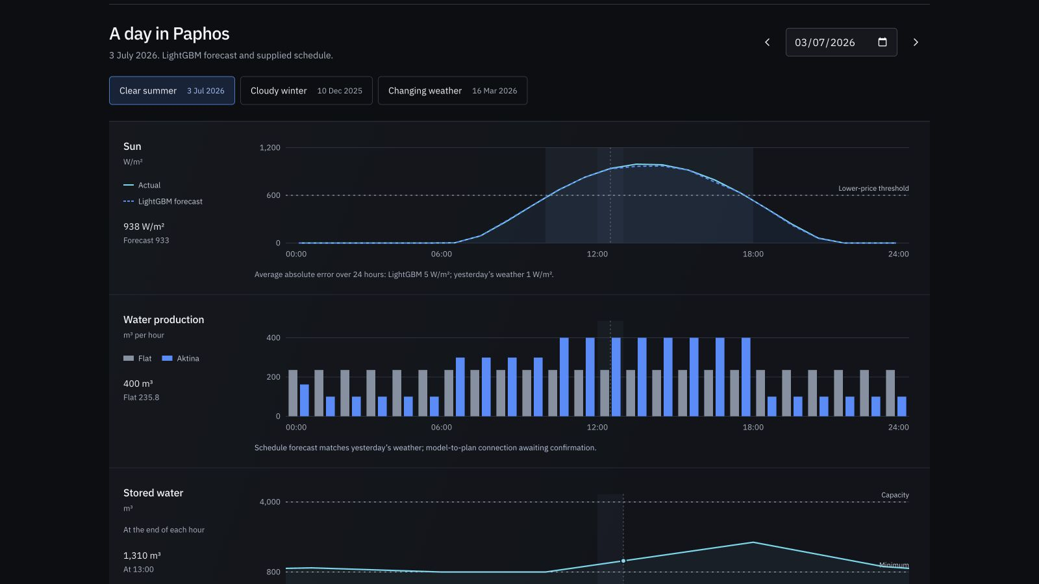
Inside the demonstration
3 July
Matched daily example
10 December
Low radiation
AktinaBench
Every retained test hour
aktina-pafos-2026.vercel.app Offline fallback: 60-second silent walkthrough
06 / 12
Notes:
SLIDE 6: Inside the demonstration
Demo and fallback
We will show three days, then the full benchmark. July 3 shows midday production and the matched daily cost. December 10 has no high-radiation hours; the retained tank still stays at or above its declared minimum. March 16 shows a day when the original model predicts better than persistence. We then return to all test hours so that one good day does not become the headline result.
Live cues:
- Open Aktina locally. Choose **3 July 2026**; inspect sun, production, tank and cost.
- Choose **10 December 2025**; point to low radiation and the tank minimum.
- Choose **16 March 2026**; MAE is 48.48 W/m² for the original model versus 156.33 for persistence.
- Open **AktinaBench**; show the original test comparison, then select **Archived weather forecast** and **Weather + past errors**.
Fallback: `Aktina-Backup-Final.mp4`, 44 seconds, no audio. It is a product screenshot walkthrough, not a live interaction recording. Do not play both sequences. Online address: https://aktina-pafos-2026.vercel.app/.
Data and artifact provenance: delivery/Aktina-Deck-Source/inputs.sha256.json. Historical original remains unchanged.

Slide 7
Original forecast against persistence
Mean absolute error, W/m²
Test F1
LightGBM 0.9655
Persistence 0.9777
Test winner:
persistence
3,566 validation and 3,567 test hours. Validation informed fitting. Original splits lack a 24-hour purge.
07 / 12
Notes:
SLIDE 7: Original forecast against persistence
What the original model achieves
We evaluated every retained prediction: 3,566 validation hours and 3,567 test hours. Validation MAE is 29.34 watts per square metre for LightGBM versus 32.47 for persistence. On the test period, that reverses: 14.27 versus 12.26. Test precision, recall and F1 also favour persistence. The model's test F1 is 0.9655; persistence reaches 0.9777.
Validation informed early stopping, and the original validation and test files come from different model fits. The adjacent original splits also lack a 24-hour prediction-horizon purge. These limits stay in the benchmark. Radiation above 600 watts per square metre defines the label; it is not observed grid curtailment.
Source cue: `app/handoff/ACTINABENCH.md`; full MAE, RMSE, precision, recall, F1, confusion counts and month/hour breakdowns are retained. Partial boundary days remain in full-period results.
Data and artifact provenance: delivery/Aktina-Deck-Source/inputs.sha256.json. Historical original remains unchanged.

Slide 8
Archived weather inputs
Retrospective comparison, the same 3,567 test hours
 | Precision | Recall | F1
Original | 97.57% | 95.54% | 96.55%
Day2 forecast | 98.51% | 98.32% | 98.41%
Raw analogue | 98.41% | 98.32% | 98.37%
Raw analogue lowers MAE. False alarms rise from 15 to 16.
Model-derived reference. Previously inspected test. Historical forecast publication time unverified.
08 / 12
Notes:
SLIDE 8: Archived weather inputs
Research comparison
The strongest completed progress comes from additional weather information. On the same 3,567 original test hours, the original model has MAE 14.27 W/m². The fixed archived day2 forecast has MAE 8.81, and raw residual analogues reduce it to 6.92. Precision, recall and F1 are 97.57%, 95.54%, 96.55% for the original model; 98.51%, 98.32%, 98.41% for the archived forecast; and 98.41%, 98.32%, 98.37% for the raw analogue. These are retrospective comparisons against the original model-derived reference.
The analogue reuses 64 historical residuals to form hourly scenarios. Its lower MAE comes with one extra false alarm: 16 instead of the archived forecast's 15, with 17 misses for both. Validation retains the fixed archived forecast. On the harder 3,566-hour validation period its F1 is 90.08%, compared with 80.07% for the original model and 89.95% for raw analogues. No learned candidate is promoted. The original model remains intact.
We also checked the same fixed forecasts against the SARAH3 satellite estimate. On 3,517 common test hours, with 50 missing reference hours retained as unscored, archived-forecast F1 is 96.59% and raw-analogue F1 is 96.54%. MAE is 19.33 versus 18.23 W/m², while false alarms rise from 42 to 43. The harder satellite validation gives the archived forecast F1 of 80.71% on 3,419 common hours. The reference changes the apparent accuracy, so the near-99% weather-reference scores cannot stand alone.
These tests were already inspected during development. Historical forecast publication times are unverified, and satellite estimates are not local ground-sensor measurements. We have separately locked 48 future forecast hours for later satellite evaluation, with no outcomes scored yet. This is evidence to review with Stefanos, not a claim of live superiority, measured curtailment recovery or field savings.
Source cue: `app/experiments/f1-004/result/comparison.csv` (fixed defaults, full test), `app/experiments/reference-sensitivity-001/result-amended/metrics.csv` (identical common-hour bases), and the frozen prospective capture. The fixed 600 W/m² event remains a radiation proxy. Analogue decisions use scenario probability strictly above 0.5. Keep original, archived-control and synthesis results distinct.
Data and artifact provenance: delivery/Aktina-Deck-Source/inputs.sha256.json. Historical original remains unchanged.

Slide 9
Business hypotheses
Potential customers
Commercial model
Water and plant operators
Hotels and managed gardens
Setup and integration
Subscription and support
Customer interviews and a measured pilot
Pricing, willingness to pay and margins remain untested. No customer agreements claimed.
09 / 12
Notes:
SLIDE 9: Business hypotheses
Business hypotheses
The canvas separates potential Grid customers from Sites customers. Water operators would need integration and evidence that a plan fits their operations. Hotels or managed gardens would need usable meters and a measurable water-management problem. Setup fees, subscriptions and support are revenue hypotheses. We have not established pricing, willingness to pay, margins or customer agreements. Those assumptions need to be tested with prospective users.
Presenter cue: show the updated one-page business model canvas; older PDF exports are excluded from the current review pack.
Data and artifact provenance: delivery/Aktina-Deck-Source/inputs.sha256.json. Historical original remains unchanged.

Slide 10
What the model does not establish
Declared scenario
Operator evidence needed
100–400 m³/h production
4,000 m³ tank
800 m³ minimum
3.4 kWh per m³
Pressure and water quality
Flushing and maintenance
Ramps and operating states
Plant access to curtailed power
Retrospective demand uses recorded target-day temperature. No plant control or measured savings.
10 / 12
Notes:
SLIDE 10: What the model does not establish
What remains outside the model
The supplied scheduler uses illustrative production, demand, tank and electricity assumptions. Demand includes the target day's recorded temperature, so this is a retrospective scenario. Pressure, flushing, water quality, ramps and maintenance are not established by these charts. A real operator would need to supply those constraints and approve any trial. There is no plant control connection, and no measured electricity-bill saving or solar recovery is claimed.
Source cue: original `model/scheduler.py`; production 100–400 m³/h, tank 4,000 m³, minimum 800 m³, start 2,000 m³ at each period. Keep hourly endpoints distinct from continuous physical safety.
Data and artifact provenance: delivery/Aktina-Deck-Source/inputs.sha256.json. Historical original remains unchanged.

Slide 11
Next evidence
Submission
Model v2
Pilot
Confirm the intended
schedule version
Rehearse the offline demo
Controlled features
Fixed time boundaries
Fresh held-out period
One operator
One data contact
Agreed measurement plan
V2 is pending. Improvements and pilot benefits must be demonstrated.
11 / 12
Notes:
SLIDE 11: Next evidence
Next evidence
First, confirm which retained schedule should be submitted and rehearse the offline demo together. For the next model, controlled comparisons can test solar geometry, clear-sky normalisation and forecasts of tomorrow's cloud that were available today. Each addition needs a controlled comparison, fixed time boundaries and a fresh holdout. Difficult test hours must stay in the evaluation.
For a pilot, we need an operator, a data contact and an agreed measurement plan. We would check plant constraints, demand, tariffs and available curtailment signals before considering an operational trial. The business case should follow measured results rather than assumed savings.
Source cue: `app/handoff/MODEL-V2-FEEDBACK.md`. These are proposed v2 directions, not a completed v2 model or guaranteed gains. Two team rehearsals remain uncompleted.
Data and artifact provenance: delivery/Aktina-Deck-Source/inputs.sha256.json. Historical original remains unchanged.

Slide 12
The team and the ask
A Paphos operator
and a data contact
Loukas Louka
Andreas Nikolaides
Stefanos Bordea
Cleopas Cleopa
aktina-pafos-2026.vercel.app
12 / 12
Notes:
SLIDE 12: The team and the ask
Team and ask
Our team is Loukas Louka, Stefanos Bordea, Andreas Nikolaides and Cleopas Cleopa. We are asking for a Paphos operator and a data contact to help test the idea against real operating needs. The current evidence gives us a reviewable starting point, with its limits visible.
Preparation checks: confirm the team contact, final slide alignment, required competition declarations and intended schedule before submission. Keep the original source credits and third-party licences. Keep the earlier reference experiment distinct from the original model.
Data and artifact provenance: delivery/Aktina-Deck-Source/inputs.sha256.json. Historical original remains unchanged.

