Slide 1
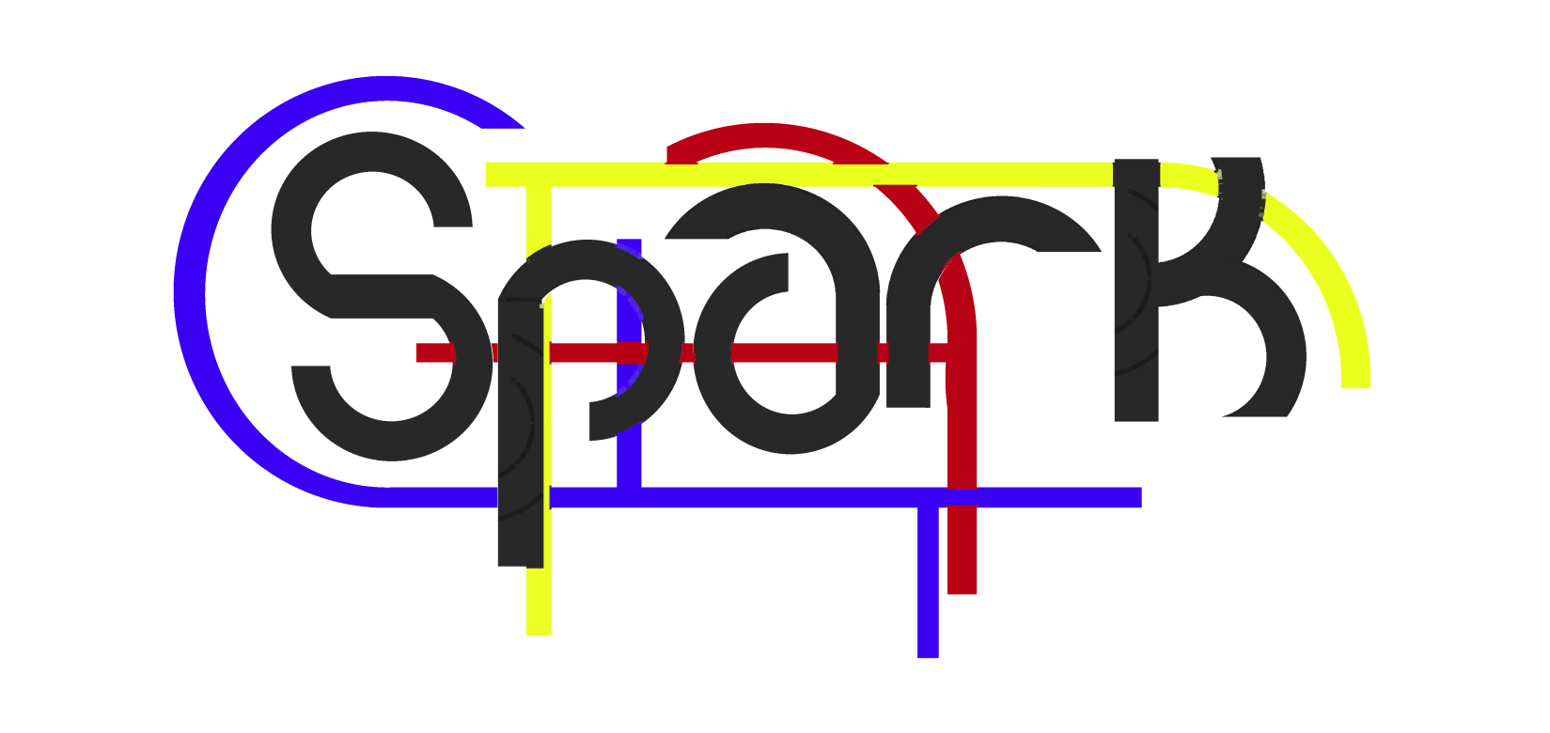

By team:

Slide 2


Who we are
Stefano Sesia
Seoras MacDonald
Andrew McCluskey

Slide 3
About Spark
A Real-Life social network
to enable PEOPLE to get in touch with PEOPLE
to take advantage of technology and not the other way around.

Slide 4
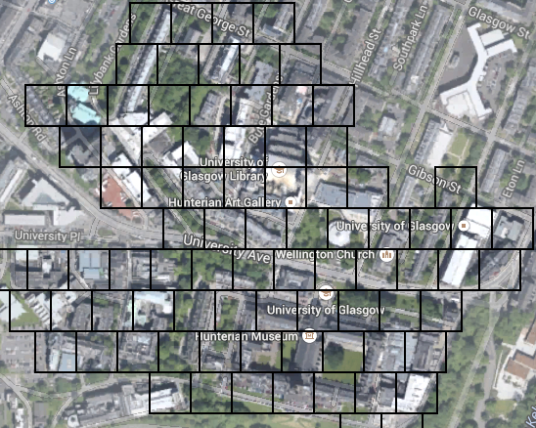
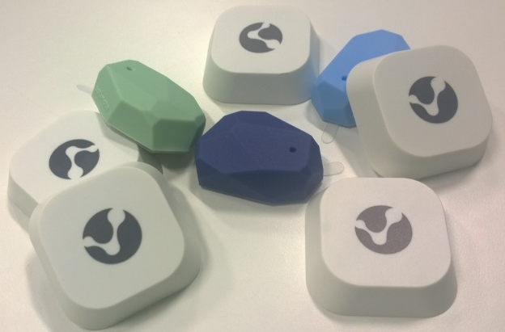
The ‘Beacon’ Environment
By deploying Beacons over the campus the app is able to ‘Learn’ the habits of students

Slide 5
Real-Life Social Network
The app checks the position of your nearby friends and tells you to ‘Say Hi!’
It also checks the routes and habits similar to yours and suggests friendships for a social commuting

Slide 6
How it works
An Android or IOS(coming soon) smartphone with bluetooth enabled comunicates with beacons on campus
The app elaborates the data and send it to the server

Slide 7
How it works
The database send back data, enabling interactions between users.
Comunication with the server is encrypted and ‘friendship suggestions’ based on routes comply with privacy policy chosen by the user

Slide 8
The future of this project
Expanding to urban and metropolitan context
Including servicies such as car sharing to the target of research

