Slide 1
PROJECT WORK ON MACHINE LEARNING AND DATA MINING M
Presented by
Stefano Spadari
Supervisor
Prof. Claudio Sartori
Dipartimento Informatica – Scienze e Ingegneria
ALMA MATER STUDIORUM - UNIVERSITÀ DI BOLOGNA

Slide 2

THE CHALLENGE
Airpassengers: | Kaggle time series forecasting challenge
Dataset: | Monthly airline passengers (1949–1960)
Goal: | Development of an efficient forecasting model
Purpose: | Practice and deepen understanding of time series forecasting
Kaggle - AirPassengers

Slide 3
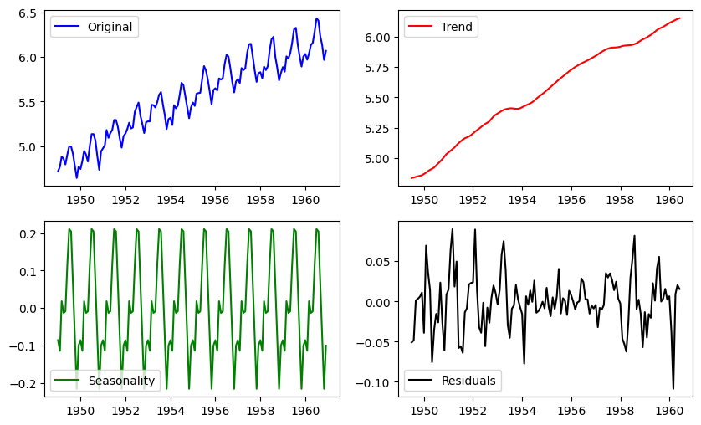
What are time series?
"A sequence of data points indexed in time order, most commonly taken at successive equally spaced points in time."
— Statistical Theory & Mathematics
Wikipedia
It captures the 'story' of a phenomenon
It models how a specific variable evolves and changes over time
It identifies hidden patterns to anticipate future behavior, such as:
  Trend: The general direction of the time series (upward or downward)
  Seasonality: Patterns that repeat at fixed intervals.
  Noise: Random variations and unpredictable events.
Airpassengers dataset plot

Slide 4
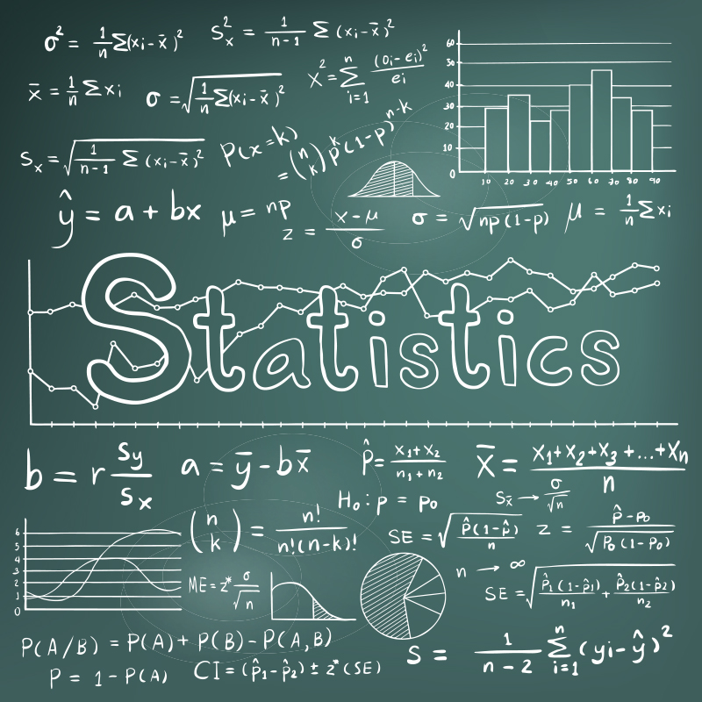
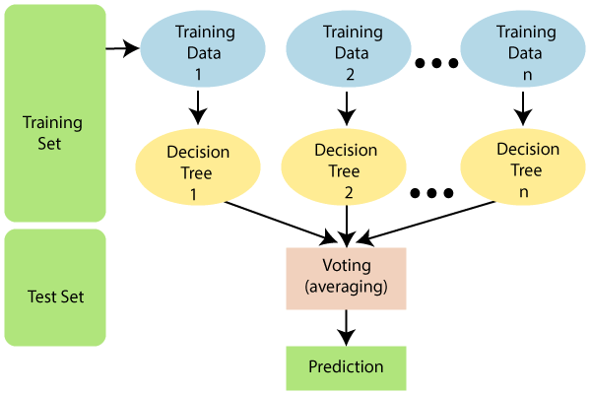
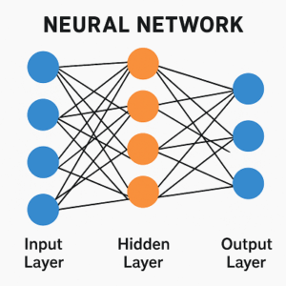
Time Series Forecasting Approaches
Statistical Model
Machine Learning
Deep Learning
Model-driven approach
Based on maths assumptions
Require stationary
Example: ARIMA
Data-driven approach​
Time series astabular features
Capture non-linear relationship
Examples: Random Forest, AdaBoost
Sequence-based neural networks
Learn temporal dependencies by itself
It can capture complex patterns
Example: LSTM
Models selected: ARIMA and LSTM

Slide 5

ARIMA
ARIMA = Auto Regressive Integrated Moving Average
The main idea is the union between AR models with MA, with the help of Integration to reach stationary
Auto Regression
Moving Average
AR(p): yₜ = c + φ₁yₜ₋₁ + φ₂yₜ₋₂ + ... + φₚyₜ₋ₚ + εₜ
MA(q): yₜ = μ + εₜ + θ₁εₜ₋₁ + θ₂εₜ₋₂ + ... + θ_{q}ε_{t-q}
Current value depends on past values
Captures persistence in the series
Current value depends on past errors
Captures shock propagation
ARMA(p,q)
yₜ = c + εₜ + (φ₁yₜ₋₁ + ... + φₚyₜ₋ₚ) + (θ₁εₜ₋₁ + ... + θ_{q}ε_{t-q})
Before applying ARMA the time series must be stationary
Applying differencing (d)
ARIMA (p,d,q)

Slide 6


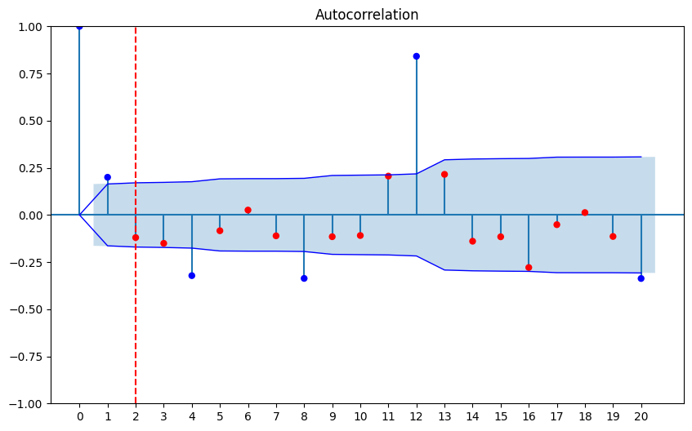
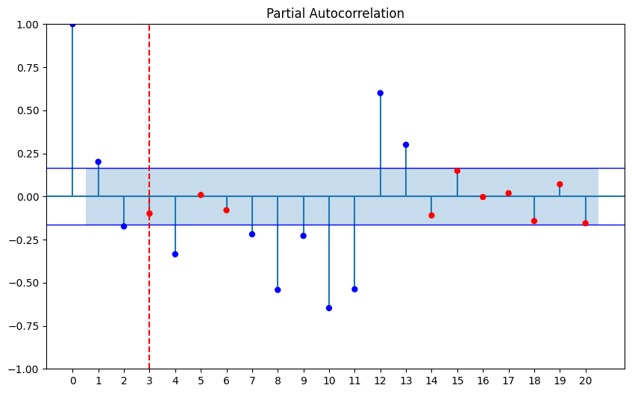
ARIMA: implementation
Requirements​
Selection of three parameters: (p, d, q)
Time series stationary with differentation order of d
Automatically
AutoARIMA from pmdarima selects them automatically
How to select (p,d,q)?
Manually
Selected looking at ACF and PACF
Order: (p=2, d=1, q=1)
Seasonal: (P=1, D=0, Q=1, s=12)

Slide 7
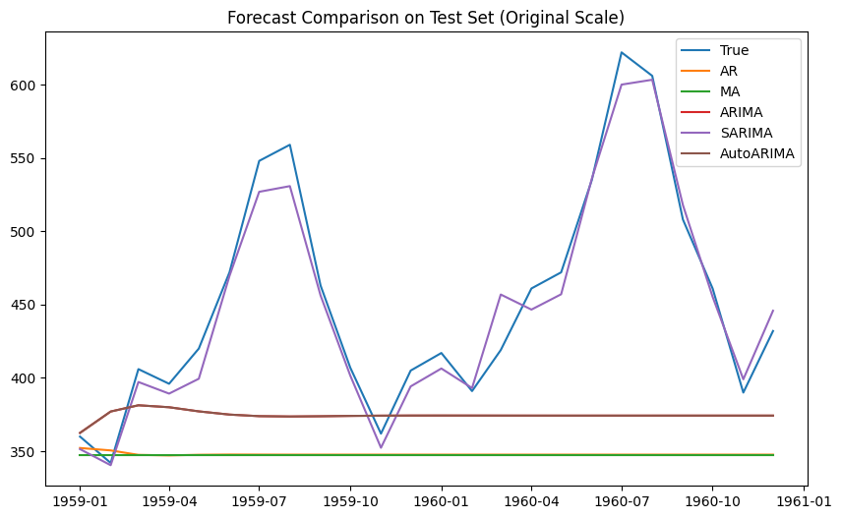
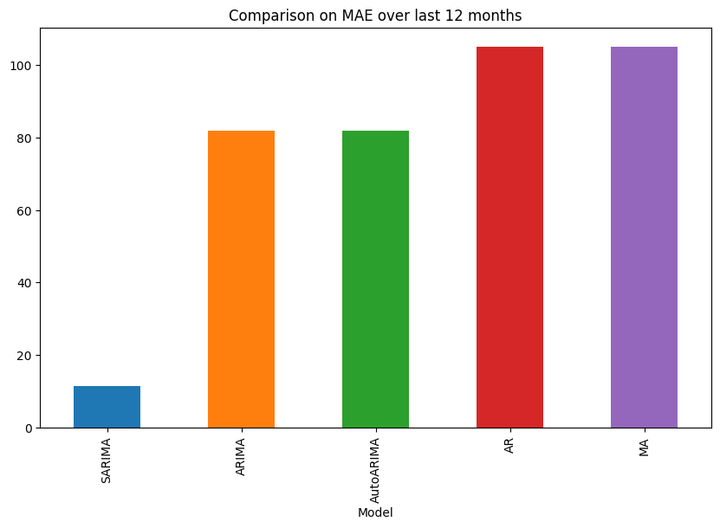
ARIMA: results
Model | RMSE | MAE | MAPE (%)
SARIMA | 14.47 | 11.43 | 2.51
ARIMA | 107.84 | 81.87 | 16.26
AutoARIMA | 107.84 | 81.87 | 16.26
AR | 128.52 | 105.03 | 21.29
MA | 128.53 | 105.08 | 21.30
Model tested:
AR(2)
MA(1)
ARIMA(2,1,1)
SARIMA(2,1,1)(1,0,1)(12)

Slide 8
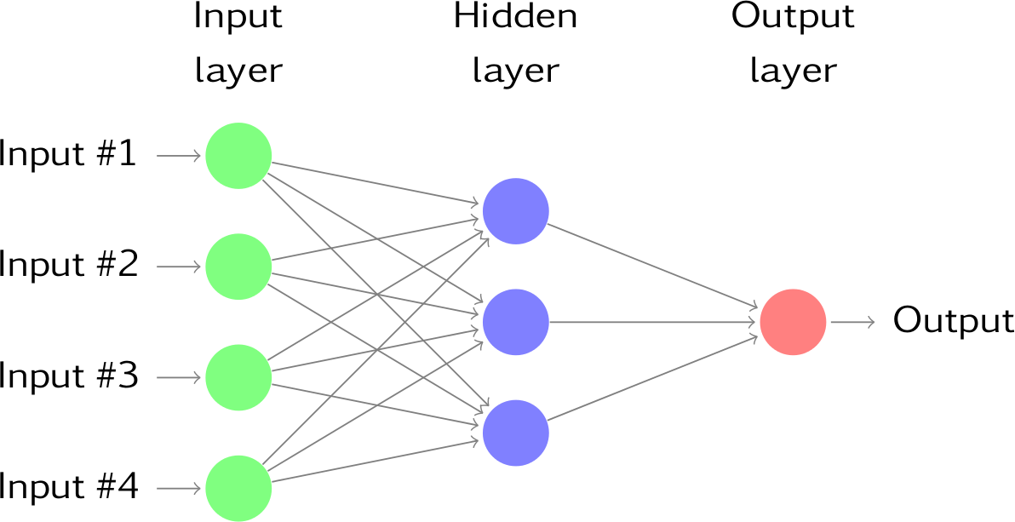
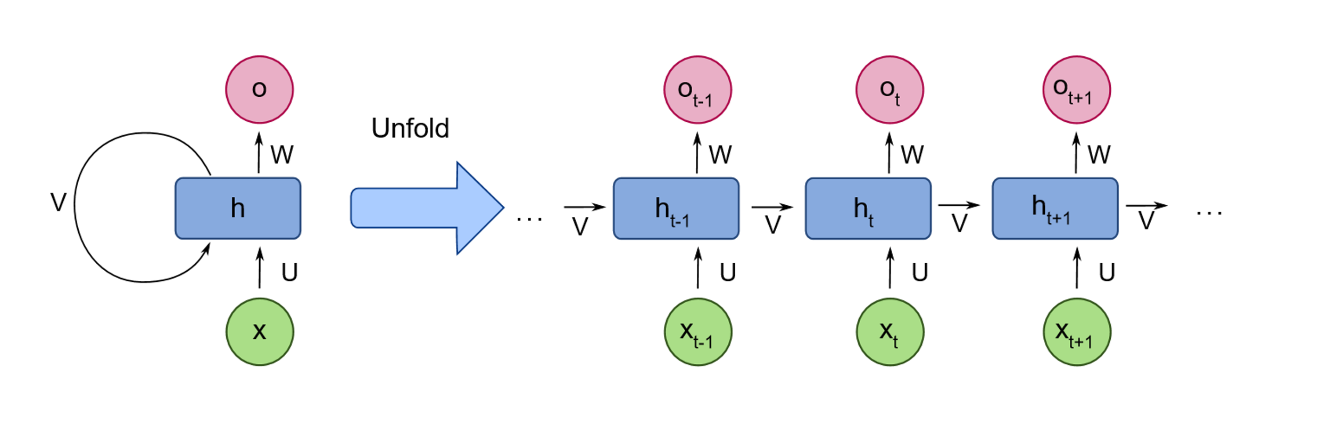
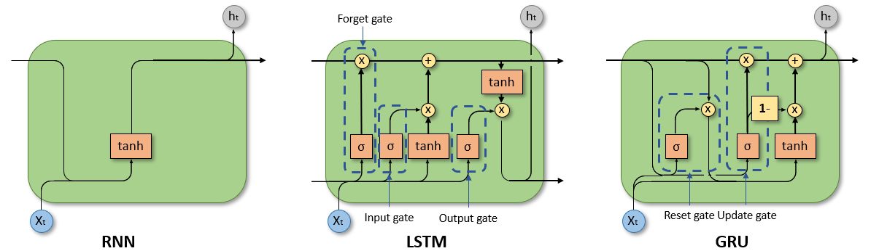
LSTM
Neural Network
Recurrent Neural Network

Slide 9
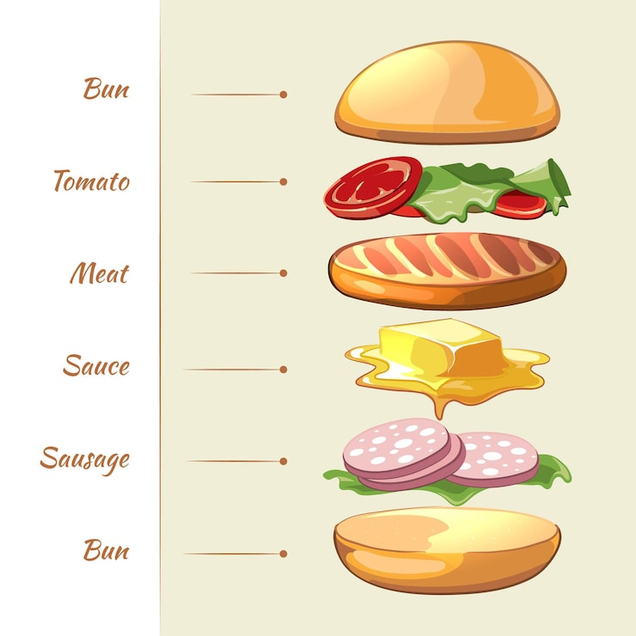
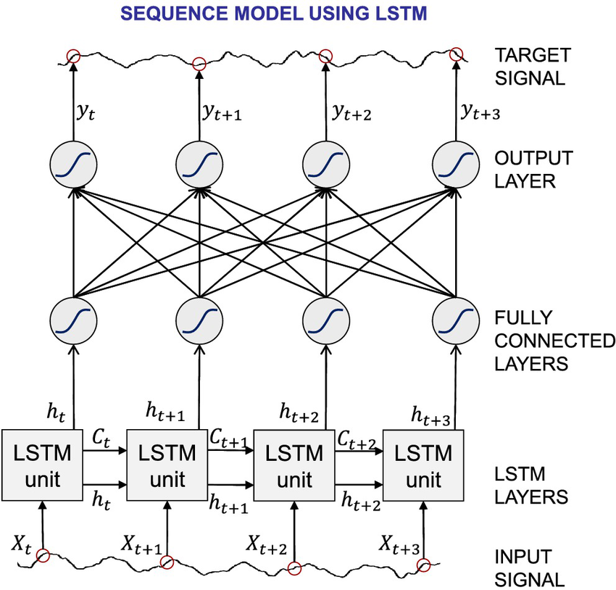
LSTM: implementations
NN = Sequence of layers working together
Task = designing the achitecture
choosing which layers to use and how to combine them
Fixed
Just as ingredients determine the flavor,
hidden layers determine the learning behaviour of the model.
Fixed
Top bread = Output layer
Ingredients = Hidden layers
Bottom bread = Input layer

Slide 10
LSTM: architecture design
Ingredients
Input
Layers
LSTM
LSTM
Captures temporal dependencies
Dense
Learns complex relations
LSTM
Dropout
Prevents overfitting
Dense
Input
Dropout
Input
LSTM
Input
LSTM
Input
LSTM
LSTM
LSTM
LSTM
Dense
Output
Output
LSTM
Dense
Baseline
Output
Dropout
Stacked LSTM
Output
Stacked + Dense
Output
Final

Slide 11
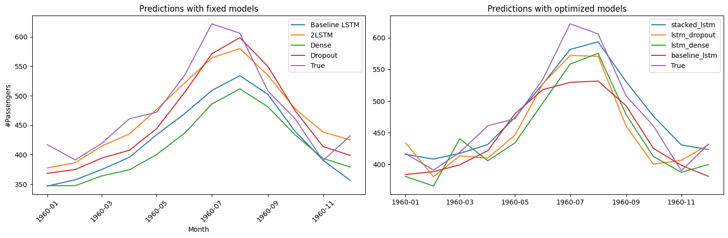
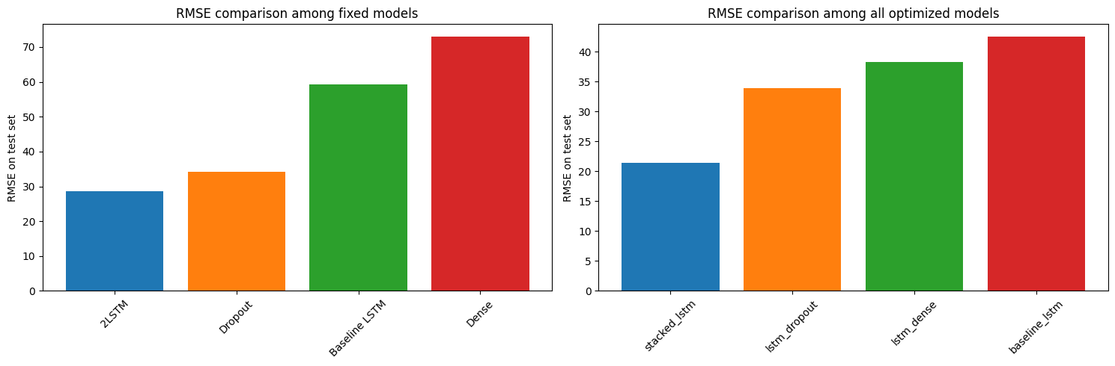
LSTM: results

Slide 12
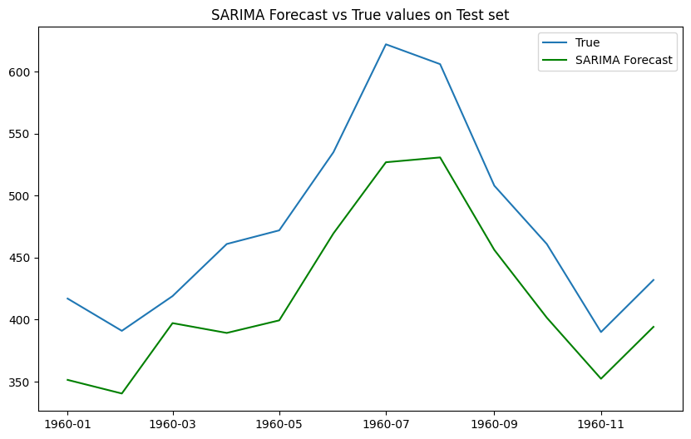
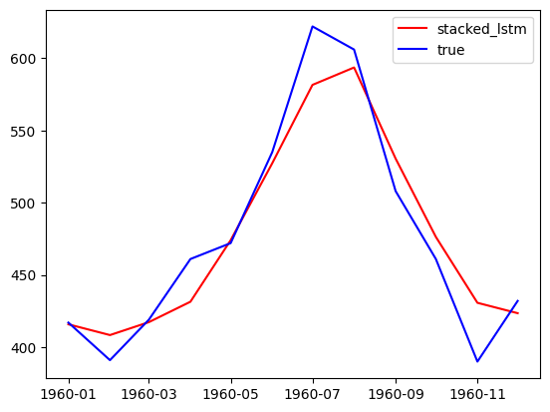
Conclusion
SARIMA
LSTM
RMSE: 213.93
MAE: 58.71 MAPE: 0.12
RMSE: 21.42
MAE : 16.62 MAPE: 0.03

Slide 13
Vi ringrazio per l'attenzione
E-mail stefano.spadari@studio.unibo.it

