Slide 1
Agent-based computational approach modelling dynamics between civilians and organised groups
Otto Schullian, Stefano Weidmann

Slide 2
Overview
Motivation and Aim
Model description
  Agents
  Agent interactions
Results
  Sensitivity Analysis
  Police-Civilian Interaction
Conclusion

Slide 3

Motivation and Aim
based on existing agent-based models
  models civilians, police, criminal organisation
Which parameter has biggest influence?
Which of the most influential parameters could be controlled by the government?

Slide 4
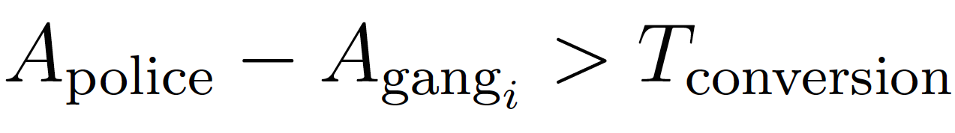
Civilians
anger value in [0,1] for police and each gang type
threshold in [0,1]

Slide 5
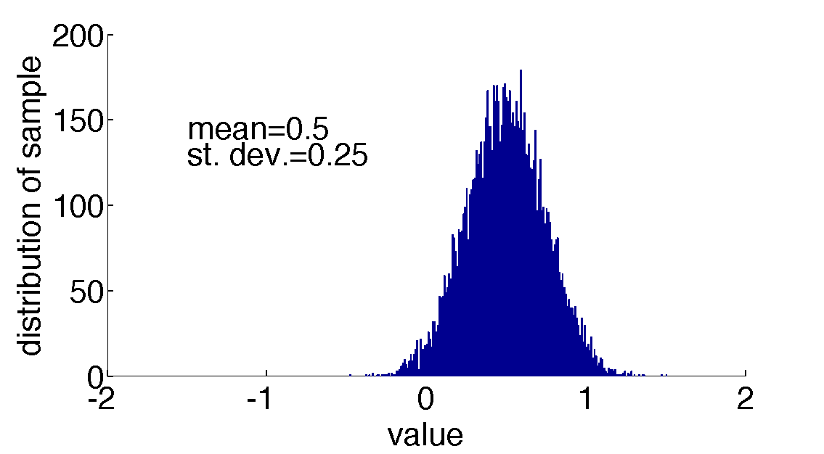
Police and Gangs I
efficiency in [0,1]
accuracy in [0,1]
gaussian distributed
Determine outcome of fights and amount of collateral damage

Slide 6
Police and Gangs II
risk aversion
attack threshold
attack probability
„change“ parameter

Slide 7
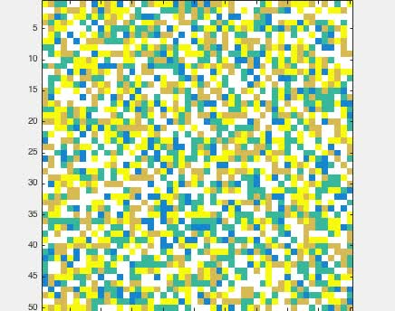
Algorithm
grid
Moore neighbourhood

Slide 8
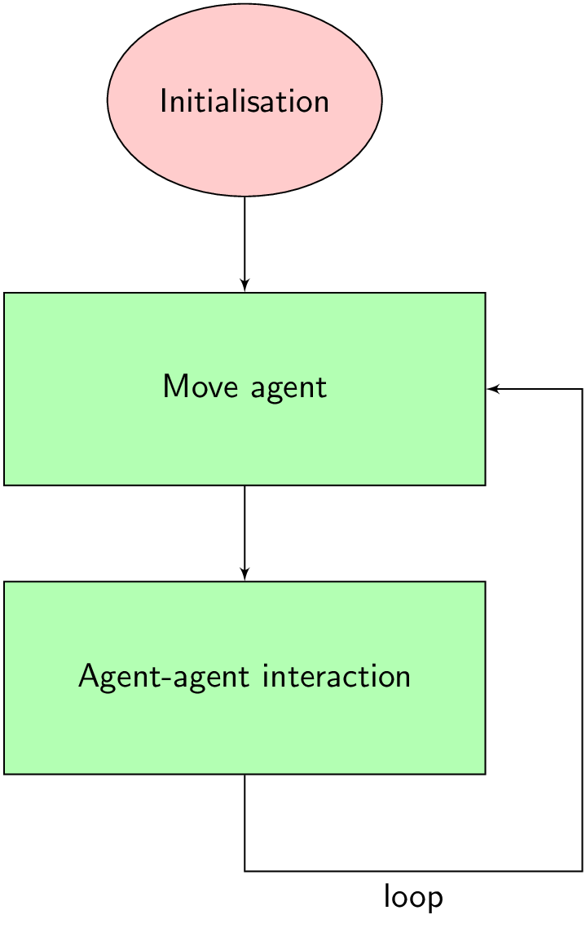

Slide 9
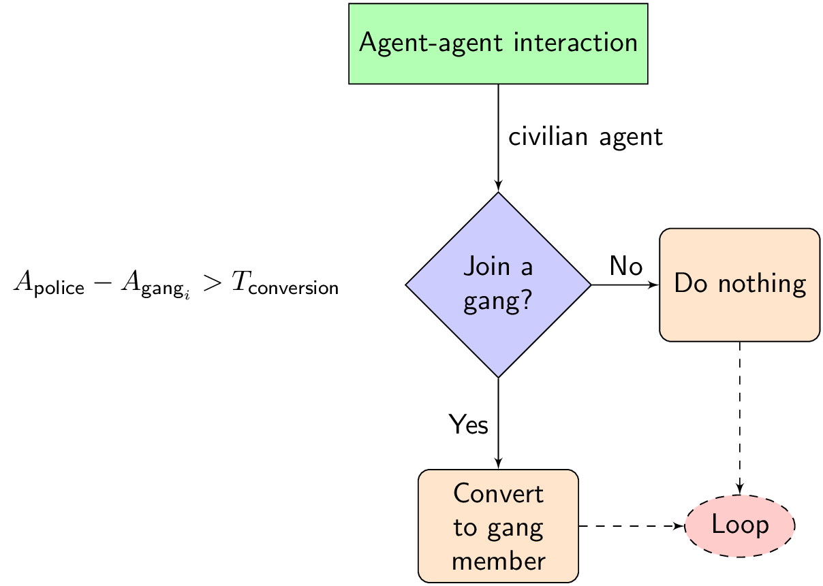

Slide 10
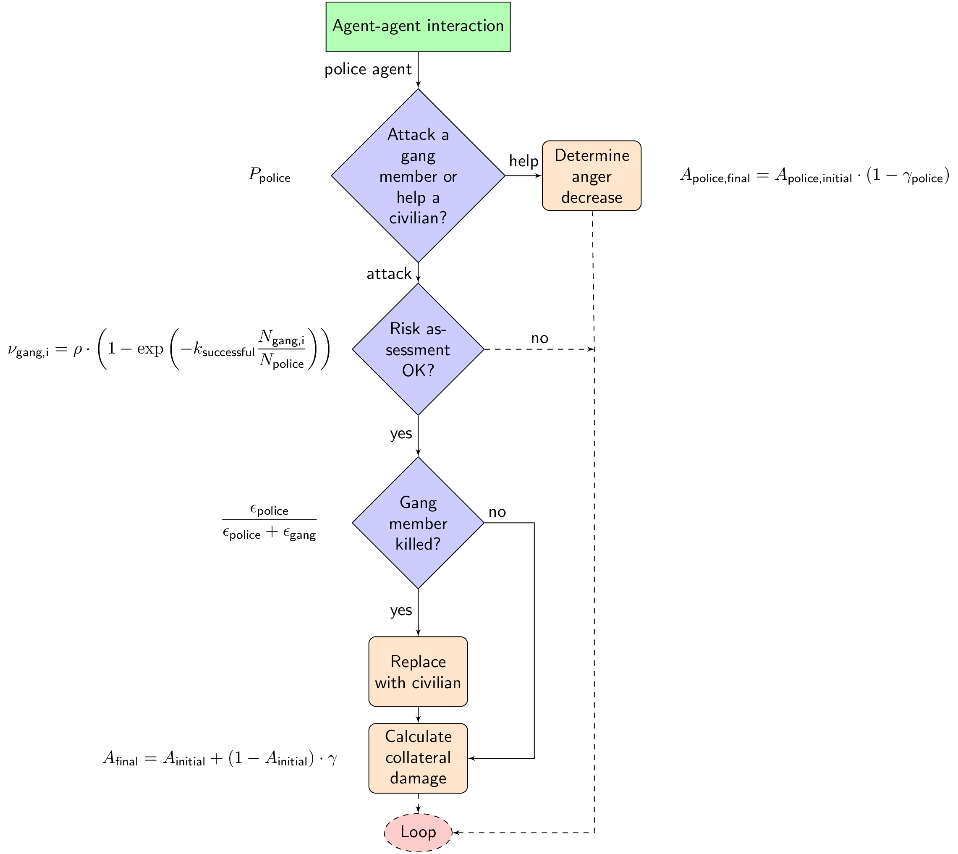

Slide 11
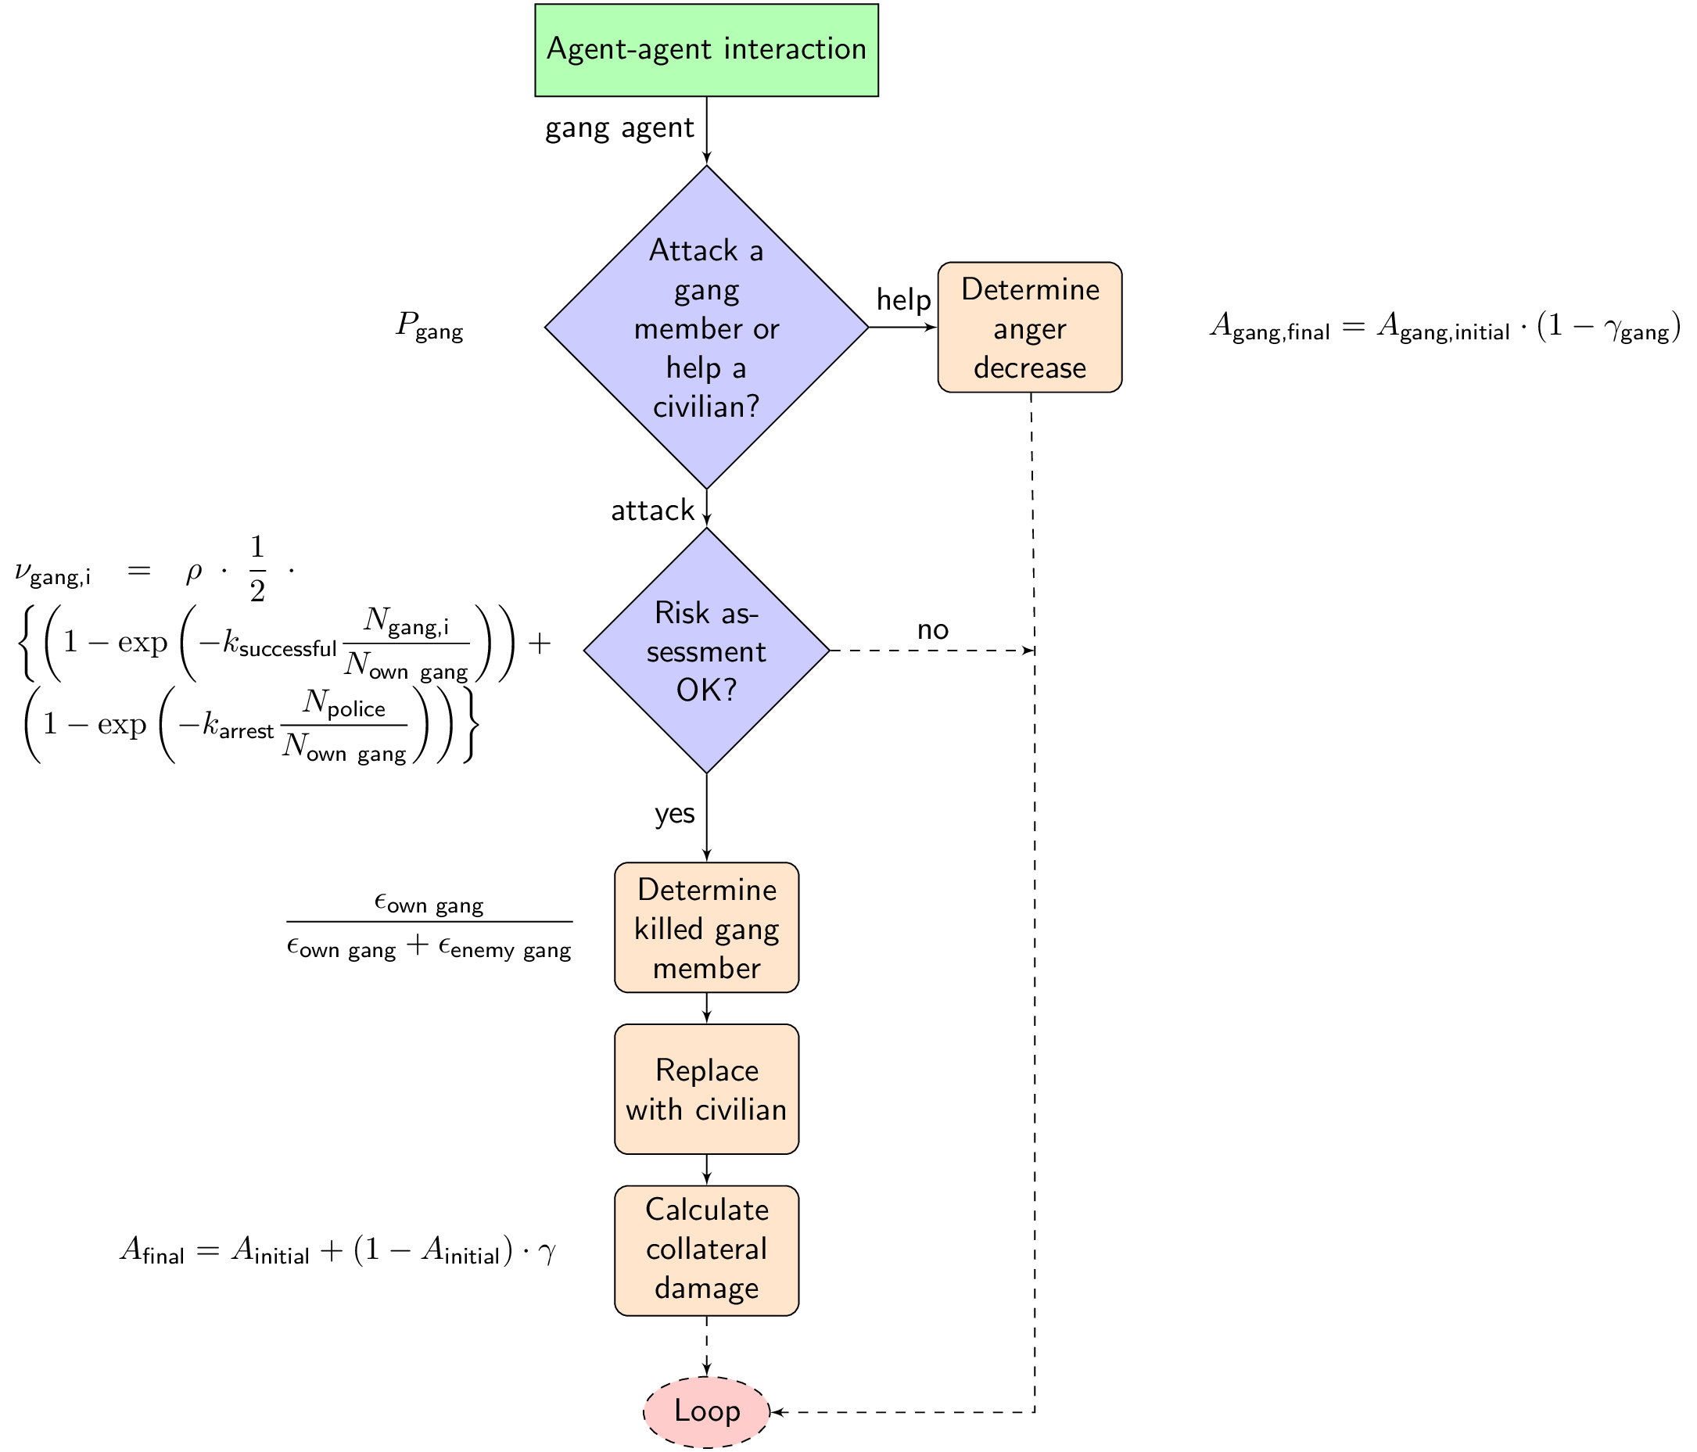

Slide 12
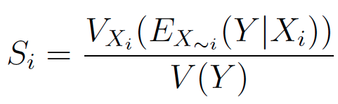
Sensitivity analysis
which parameter has biggest influence

Slide 13
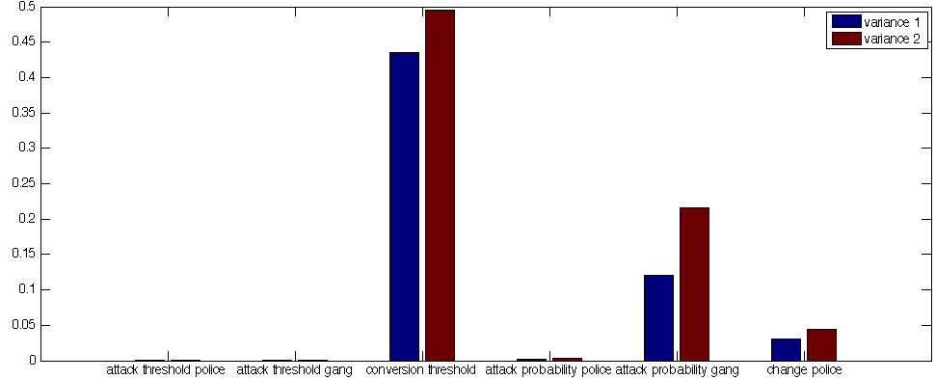
Sensitivity analysis

Slide 14
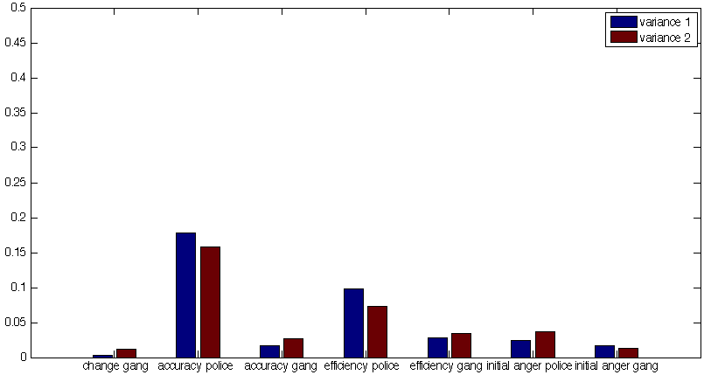
Sensitivity analysis
d

Slide 15
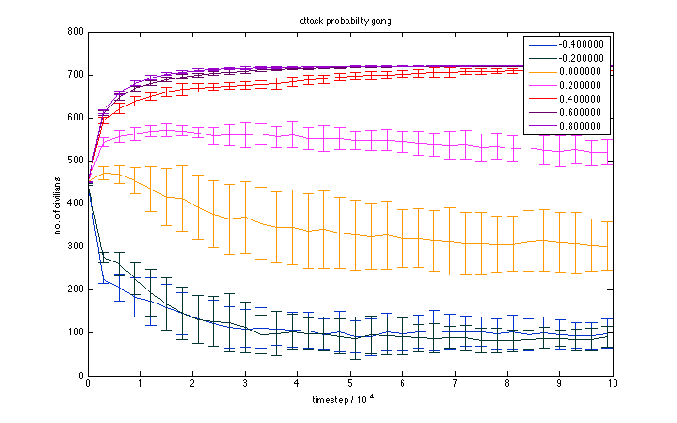

Sensitivity analysis

Slide 16
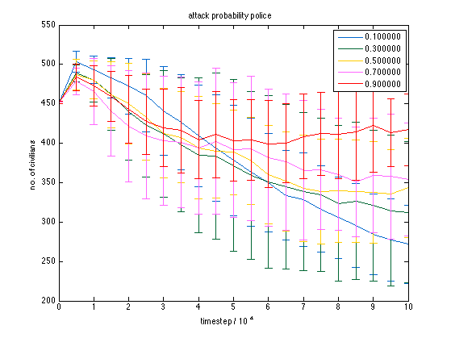
Attack probability analysis

Slide 17
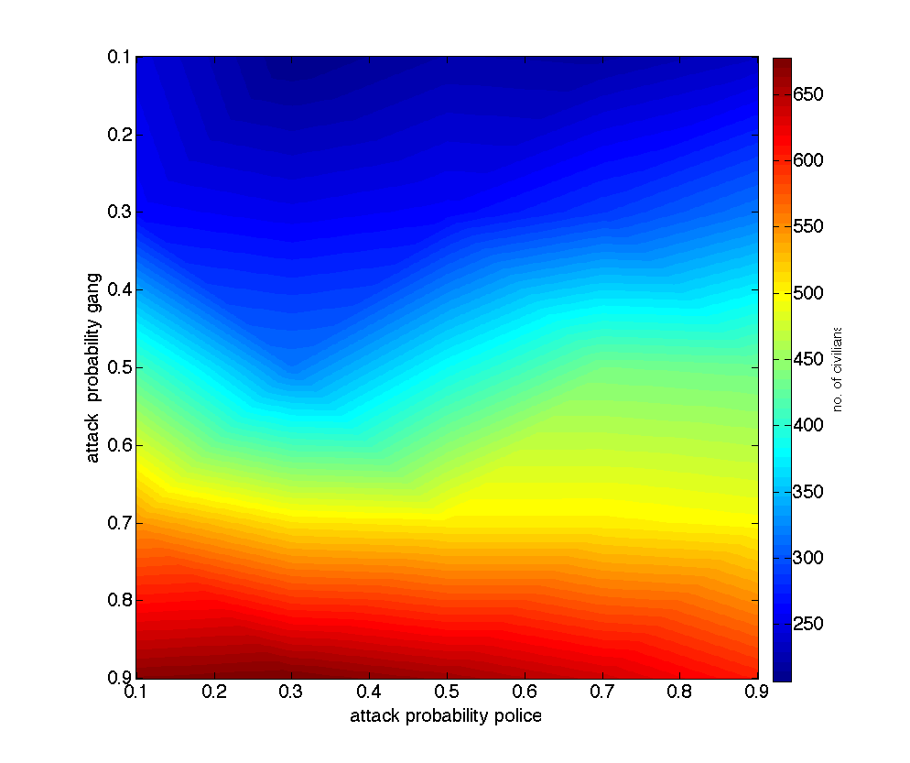
Attack probability analysis

Slide 18
Conclusion
reproducible results
most influential parameters:
  conversion threshold
  attack probability gang
  efficiency/accuracy police
minor influence: attack probability of the police
  related to overall parameters

Slide 19
Outlook
possible oversimplification
possible future work
  adding fear factor
  parameter changes during the simulation

