Slide 1















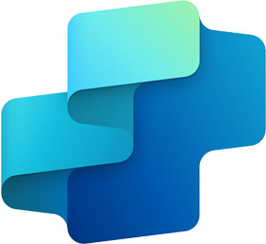





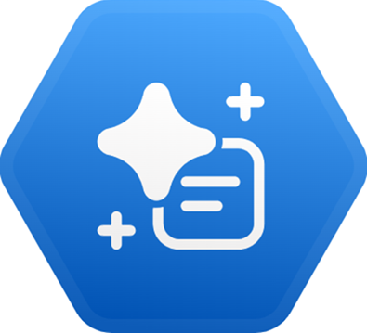
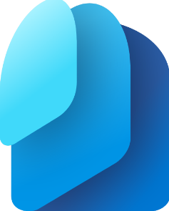






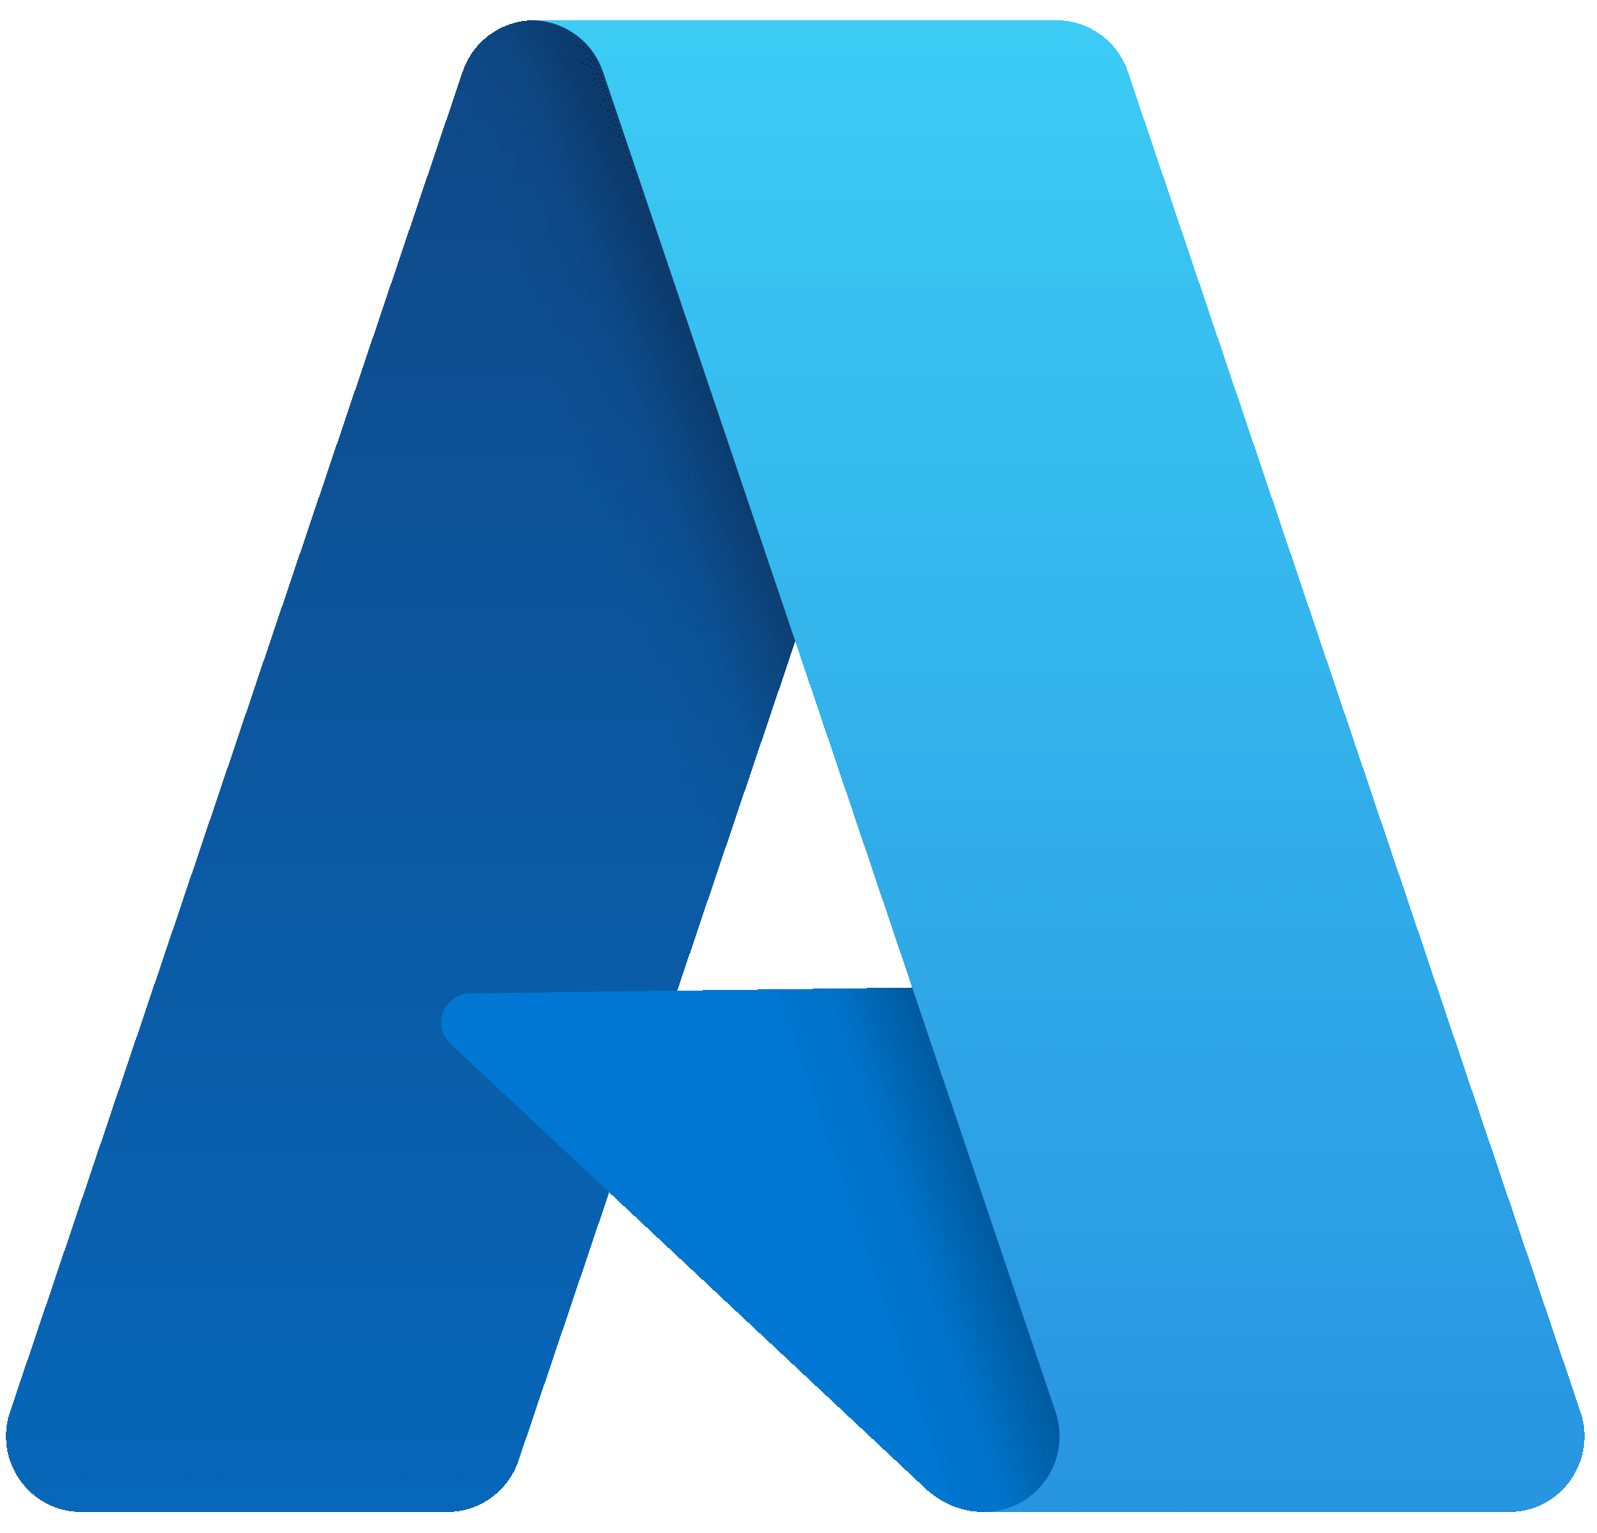




Custom Agents Enabling Different SOC Personas to Access AI‑Ready Microsoft Security Tools
MS Security Tool
MCP Servers
AI Environments
AI Agents
Main UIs
SOC Personas
(simplified)
Security Copilot
MCP "Native" Support
in AI Environments
(Existing and Upcoming)
Agent Orchestrators
Development
Environment
Expected
Tool Preference
Agent Creation
Toolset
Graph
Toolset
LLM
MS Defender
[*]
VS Code
GitHub Copilot
Triage
Toolset
[*]
[*]
Microsoft Foundry
Develop and publish
For Partners selling in the MS ecosystem
Solution Developer
Sentinel SIEM
[*]
LLM
Other channels
Custom
Toolsets
Workflow
Data Mirroring and Ingestion
Custom Agent(s)
Data Exploration
Toolset
Copilot Studio
MS Teams
Agent
Flow
LLM
Sentinel
Data Lake
Entity Analyzer
Tool
SOC Operator
Custom Agent(s)
LLM
Copilot Chat
Alerts
Security Copilot
LLM
MS Purview
Sentinel
MCP Server
[*]
[***]
Custom Agent(s)
LLM
Security Copilot
Power Automate
SOC Manager
MS Entra
Flow
Plug-ins
[**]
Partner Agents
Graph API
Microsoft Azure
Logic App
MS Defender
MS Security Store
[*]
MCP Server for Enterprise
LLM
LLM
1st Party and Partner Agents
MS Intune
Plug-ins
Connectors
Sentinel
MCP Server
ChatGPT Enterprise
LLM in Azure
Security Copilot
[*]: Not available today; expected to arrive in the future
MCP Server for Enterprise
Claude.AI
[**]: Integration available today only for 1st party and partner agents, not for custom agents
(…)
[***]: Not yet officially documented. Read here.
Up to date as of Feb. 15, 2026 – This is not official Microsoft content: please check for accuracy and completeness!

Slide 2

Up to date as of Feb. 15, 2026 – This is not official Microsoft content: please check for accuracy and completeness!
Security Copilot – MS-Built Agents
Security Copilot – Custom Agents
Copilot Studio – Custom Agents
GitHub Copilot in VS Code –
Custom Skills
Accessible through Microsoft Security Portals (Defender, Entra, Intune, Purview).
Accessibility
Can be published in Teams and Copilot Chat/Copilot 365.
Pre‑programmed to perform specific tasks, in an extended, optimized, and high‑performance mode
Instructions Model
Open instructions: each user can modify the agent’s instructions (not only the author).
Users can directly leverage GenAI to easily and effectively modify the agent’s instructions.
Users can directly collaborate through DevOps tools, supporting continuous improvement.
Can connect to the Sentinel Data Lake via the Sentinel MCP Server.
Can connect to all existing toolsets in the Sentinel MCP Server (Sentinel and Defender).
Can connect to the MCP Server for Enterprise (Microsoft Entra).
Connectivity
Can connect to external systems directly via existing or custom Security Copilot plugins.
Can connect to external systems directly via Power Platform connectors.
Can connect to external systems directly via Microsoft or third‑party hosted MCP Servers.
Can connect to external systems directly via existing or custom local MCP Servers.
Allow selection of the preferred GenAI model.
Offer a wide range of GenAI models to choose from, including top‑performing ones.
Enable conversational user interaction through text chat.
Support multimodal inputs, including images (e.g. screenshots of evidences).
GenAI Capabilities
Provide responses with graphical controls (geomaps, heatmaps, etc.).
Support the creation of complex solutions with multi‑agent coordination.
Show a graph displaying the steps executed in each run.
Offer a native mechanism to evaluate and improve instruction effectiveness.
Evaluate instructions and responses and suggest improvements
Miscellaneous
Can be exported and imported between different environments.
Possibility of licensing through the purchase of per‑user licenses or specific consumption credits.
Licensing
Possibility of licensing through the use of Azure consumption credits.
Possibility to leverage the free SCUs included with Microsoft E5 for licensing purposes.

