Slide 1

Effectiveness of the EU Emissions Trading System

Slide 2

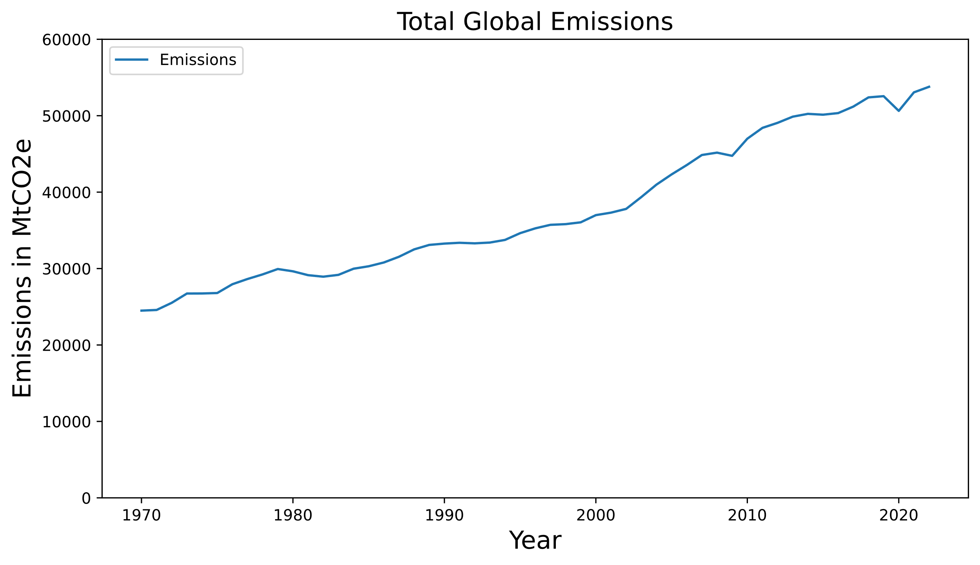
Motivation
Global Emissions Are Rising
Total Global Emissions
25.000 MtCO2e in 1970
54.000 MtCO2e in 2022
Increase of 119%

Slide 3
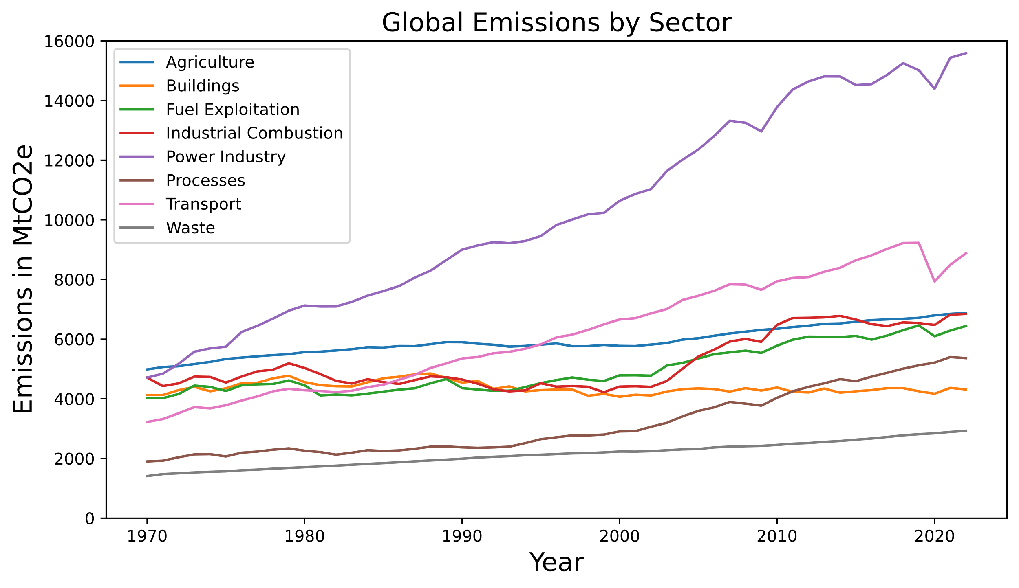
Motivation
Global Emissions Are Rising
Emissions by Sector
Largest Sectors:
1970: Agriculture
2022: Power Industry, Transport

Slide 4
Motivation
The European Union Emissions Trading System (EU ETS)
A Solution: Emissions Trading Systems - The EU ETS
Regulate Companies
Cap the allowed CO2 equivalent (CO2e) emissions via certificates
Regulation for Power Industries and Transport sector
Reduce the amount of emitted emissions
Support Reducing Emissions
Companies can sell unused CO2e certificates
Emission producers support emission reducer directly
Sanction Producing Emissions
Companies must buy CO2e certificates to increase their CO2e emission cap
Creates pressure to reduce emissions to avoid sanctions

Slide 5
Main Question
Does the European Union Emissions Trading System help in decreasing emissions in the EU and if so, does it also have an impact on global emissions?

Slide 6
Agenda
01
Motivation
02
Analyzed Data
03
Emissions in the EU
04
Comparison to Global Emitters
05
Conclusion

Slide 7
Analyzed Data

Slide 8


Analyzed Data
Data Source | Origin | License | Copyright | Format
CO2e Prices | Umweltbundesamt | § 12a EGovG | © 2024 Umweltbundesamt | .xlsx
Global Emissions | The EU / EDGAR | CC BY-NC-ND 4.0 | © European Union, 1995-2024 | .xlsx
Notes:
The CO2e Prices data lists the price of CO2e certificates at distinct days since 2008 up until 2023. The Global Emissions data contains information on global emissions per country and sector per year since 1970 up until 2022. Emissions are registered in MtCO2e (Megatons of CO2e)

Slide 9
Emissions in the EU

Slide 10
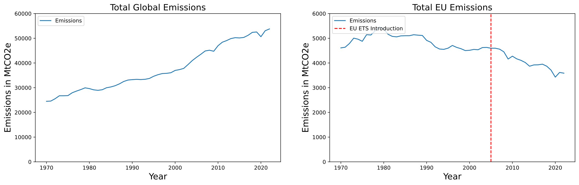
Emissions in the EU
EU Emissions Are Decreasing

Slide 11
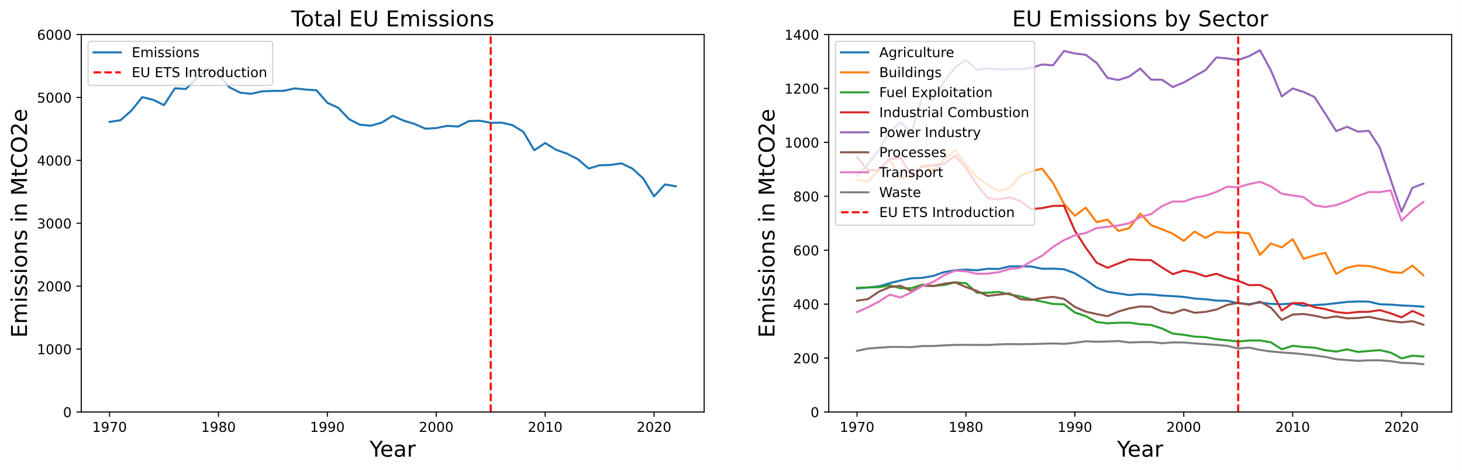
Emissions in the EU
Power Industry and Transport as Biggest Sectors

Slide 12
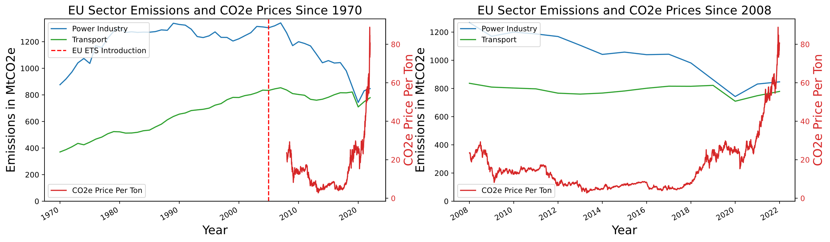
Emissions in the EU
CO2e Prices Are Connected to CO2e Emissions

Slide 13
Comparison to Global Emitters

Slide 14
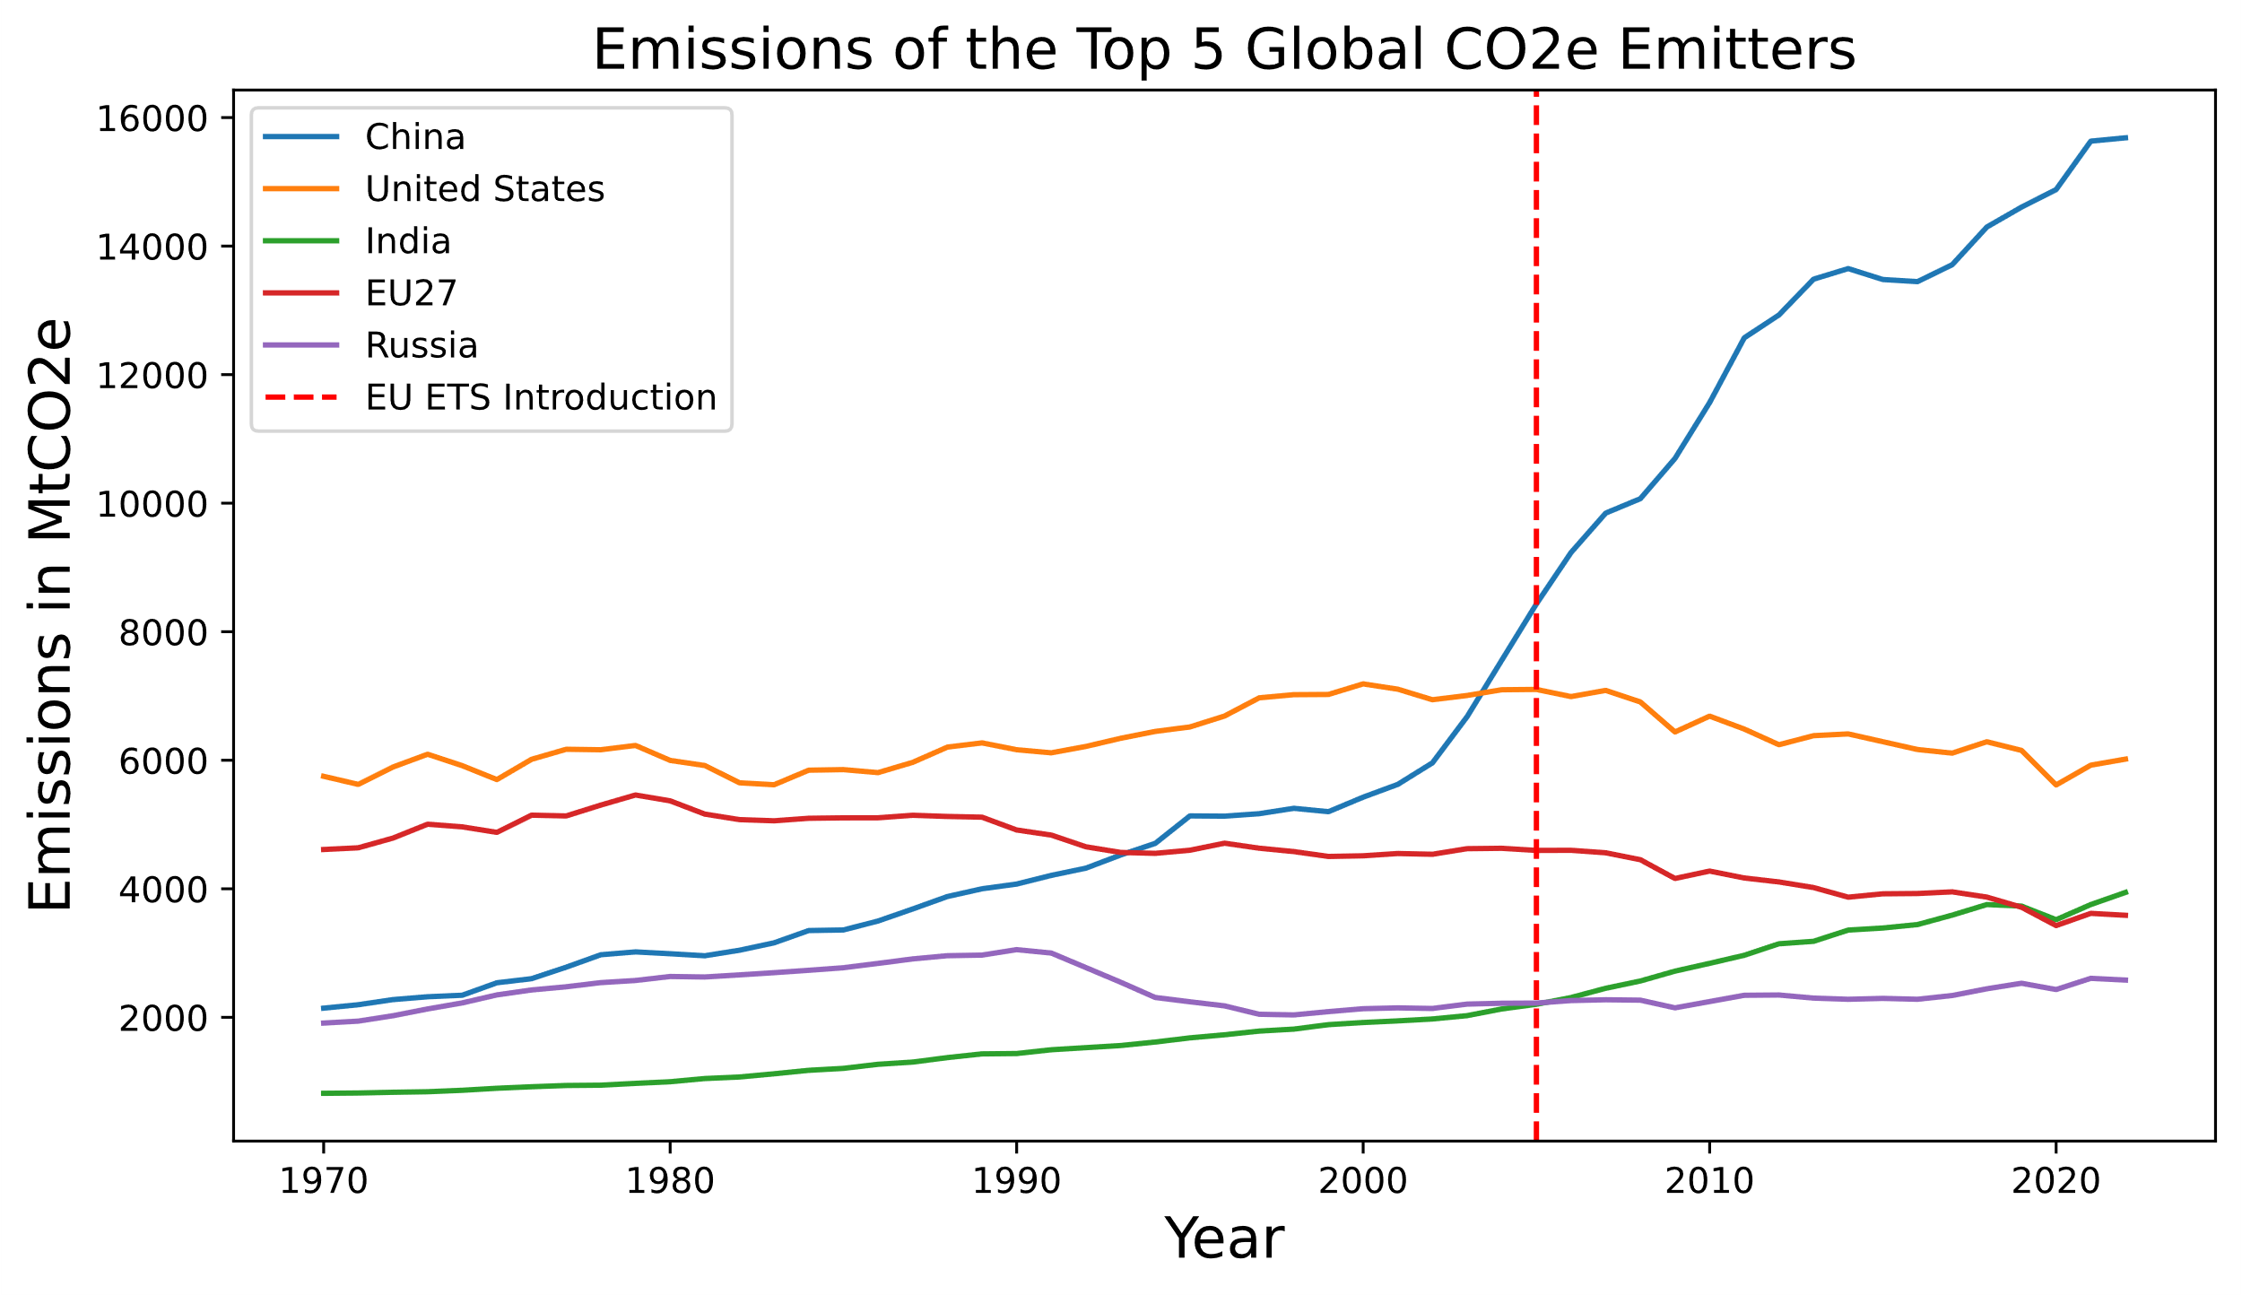
Comparison To Global Emitters
Global Comparison
USA and EU decreased emissions
Emissions of the others increased

Slide 15
Conclusion

Slide 16
Conclusion
Does the European Union Emissions Trading System help in decreasing emissions in the EU and if so, does it also have an impact on global emissions?
Yes, there is a direct connection between CO2e prices and CO2e emissions
The EU decreased CO2e emissions significantly since 2005
Nevertheless, global emissions are still rising
Emissions Trading Systems have to be introduced in more states

